Slide 1
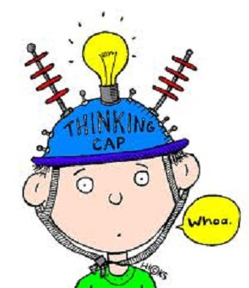
Year 3 Week 6 Day 1
Maths order of learning
Starter
Main Activity
If you want to Challenge yourself,
try our
HOTs

Slide 2
Answers will be given on the answer sheet on Friday
To be completed by everyone
Starter:
Watch the following video to explain the differences
https://www.youtube.com/watch?v=j7WhRMvlQwo
What is it called?

Slide 3
Maths – Fractions
To be completed by everyone
Main Activity
Click on the link and begin your learning journey.
Complete the pre-quiz, watch the video and complete the activities
https://www.thenational.academy/year-3/maths/to-describe-the-part-whole-relationship-year-3-wk1-1
The answers will be given at the end of the video.
Please stop the video and complete the activity before listening to the answers.

Slide 4
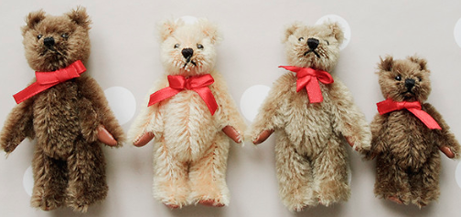
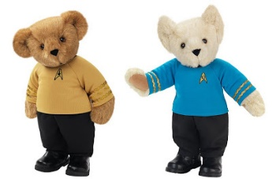
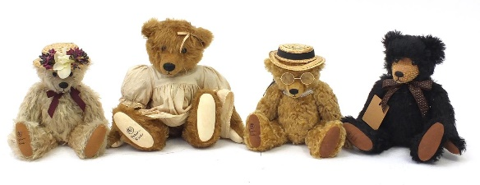
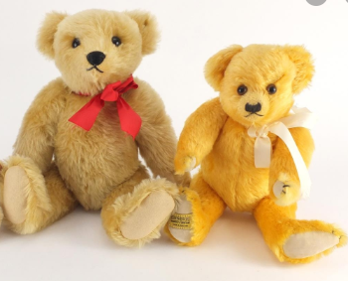
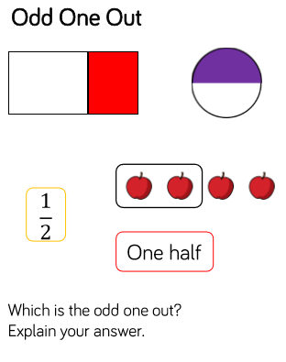
Maths – Fractions
These teddy bears belong to Sally.
HOTs
She wants to share them equally between her friends.
How many friends can she have to share her teddy bears equally.
How many different ways can you find?
Answers will be given on the answer sheet on Friday

Slide 5
Spellings
Can you write a sentence with each of these spellings in? Check they’re spelt correctly.
eighth 2. busy 3. knowledge
4. library 5. medicine 6. certain
7. naughty 8. strength

Slide 6
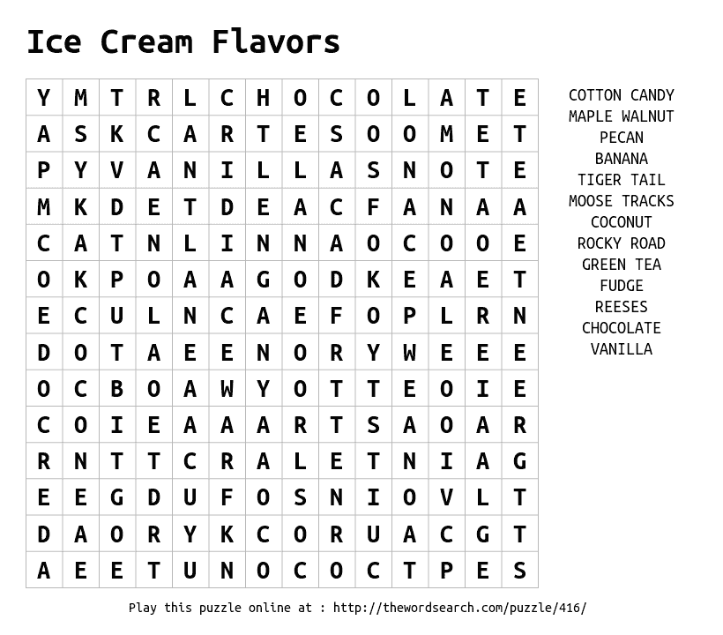
Can you create a word search puzzle including the 8 spellings for this week?

Slide 7
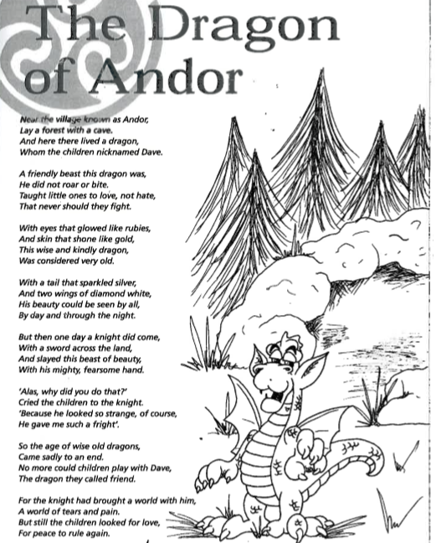
Read the text and answer the questions carefully. Remember to use the text!
Copy the title into your book –Do you think this text is factual or fictional? Underline the word in the title that tells you this.
What colour were Dave’s eyes in verse 4?
In verse 2 was Dave a noisy or quiet dragon?
How do we know in verse 5 that the knight was violent before he killed Dave?
Were the children sad when Dave the Dragon died? How do you know?
In the final verse does the poet believe adults or children are to blame for war and suffering?
Is this a poem that rhymes? Make a list of rhyming words you can see in the poem. (Pair them up)
Find and copy a word that means clever.
Can you find an old English word in verse 6?
What do you think the old English word means?

Slide 8
English – Poetry Lesson 1
This week we are going to follow some lessons from Oak National Academy. Click the link to enter your online classroom.
https://www.thenational.academy/year-3/english/poetry-reading-comprehension-word-meaning-year-3-wk3-1
Make sure as a starter you complete the pre-learning quiz so your adult can see where you might get a bit stuck!

Slide 9
Activity – Poetry Lesson 1
Once you have watched the video there is an activity to complete, this activity can be completed in your books.
At the end of the activity click the link on screen and listen to Roger McGough read his poem!
The quiz at the end of the lesson tests your knowledge from the lesson and will give you your score and the answers straight away!

Slide 10
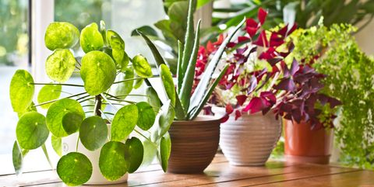
Science
https://www.thenational.academy/year-3/foundation/plants-what-conditions-could-we-change-to-investigate-the-growth-of-a-plant-year-3-wk1-3
This lesson above is looking at what conditions we might change to investigate the growth of plants. Follow the link in order to access the lesson and activities.

