Slide 1
Year 3 Week 6 Day 2
Maths order of learning
Starter
Main Activity
If you want to Challenge yourself,
try our
HOTs

Slide 2
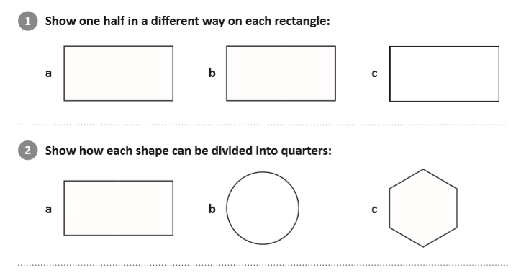
Answers will be given on the answer sheet on Friday
To be completed by everyone
Starter:
Watch the following video to help solve the problem
https://www.youtube.com/watch?v=DnFrOetuUKg

Slide 3
Maths – Fractions
To be completed by everyone
Main Activity
Click on the link and begin your learning journey.
Complete the pre-quiz, watch the video and complete the activities
https://www.thenational.academy/year-3/maths/to-recognise-parts-that-are-equal-and-parts-that-are-unequal-year-3-wk1-2
The answers will be given at the end of the video.
Please stop the video and complete the activity before listening to the answers.

Slide 4
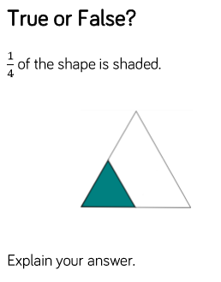
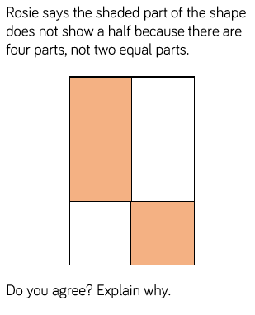
Maths – Fractions
Ryan has 14 sweets to share between his friends.
HOTs
Ryan thinks he can share the sweets equally.
Is he correct? Explain your answer
Answers will be given on the answer sheet on Friday

Slide 5
Spellings
All of these words are spelt incorrectly can you correct them?
eighf 2. bizi 3. nolidg
4. libarry 5. medisin 6. sertin
7. norti 8. strenf

Slide 6
Can you sort the spelling for this week into word classes?
Adjective | Adverb | Noun | Verb
Can you write what each of the word classes mean?
An adjective is…
An adverb is…
A noun is…
A verb is…

Slide 7
English – Poetry Lesson 2
Here is the second lesson of the week.
https://www.thenational.academy/year-3/english/poetry-reading-comprehension-inference-year-3-wk3-2#slide-1
Complete the quiz before starting the lesson so you can see the pre-learning (if you listened super carefully to yesterday’s lesson this may help you with the quiz!) and also see where you may get stuck!

Slide 8
English – Poetry Lesson 2
Once you have watched the video there is an activity to complete, this activity can be completed in your books.
At the end of the activity click the link on screen and watch the animation video that is available to watch.
The quiz at the end of the lesson tests your knowledge from the lesson and will give you your score and the answers straight away!

Slide 9
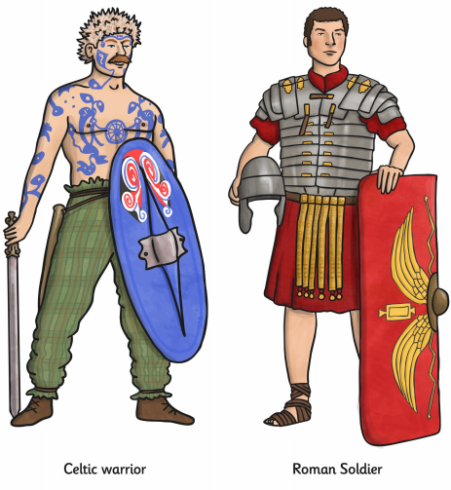
Topic
Celtic Warrior Vs Roman Soldier

Slide 10
Aim
I can identify the similarities and differences between a Celtic Warrior and a Roman Soldier,
Step 1 - We would like you to carry out some research on Celtic Warriors and Roman Soldiers.
Step 2 - We would like you to complete a table of Similarities and Differences.
Step 3 - We then have some questions for you to complete.

Slide 11
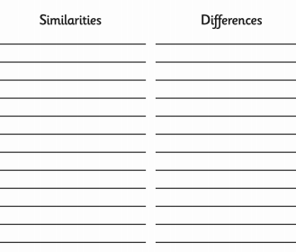
Celtic Warrior VS Roman Soldier
Complete a table that looks like this in your books –
What is similar about Celtic Warriors and Roman Soldiers?
What is different about Celtic Warriors and Roman Soldiers?

Slide 12
Celtic Warrior VS Roman Soldier
What information did you find out about Celtic Warriors and Roman Soldiers? Summarise in a short paragraph what you found out.
2. Would you rather be a Celtic Warrior or a Roman Soldier? Why?
3. Draw a Celtic Warrior and a Roman Soldier in your book.

