Slide 1
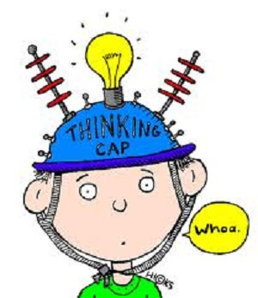
Year 3 Week 6 Day 3
Maths order of Learning
Starter
Main Activity
If you want to Challenge yourself,
try our
HOTs

Slide 2
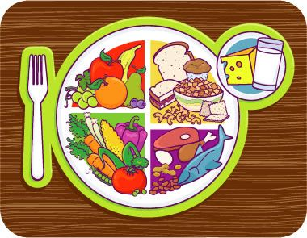
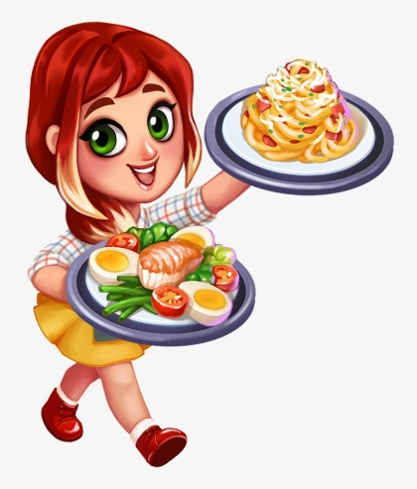
Answers will be given on the answer sheet on Friday
To be completed by everyone
Starter:
https://www.youtube.com/watch?v=6ZrNQ3y_q4M
https://www.youtube.com/watch?v=bnfIzE7PnC0&t=10s
To complete this activity you will need to design a meal.
On your plate you will need to have the following things.
of the plate will need to be protein
of the plate will need to be fruit or vegetables
of your plate will need to be carbohydrates

Slide 3
Maths – Fractions
To be completed by everyone
Main Activity
Click on the link and begin your learning journey.
Complete the pre-quiz, watch the video and complete the activities
https://www.thenational.academy/year-3/maths/to-recognise-identify-and-describe-unit-fractions-year-3-wk1-3
The answers will be given at the end of the video.
Please stop the video and complete the activity before listening to the answers.

Slide 4
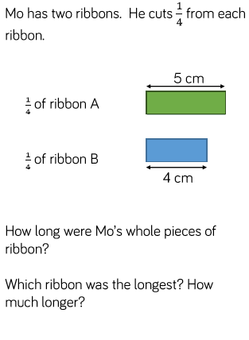
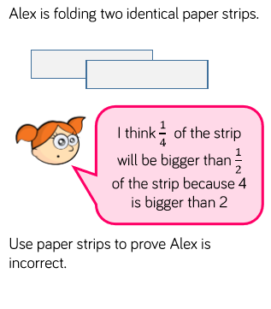
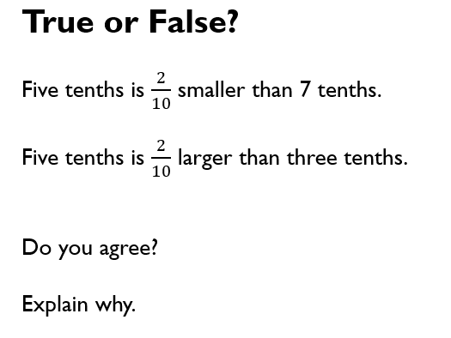
Maths – Fractions
HOTs
Answers will be given on the answer sheet on Friday

Slide 5
Spellings
Can you write a definition for each of these eight spellings?
eighth 2. busy 3. knowledge
4. library 5. medicine 6. certain
7. naughty 8. strength

Slide 6
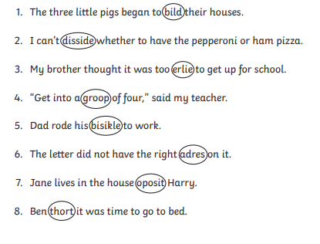
Write the sentence out in your book with the words circled spelt CORRECTLY.

Slide 7
English – Poetry Lesson 3
This is Lesson 3 of the week and looks at the features of a poem.
https://www.thenational.academy/year-3/english/poetry-identifying-the-features-of-a-text-year-3-wk3-3
Complete the quiz before starting the lesson so you can see the pre-learning (if you listened super carefully to yesterday’s lesson this may help you with the quiz!)

Slide 8
English – Poetry Lesson 3
Once you have watched the video there is an activity to complete, this activity can be completed in your books.
The quiz at the end of the lesson tests your knowledge from the lesson and will give you your score and the answers straight away!
Don’t forget if there is anything you are stuck on from this week so far you can go back and re-cap at any point! – You can re-watch the lessons and re-take the quizzes if you would like to also!

Slide 9
Computing
Using Purplemash we would like you to create a blog about either a Celtic Warrior or a Roman Soldier. Using the information you have found for your topic work and your opinions too!

Slide 10
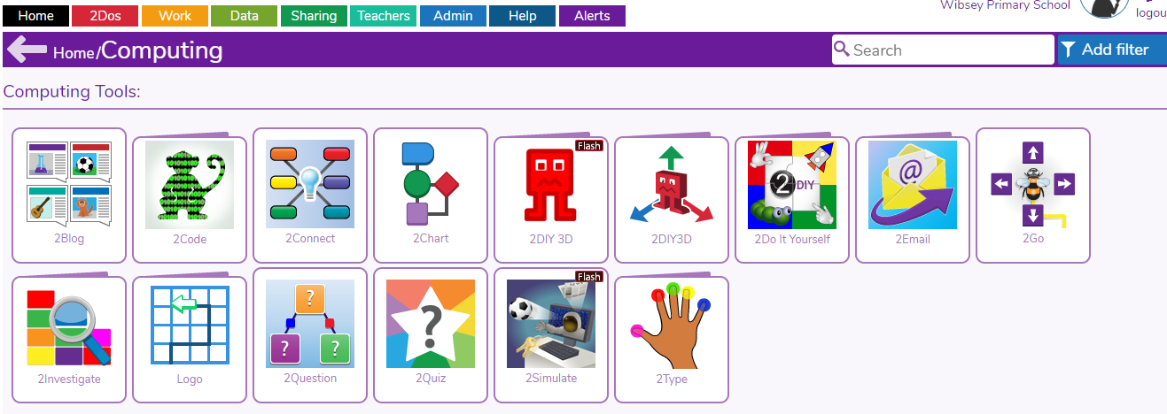
Log in Purplemash and click on computing
Then following computing click on 2blog

Slide 11
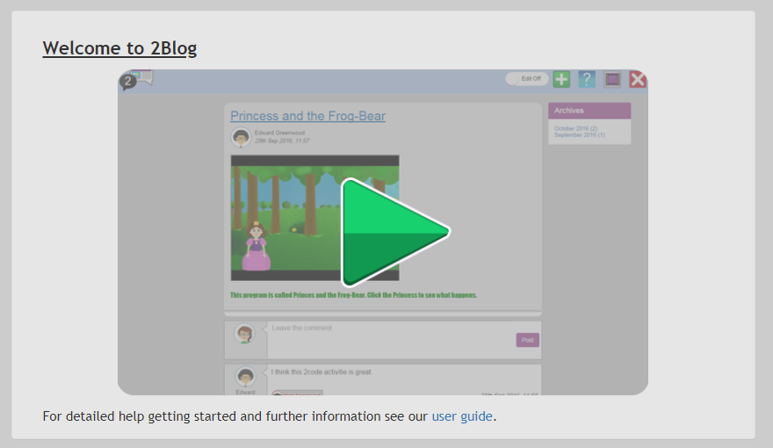
Follow the instructions that follow on screen.
Watch the video with a guide on how to create your blog!
Get creating!

Slide 12
DON’T FORGET TO SAVE YOUR BLOGS IN YOUR CLASS FOLDER!

