Slide 1
Year 3 Week 6 Day 4
Maths order of learning
Starter
Main Activity
If you want to Challenge yourself,
try our
HOTs

Slide 2
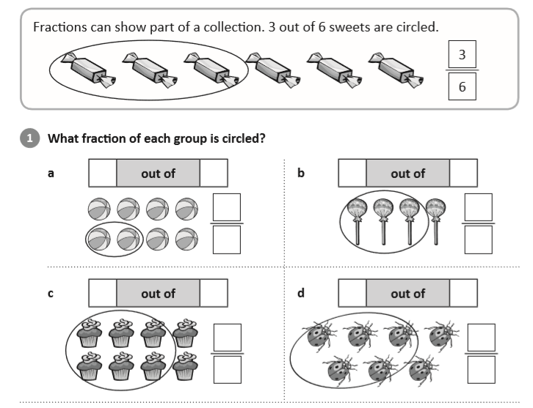
Answers will be given on the answer sheet on Friday
To be completed by everyone
Starter:
https://www.youtube.com/watch?v=lTce7f6KGE0

Slide 3
Maths – Fractions
To be completed by everyone
Main Activity
Click on the link and begin your learning journey.
Complete the pre-quiz, watch the video and complete the activities
https://www.thenational.academy/year-3/maths/to-find-unit-fractions-of-a-given-quantity-year-3-wk1-4
The answers will be given at the end of the video.
Please stop the video and complete the activity before listening to the answers.

Slide 4
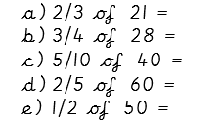
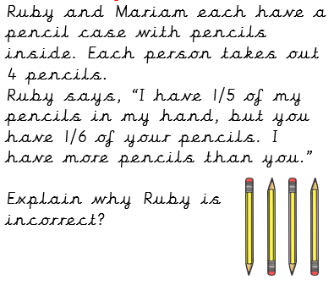
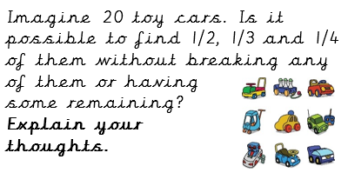
Maths – Fractions
HOTs
Answers will be given on the answer sheet on Friday

Slide 5
Spellings
Can you draw an image linked to each of these words – make them as creative as you can and write the spelling CORRECTLY underneath your image.
eighth 2. busy 3. knowledge
4. library 5. medicine 6. certain
7. naughty 8. strength

Slide 6
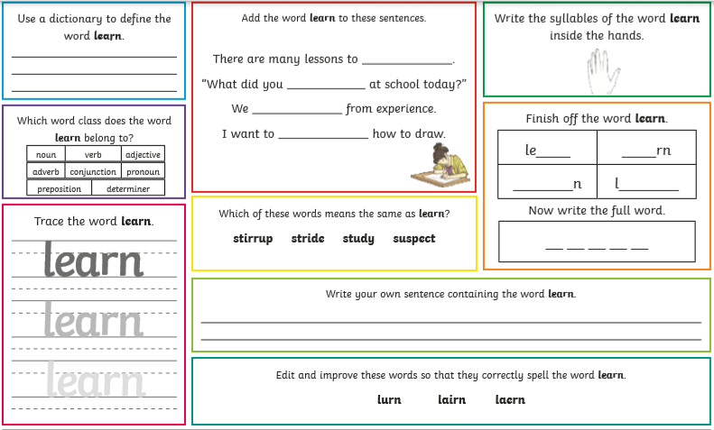

Slide 7
English – Poetry Lesson 4
You should all be experts on today’s lesson as we have done lots of work on expanded noun phrases before!
https://www.thenational.academy/year-3/english/poetry-spag-focus-expanded-noun-phrases-year-3-wk3-4#slide-1
Complete the quiz before starting the lesson so you can see the pre-learning (if you listened super carefully to yesterday’s lesson this may help you with the quiz!) – I know you’ll all get full marks on this because you’re just experts!

Slide 8
English – Poetry Lesson 4
Once you have watched the video there is an activity to complete, this activity can be completed however you would like as it involves you going on a SOUND HUNT!
The quiz at the end of the lesson tests your knowledge from the lesson and will give you your score and the answers straight away!
Don’t forget if there is anything you are stuck on from this week so far you can go back and re-cap at any point! – You can re-watch the lessons and re-take the quizzes if you would like to also!

Slide 9
English – Poetry Lesson 4
Your sound hunt is going to form the planning for your very own sound poem!

Slide 10
WSFL

Slide 11
Road Safety As you may have been doing lots of walking around your local community and seeing lots of people doing the same we want you to design a Road Safety presentation! This can be however you like it could be a poster, a video presentation, a PowerPoint, a leaflet! Be as creative as you like with this! Think about all those things you learnt on your Road Safety training back in September! What important messages should be on your poster?

