Slide 1
Year 3 Week 6 Day 5
Maths order of learning
Starter
Main Activity
If you want to Challenge yourself,
try our
HOTs

Slide 2
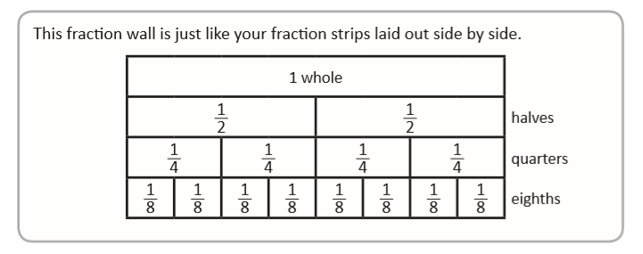
Answers will be given on the answer sheet on Friday
To be completed by everyone
Starter:

Slide 3
Maths – Fractions
To be completed by everyone
Main Activity
Click on the link and begin your learning journey.
Complete the pre-quiz, watch the video and complete the activities
https://www.thenational.academy/year-3/maths/to-describe-unit-and-non-unit-fractions-year-3-wk1-5
The answers will be given at the end of the video.
Please stop the video and complete the activity before listening to the answers.

Slide 4
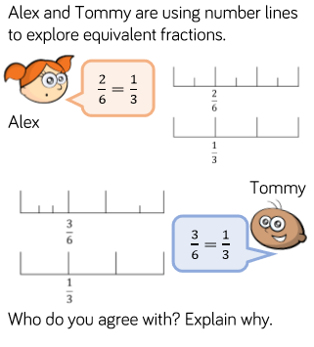
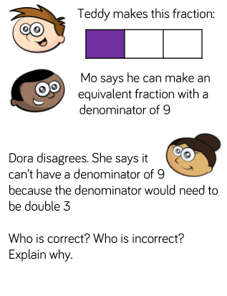
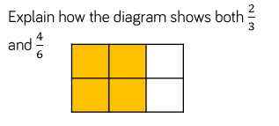
Maths – Fractions
HOTs
Answers will be given on the answer sheet on Friday

Slide 5
Spellings
Mini Spelling Test – ask your adult/sibling to test you on this weeks spellings! How many did you get correct?
eighth 2. busy 3. knowledge
4. library 5. medicine 6. certain
7. naughty 8. strength

Slide 6
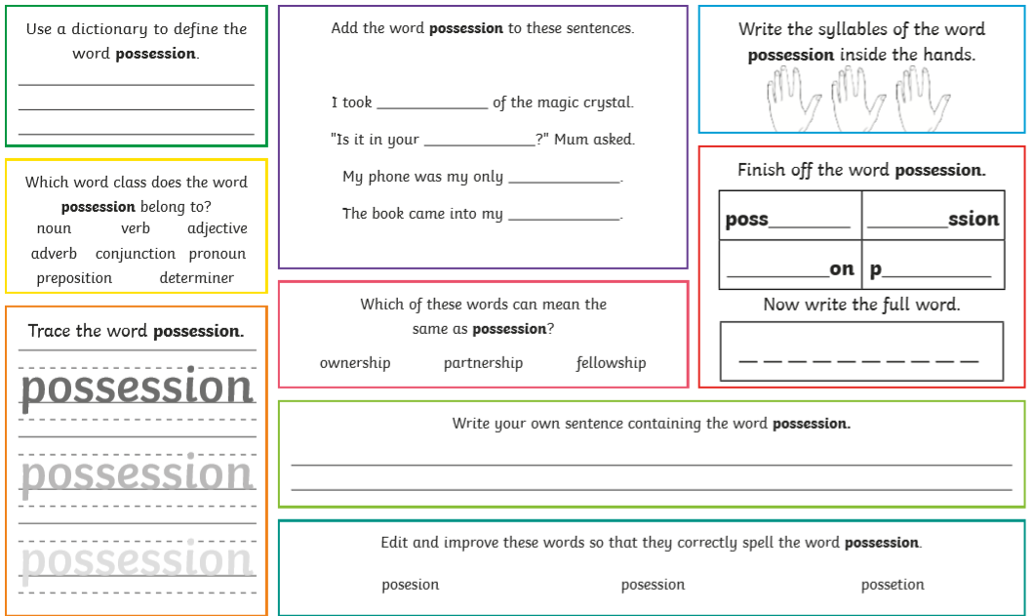

Slide 7
English – Poetry Lesson 5
This is where your poem is going to come together! Remember to watch the lesson very carefully!
https://www.thenational.academy/year-3/english/poetry-write-a-sound-poem-year-3-wk3-5
Complete the quiz before starting the lesson so you can see the pre-learning (if you listened super carefully to yesterday’s lesson this may help you with the quiz!)

Slide 8
English – Poetry Lesson 5
Once you have watched the video there is an activity to complete, this is your independent activity and this is where you are going to write your sound poem! Be as creative as you can and use the information on the lesson to help you!
Don’t forget if there is anything you are stuck on from this week so far you can go back and re-cap at any point! – You can re-watch the lessons and re-take the quizzes if you would like to also!

Slide 9
Art
We want you to design a Celtic Warrior or a Roman Soldier shield.
Collect as many different materials as you can – from your garden, from your kitchen, when out on a walk and use these materials to create your warrior or shield!
You could even draw, design and label your shield, be as creative as you can!

Slide 10
