Slide 1
Reception and Nursery dropping off/collection arrangements from 21st September 2020.

Slide 2
Reception and Nursery children will be entering through the top gate from 21st September.

Slide 3
Children in R1 will enter through the back Reception door.

Slide 4
Parents will then continue to follow the orange cones through the gate.

Slide 5
Children in R3 will enter through the gate in the Upper Deck.

Slide 6
Parents will continue down the path towards Nursery.

Slide 7
Children in Nursery will enter the Nursery building.

Slide 8
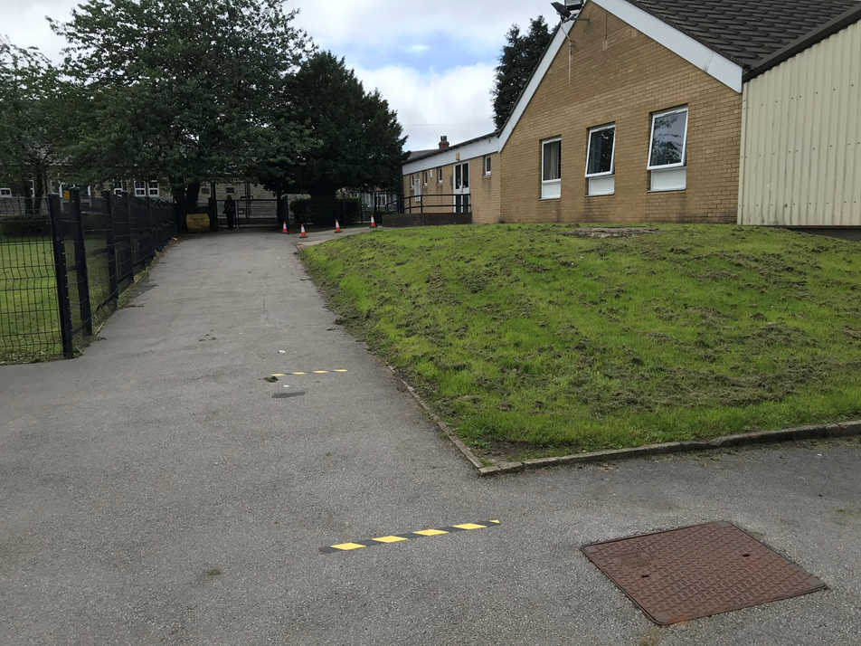
Parents will continue to walk around the Reception building.

Slide 9
Children in R2 will enter through the main Reception door.

Slide 10
All parents will exit via the gates.

Slide 11
Parents will need to follow the same route when collecting children.

