Slide 1
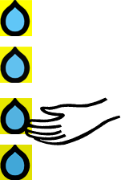
Distilling
What it should like:
I can identify key information
Can I separate key information from the details?
Do I summarise?
I link new acquired learning with existing knowledge
I can apply new learning to other subjects and situations

Slide 2
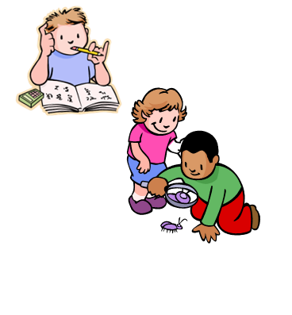
Interdependence
What it should like:
I notice useful learning behaviours of others
I imitate the learning behaviours and skills of others
I know that I am responsible for my learning
I enjoy and gain from learning with others
I know when I need to let others contribute

Slide 3
Imagining
What it should like:
I notice details
I imitate others
I draw on my senses
I see things from different angles
I play around with different ideas
I don’t mind rethinking my ideas
I take risks with my final outcome

Slide 4
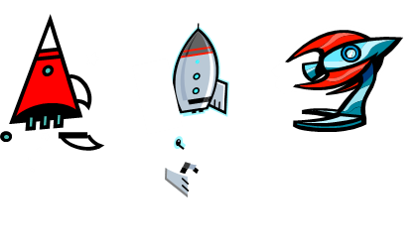
Revising
What it should like:
1) Am I on the right lines?
2) Have I used my stuck prompts?
3) I regularly check my work against my goals, objectives and success criteria
4) I think about how to do something better or differently
5) I change direction if I need to
6) I challenge myself to produce the best quality work I can

