Slide 1
Blogs
Learning Intentions :
to learn about the various types of blogs on the Internet
to learn how to post to a blog appropriately
to define selected vocabulary
to post a review of a book

Slide 2
Dear Sam,
I keep hearing about blogs.
What is a blog?
Thanks,
Erin

Slide 3
A blog is…
a website
written in a diary style.
What is a blog?

Slide 4
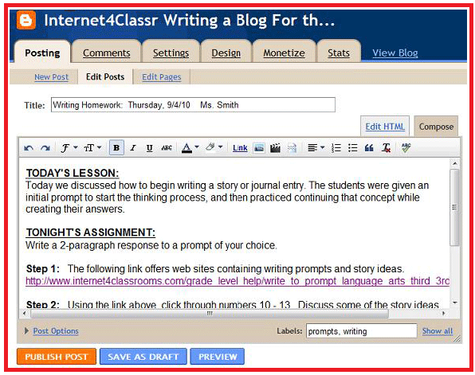
Usually a blog will have many entries.
The entries will be arranged in reverse chronological order.

Slide 5
Blog is short for
Web Blog.

Slide 6
Use a blog as a way of keeping a personal journal or diary online.

Slide 7
Some people have blogs that are almost like news sites.

Slide 8
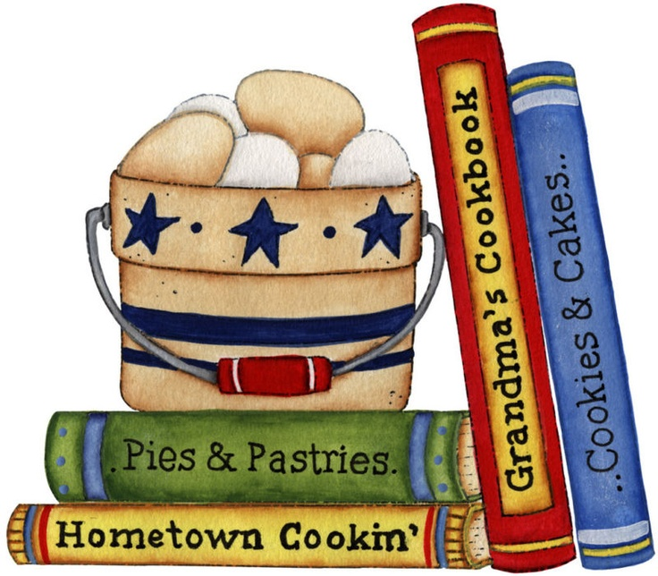
A person
might post recipes or stories.

Slide 9
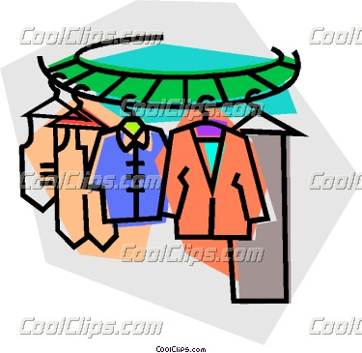
There are:
Fashion blogs
Community blogs
Science blogs
Art blogs

Slide 10
Leave your comment:
Name: Tom
Message:
I love this recipe!
Submit

Slide 11
Having a blog is also a cheap and effective way for people to show their work on the Internet.

Slide 12
There are places on the Web you can go to
sign up for a free blog.

Slide 13
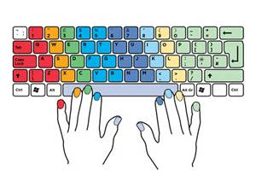
Once you’ve started, you can post pictures, music, or writing on your blog.

Slide 14
Sam’s Blog
Hope you like my new picture.

Slide 15
With an audio blog, you can upload music or other audio files that anyone can download.

Slide 16
A photo blog is a blog that features photographs: kind of like an
electronic photo album.

Slide 17
A video blog is the same, but for video.

Slide 18
Blogs first popped up in the mid 1990s.

Slide 19
The first blogger was Justin Hall –
a college children who blogged online in 1994.

Slide 20
Today there are tens of millions of blogs!

Slide 21
Be careful what you post on your blog.

Slide 22
Never reveal any personal information
like your
name or other contact information.

Slide 23
Think of a story in the news right now.
Research it on the internet.

Slide 24
Food Blog
News Blog
Book Blog
Music Blog
Blogs
Fill in these blogs.

Slide 25
Music Blog
Food Blog
Book Blog
News Blog

Slide 26
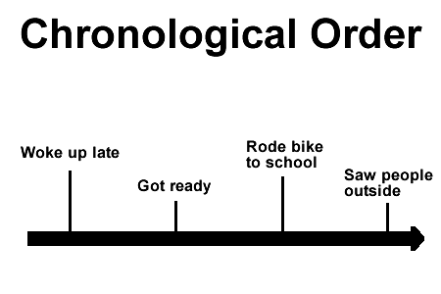
What do these words mean?
blog: ____________________________
chronological __________________
journal ________________________

Slide 27
Blogging Book Reviews Lesson Plan:
to explore the various types of blogs on the Internet
to learn how to post to a blog appropriately.
to demonstrate their understanding by blogging a book review
Lesson : Ask the children if they have ever read a blog.
Use answers to help the class create a list of blogs on the whiteboard.
Share some blogs with the class.
Select blogs that vary in theme/subject -sports, animals and music to explore with children.
Show a reading blog as an example.
Explain that each child will create a reading blog as a way to share the books they have read.
Children create a post on the blog for a book they have read- independent reading or class novel.
Discuss appropriate postings versus inappropriate.
Children use pencil and paper to write a rough draft of their book review.
Book review rough drafts are peer edited and then children post them to the blog.

Slide 28
Let’s look at an online book review.

Slide 29
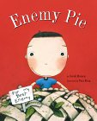
When a new boy moves into the neighbourhood, all is not well for one little boy. He thinks the new boy, Jeremy, is mean and decides that he is his enemy. The little boy's father suggests he spend the day with Jeremy while he makes a secret "enemy pie."
Learn how these two boys become friends and find out the real ingredients of the enemy pie. Richly coloured illustrations and an emphasis on the characters' faces make this book stand out.
Reviewed by: Sandy / Central Library
If you liked this book, you may also like: Yo! Yes? Chris Raschka
Comments from Readers
Hills, age 9 from Texas
Well this book is so good. It was funny to me. still funny!
Rob, age 42 from California
I have read this book to well over 300 boys & girls - they love it!
Terri, age 40 from North Carolina
This is a wonderful story for "children" of all ages. It is a great example of how to deal with enemies.

