Slide 1
Day 1 Creating Op Art

Slide 2
Lesson Objective To Look at art from other times and cultures. To gain an understanding of OP Art.

Slide 3
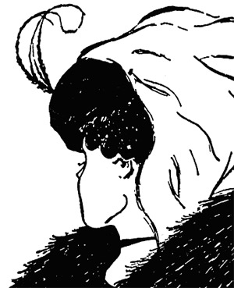
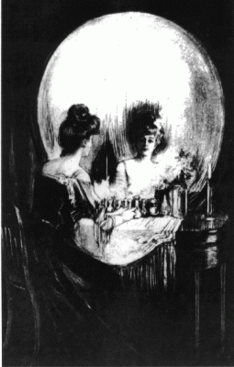
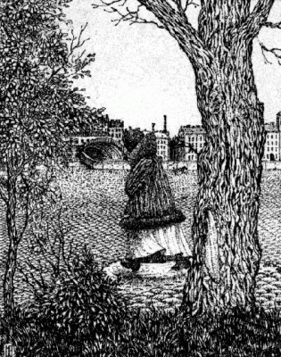
What Can You See?

Slide 4
What is “Op” Art?
“Op” is short for optical. Optical means having to do with the eye.
You may have heard of an Optician. An Optician is an eye doctor.
Op Art began in the 1960’s.
Optical Art is a mathematically-themed form of Abstract art. Abstract meaning it doesn’t have to look like something.
The point of optical art is to confuse the eye.

Slide 5
You may have heard of an “Optical Illusion.”
Is this ball moving?

Slide 6
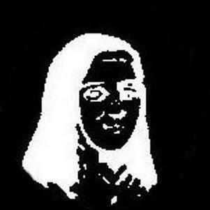
Stare at the 3 dots on her nose for 10 seconds

Slide 7
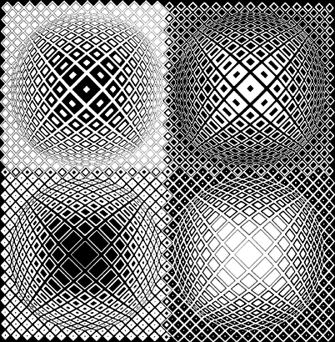
There are three main effects of Op Art
What effect is being created here?
3 Dimensional

Slide 8
Illusion
What effect is being created here?

Slide 9
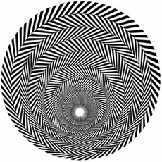
Movement
What effect is being created here?

Slide 10
Day 2, 3 Creating Simple Op Art
Use a ruler.
Have a Sharp pencil.
Do not press too hard.
When shading avoid going over any lines.
When shading make sure to use even colour.
Use success criteria.

Slide 11
Draw a set of parallel lines down the centre of your page.

Slide 12
Now draw vertical lines through the lines. Make the lines get gradually closer towards the centre then gradually increase the spacing towards the other side.

Slide 13
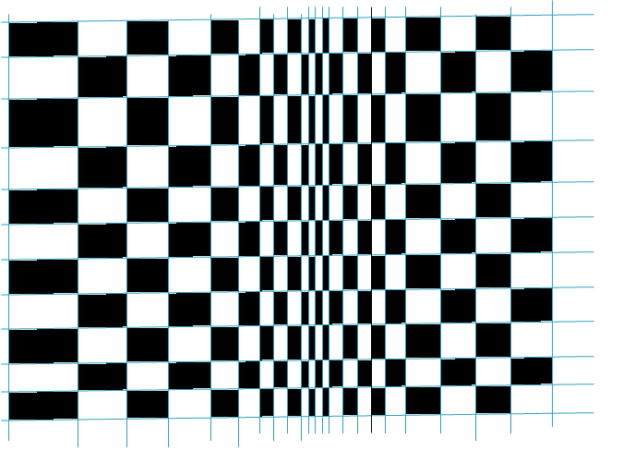
Neatly colour squares alternately in black.
What effect have you created?

Slide 14
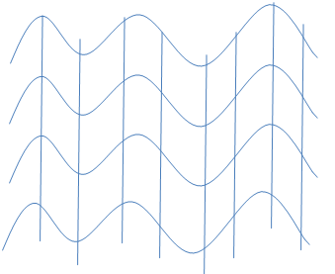
Waves
Draw a set of wavy lines.
Then draw vertical lines through them as before .

Slide 15
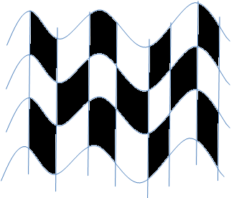
Neatly colour squares alternately in black.
What effect have you created?

Slide 16
Draw another set of wavy lines.
Now draw wavy lines going vertically through those lines.

Slide 17
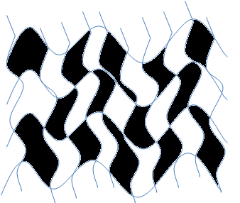
Neatly colour squares alternately in black.
What effect have you created?

Slide 18
Lesson Evaluation.
Art
To improve my work today I could?
Look at the success criteria and level your work. Pick two ways in which you could improve your work.
Design Faculty
Date

Slide 19
Day 4 Lesson Objective To Look at art from other times and cultures. To use skills from previous lesson to develop more complex Op art designs.

Slide 20
Remember
Use a ruler.
Have a Sharp pencil.
Do not press too hard.
When shading avoid going over any lines.
When shading make sure to use even colour.
Use success criteria.

Slide 21
Creating 3D Effects
Draw a circle. Grid the circle but make the lines flex with the shape of the circle.
Draw a grid in the back ground.

Slide 22
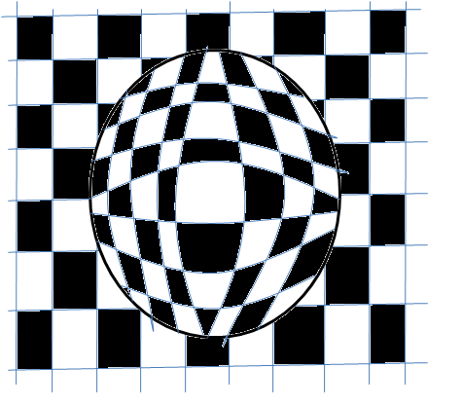
LO:To Look at art from other times and cultures. To use skills from previous lesson to develop more complex Op art designs
Neatly colour squares alternately in black.
What effect have you created?

Slide 23
Try the same technique with a pyramid.

Slide 24
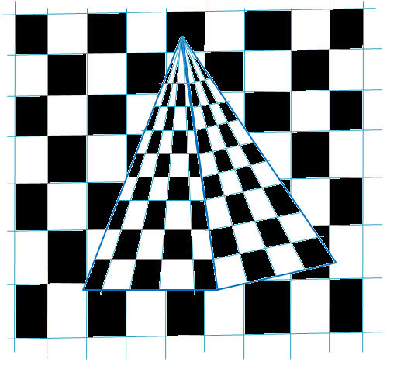

Slide 25
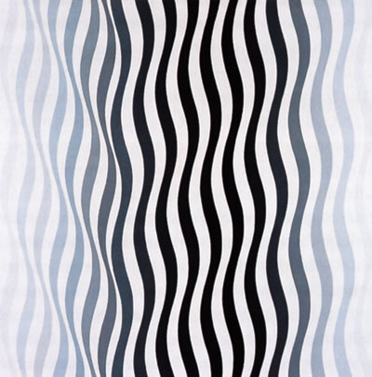
Day 6 Learning about other artists
Find and present information neatly in your sketch book on the Artist Bridget Riley.

Slide 26
Day 7 Lesson Objective To use ICT to create art.

Slide 27
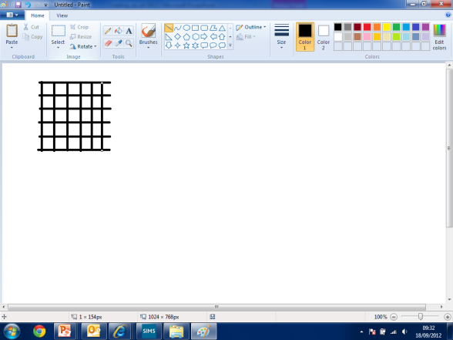
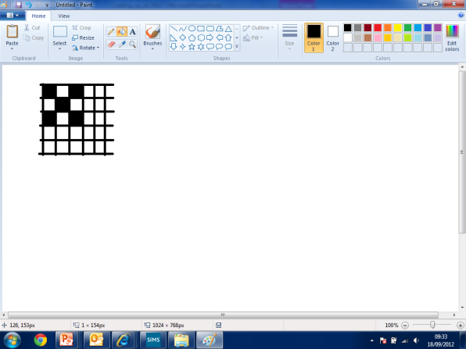
Using 2 simple 2Paint start by creating simple grid patterns. Use the fill tool to colour alternate shapes.

Slide 28
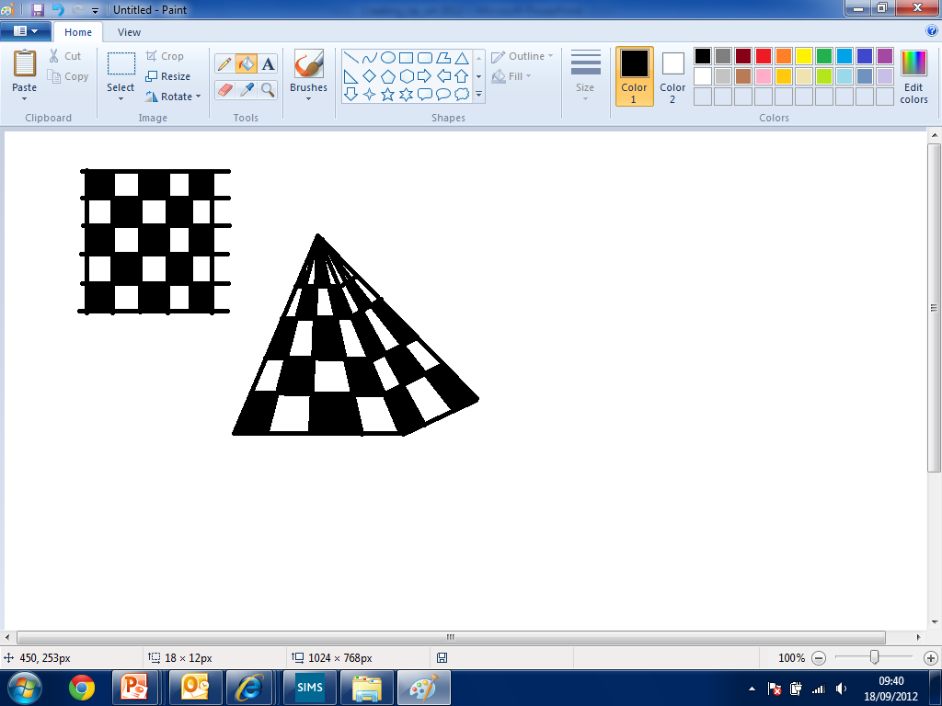
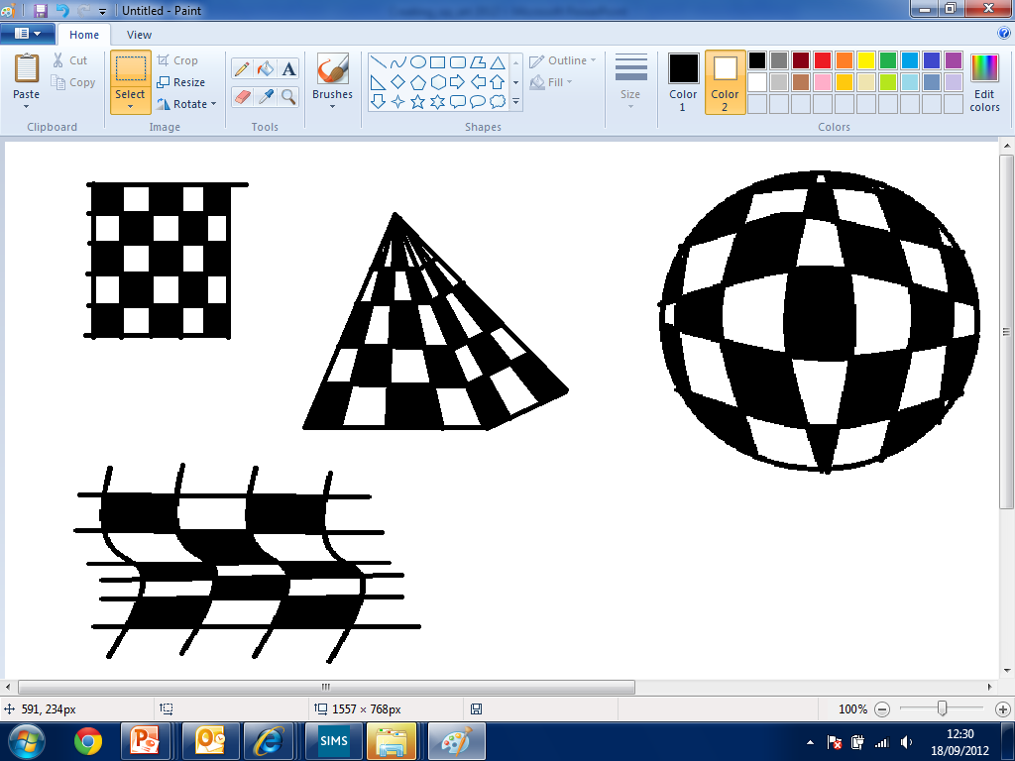
Start to develop and experiment with more complex designs. Try combining grids with shapes as we did with our drawings.

Slide 29
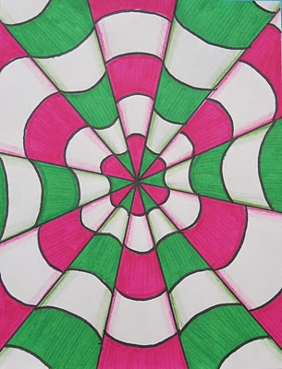
Can you create this OP Art effect?
Have ago.

Slide 30
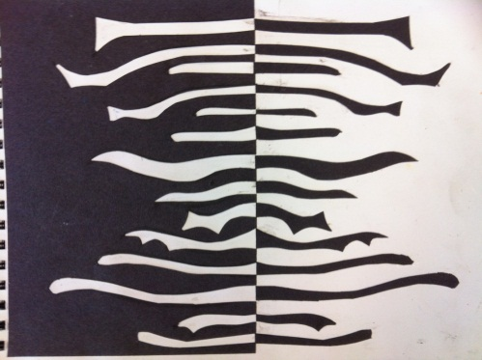
Day 8 Lesson Objective To use other art materials to create art.

Slide 31
Using other art media
Using the black paper we are going to create some op art designs.
How could we do this?

Slide 32
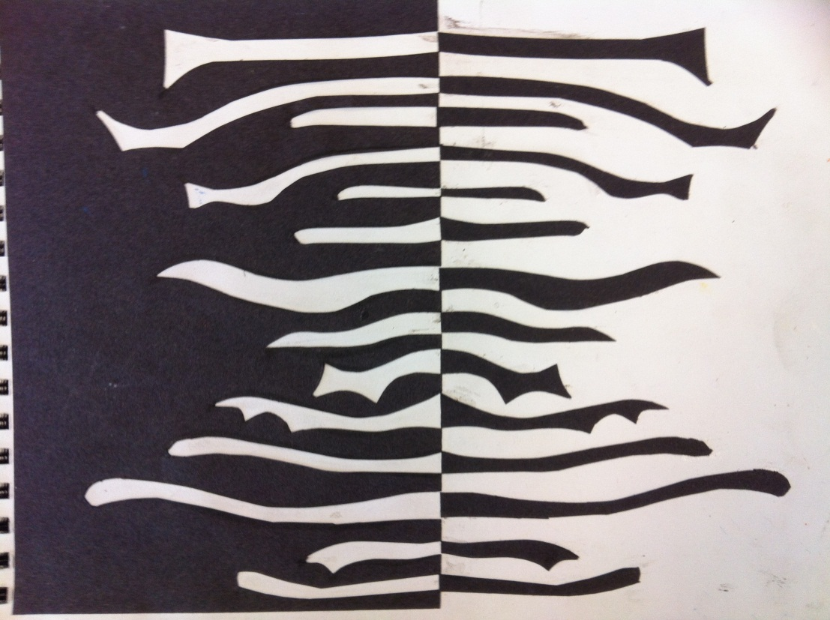
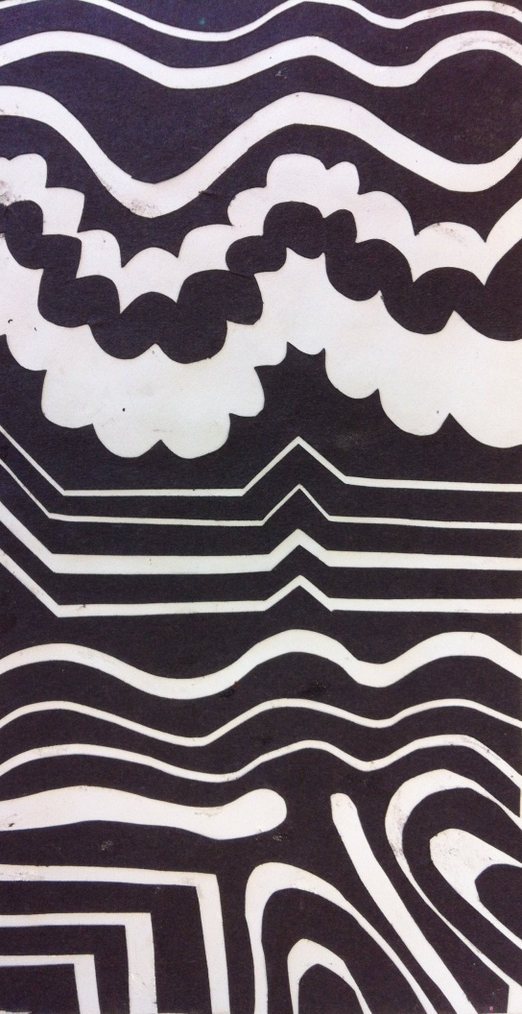
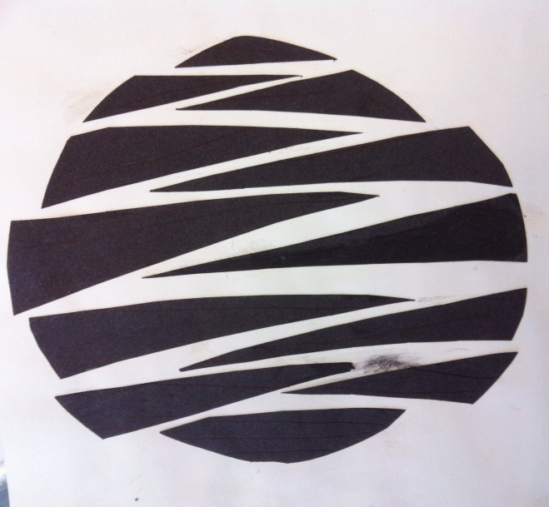

Slide 33
Day 9 Lesson Evaluation.
Art
Peer Assessment
Teacher Assessment
Level
Level
Swap your work with a partner and ask them to level your work using the success criteria and discuss.
Design Faculty
Date

Slide 34
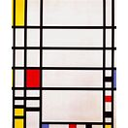
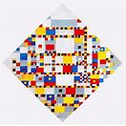
Day 10, 11
Find and present information neatly in your sketch book on the Artist Mondrian.
Use ICT create your own Mondrian using word.

Slide 35
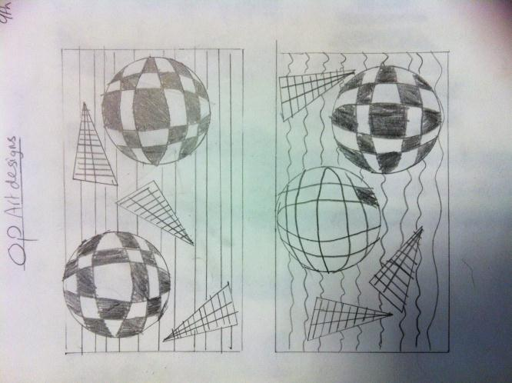
Lesson Objective: To use skills learnt from previous lessons to develop a op art design for a final piece of art work.
Title your page Op Art Designs. Using
The skills and ideas from previous lessons and home learning's plan 2 ideas for your final design
Carefully and accurately draw out using feint lines your final design.

Slide 36
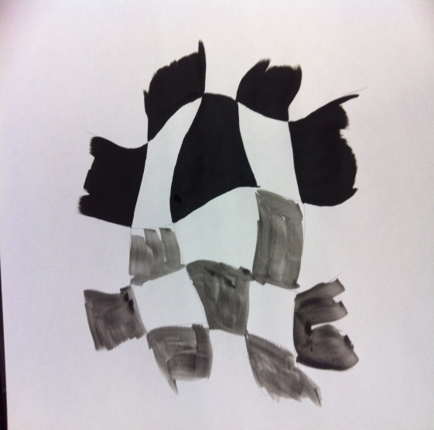
Day 6 Lesson Objective
To use paint in a controlled way to complete you Op Art design.

Slide 37
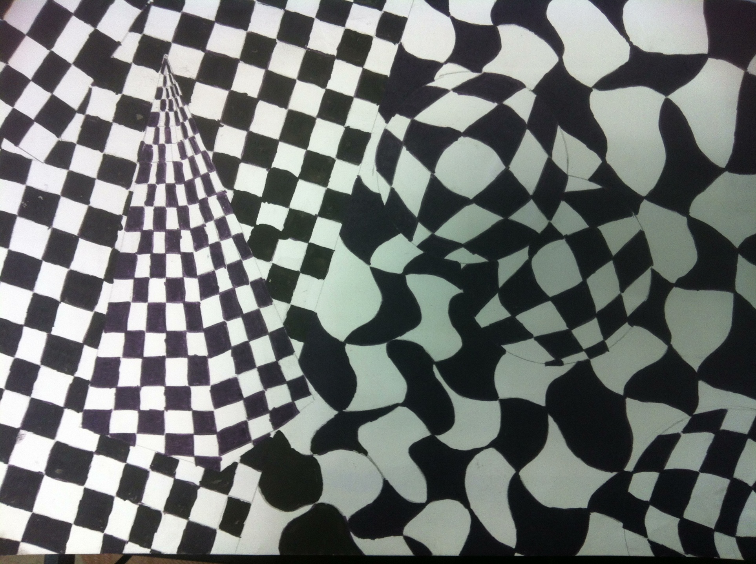
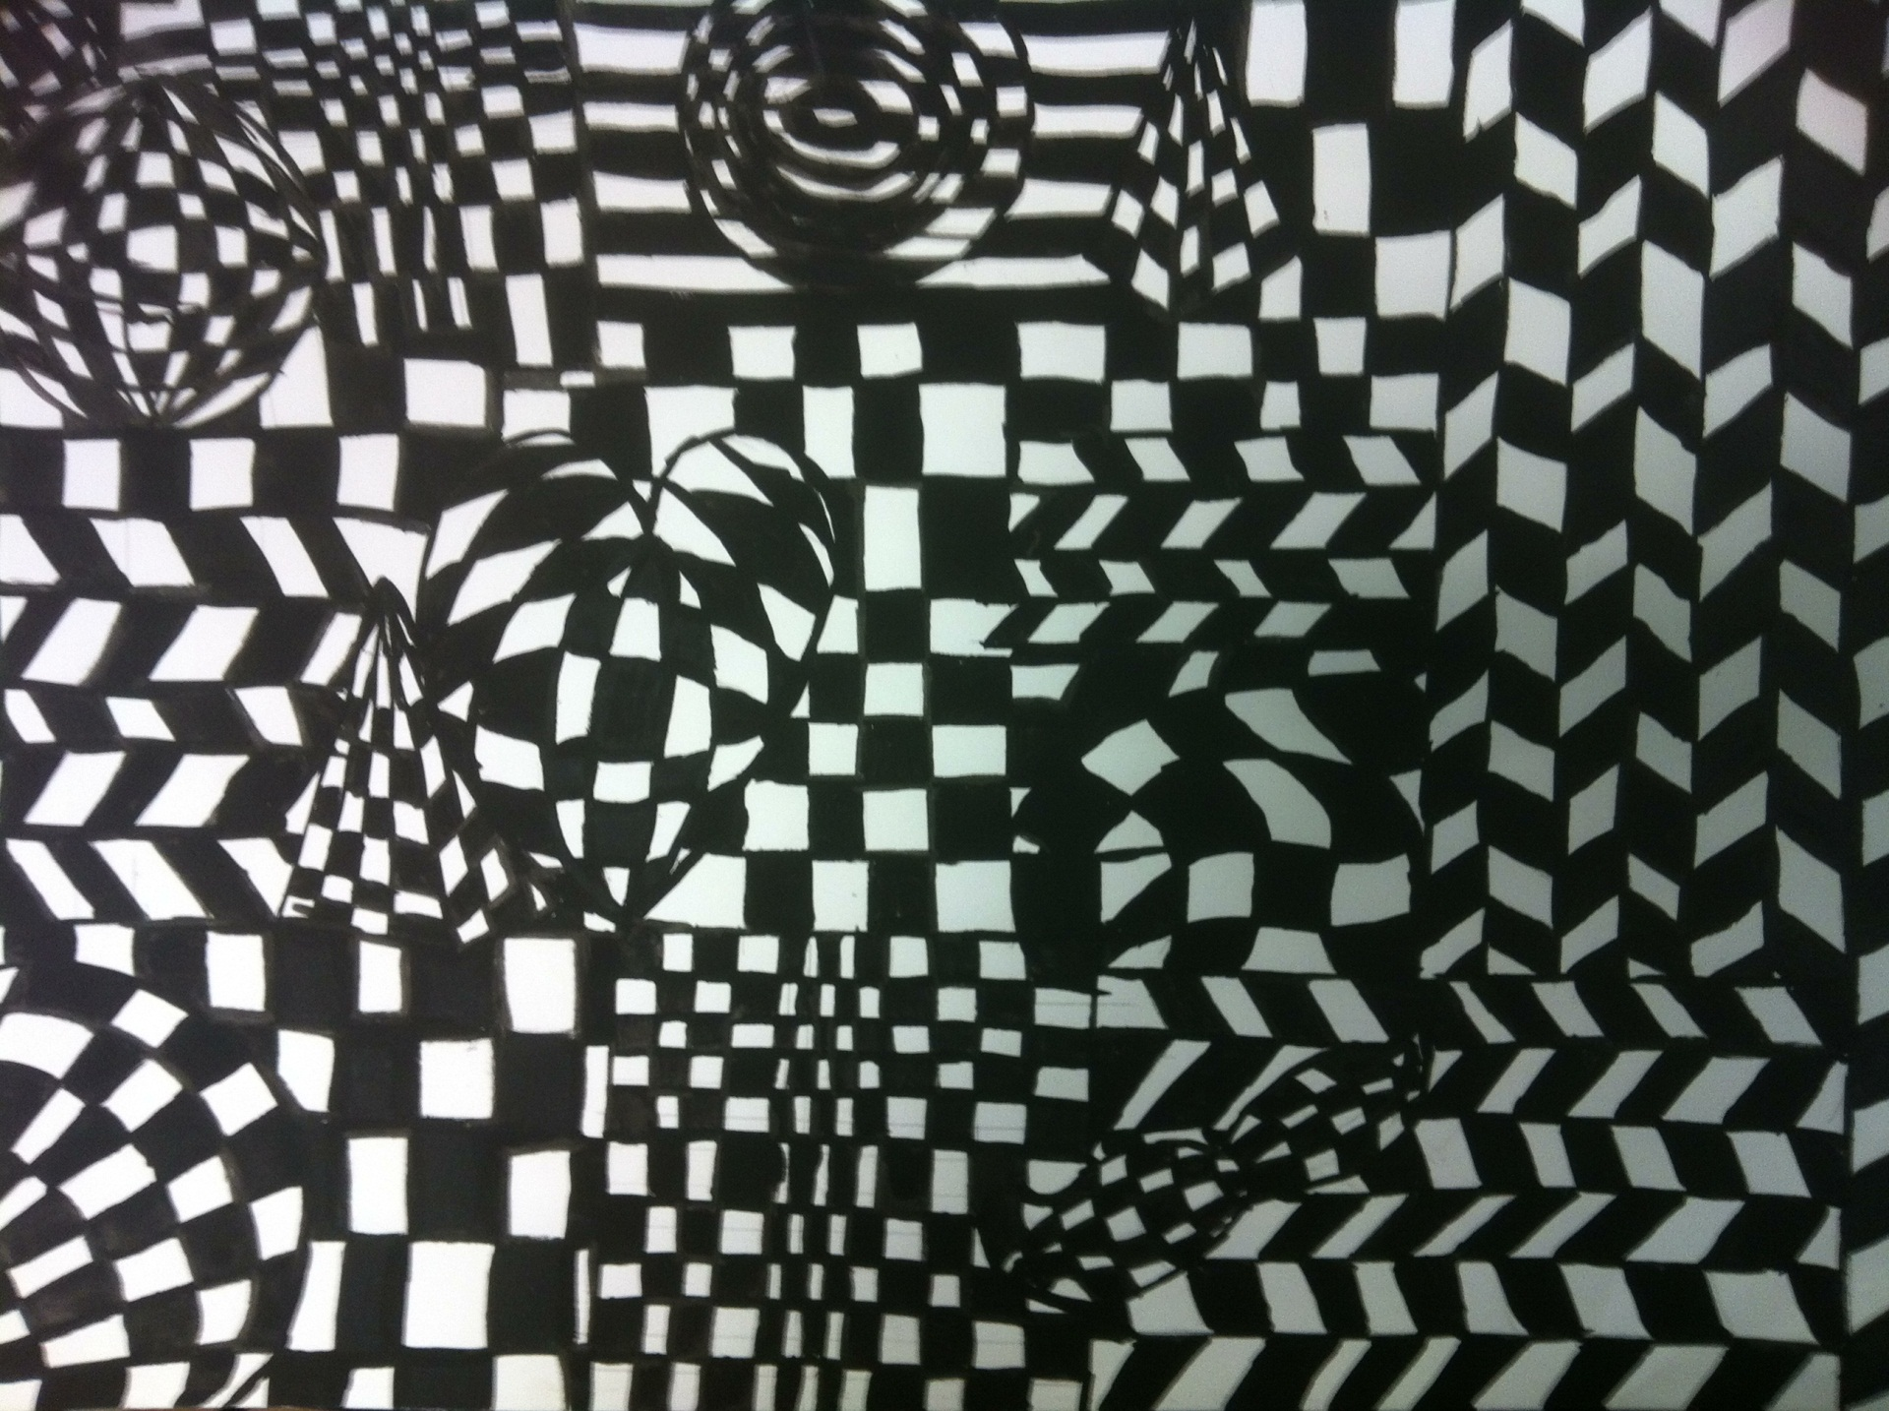

Slide 38
Day 12 Evaluation
What materials have You used?
What techniques have you used?
What artists have you learnt about? Name, Country, Dates, Key works.
What formal elements have you used?
WWW What went well?
EBI Even better if?
Look at progress chart-Give yourself a level.
Comment on what you enjoyed or disliked about the unit

