Slide 1
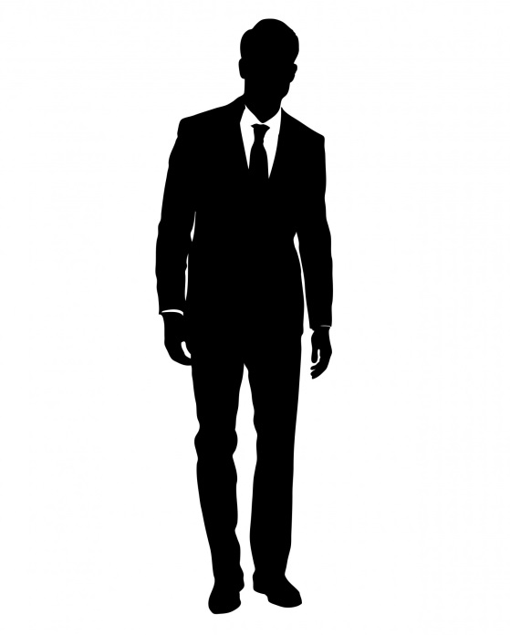
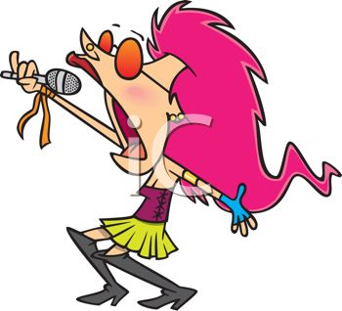
Formal or Informal?

Slide 2
Formal
We use formal language when:
Talking/writing to someone we don’t know;
Writing non-fiction such as instructions, explanations or reports;
Writing formal letters.

Slide 3
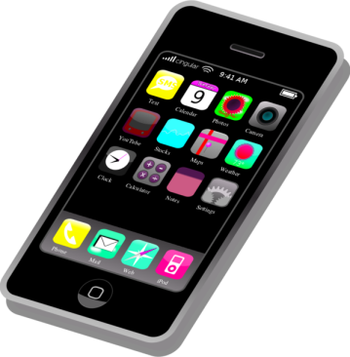
Informal
We use informal language when:
Talking/writing to someone we know well;
Writing letters to friends and close family;
Writing emails and texts to people we know.

Slide 4
Formal Letter
Dear sir or madam,
I am writing to inform you that I had a most enjoyable experience at your wonderful leisure establishment.
I and my family enjoyed magnificent refreshments. Indeed, the cuisine was heavenly…

Slide 5
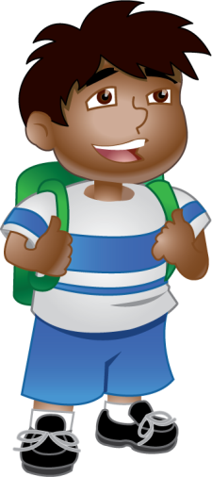
Informal Letter
Hi Laura,
I had a great time coming to stay with you last weekend. It was really cool meeting your family and awesome bunny rabbits.
That pasta we had a A-MAZE-ING! Could you get your mum to send minethe recipe? That would be SO wicked…

Slide 6
Formal or Informal?
How’s it going?
Informal
?

Slide 7
Formal or Informal?
How do you do?
Formal
?

Slide 8
Formal or Informal?
Yours sincerely
Formal
?

Slide 9
Formal or Informal?
See you later!
Informal
?

Slide 10
Formal or Informal?
Kids
Informal
?

Slide 11
Formal or Informal?
Children
Formal
?

Slide 12
Formal or Informal?
Mates
Informal
?

Slide 13
Formal or Informal?
Companions
Formal
?

Slide 14
Formal or Informal?
Magnificent!
Formal
?

Slide 15
Formal or Informal?
Cool!
Informal
?

Slide 16
Formal or Informal?
Delicious
Formal
?

Slide 17
Formal or Informal?
Yummy
Informal
?

