Slide 1
Science
Everyday Materials
Year One
Science | Year 1 | Everyday Materials | Naming Materials | Lesson 1

Slide 2
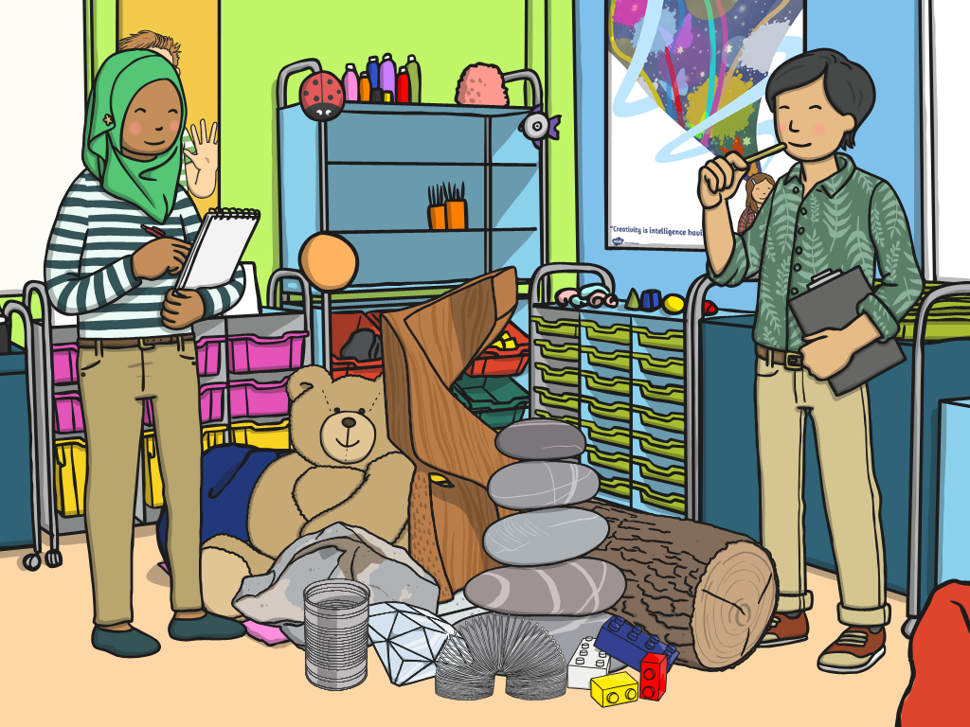
Naming Materials

Slide 3
Aim
I can identify and name different materials.
Success Criteria
I can recognise different materials and identify them by a picture.
I can match a material to its name.

Slide 4
Exploring Materials
Today you are going to explore some different materials, which is very exciting!
These are the very important things you need to remember to stay safe.
Listen to all the instructions carefully.
Be sensible.
Be gentle with the materials.
Look out for any sharp edges.

Slide 5
Naming Materials
wood
Photo courtesy of Kat…@flickr.com) - granted under creative commons licence – attribution

Slide 6
Naming Materials
plastic
Photo courtesy of woodleywonderworks@flickr.com) - granted under creative commons licence – attribution

Slide 7
Naming Materials
glass
Photo courtesy of DaveBleasdale@flickr.com) - granted under creative commons licence – attribution

Slide 8
Naming Materials
metal
Photo courtesy of Bart Kuik@flickr.com) - granted under creative commons licence – attribution

Slide 9
Naming Materials
water
Photo courtesy of Infomastern@flickr.com) - granted under creative commons licence – attribution

Slide 10
Naming Materials
rock
Photo courtesy of stebulus@flickr.com) - granted under creative commons licence – attribution

Slide 11
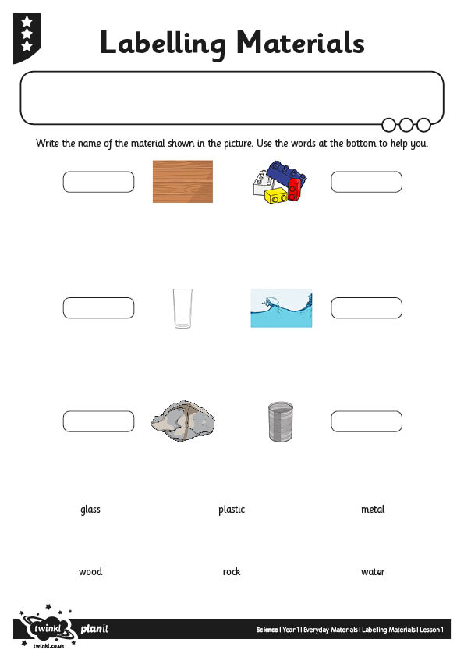
Matching Materials

Slide 12
Keywords
Can you think of three words to describe your material?

Slide 13
Aim
I can identify and name different materials.
Success Criteria
I can recognise different materials and identify them by a picture.
I can match a material to its name.

Slide 14
