Slide 1
Shared Write Example Paragraph 2
Mrs Choudhery example from video

Slide 2
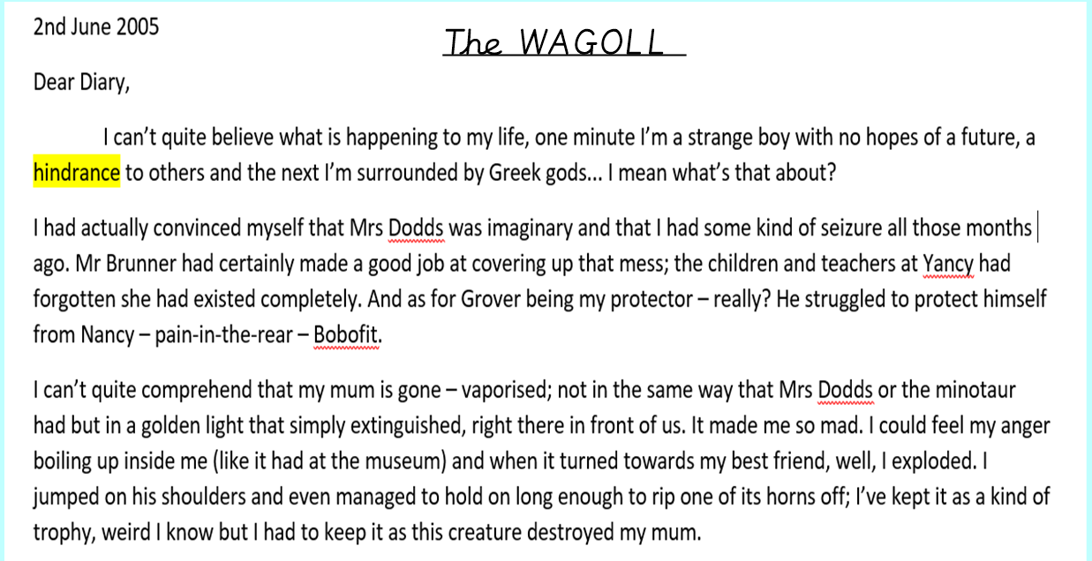

Slide 3
