Slide 1
Shared Write Example Introduction and Paragraph 1
Mrs Choudhery example from the video

Slide 2
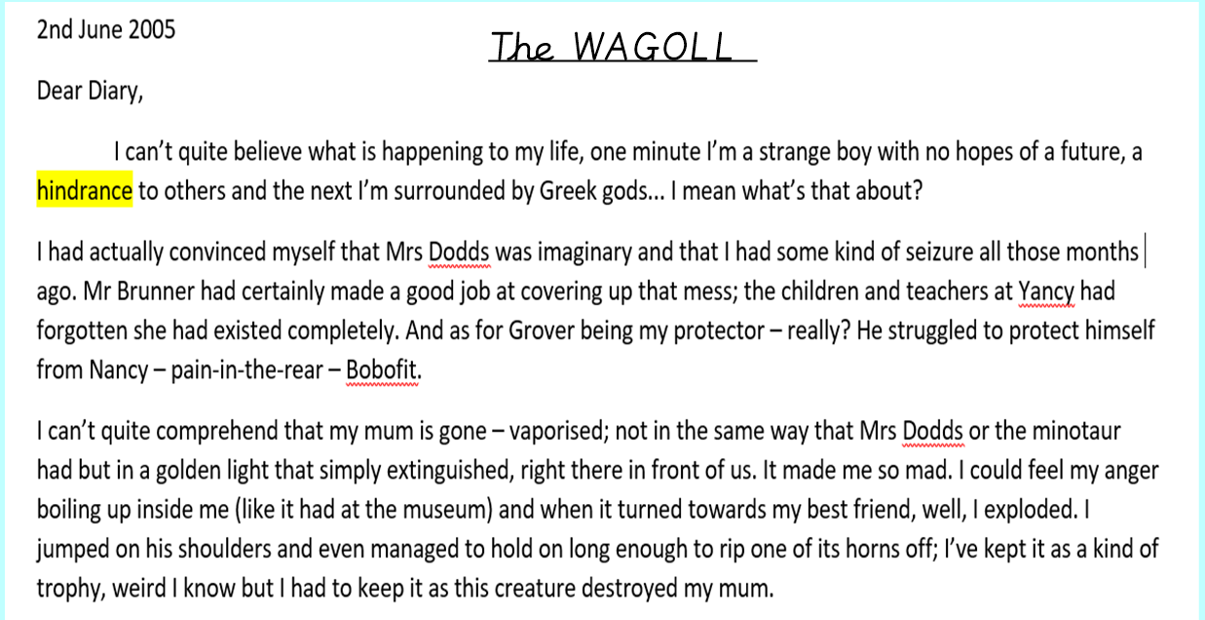

Slide 4
