Slide 1
A quick recap...
What can you remember from last week’s lesson?
Which other organs are important?
Why do your organs need oxygen?
Where does the blood from the heart travel to pick up oxygen?
So, how does the oxygen get to the lungs ready for the blood to collect?

Slide 2
The Lungs in the Human Body

Slide 3
What do the lungs do?
About 20 times a minute, we all do something without even thinking about it. In fact, we do it on average around 20,000 times a day! Can you think what it is?
BREATHE
The lungs are the organ in your body that allow you to breathe.

Slide 4
Why do we breathe?
Our lungs are there to make sure ‘good’ air (oxygen) is delivered to the heart and that ‘bad’ air (carbon dioxide) is delivered back out again through your mouth or nose.
Through breathing we are guaranteeing that our muscles and organs have enough oxygen to keep them working properly.
Q: When we exercise, why do we get out of breath?
What happens to our breathing when we get out of breath?

Slide 5
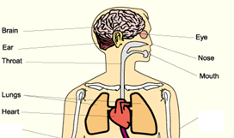
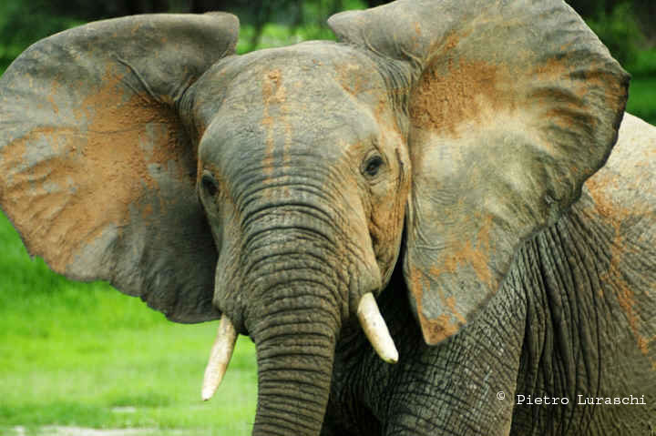
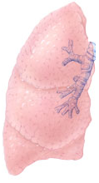
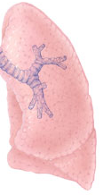
Where are your lungs?
Your lungs are very close to your heart, one lung sits either side and are protected by your rib cage.
Picture an elephant:
Pretend its face is your heart and its ears are your lungs.
Your lungs are bigger than your heart, much like an elephants ears are larger than its face, and they take up most of the room in your chest.

Slide 6
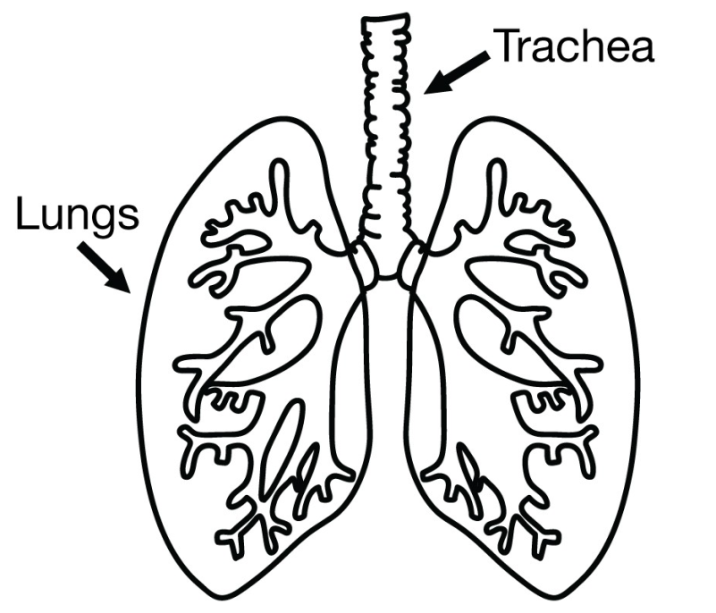
How does oxygen get in to your blood?
This is known as: RESPIRATION
When you breathe in through your nose or mouth, air travels down your windpipe, scientifically known as the trachea, and enters your lungs. Your trachea is divided into two passages, one headed to your left lung and one to your right lung.
Inside your lungs, oxygen is removed from the air you have just breathed in, and it is this oxygen that is then transported round your body by the heart.
As the heart drops off oxygen, it also picks up any carbon dioxide and we remove it from the body by breathing out again.

Slide 7
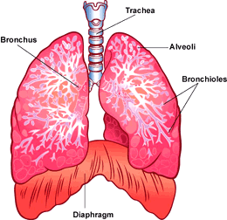
Inside your lungs
Inside your lungs, there are lots of little tree like stems. However, instead of having leaves on the end of their branches, there are lots of little sacks of air that connect your lungs with the blood being pumped from the heart in tiny blood vessels called capillaries. These air sacks are known as Alveoli, and the branches that they are attached to, Bronchioles.
Much like trees have roots to keep them in the ground, Bronchioles are secured to the trachea by the Bronchus.
Beneath your lungs is your Diaphragm, a dome shaped muscle that works with your lungs to allow you to breath in and out.

Slide 8
What happens when we breathe in and out?
Lungs fill with air and increase in size
Diaphragm stretches to allow for the lungs to increase in size
Ribs move upwards and outwards to allow for the lungs to increase in size
Lungs shrink as the air is exhaled
Diaphragm tightens and the lungs get smaller
Ribs move downwards and inwards as the lungs shrink in size
http://www.smm.org/heart/lungs/breathing.htm

Slide 9
Points to think about
The lungs can be effected by a number of medical conditions, but also by certain choices we decide to make.
Q: do you know of any medical conditions that may affect your lungs?
ASTHMA: asthma narrows the bronchioles in your lungs, making it harder to breathe as less air can fit down the tubes
Q: can you think of any other things that can affect your lungs?
SMOKING: smoking damages the alveoli and bronchioles in your lungs, making it harder to breath as less oxygen can reach your blood

Slide 10
Video
https://www.youtube.com/watch?v=p4zOXOM6wgE

