Slide 1
The subjunctive form.

Slide 2
The what?
The subjunctive form sounds scarier than it actually is.
The subjunctive form is mostly used in formal language
(if you were the queen for example).
It can be used to give advice of talk about unreal situations.

Slide 3
Advice
Unreal situations
Advise
Ask
Command
Demand
Insist
Propose
Recommend
Request
Desire
Wish
Hope
Dream

Slide 4
To advise
Advise
Ask
Command
Demand
Insist
Propose
Recommend
Request
Noun/Pronoun | Verb (can change for tense etc) | That | Noun/Pronoun | Infinitive verb (must always be in root form for the subjunctive to be grammatically correct)
I | propose | that | dad | listen
She | demanded | that | he | be
We | command | that | she | write
Sarah | insist | that | John | have
Mr Jones | ask | that | the school team | attend

Slide 5
Unreal situations
Desire
Wish
Hope
Dream
If | Noun/pronoun | were | situation
If | I | were | rich
If | I | were | famous
If | he | were | to attend they party
If | they | were | going to book the holiday

Slide 6
Which is written in the subjunctive?
If I were chosen, I would do my best.
Or
If you choose me, I would do my best.

Slide 7
Which is written in the subjunctive?
We ask that the match be postponed due to the rain.
Or
We have asked for the match to be postponed due to the rain.

Slide 8
Which is written in the subjunctive?
Honesty is part of our school rules.
Or
Our school rules require that all children be honest.

Slide 9
Which is written in the subjunctive?
It is essential that the game begin at once.
Or
The game needs to start now.

Slide 10
Which is written in the subjunctive?
Please can Matthew come home at lunchtime?
Or
I request that Matthew be allowed to come home.

Slide 11
Why do I need to know this? Do people even use it?

Slide 12
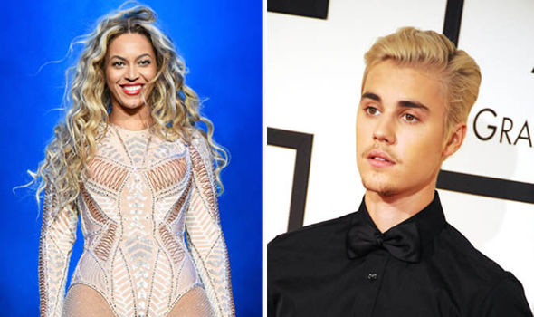
Beyonce VS Bieber

Slide 13
Justin Bieber is using the subjunctive incorrectly!!

Slide 14
Task: Write a letter to inform Mr Bieber of this, and what he needs to do to correct it!
Challenge: Write in the subjunctive in your letter.
(There’s a prize in it for you!)

