Slide 1
Aim
To learn about what sculpture is.
To learn about the materials used to create a sculpture.
To learn how to sculpt with clay

Slide 2
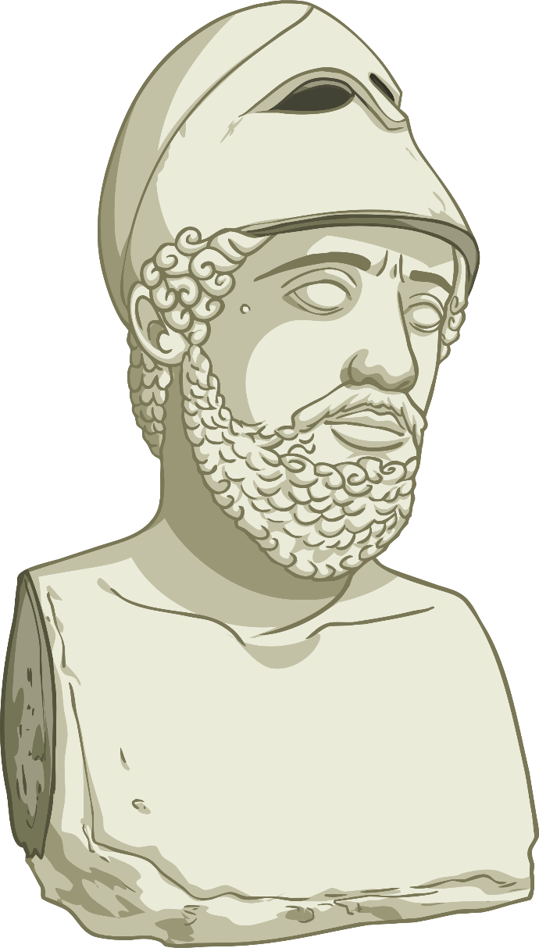
Starter Activity
What is a sculpture?
Do you know the names of any famous sculptures or sculptors?

Slide 3
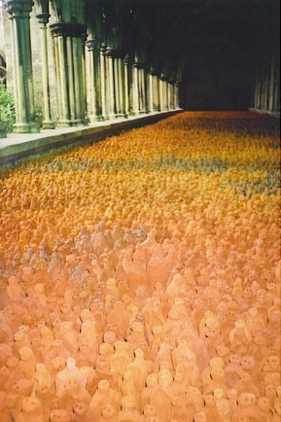
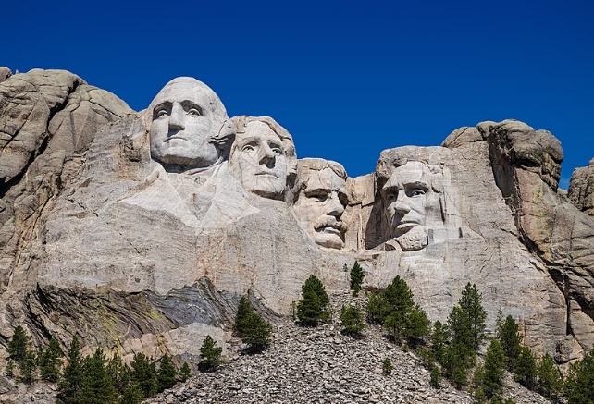
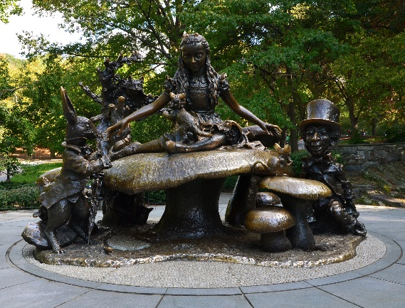
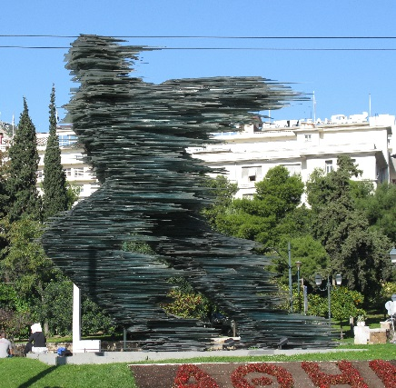
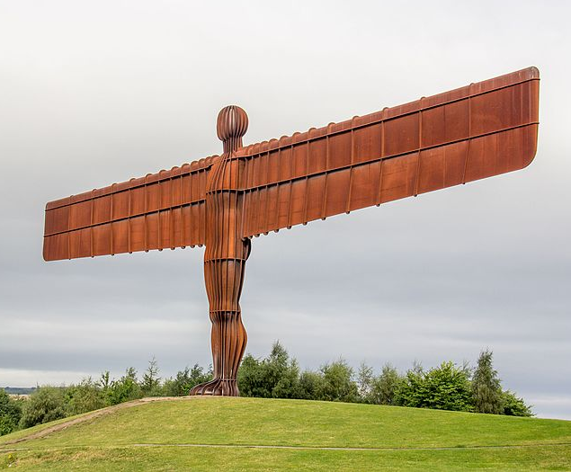
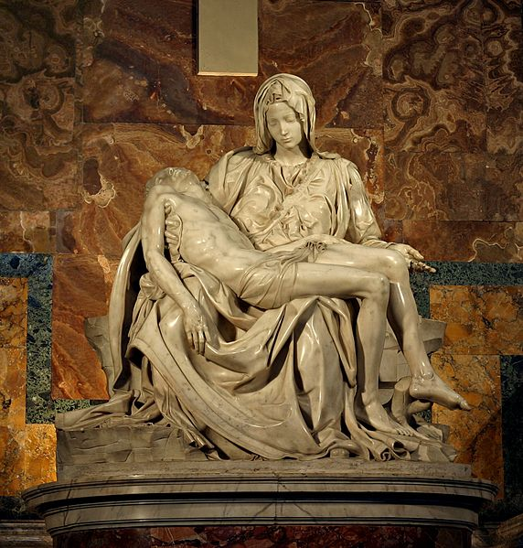
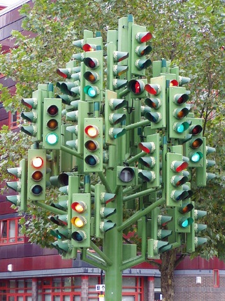
What is a sculpture?
Basically, it’s a piece of art, in 3D!
Which materials have been used to create these sculptures?

Slide 4
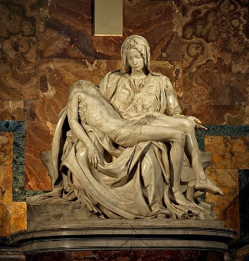
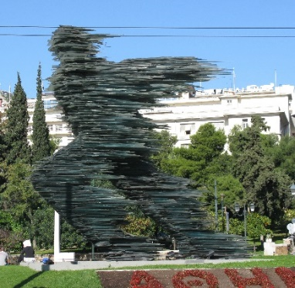
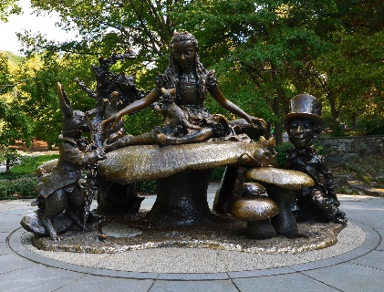
Which materials have been used to create these sculptures?
Mount Rushmore
Materials: granite
Pieta
Materials: marble
The Traffic Light Tree
Materials: metal, stone, clay, wood, plaster
Angel of the North
Materials: steel
Field
Materials: terracotta
The Runner
Materials: green glass
Alice in Wonderland
Materials: bronze

Slide 5
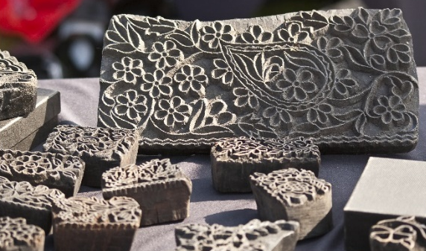
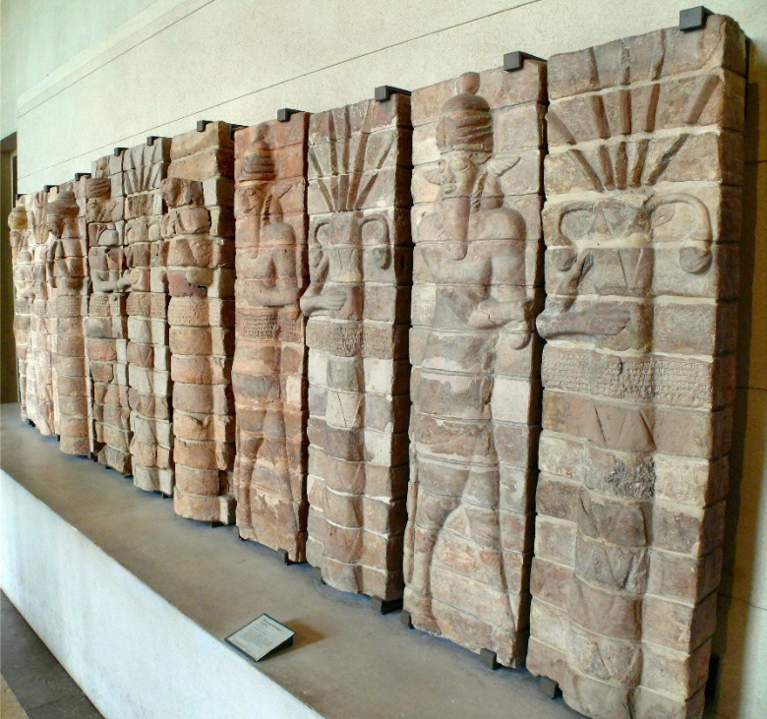
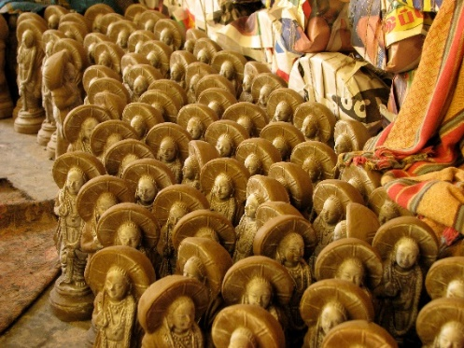
Using clay
Clay is good for sculpting because it is very malleable before being heated. You can also paint and varnish it.
There are different types of clay such as porcelain clay, red clay and black clay.

Slide 6
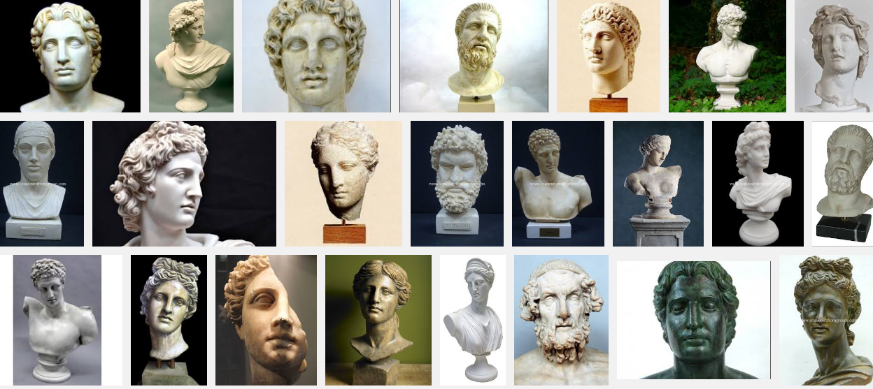
Greek Busts
When everyone returns to school, we are going to create our very own Greek God busts out of clay. A bust is a sculpted representation of a person’s head and neck.
Today, we would like you to research the different types of Greek gods and goddesses and decide which one you will make out of clay- remember that it will only be their head and neck! Take a look at the next slides to help you decide!
Greek Busts

Slide 7
Greek Busts

Slide 8
Greek Busts

Slide 9
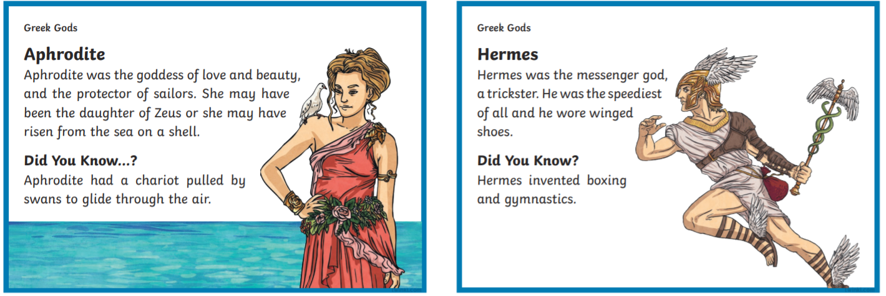
Greek Busts

Slide 10
Greek Busts

Slide 11
Greek Busts

Slide 12
Greek Busts

Slide 13
Greek Busts

Slide 14
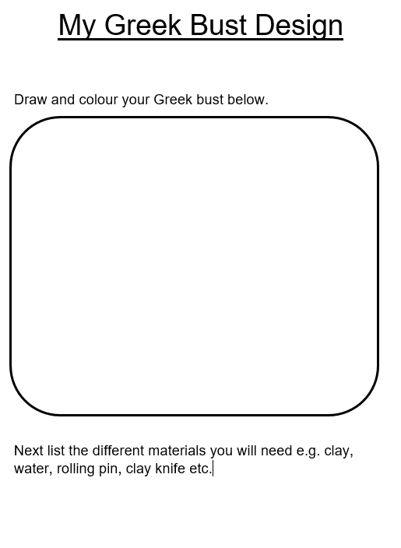
Design your Greek Bust
First, draw and colour your Greek bust. Remember it is only the Greek gods or goddess’ head and neck. Annotate items you would like to stand out e.g. headdress, earrings etc.
Create a list of the different materials you will need to create your Greek bust.
If you would like to watch a sculpture in action, take a look here: https://www.youtube.com/watch?v=6dnyYu4Ff7U

