Slide 1
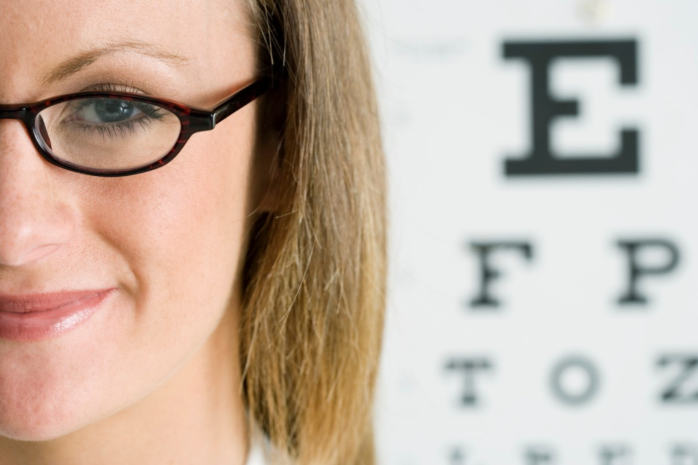
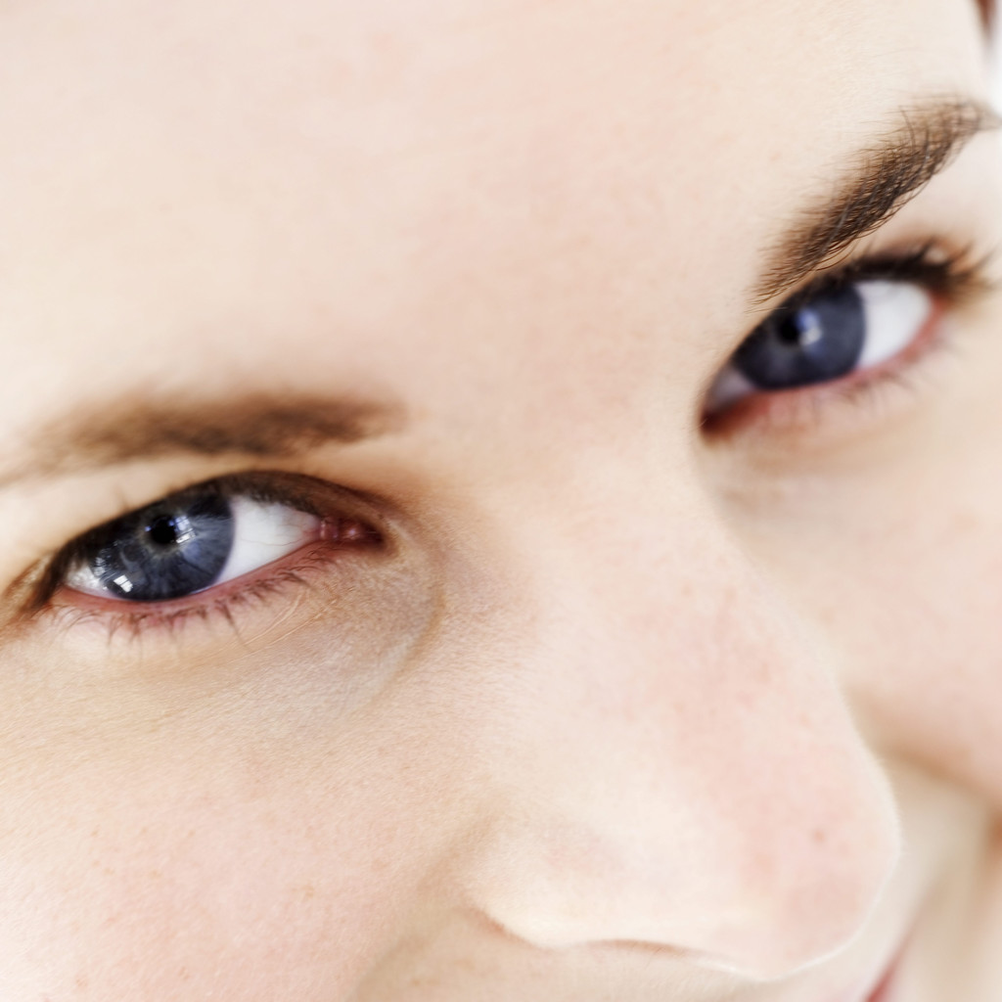
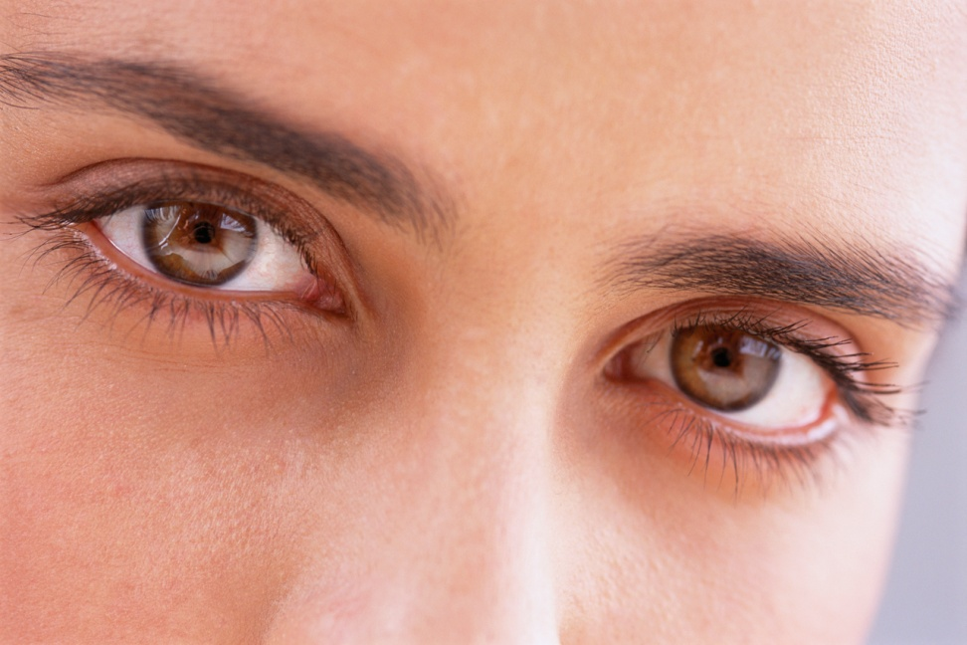
I can explain how the eye works

Slide 2
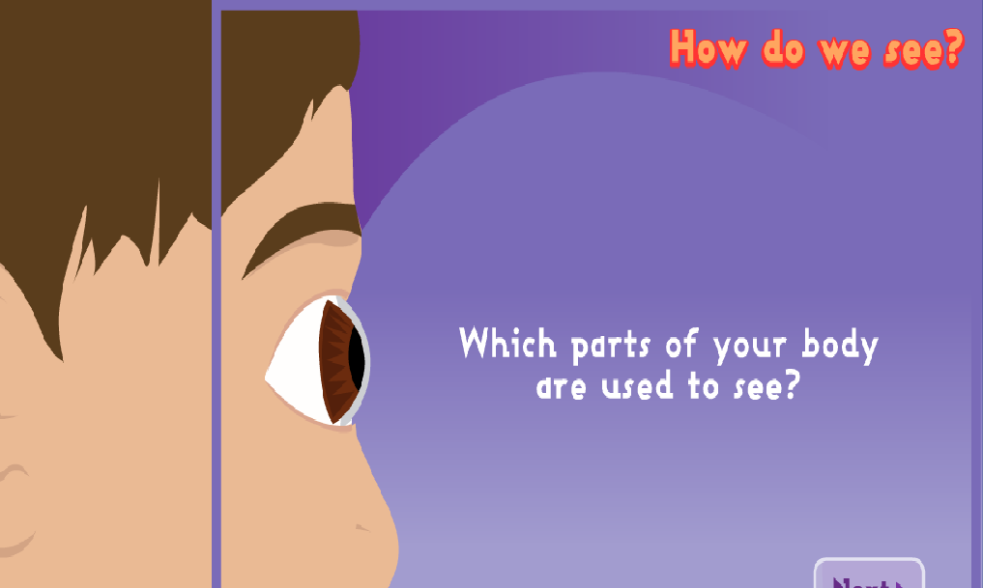

Slide 3
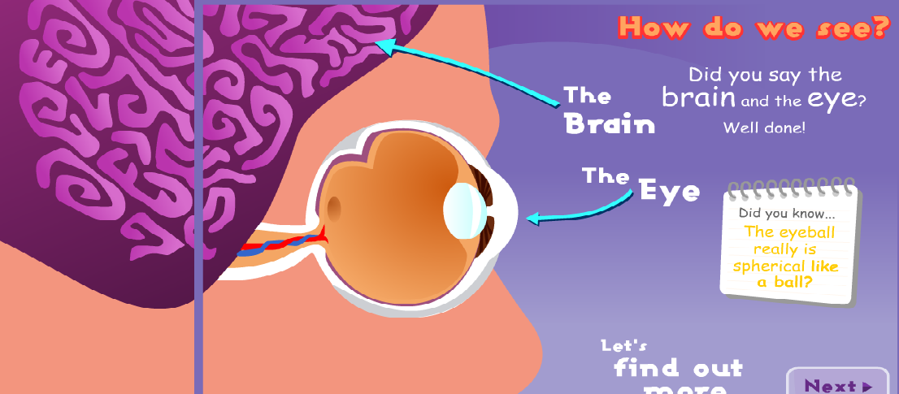

Slide 4
Your eyes are like a wonderful camera!
They take pictures of the world around you and send the pictures to your brain. Your brain works out what your eyes are seeing. This happens from the moment that you open your eyes in the morning to when you close your eyes at night.

Slide 5
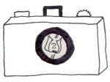
How a camera works
The light rays from an object pass through the lens of the camera and get recorded on a film or a computer chip.
Do you notice something about this drawing?
Yes, the picture that is recorded by the camera is upside down (of course, when you look at the picture as a printed photo or on a computer screen, it is not upside down).

Slide 6
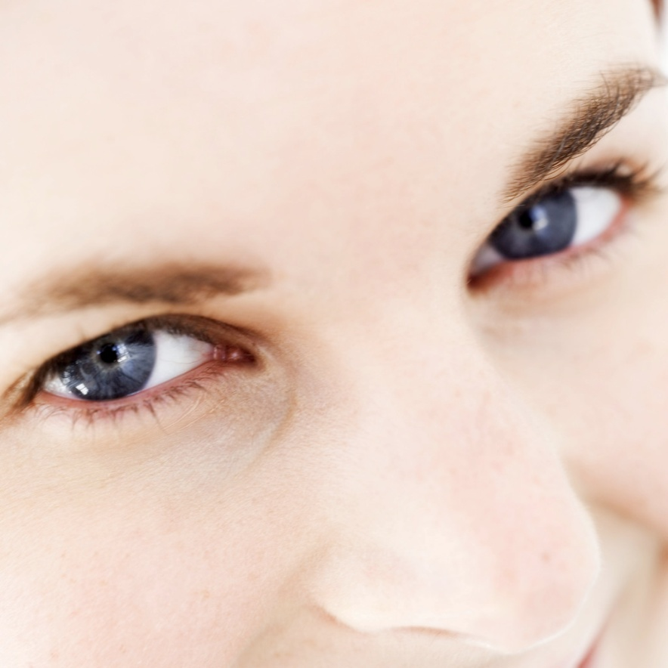
How your eyes work
Your eye works in a similar way to a camera - light passes through the lens of your eye and is 'recorded' on the back of your eye (the retina).

Slide 7
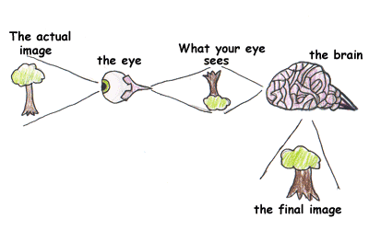
Do you notice something about this drawing?
Yes, the picture that your eye takes is upside down too!

Slide 8
Why don't you see things upside down?
Well, your eye sends the picture to your brain, and your brain turns the picture the right way up and tells you what you are looking at. So you see things the right way up.

