Slide 1
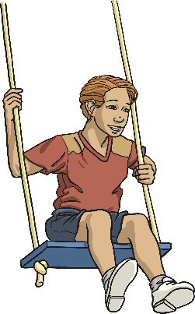
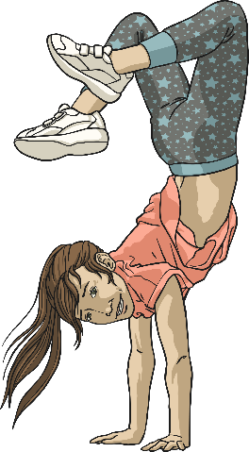
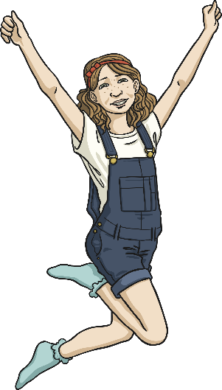
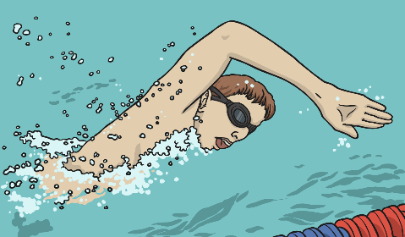
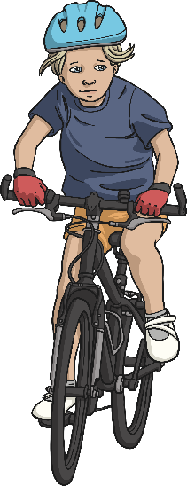
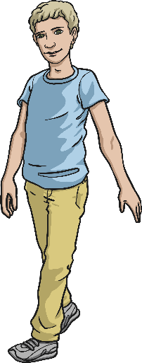
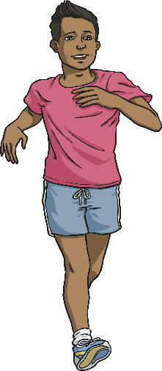
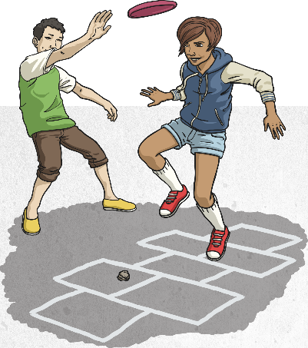
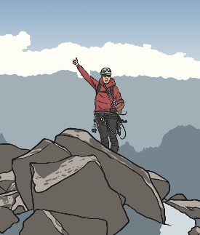
What Counts as Exercise?
Exercise is physical activity that requires effort, raises your heart rate and works your muscles.
There are two main types of exercise:
Muscle Strengthening | Bone Strengthening
 | Moderate Intensity | Vigorous Intensity

Slide 2
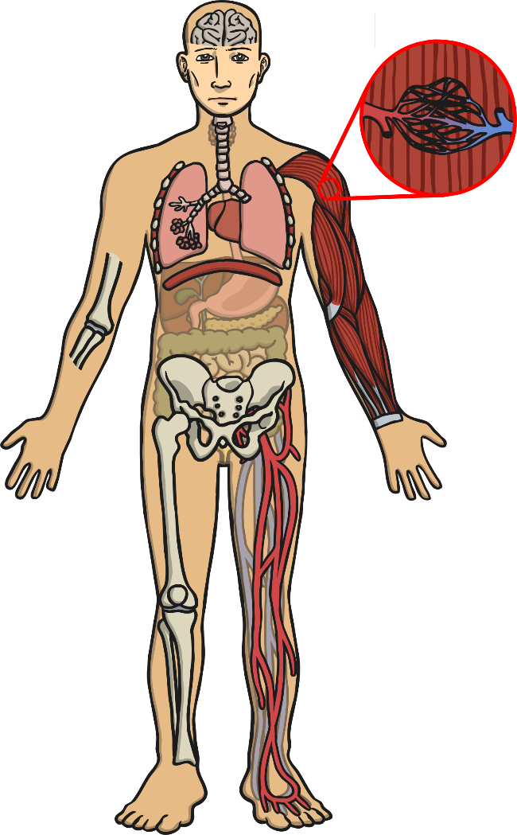
What Is the Impact of Regular Exercise?
Helps you fall asleep faster and deeper so you are better rested.
Increases the number of capillaries in the muscles.
Stimulates and releases brain chemicals – for example endorphins leave you feeling happier and serotonin helps keep your mood calm and leaves you feeling relaxed.
Strengthens heart muscle.
Strengthens diaphragm and intercostal muscles.
Increases the number of air sacs (alveoli).
Strengthens muscles.
When you exercise your body increases the circulation of blood – this means that nutrients are delivered and waste taken away faster which improves parts of the body like skin.
Increases the amount of oxygen delivered to and carbon dioxide removed from the body.
Joints are more stable.
Bones increase in width and density (The denser the bone, the stronger it is).
Increases the volume of blood and red blood cells.

