Slide 1
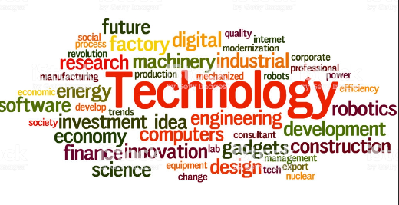
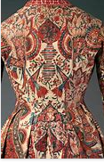
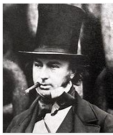
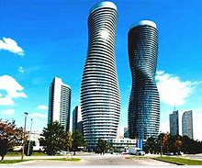
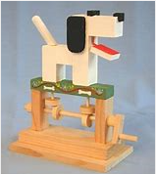
The philosophy behind DT at WPS
DT at Wibsey Primary School…
develops designers
A designer is someone who can execute designs that create structures and patterns for works of art. A designer can imagine how something can be made and creates an innovative and original product.
I notice…
“Design is intelligence made visible.” – Alina Wheeler
Evaluate
Make
I wonder what happens when/if…
Design
As pupils progress through Wibsey Primary School, they will be able to use their creativity and imagination to design and make products within a variety of contexts. They will learn how to take risks, become resourceful and innovative as well as evaluate past and present designs. With high-quality design and technology education, children will be able to contribute through creativity.
I know… so…
Vocabulary
Designer
I think… because I know…
Structures, Mechanisms, Textiles, Electrical Systems, Food

