Slide 1
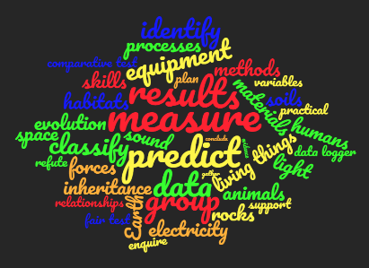
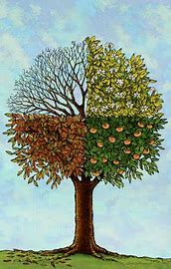
The philosophy behind Science at WPS
Science at Wibsey Primary School develops scientists…
A scientist asks questions, systematically gathers and uses research and evidence, to draw conclusions, in order to gain and share an understanding and knowledge of the world.
Our Science curriculum enables children to work scientifically by questioning, predicting, noticing, concluding and wondering.
‘Science and everyday life cannot and should not be separated.’
Rosalind Franklin
I wonder what happens when/if…
My results show… therefore..
Wondering
Concluding
Noticing
At Wibsey Primary School, we support children to make sense of the world in which they live through investigation, as well as using and applying process skills. We aim for our children to develop a lifelong love for science and be aware of the presence and application of science around them.
Our teaching enables children to:
Develop scientific knowledge and conceptual understanding through the specific disciplines of biology, chemistry and physics
Develop an understanding of the nature, processes and methods of science through different types of science enquiries
Answer scientific questions about the world around them
Be equipped with the scientific knowledge required to understand the uses and implications of science, today and for the future.
Predicting
I predict that .…
I notice…
Questioning
Vocabulary
?
Scientist
We increase children’s
vocabulary to
ensure application,
retention,
and conceptual nuance.
Working Scientifically

