Slide 1
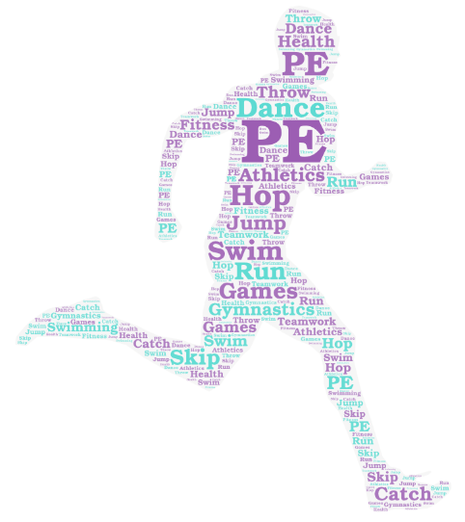
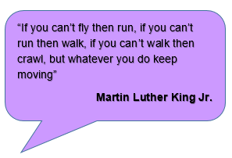
The philosophy behind Physical Education at WPS
Physical Education at Wibsey Primary School…
...develops understanding of how physical activity is part of a healthy lifestyle and the positive effect it can have on our mental health and wellbeing
As pupils progress through WPS, they develop a range of movement skills, becoming increasingly competent and confident. They have access to a broad range of opportunities to extend their agility, balance and coordination whilst participating in gymnastics, dance, games, swimming and athletics.
Children spend time mastering basic movements, participating in team games and developing an understanding of how to improve in different physical activities and sports. They learn how to evaluate and recognise their own success
Physical education poses challenges, making us realise what our minds and bodies can achieve. It makes us feel happier, improves our wellbeing and keeps our body healthy.
A key feature of PE at WPS is the opportunity to participate in a broad range of sports and physical activities. All pupils will experience competition both individually and as part of a team which enables them to develop important life skills.

