Slide 1
Welcome to Reception

Slide 2
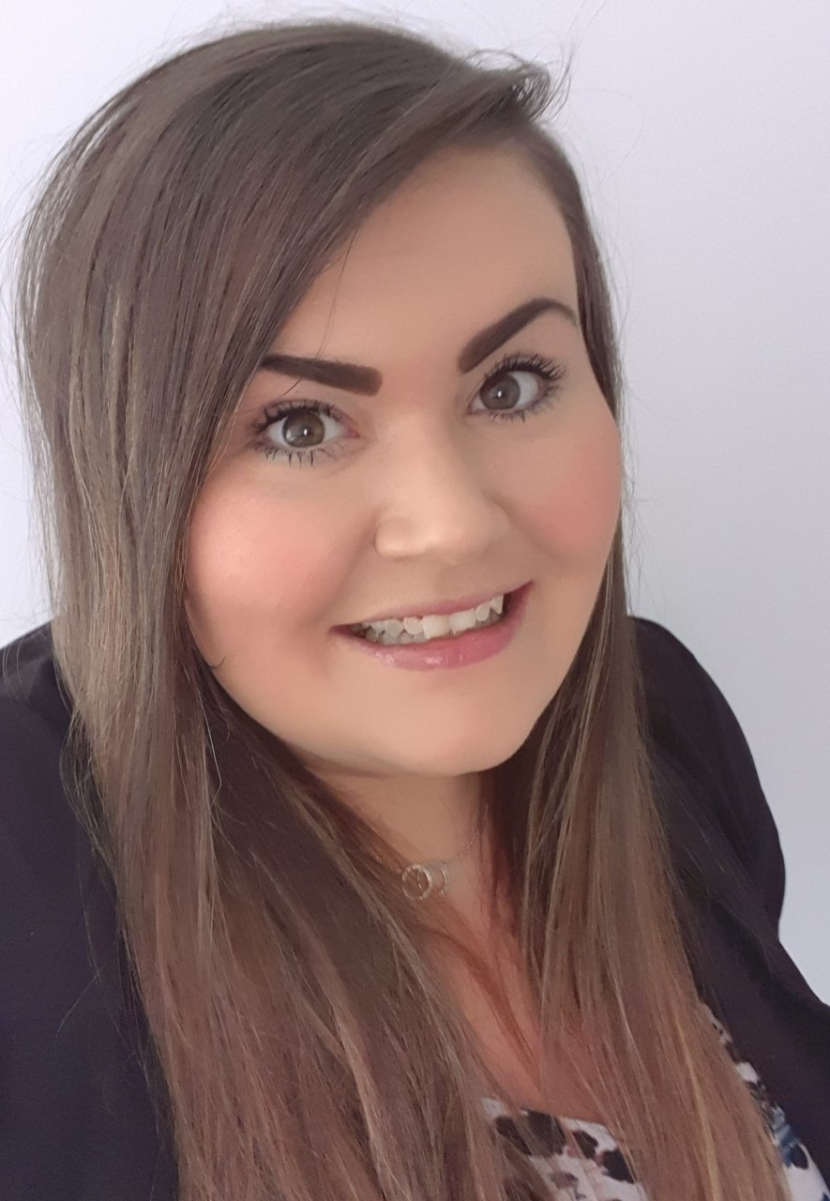
Meet the teachers
Reception 1 Mrs Davies
Reception 2
Miss Meadowcroft
Reception 3
Miss Rankin

Slide 3
Meet the associate staff
Miss Sutcliffe
Mrs Goldsborough
Mrs Arato
Miss Summerscales
Mrs Woodrup

Slide 4
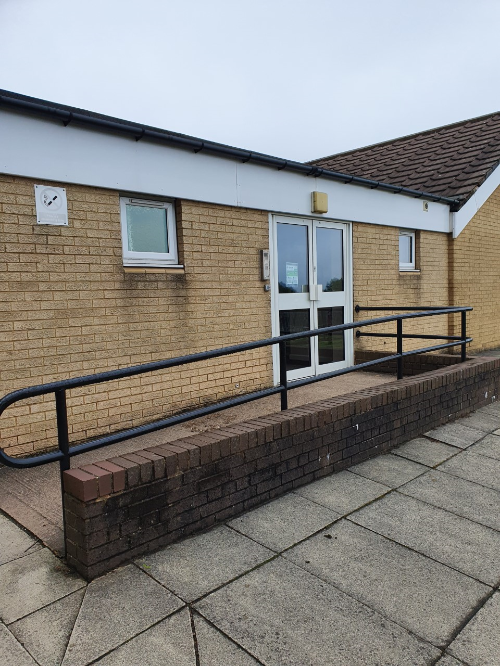
This is where you will enter the Reception building.

Slide 5
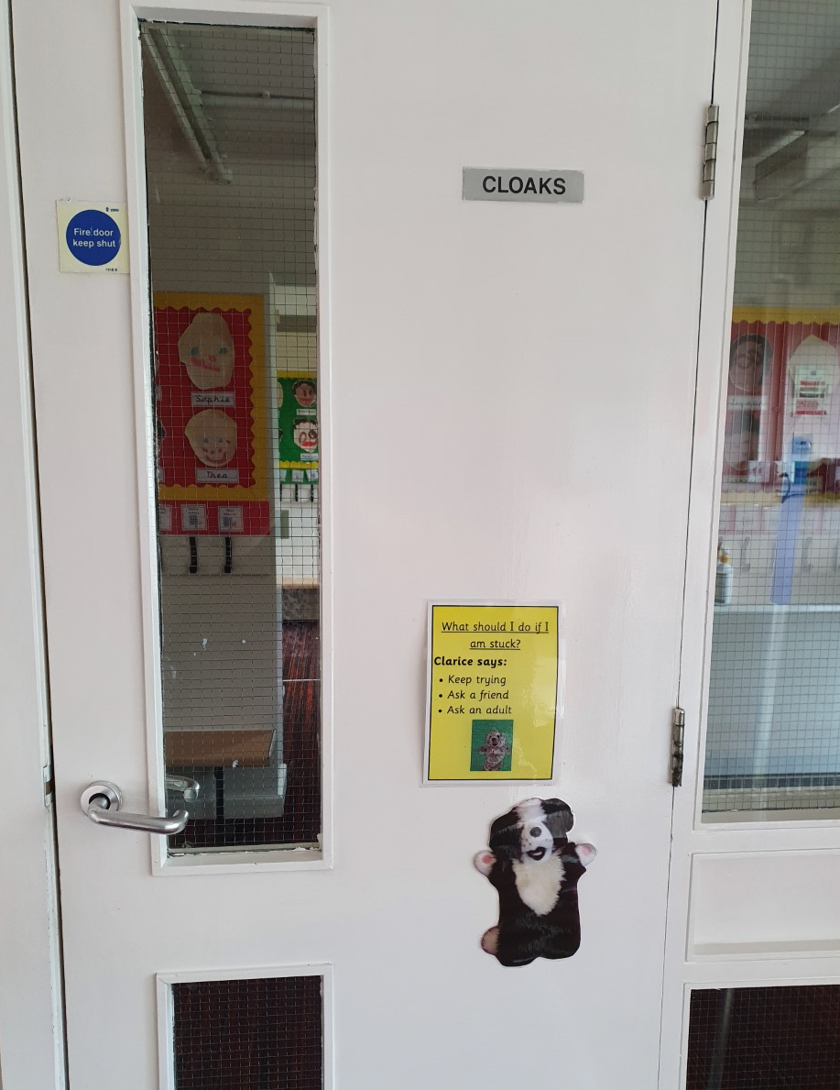
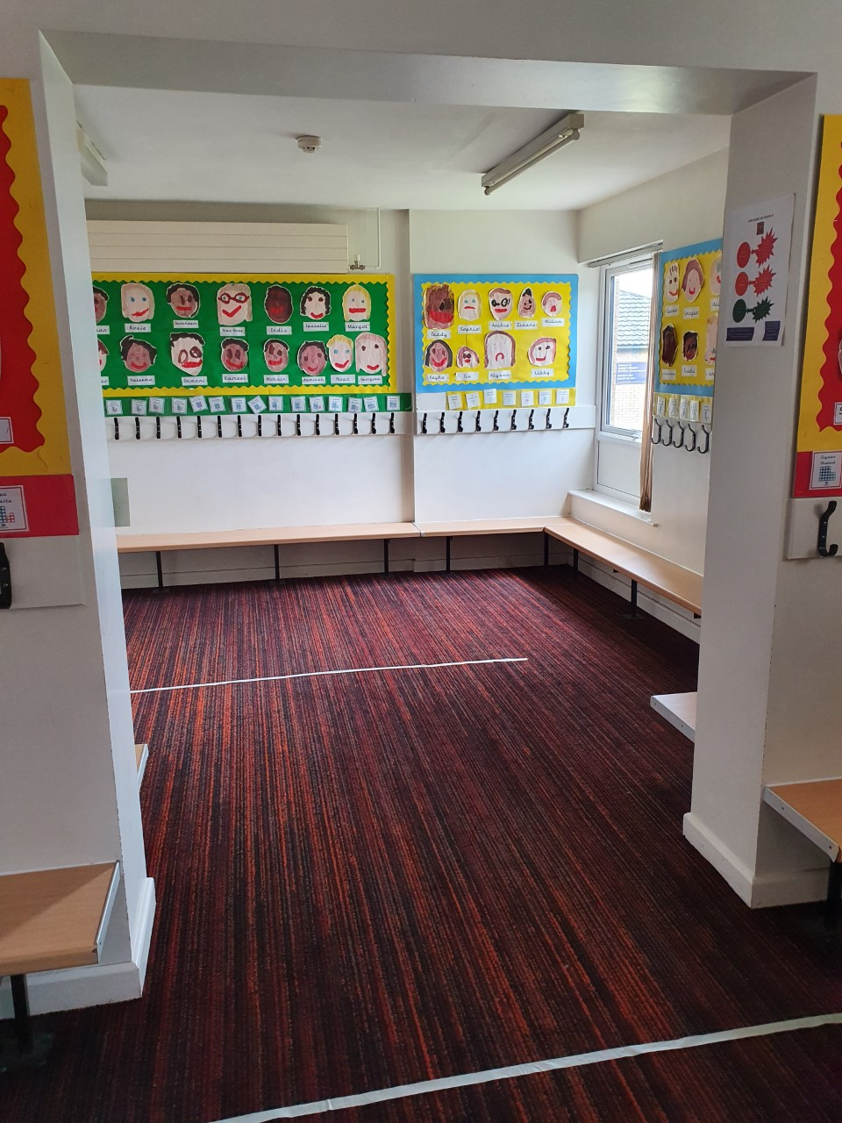
This is where you will hang up your coat.

Slide 6
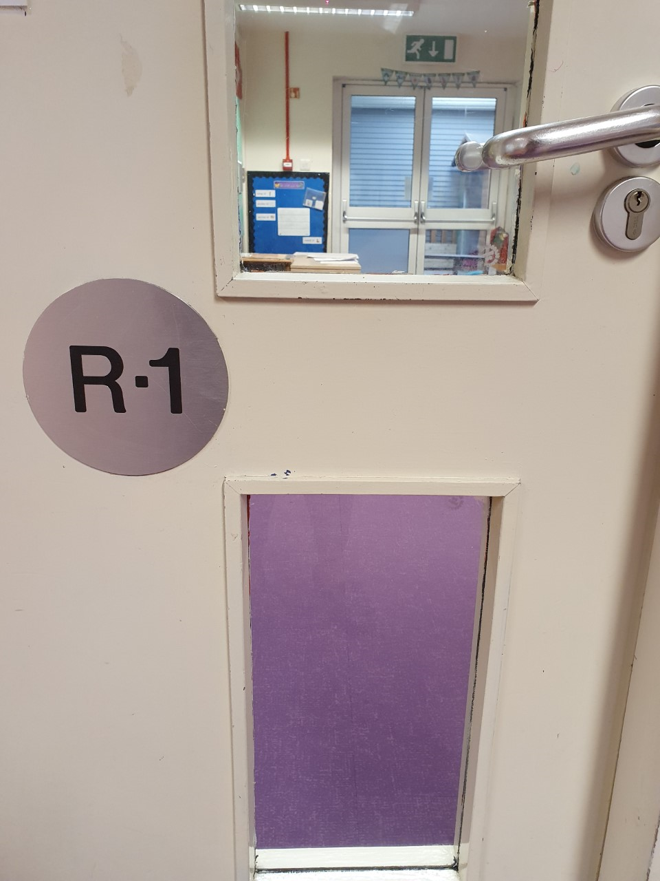
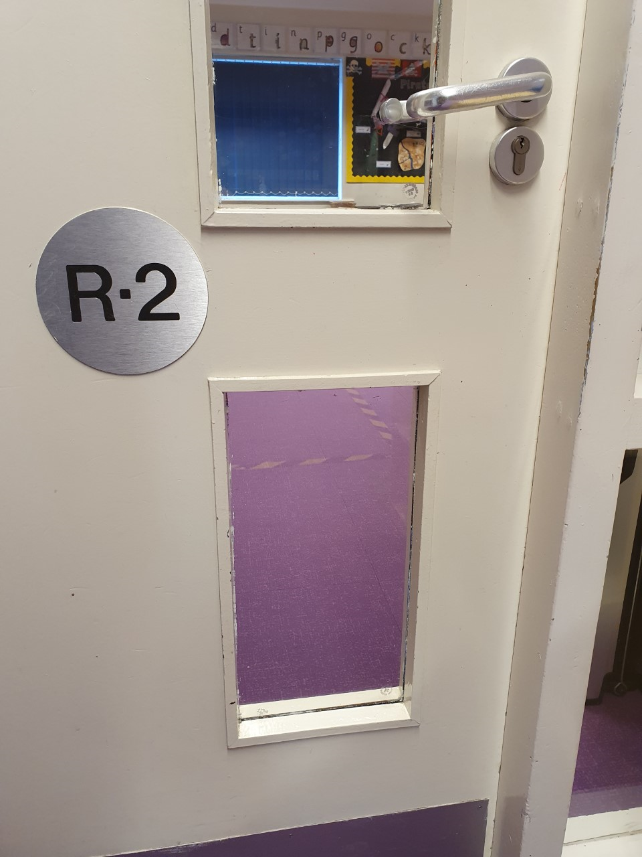
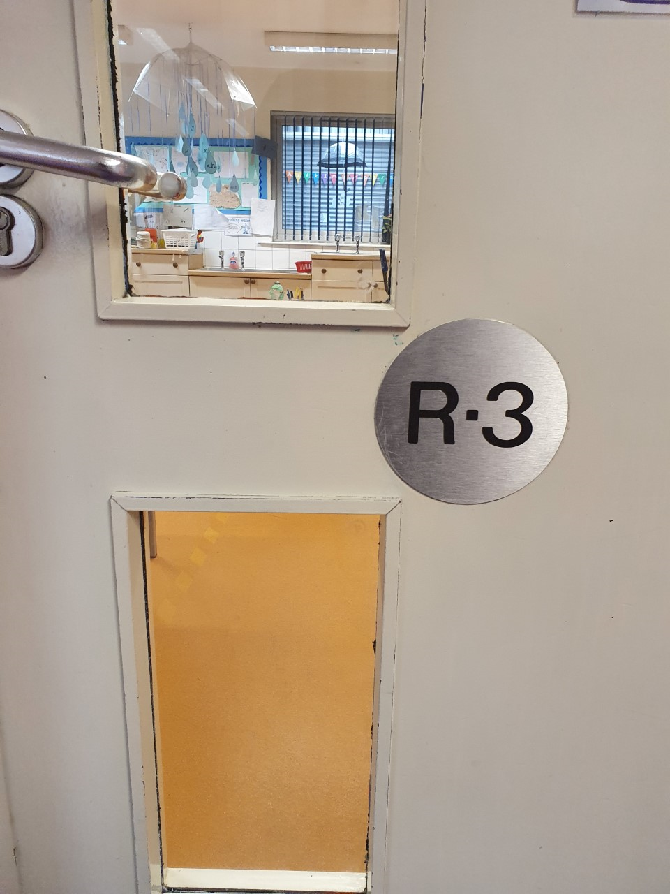
This is where you enter your classroom.

Slide 7
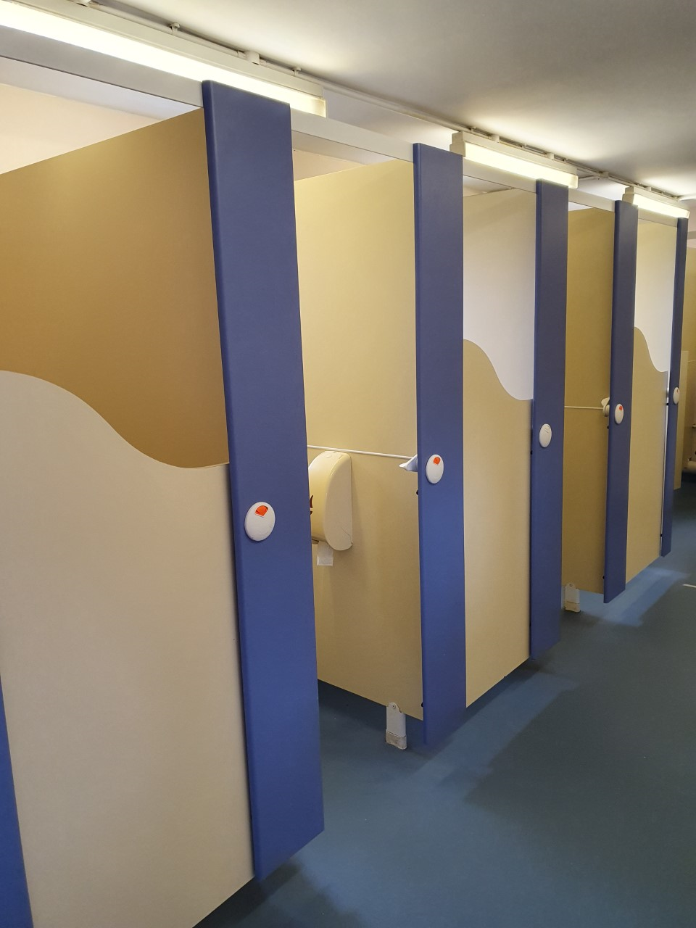
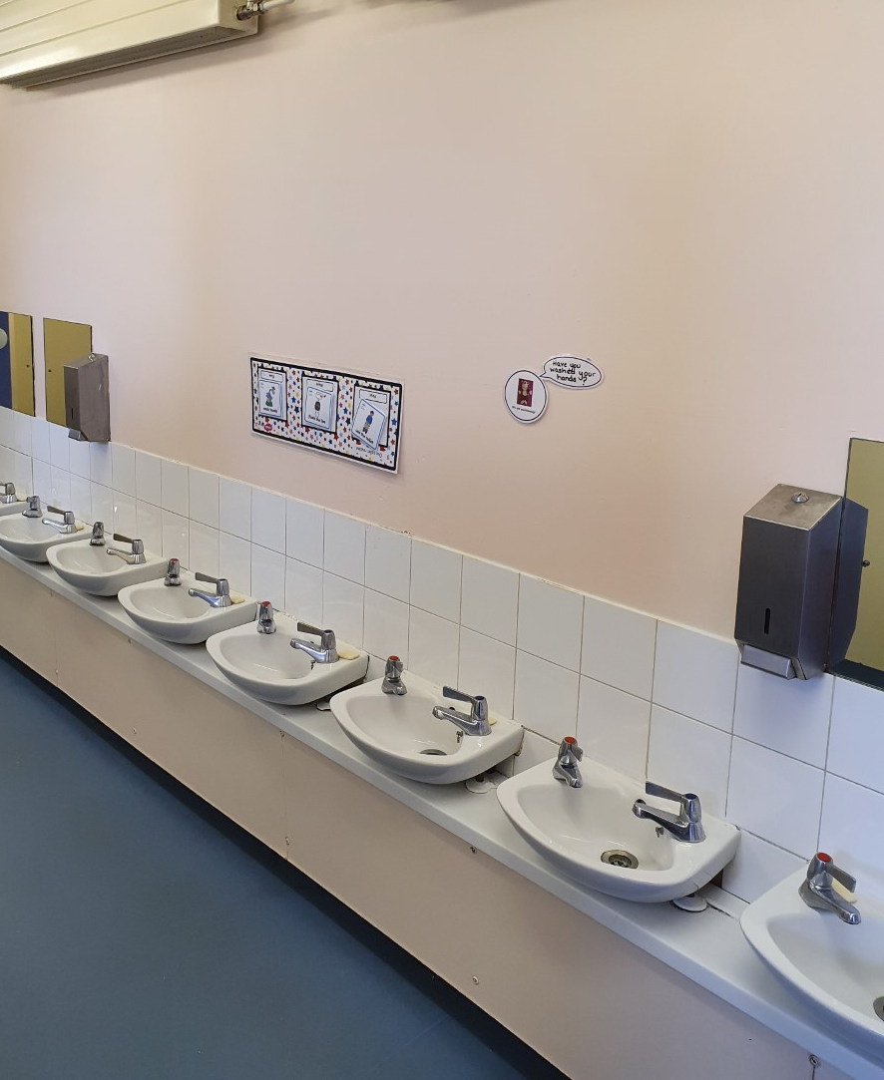
This is where you will go to the toilet and wash your hands.

Slide 8
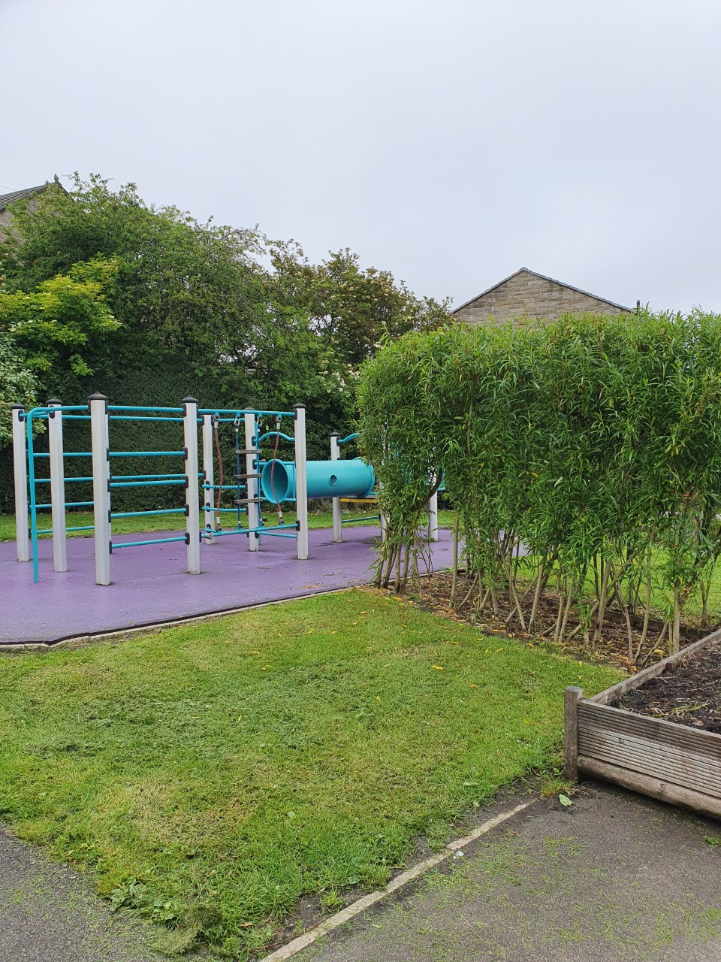
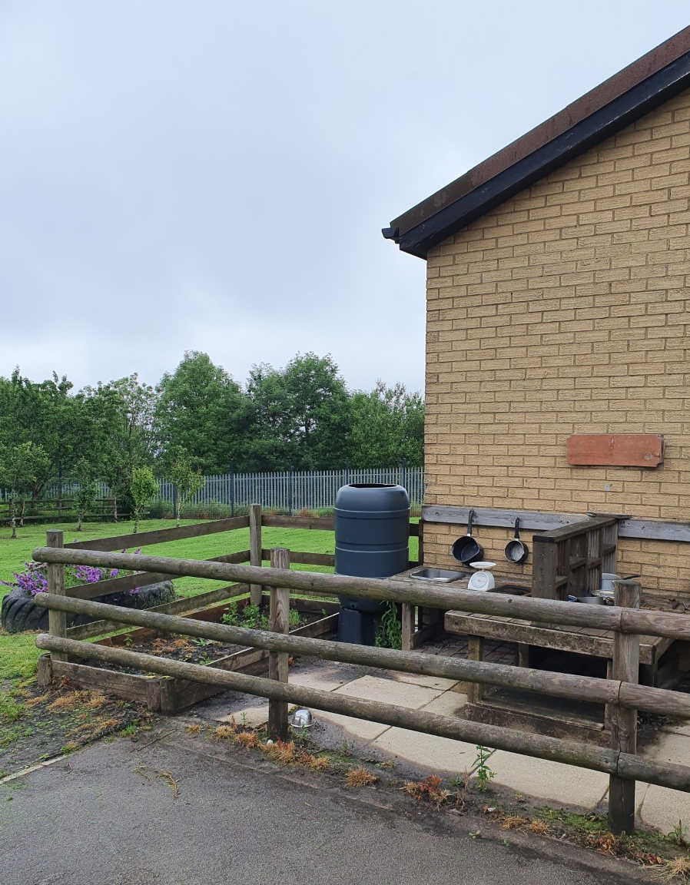
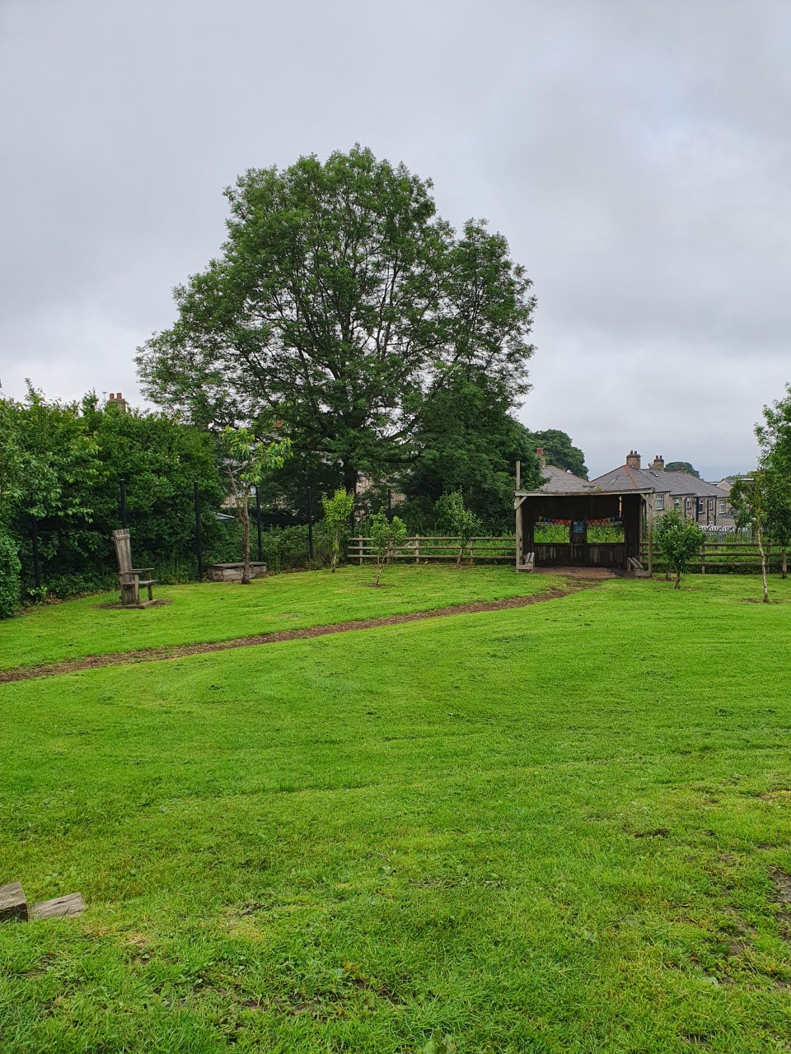
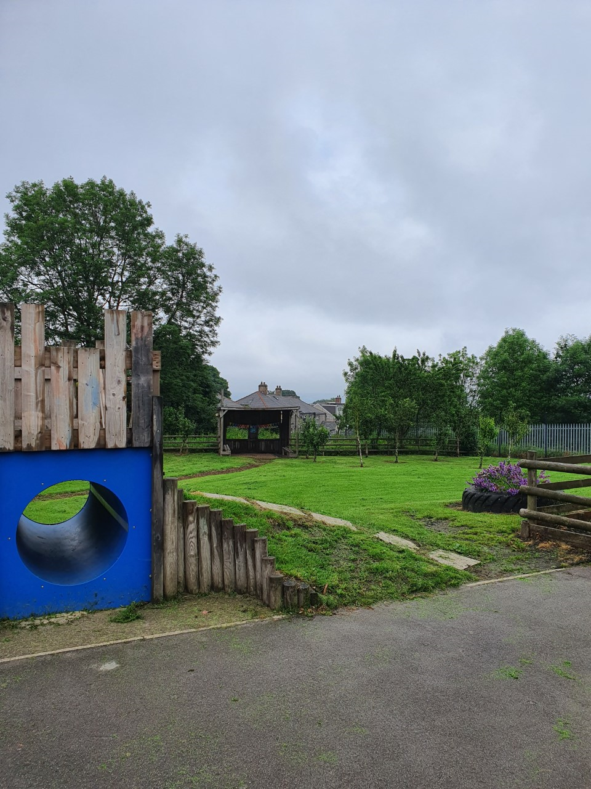
This is where you will play outside.

Slide 9
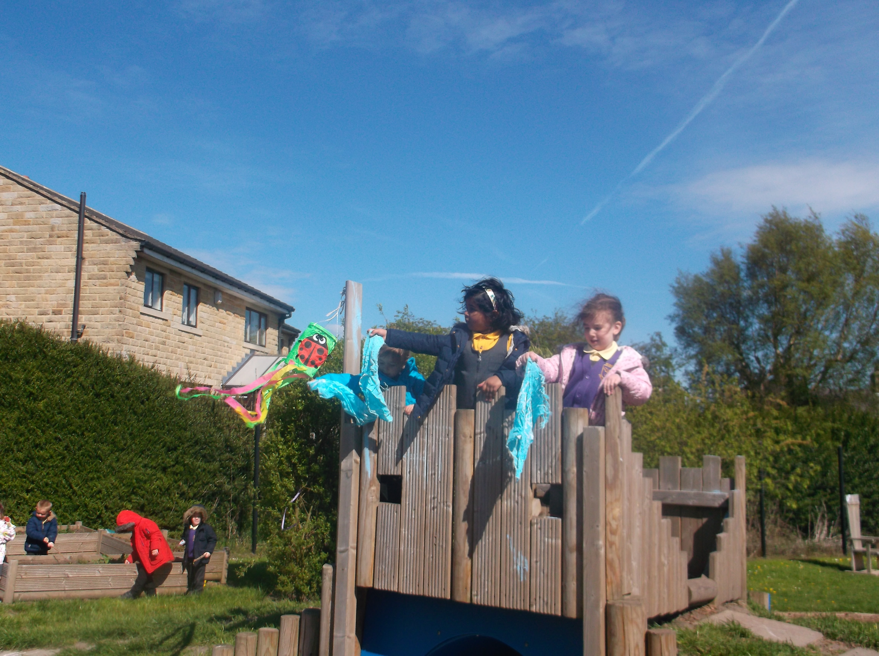
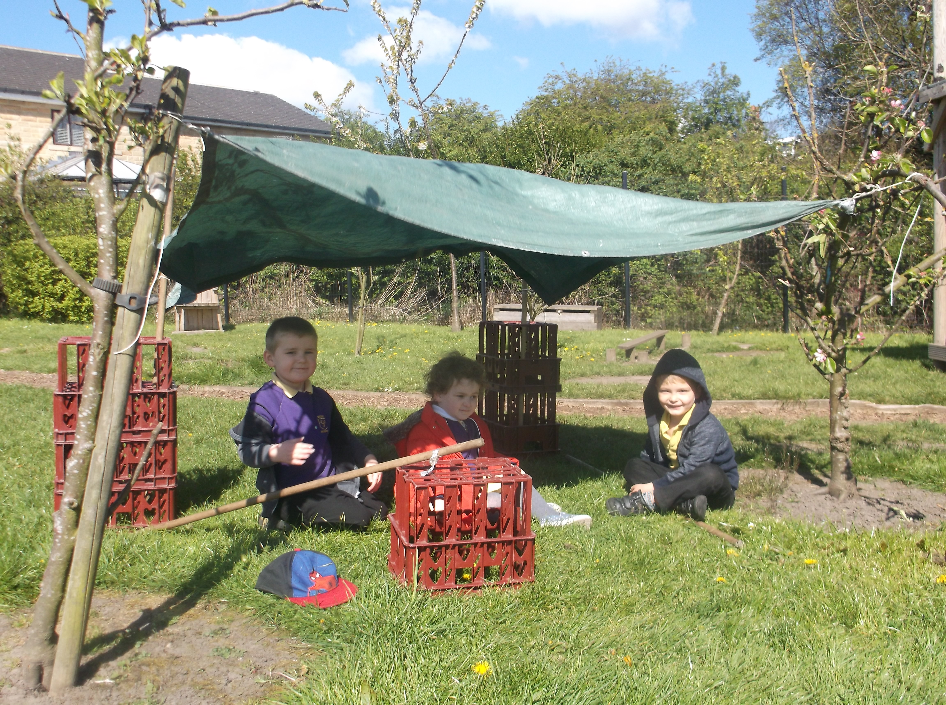
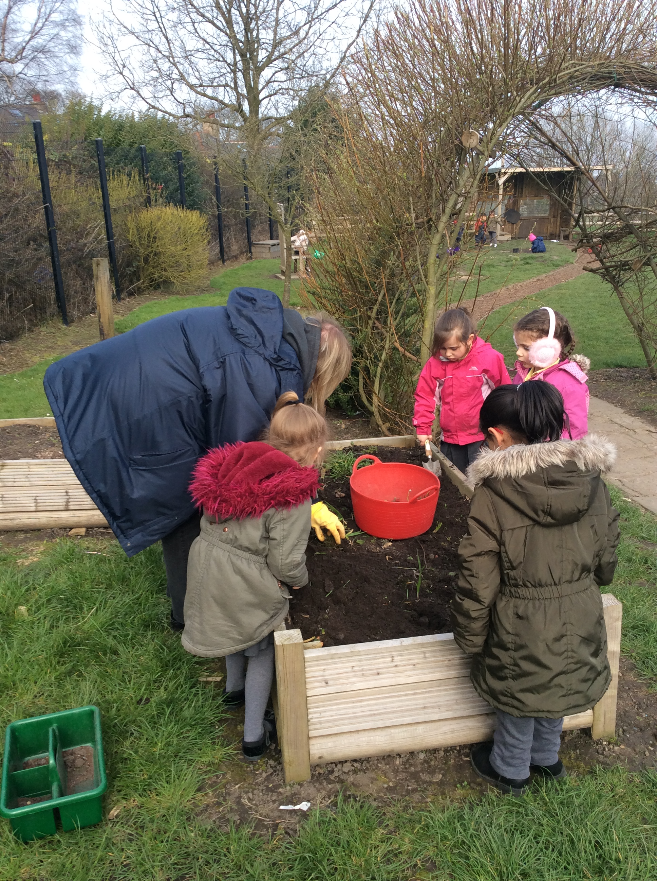
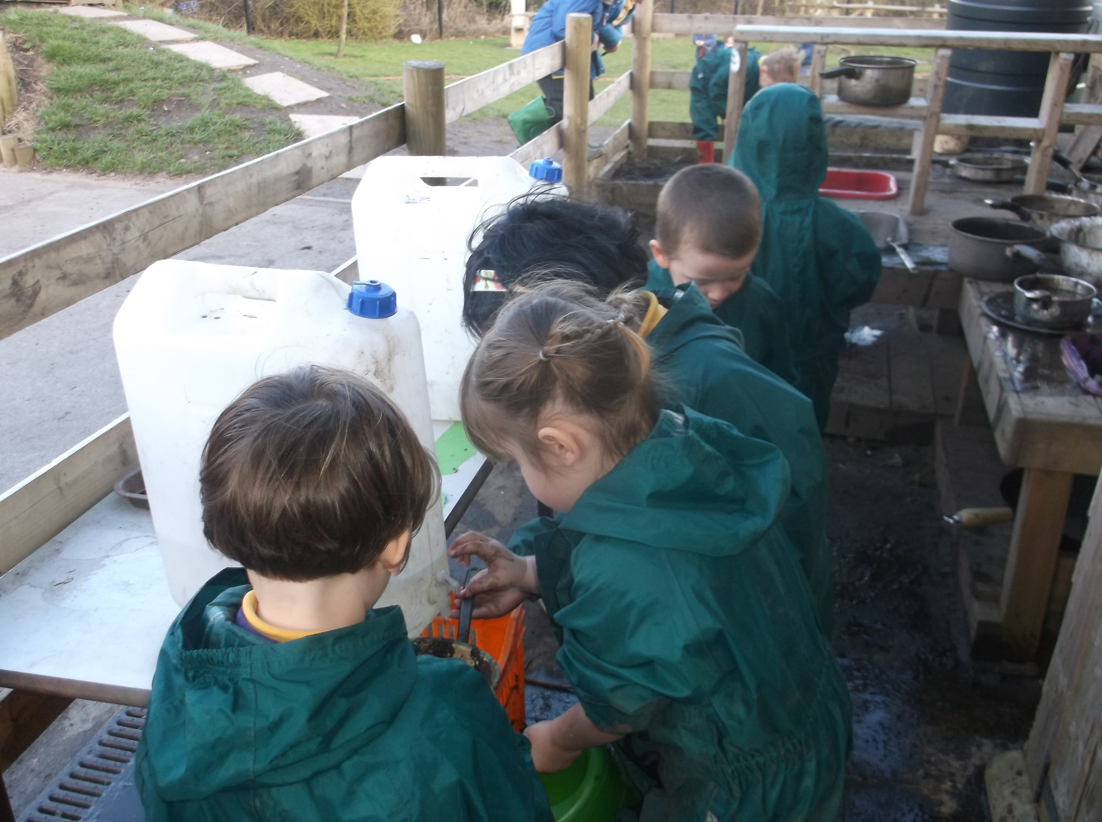
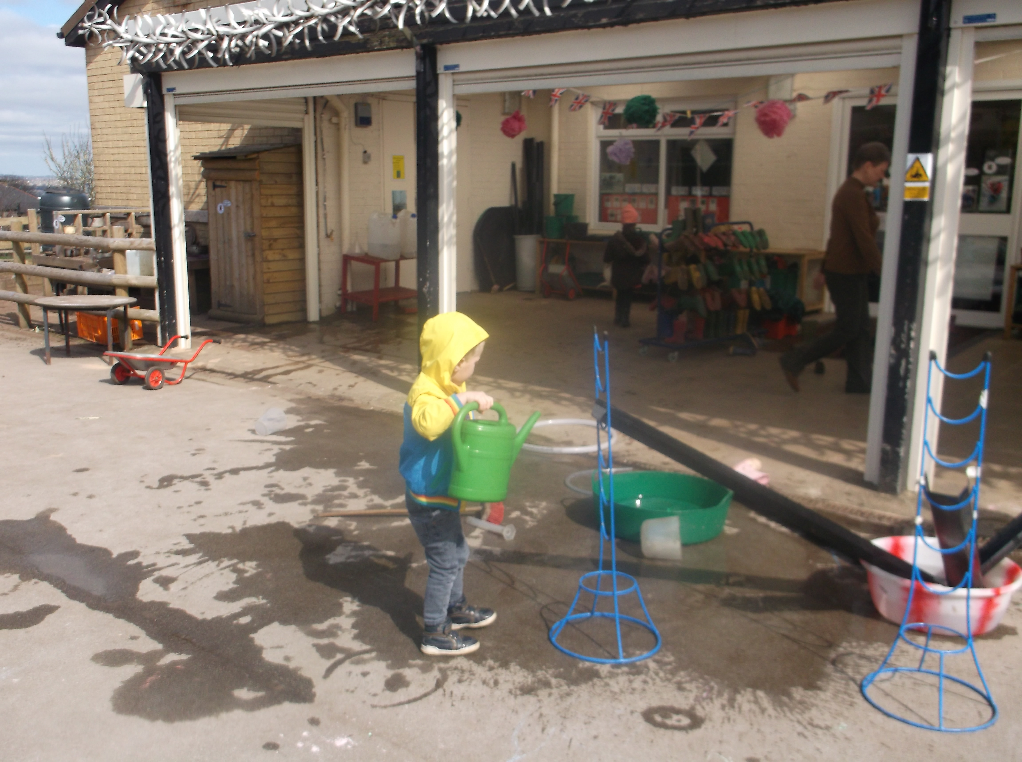
This is where you will play outside.

Slide 10
We are all very excited for you to start school in September!

