Slide 1
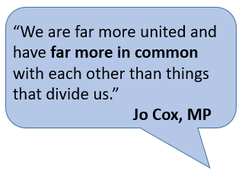
The philosophy behind Religious Education at WPS
Religious Education at Wibsey Primary School…
...develops understanding and respect for world faiths and worldviews, and encourages children to consider their own spirituality and. values.
As pupils progress through WPS, they learn about the teachings and beliefs of the 6 major world religions, along with non-religious worldviews, including humanism.
Children spend time reflecting on their own beliefs, values, experiences and viewpoints, and learn to respect the views and beliefs of others.
Religious education poses challenging questions about meaning and purpose in life, beliefs about God, ultimate reality, issues of right and wrong and what it means to be human.
A key feature of RE at WPS is the opportunity to visit places of worship and to have visits from faith leaders and humanist speakers. This first-hand experience is an excellent way for children to develop a better understanding of the diverse cultures, values and beliefs in the world.

