Slide 1
Welcome to Reception
2021

Slide 2
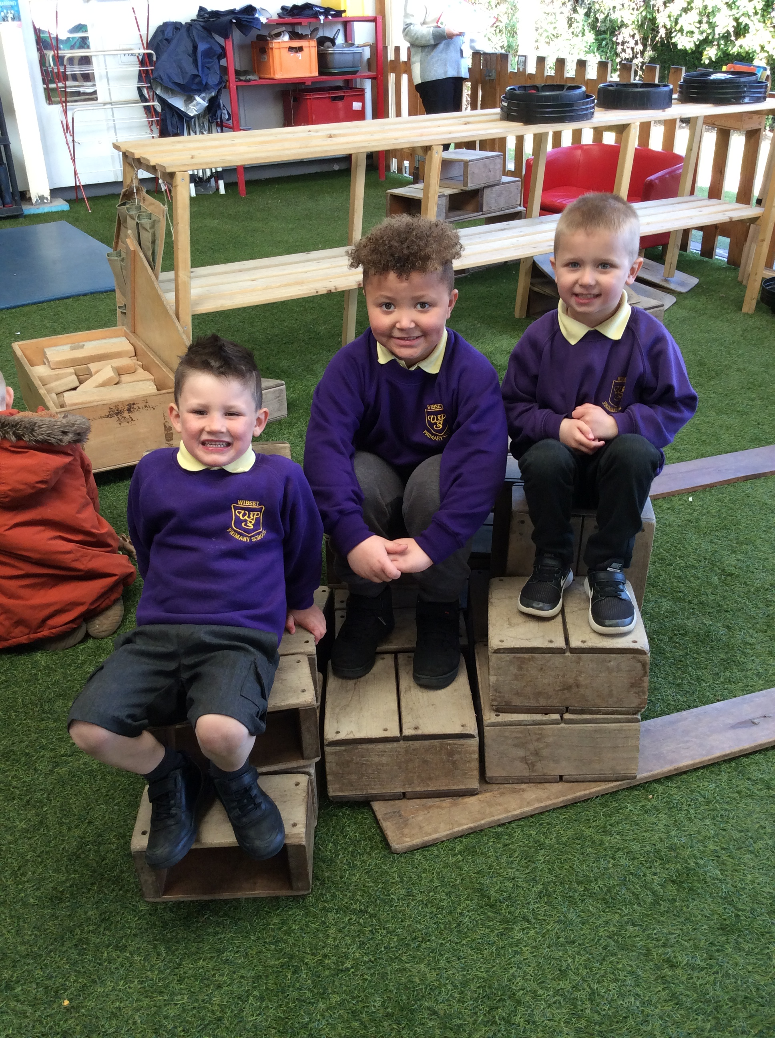
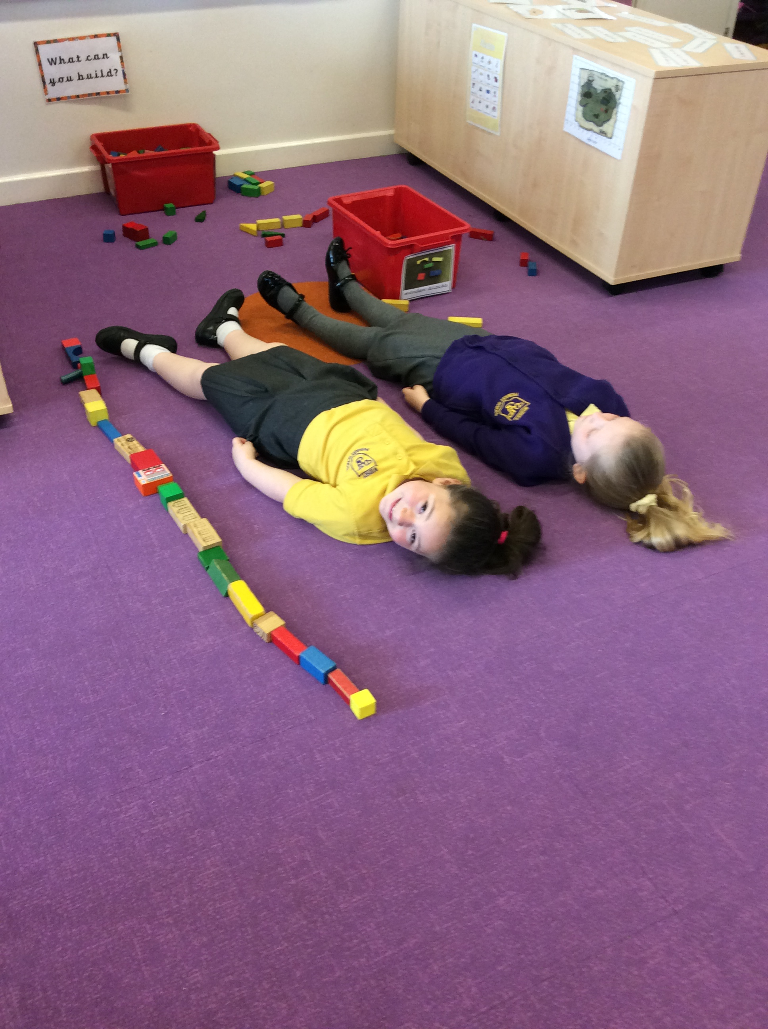

Slide 3
Staff
Lower School Assistant Head- Mrs Ellis-Barker
Class Teachers
Reception 1- Mrs Davies
Reception 2- Miss Meadowcroft
Reception 3- Miss Rankin
Associate staff
Mrs Arato, Mrs Goldsborough, Miss Sutcliffe, Miss Summerscales, Mrs Woodrup

Slide 4
EYFS in a nutshell
The Early Years Foundation Stage is a framework which aims to ensure that all children attending early years settings are kept safe and are helped to thrive, learn and develop.
The Foundation Stage Curriculum begins at birth and continues until the end of Reception.
There are 7 areas of learning
3 prime areas
4 specific areas

Slide 5
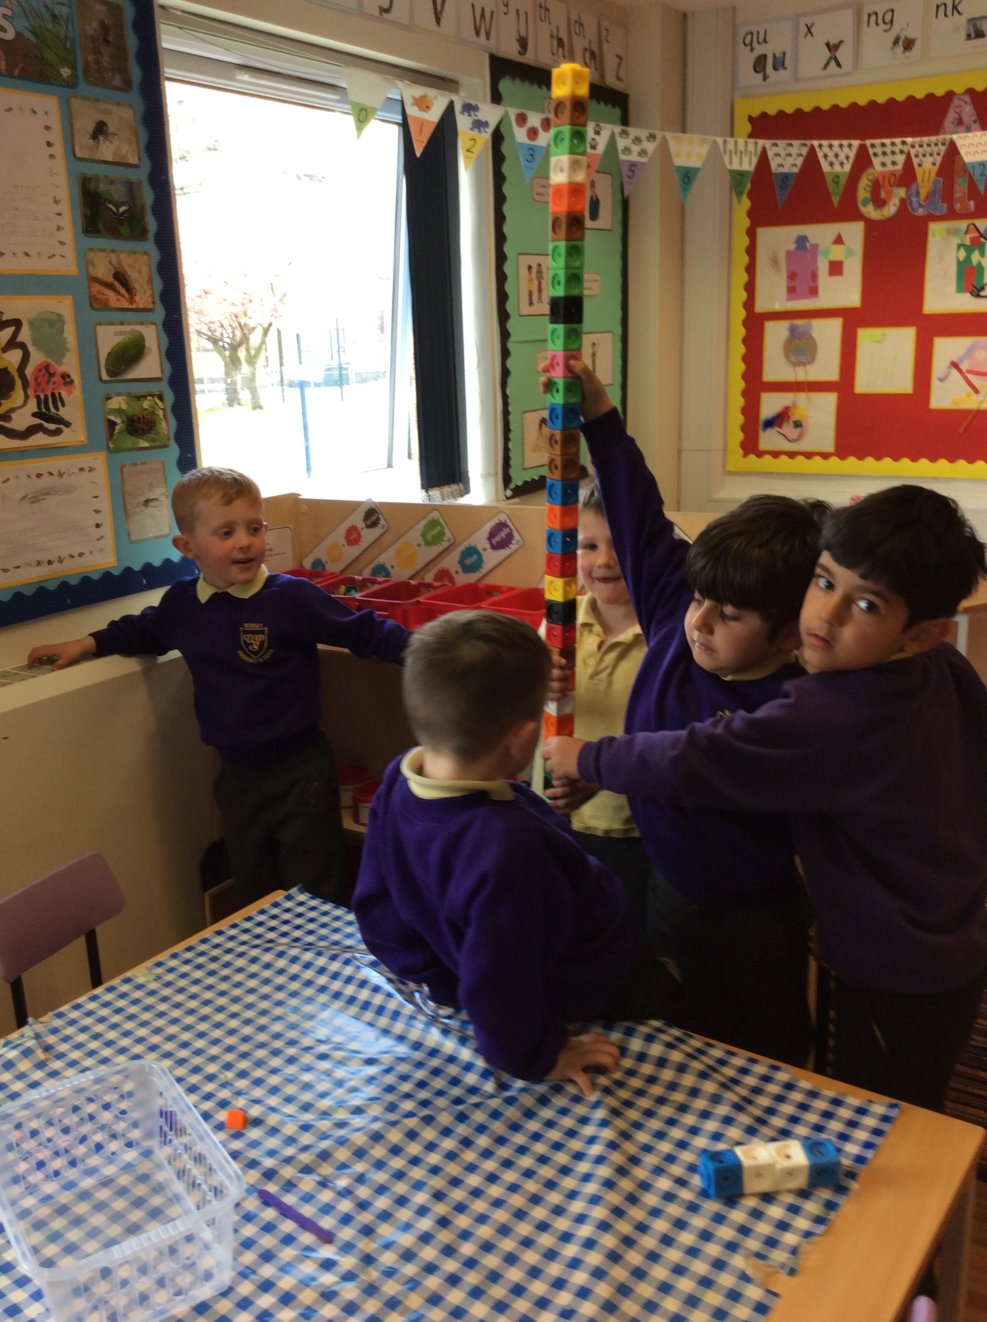
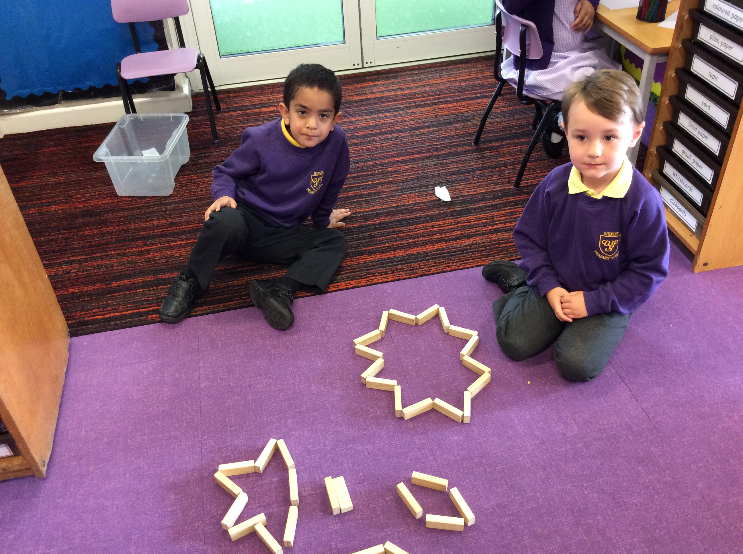
Personal, Social and Emotional development (PSED) (Prime area)
PSED is crucial for children to lead healthy and happy lives. Children are supported to manage emotions, develop a positive sense of self, set themselves simple goals, have confidence in their own abilities, to persist and wait for what they want and direct attention as necessary. They are taught how to look after their bodies, including healthy eating, and manage personal needs independently. Through supported interaction with other children they learn how to make good friendships, co-operate and resolve conflicts peaceably.

Slide 6
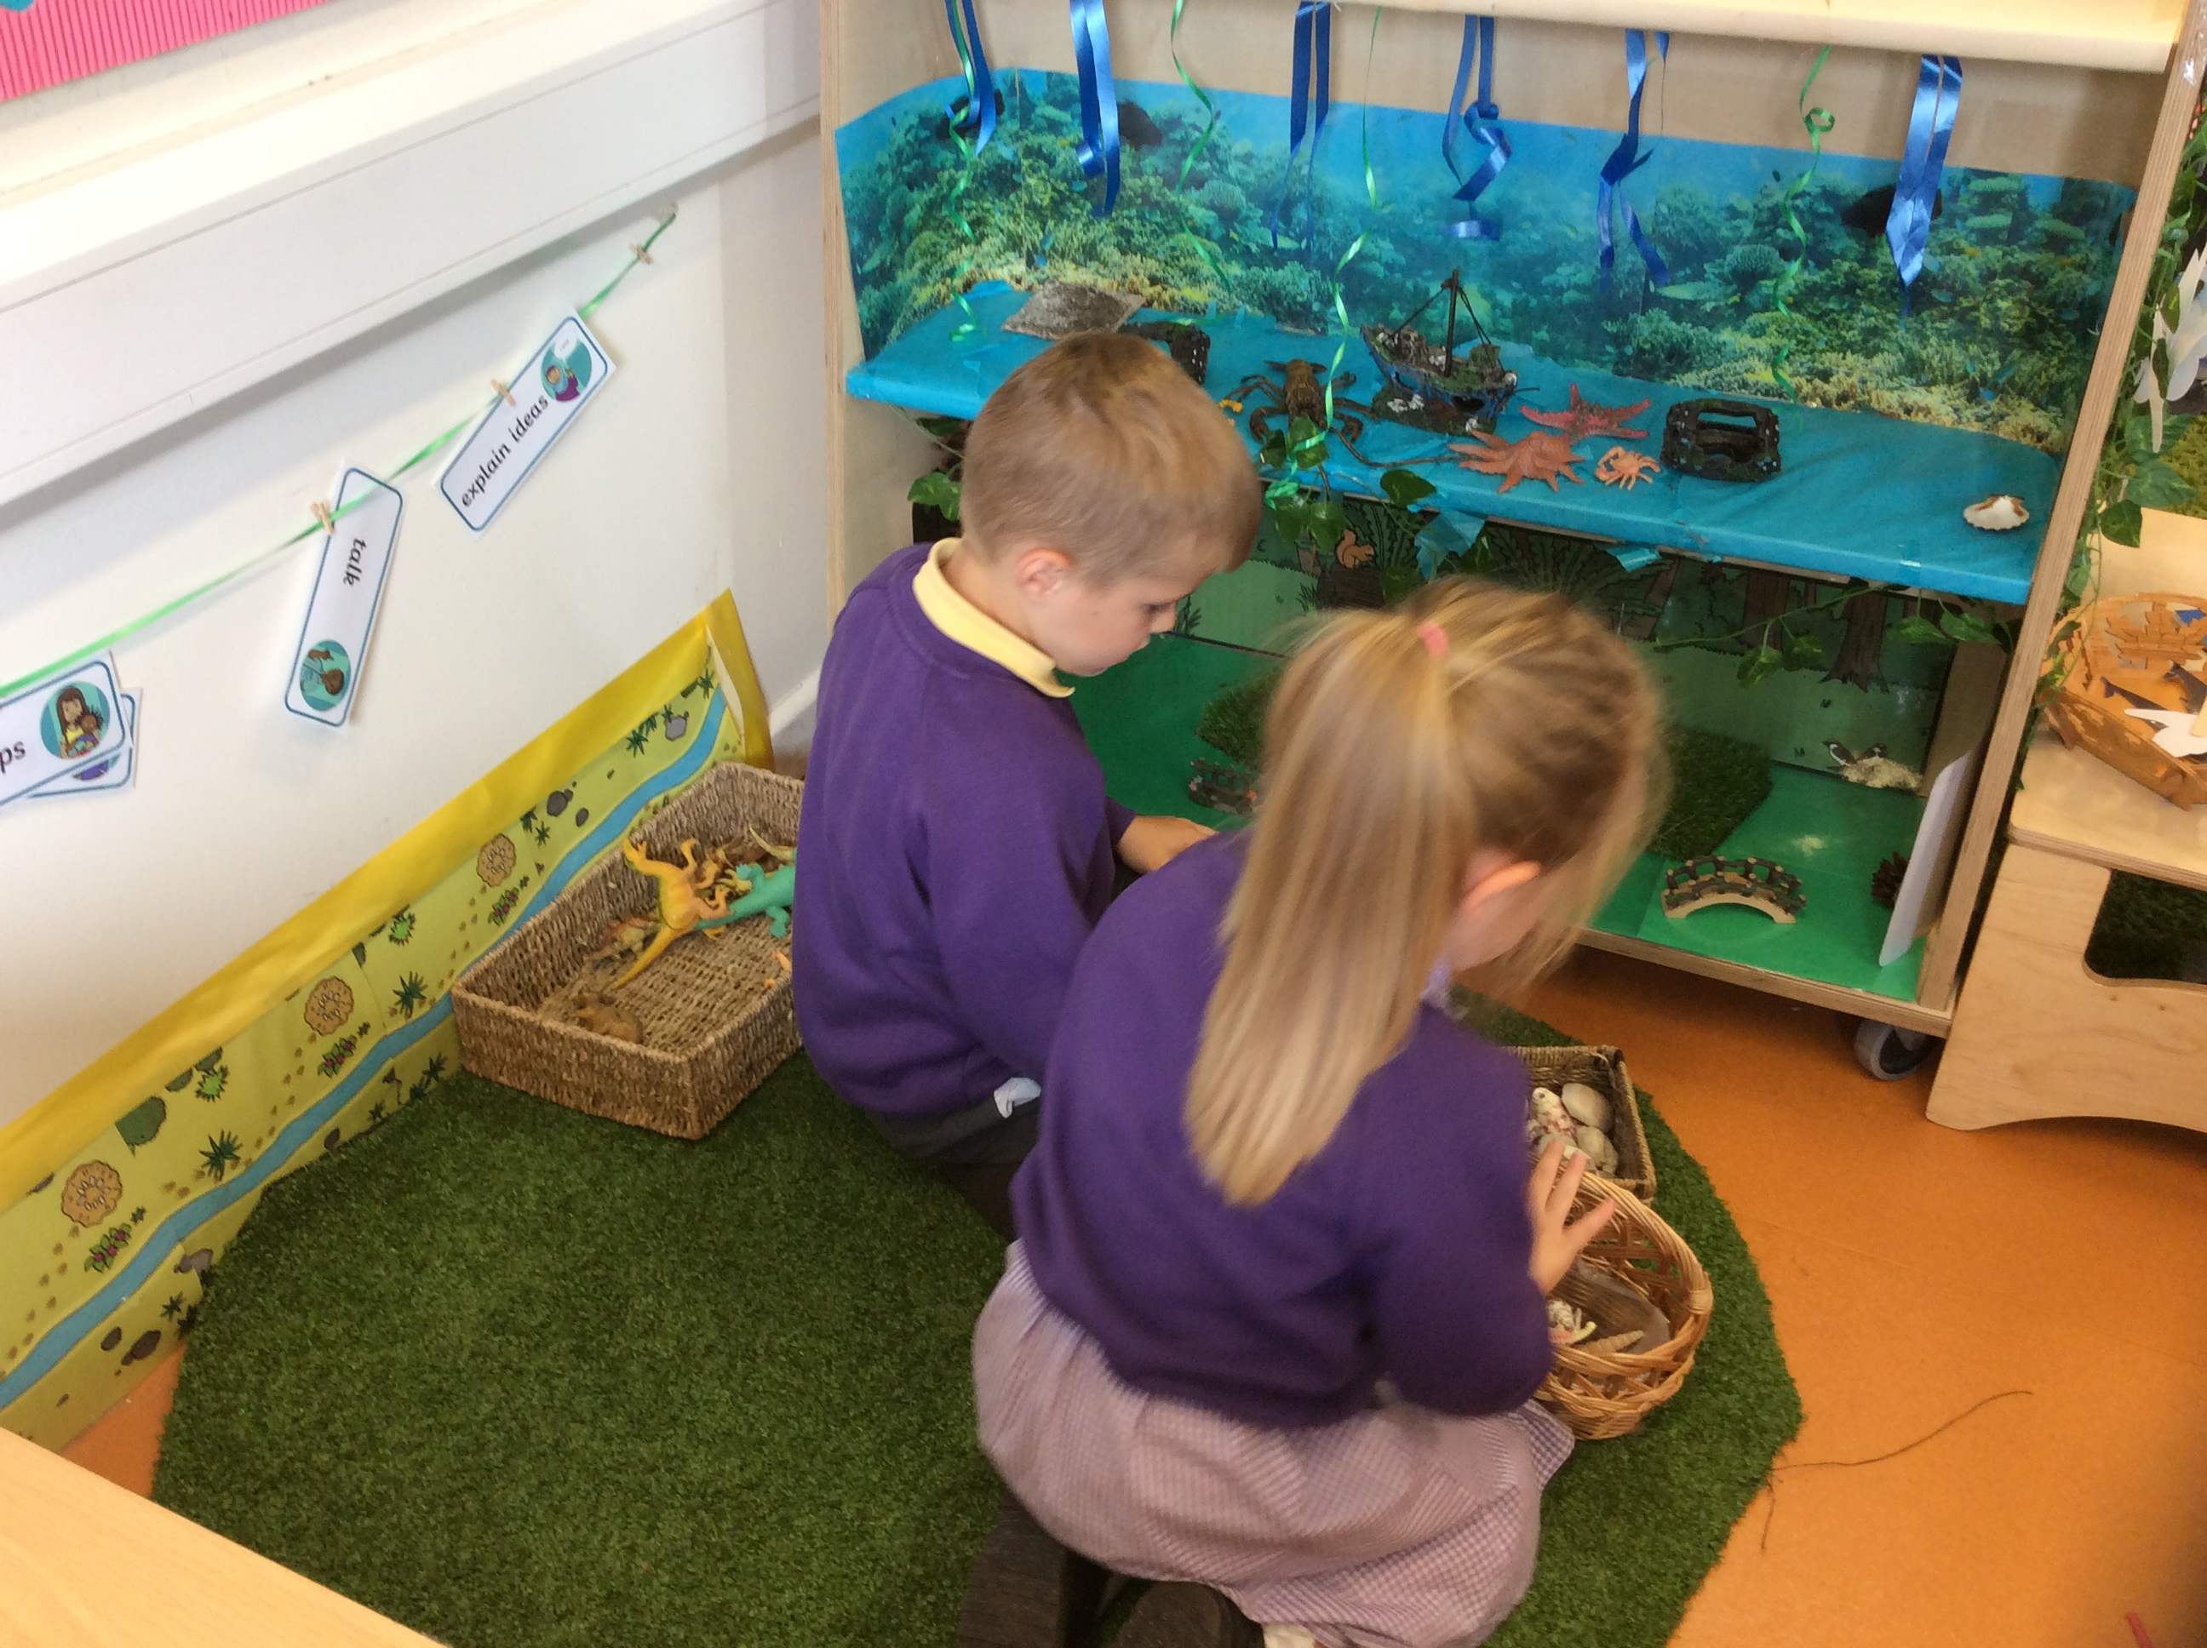
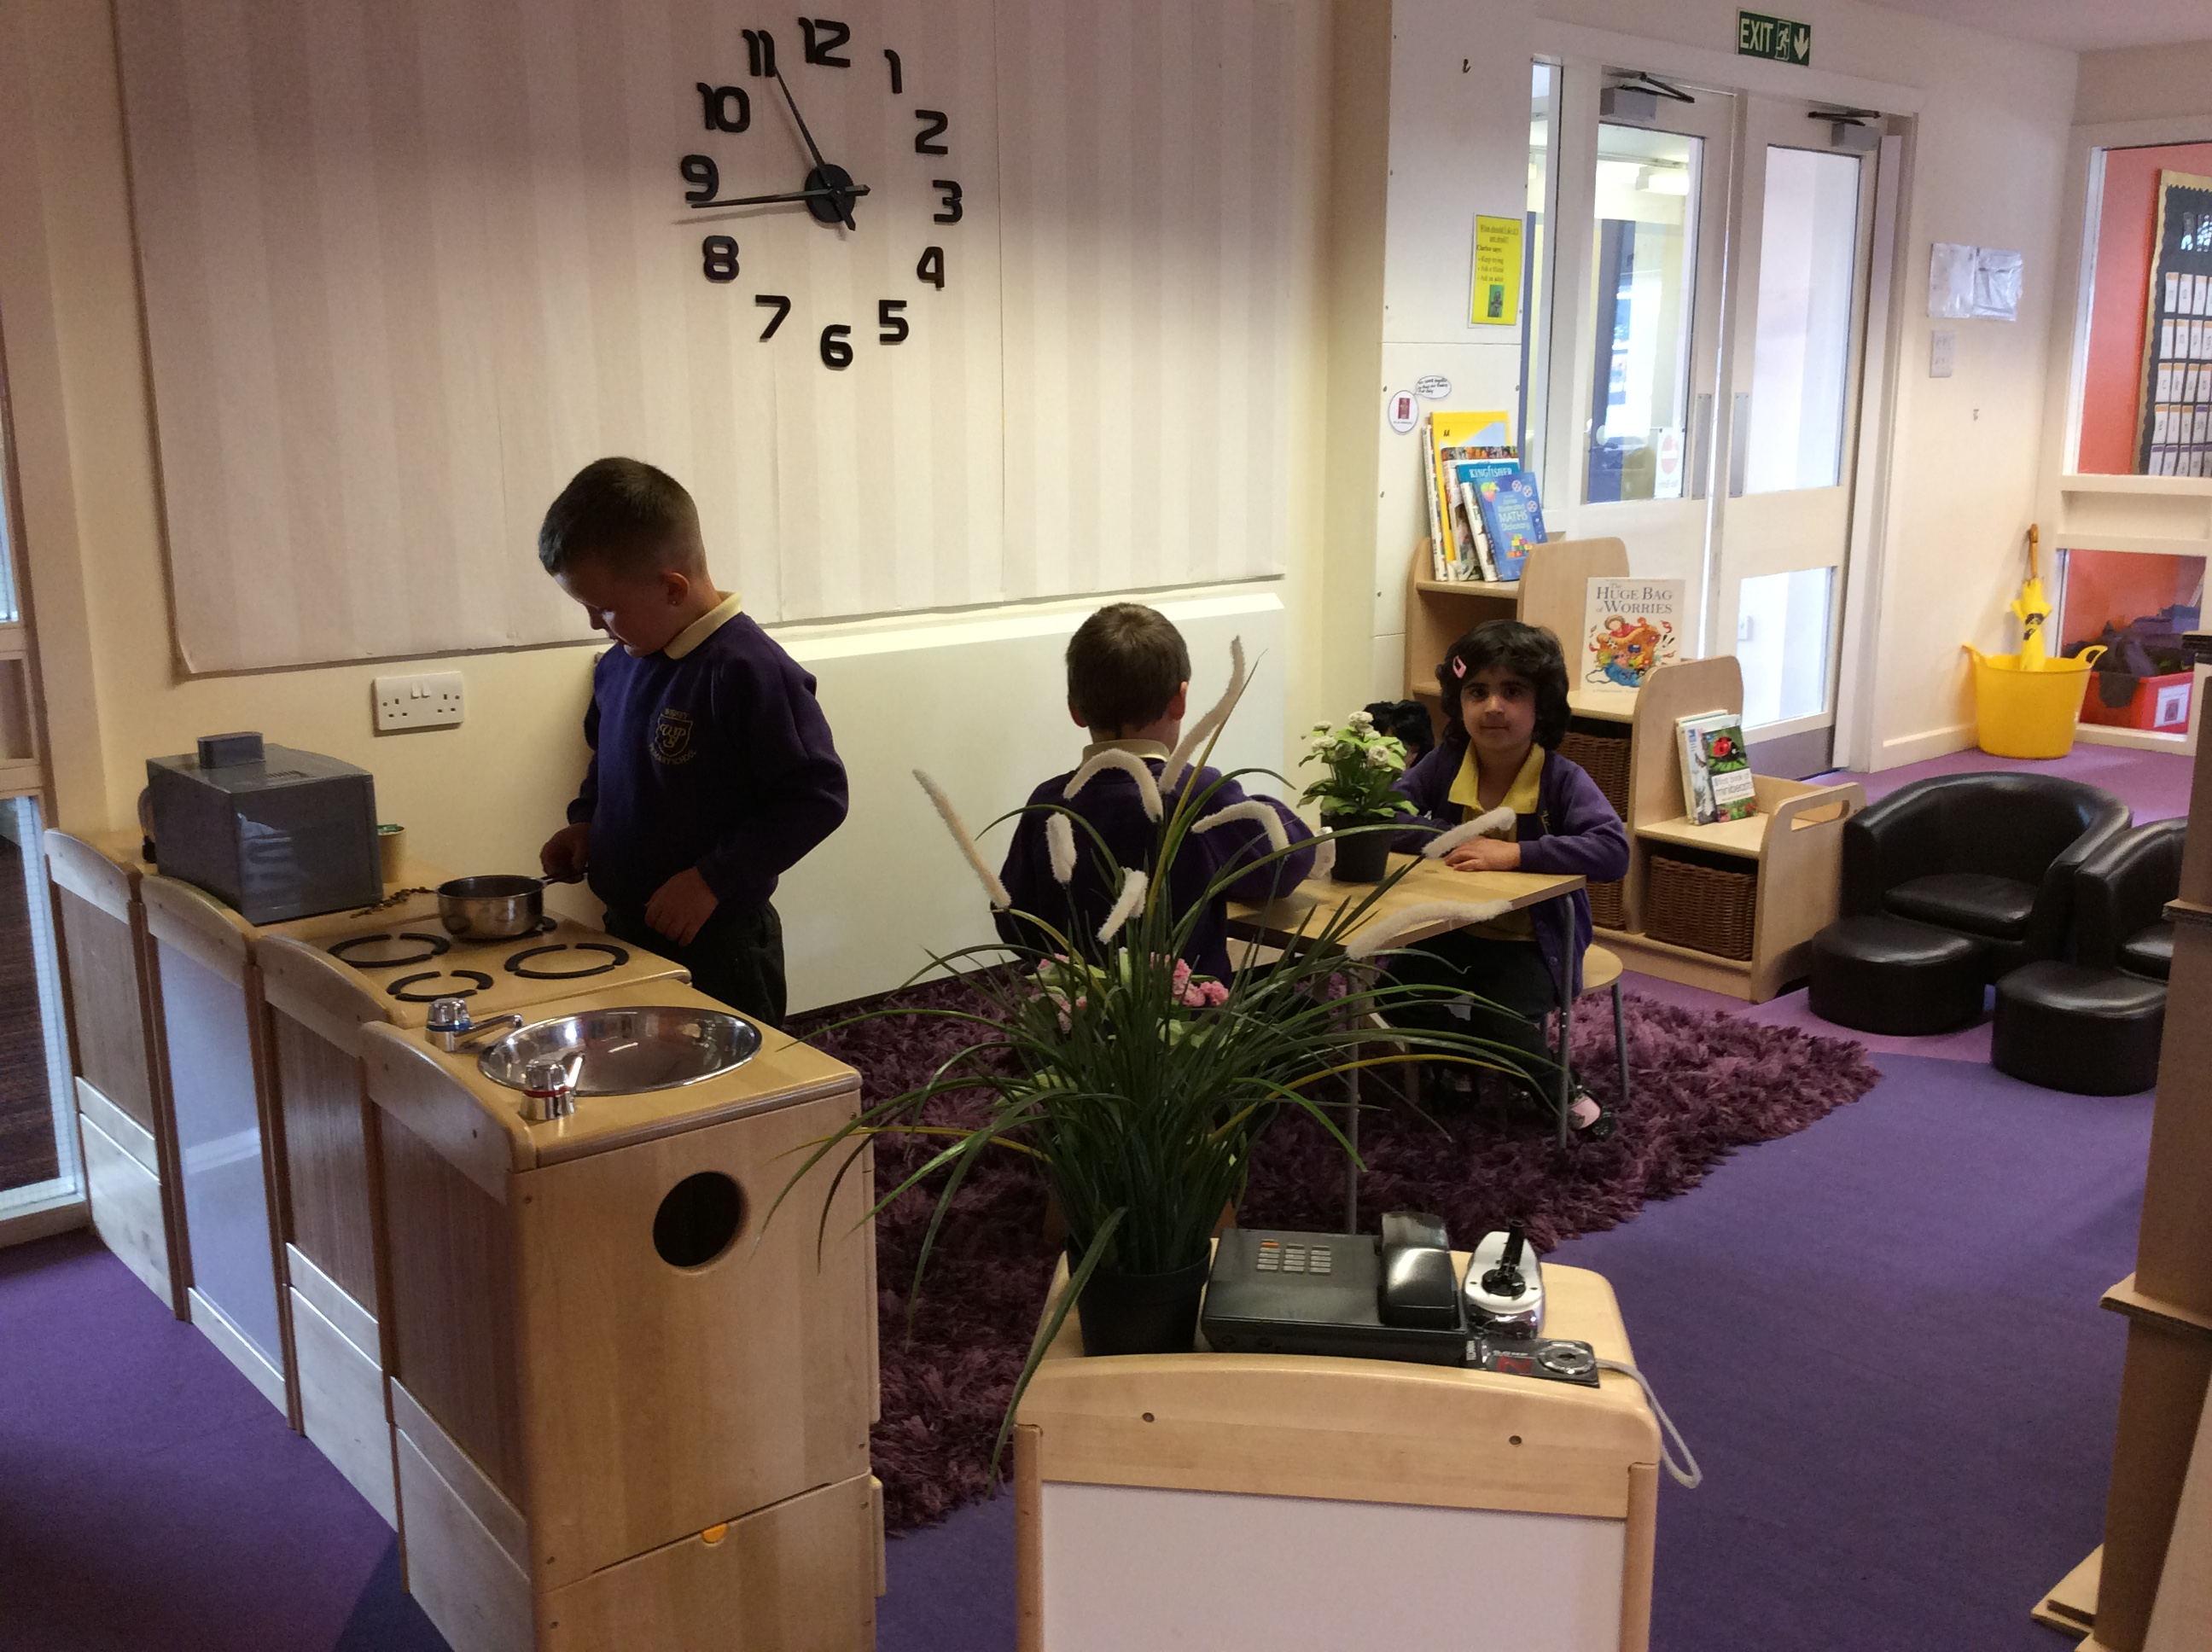
Communication and language (Prime area)
The development of children’s spoken language underpins all seven areas of learning and development. The children are encouraged to talk about their interests and what they are doing within a language-rich environment where staff introduce new vocabulary and support conversations. Children are read to frequently and are actively engaged in stories, non-fiction, rhymes and poems. They are provided with opportunities for story-telling and role play, where they are able to become comfortable using a rich range of vocabulary and language structures.

Slide 7
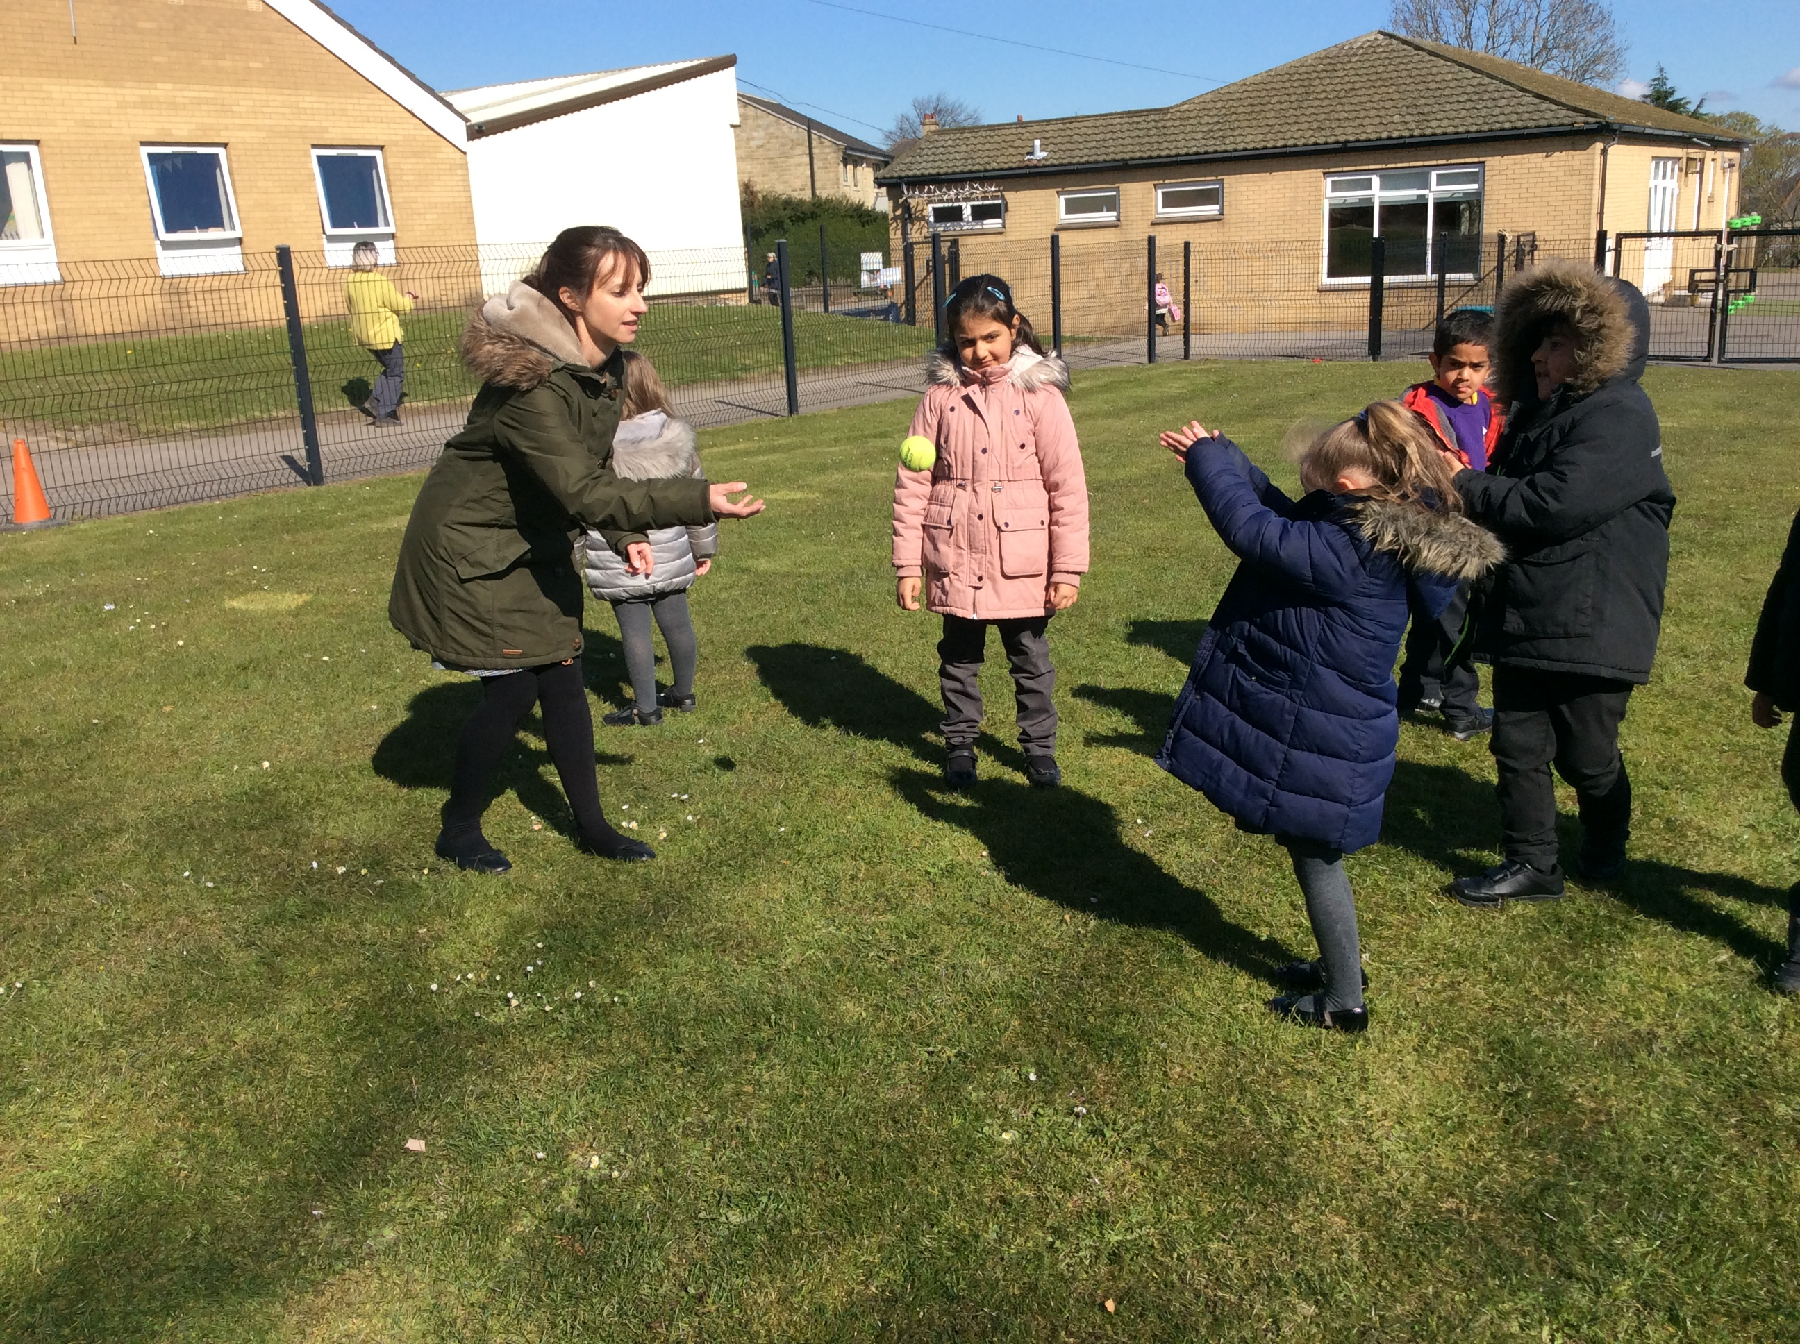
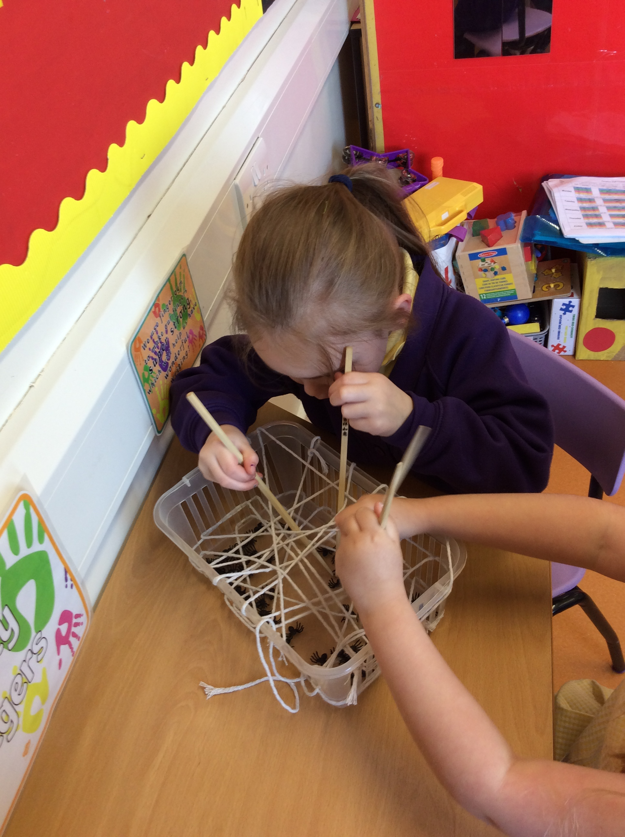
Physical development (Prime area)
Physical activity is vital in children’s all-round development, enabling them to pursue happy, healthy and active lives. Through games and a variety of opportunities both indoors and outdoors, children develop their core strength, stability, balance, spatial awareness, co-ordination and agility. Gross motor skills provide the foundation for developing healthy bodies and social and emotional well-being. Fine motor control and precision helps with hand-eye co-ordination which is later linked to early writing. Children have opportunities to explore and play with small world activities, puzzles, arts and crafts and the practice of using small tools, with support from adults.

Slide 8
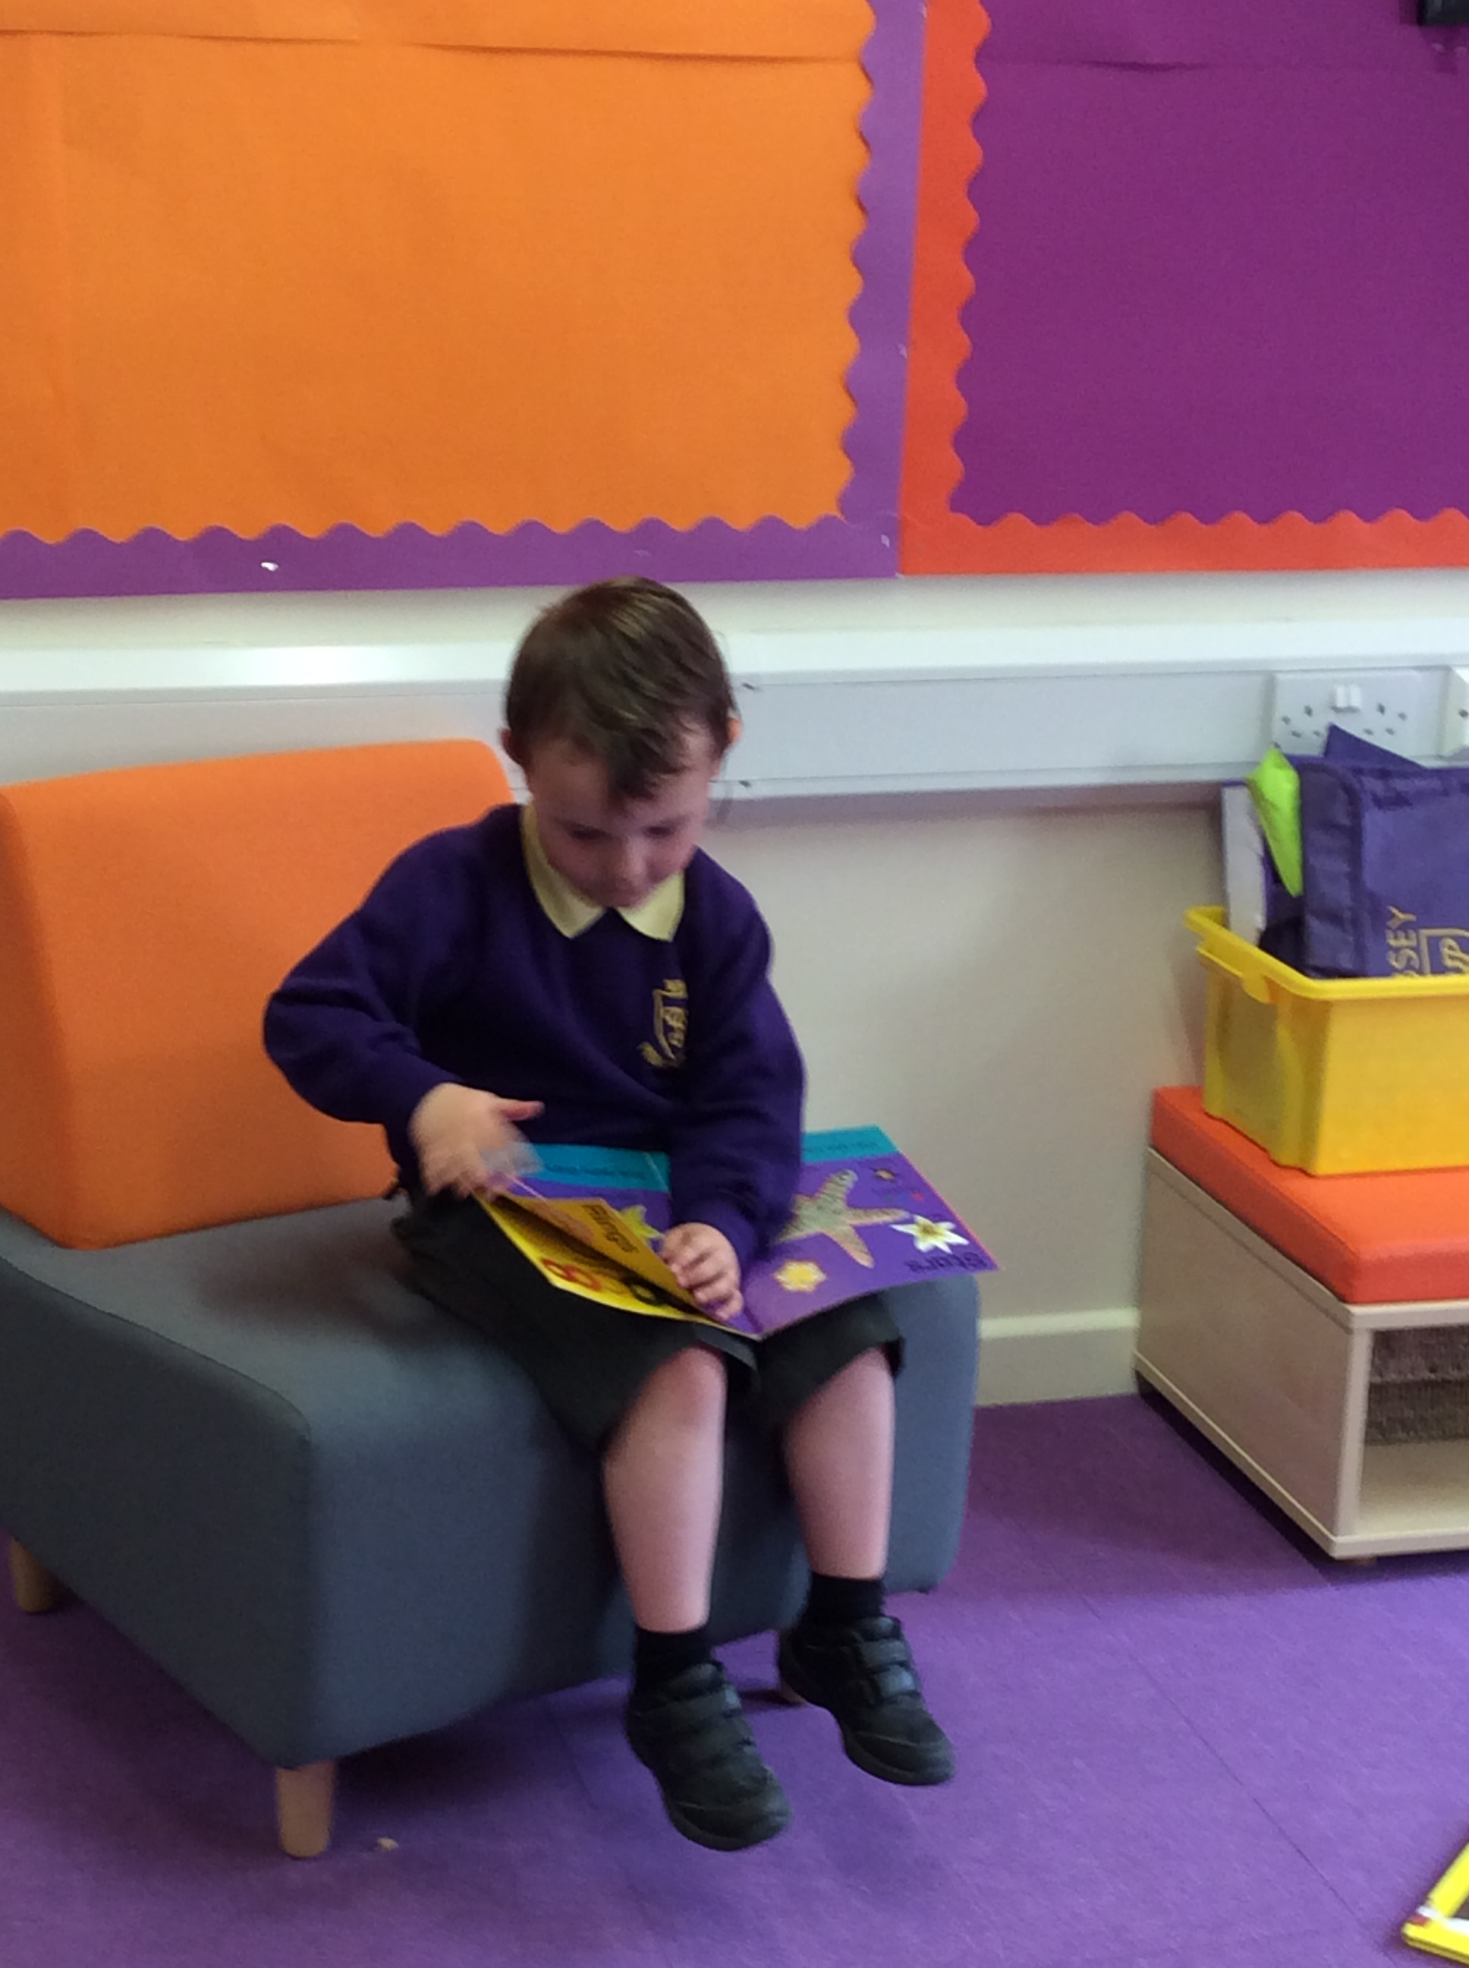
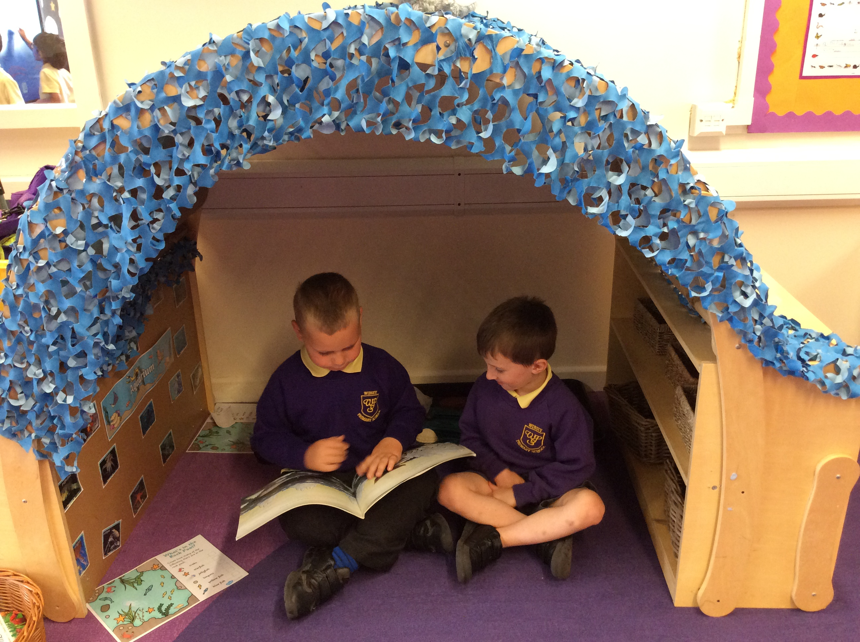
Literacy (specific area)
At Wibsey, children are encouraged to develop a life-long love of reading. Reading consists of two dimensions: language comprehension and word reading. Language comprehension is increased through adults talking with children about the world around them and reading books, enjoying rhymes, poems and songs together. Later on, children are taught how to decode words through phonics and speedy recognition of irregular words in order to read sentences. Through early mark making and the awareness that marks have meaning, children begin to use familiar shapes that gradually evolve as letters and then use phonic knowledge to construct simple words.

Slide 9
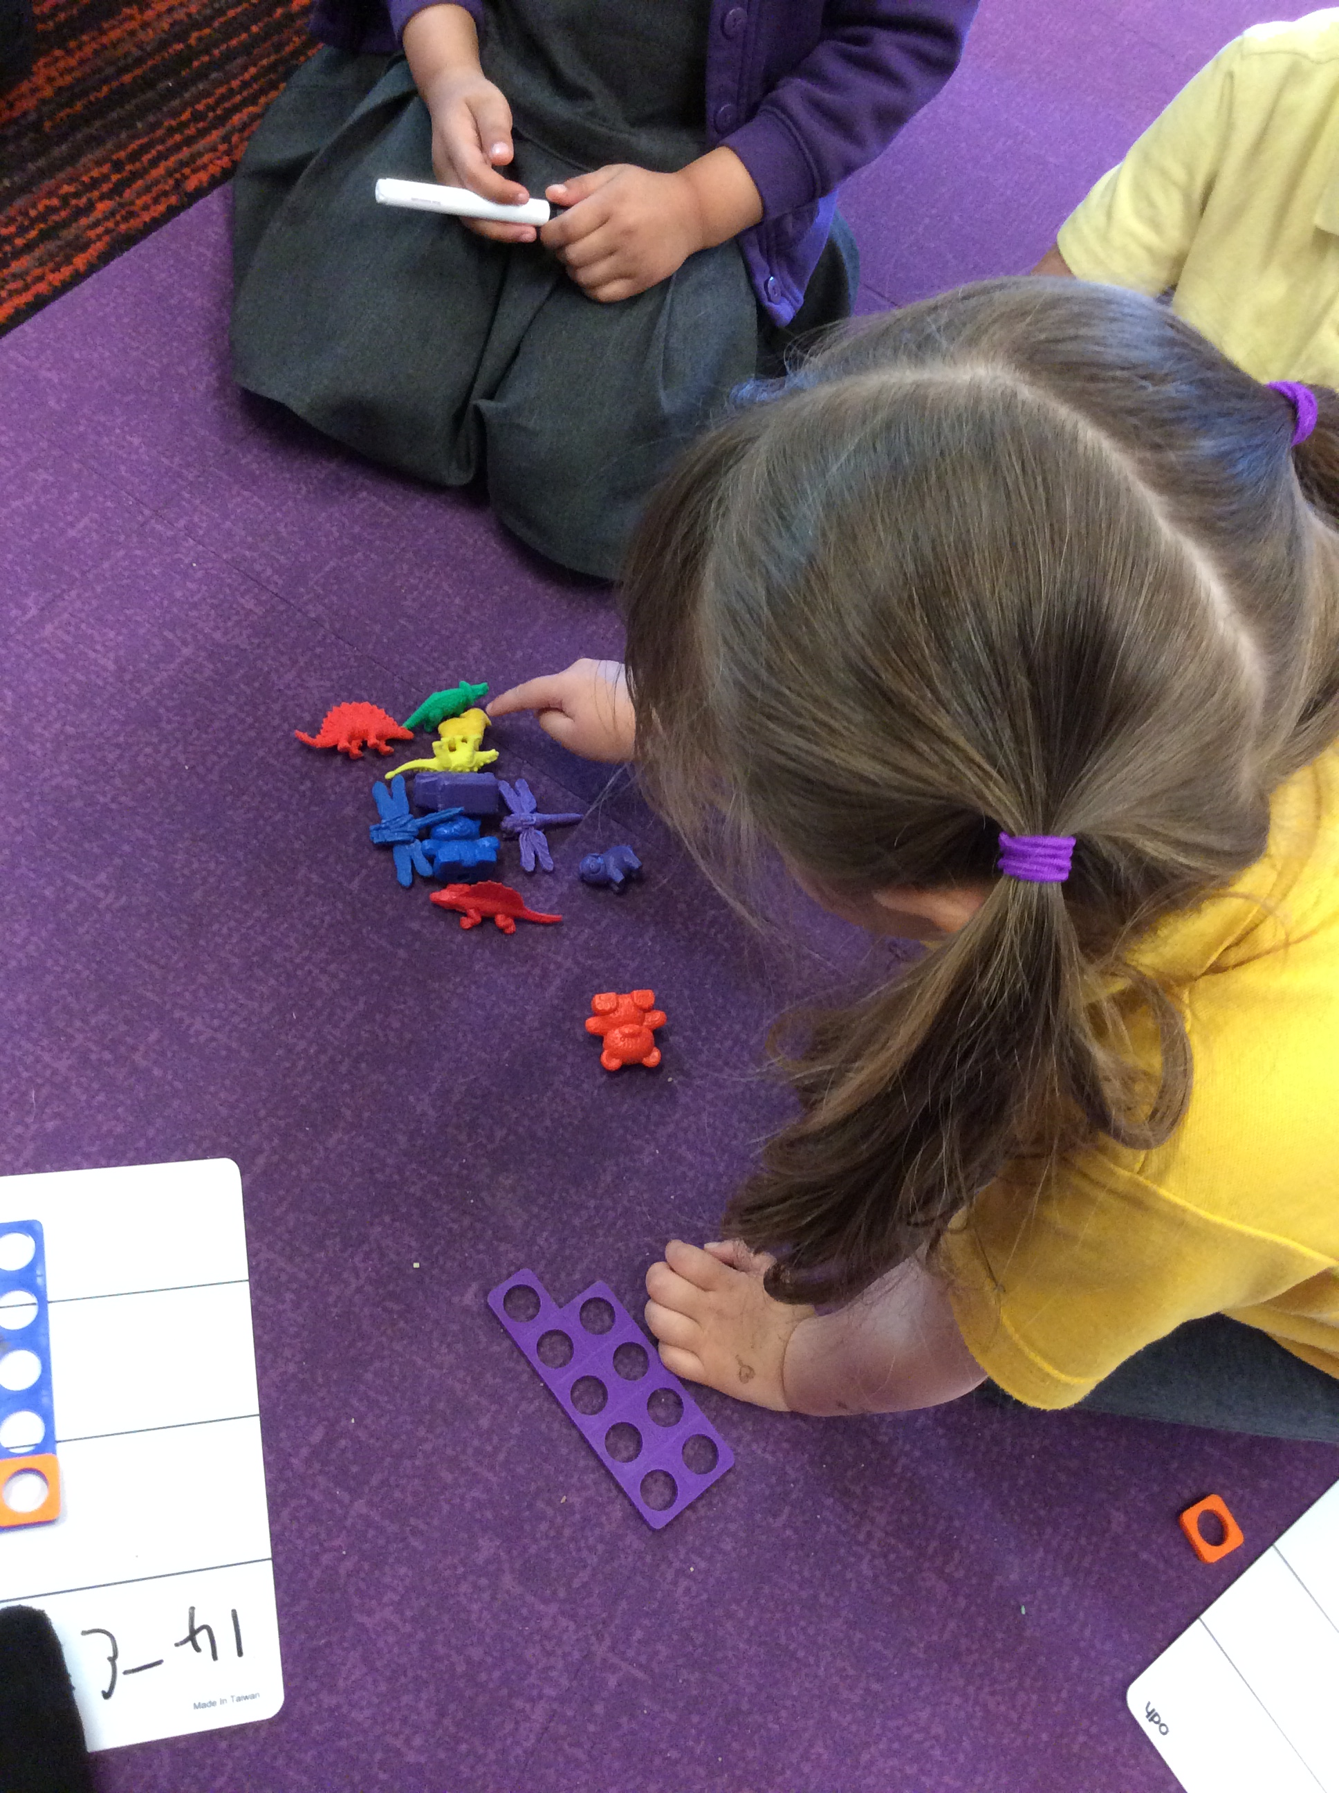
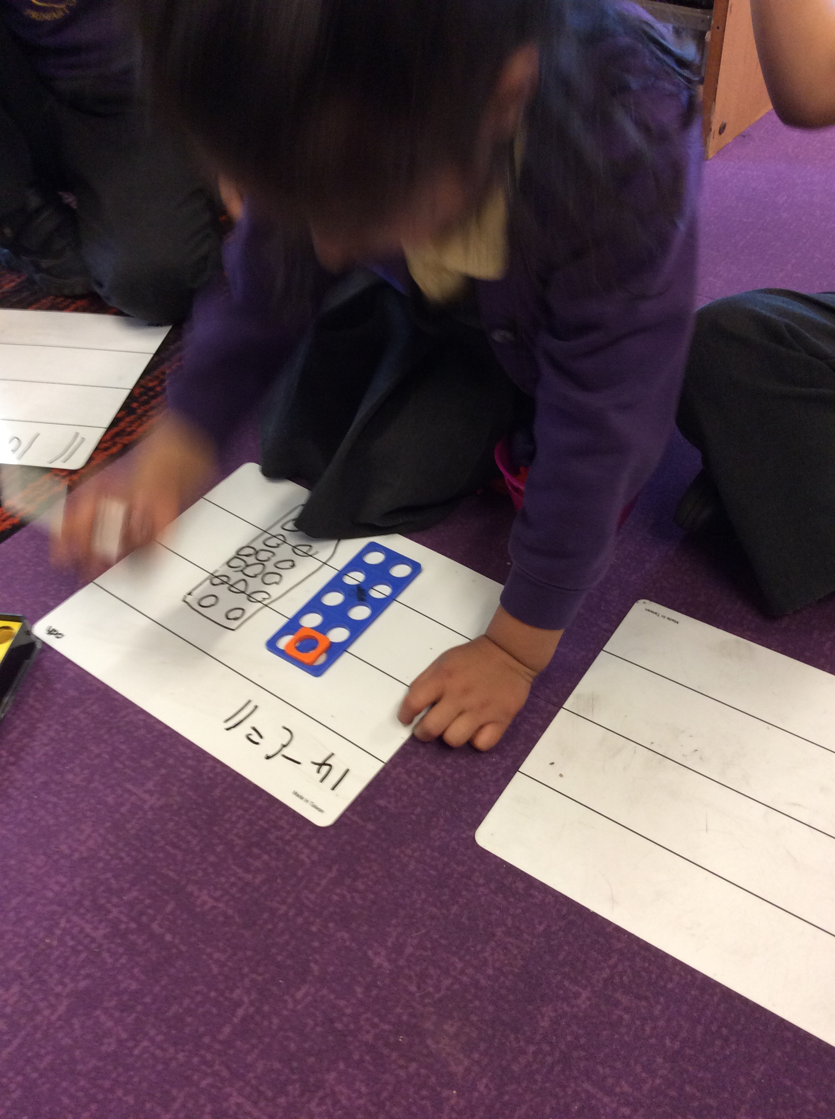
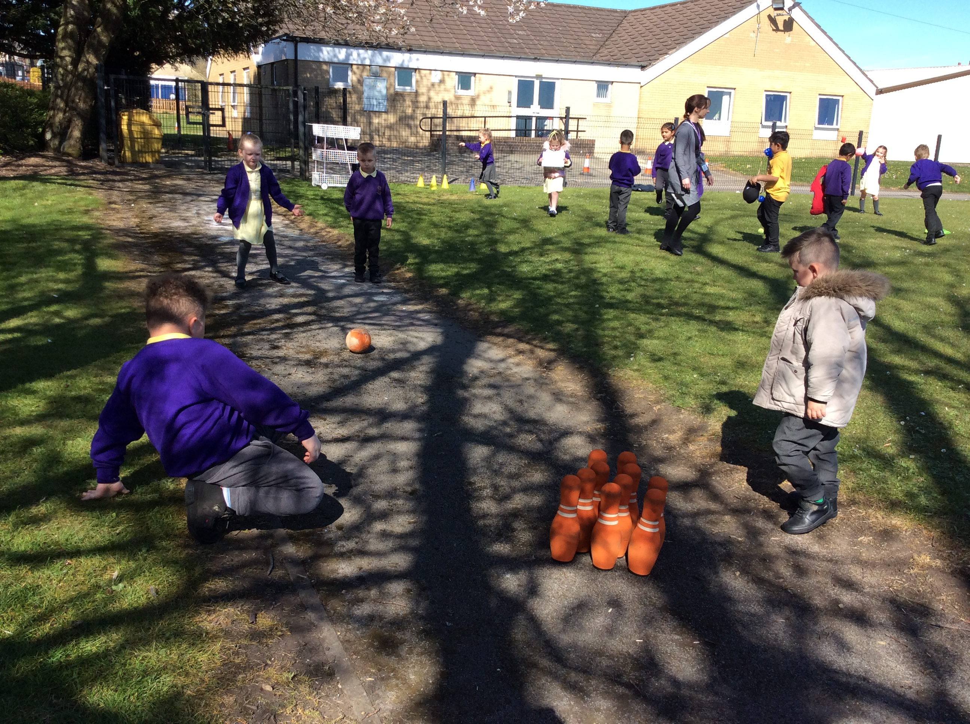
Mathematics (specific area)
Children are taught to count confidently, develop a deep understanding of the numbers to 10, the relationships between them and the patterns within those numbers. Frequent and varied opportunities are provided to build and apply this understanding through play. In addition, children are given opportunities to develop spatial reasoning skills across all areas of mathematics including shape, space and measures . We encourage children to develop positive attitudes and interests in mathematics, looking for patterns and relationships, and spotting connections.

Slide 10
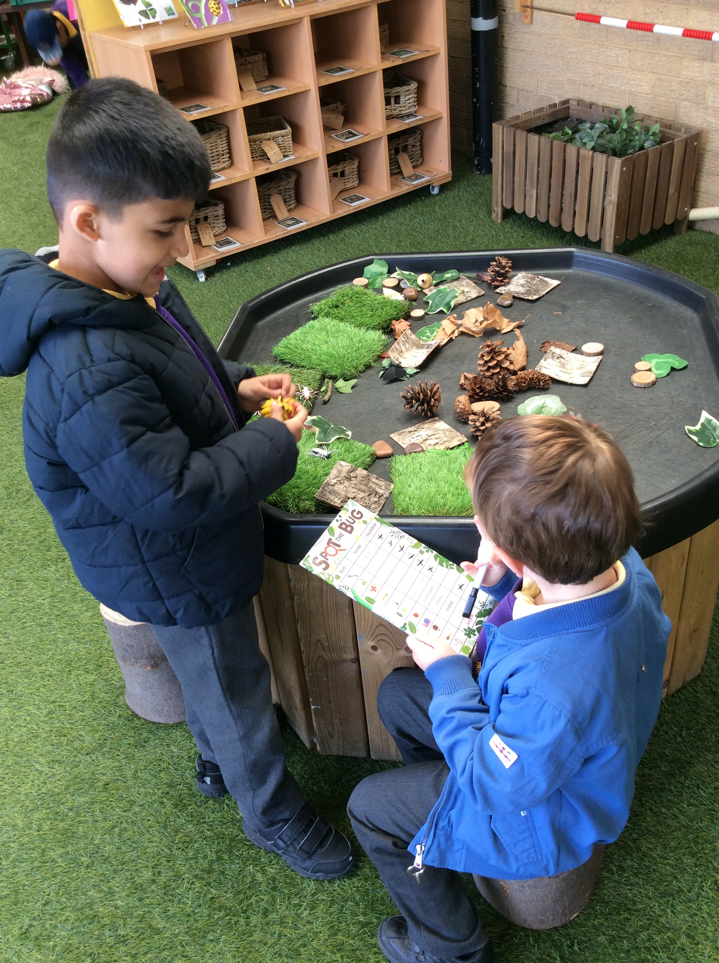
Understanding of the World (specific area)
Understanding the world involves guiding children to make sense of their physical world and their community. Every experience increases a child’s knowledge and sense of the world around them – from visiting parks, libraries and museums to meeting important members of society such as police officers, nurses and firefighters. We also listen to a selection of stories, non-fiction, rhymes and poems that foster their understanding of our culturally, socially, technologically and ecologically diverse world. As well as building important knowledge, this also enriches and widens children’s vocabulary, supporting later reading comprehension.

Slide 11
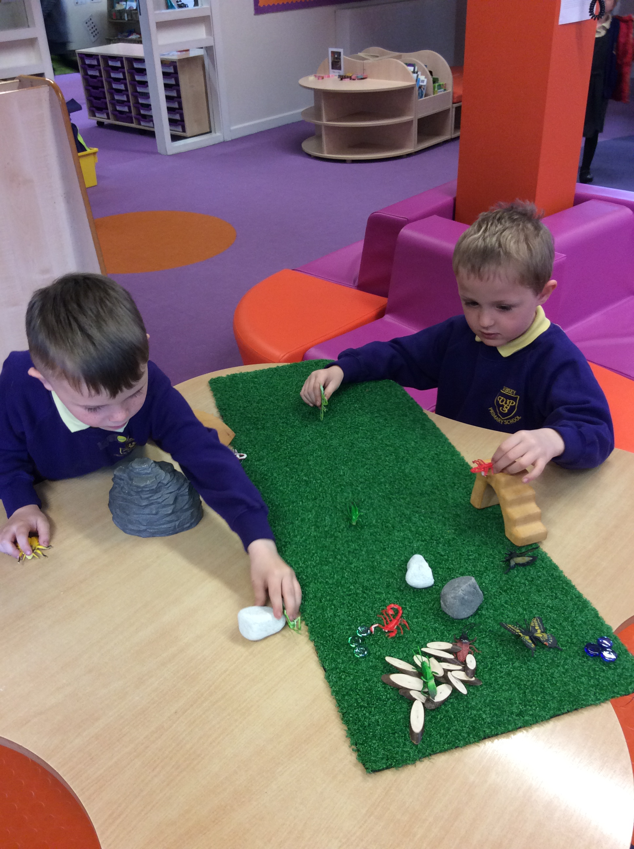
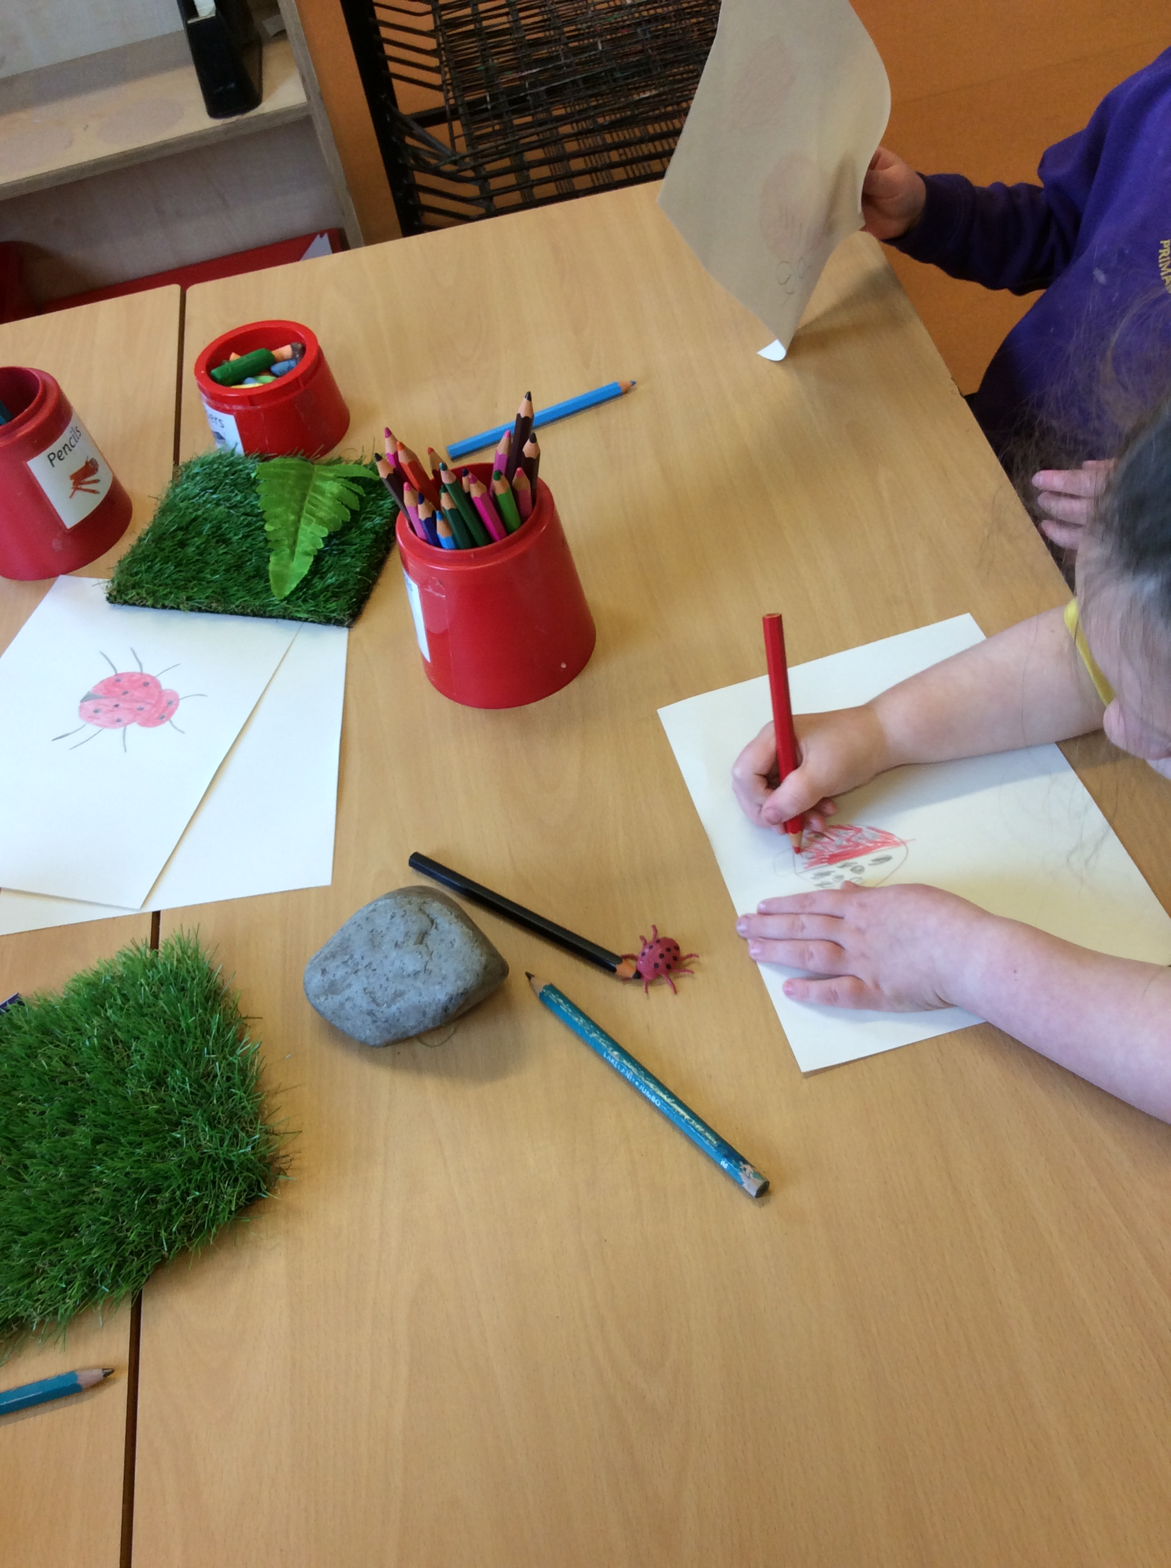
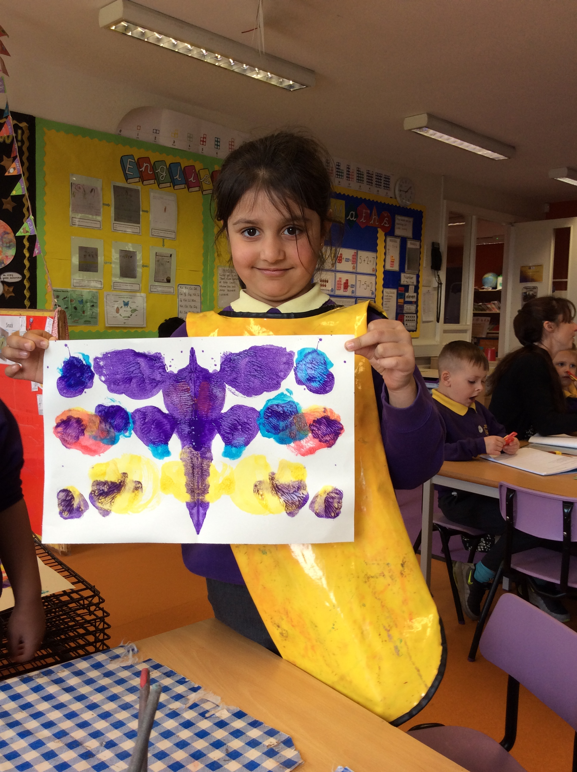
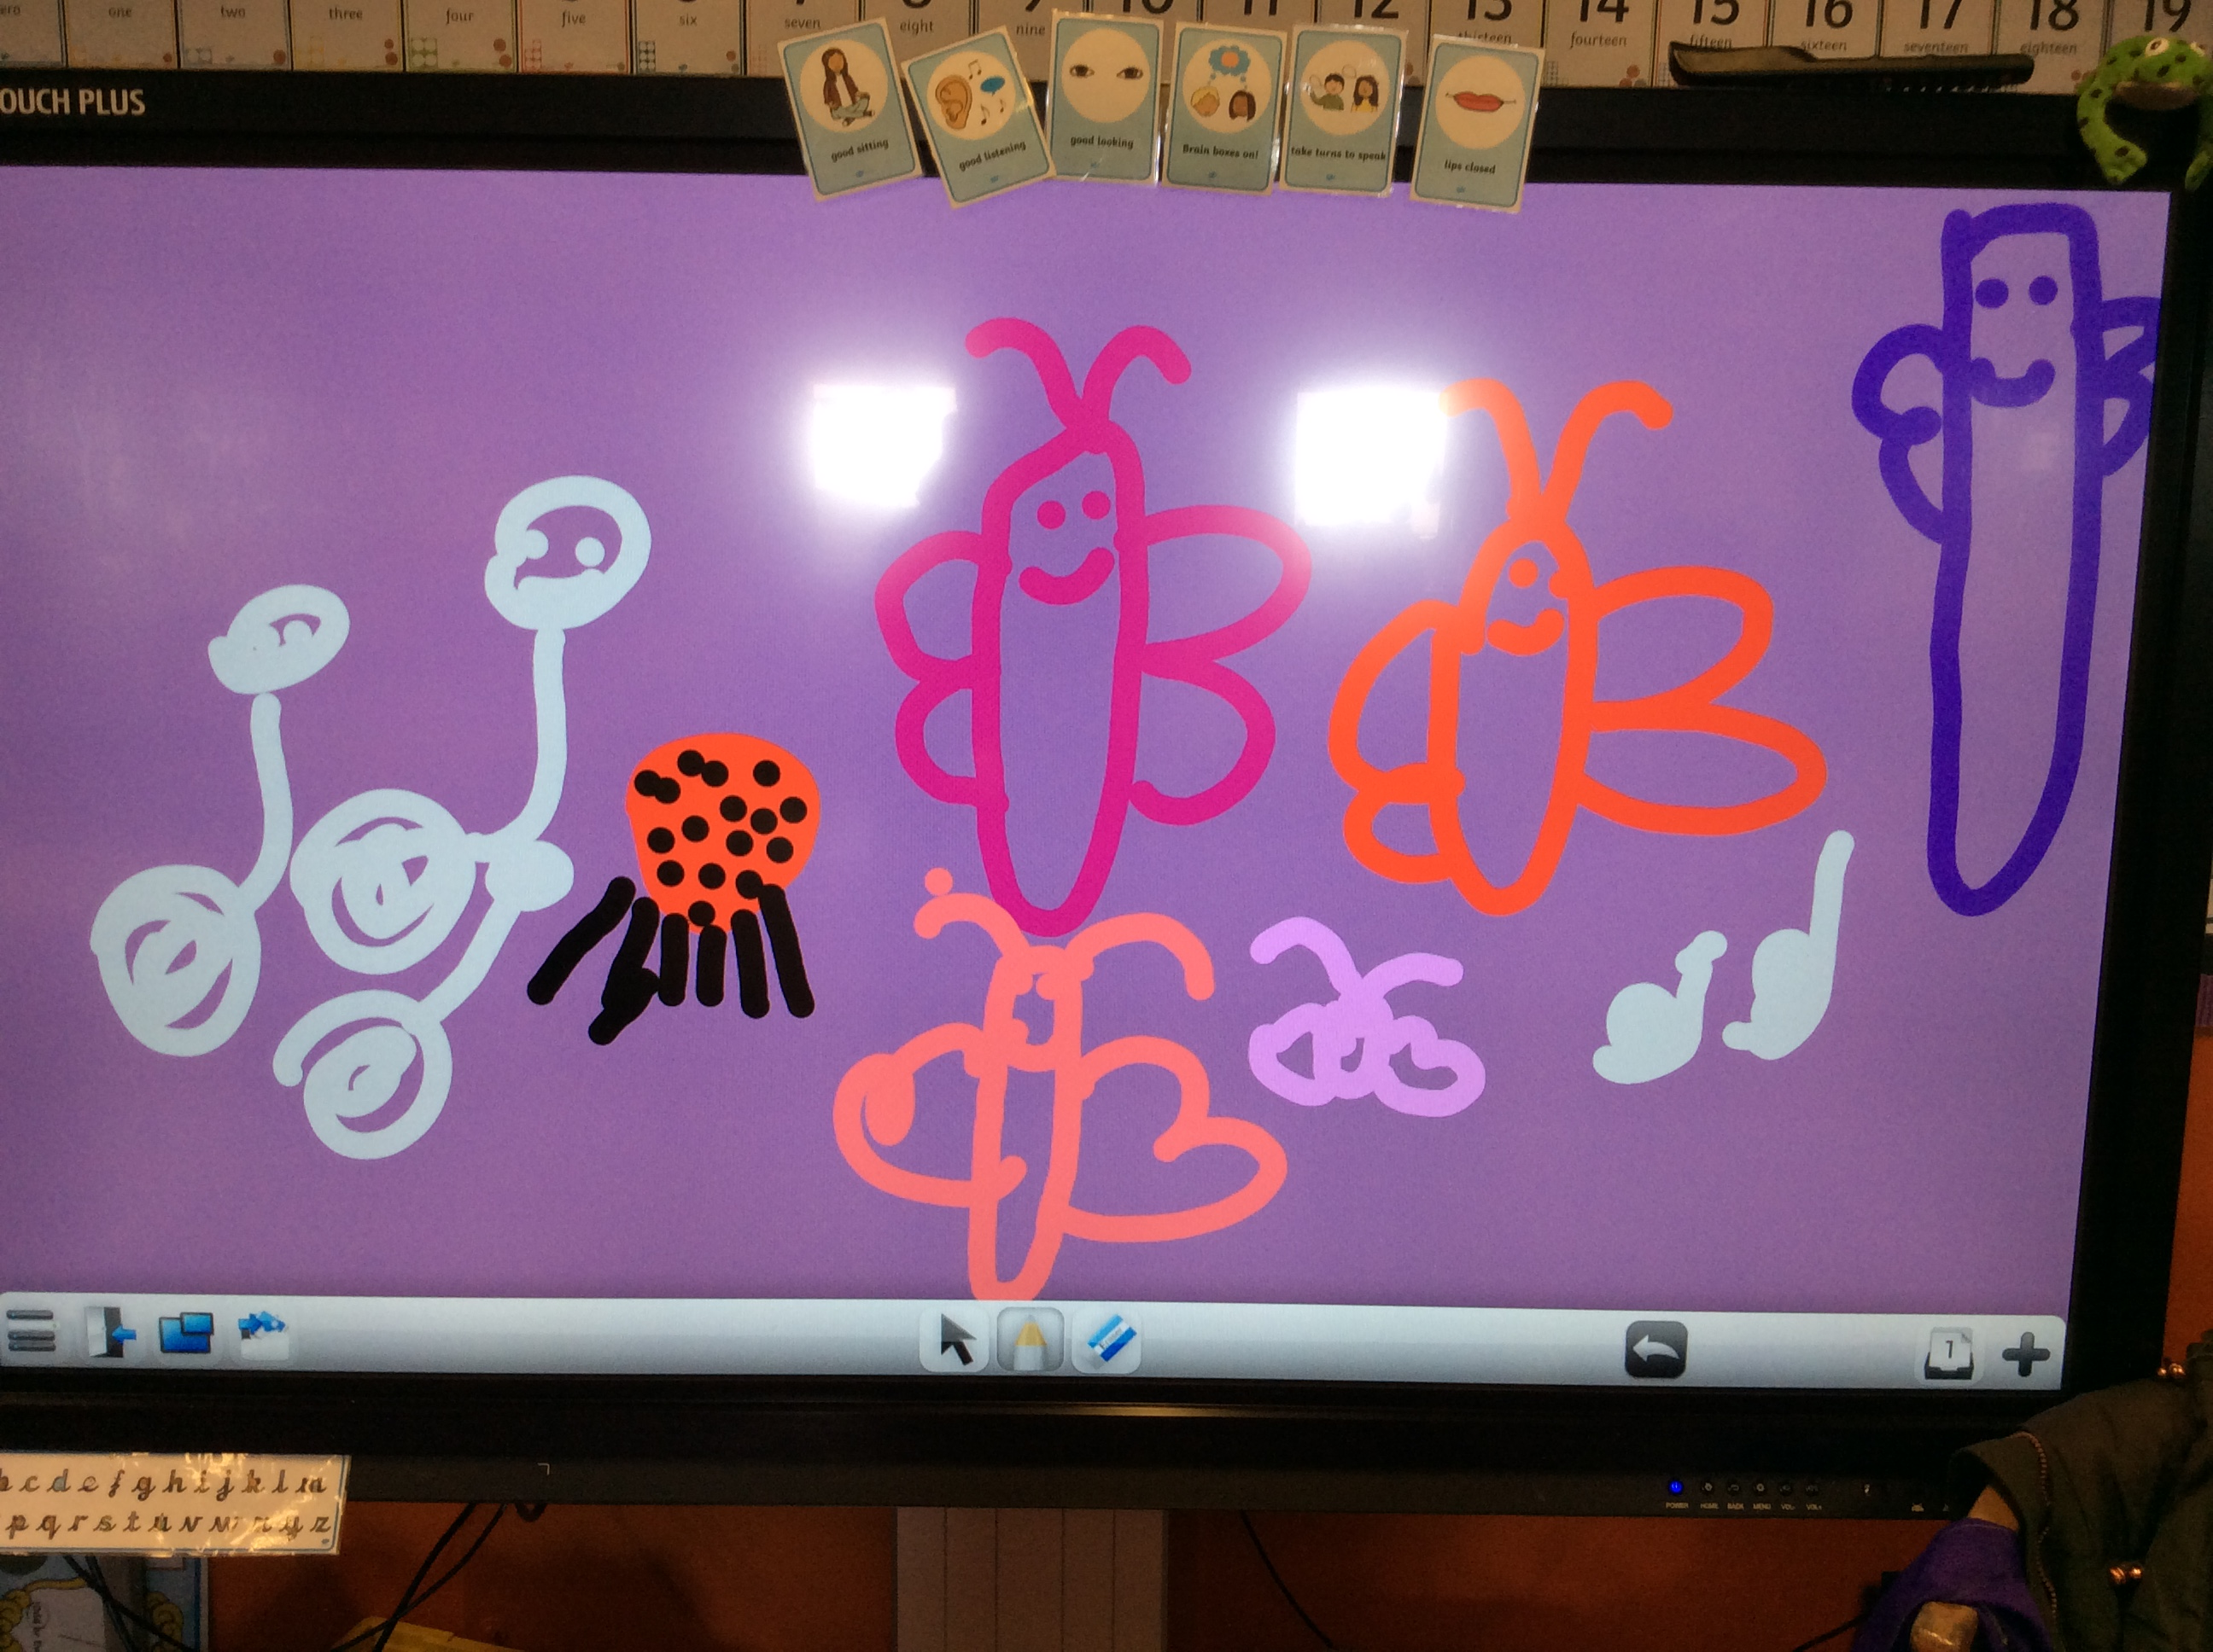
Expressive arts and design (specific area)
Children are provided with opportunities to develop their imagination and creativity. They are encouraged to engage in the arts, which enables them to explore a wide range of media and materials. A variety of experiences play an important role in helping children to develop their understanding, self-expression, vocabulary and ability to communicate through the arts.

Slide 12
Induction
In September we have phased induction to school for Reception children. For the first 4 days, each class will be split in half, 15 will visit in the morning and then the other 15 will visit in the afternoon. On Friday all children will be in for the full day. Then the following Monday the children will be full time as normal.
More information of dates and times will be given prior to September.

Slide 13
Structure of the day
Children self register in the morning.
Phonics
Snack
Areas opened- Outdoors and indoors
Topic input/writing
Dough Disco/ Shared reading
Lunch
Maths input/group work
Areas opened- Outdoors and indoors
Story time/ singing

Slide 14
Clothing- label, label, label!
Please make sure you label all items of your child’s clothing. As you can imagine, finding the correct owner of 90 identical jumpers is a nightmare at home time!
Thank you.

Slide 15
Preparing your child for Reception
If your child is starting in Reception there are ways that you can prepare them and yourself for this time of change.
Throughout the summer holidays there are small steps you can take to make sure the transition happens in a smooth and relaxed manner.
Here are our top tips for being Reception ready!
Encourage your child to practise putting on their new school uniform- and taking it off again! This will help them to establish an order to getting dressed and become quicker at doing up buttons, zips and velcro. Being able to zip up their own coat is also a bonus- and will help your child to get out to play quicker if they don’t have to wait for the teacher to help them!
Discuss how you will take your child into school in the morning and be clear about when and how you will say goodbye. This is usually the most difficult part - for parents! A positive and confident hand over is key to leaving a child happy and engaged from the very start.

Slide 16
How to prepare for Reception
To recognise their own name.
Encourage your child to write their name.
Play simple phonic and number games.
Share stories, books and rhymes.
Encourage them to be independent at the toilet and to know how to wipe their own bottom properly and to wash their hands once they have finished.
Encourage them to practise using a knife and fork during meal times.

Slide 17
Please do feel you can phone the school office during the day if you are concerned about your child and how they have settled in a morning – of course, the chances are that if they have been upset at your leaving, by the time you have reached the school gate they are laughing with their teachers and friends!
Remember- no questions are silly questions and we would always encourage you to ask us if you are unsure of anything.
Please contact us if you have questions as you prepare for the start of term. We are teachers - and parents - and know all too well the anxieties that go hand in hand with wanting to do our best by our children. We are here to support you and your child in this time of new beginnings and look forward to the partnership we share in what will be one of the most exciting years of development in your child’s life.

Slide 18
If you have any questions please don’t hesitate to email: Reception 1 (Mrs Davies) – reception1@wibsey.bradford.sch.uk Reception 2 (Miss Meadowcroft) – reception2@wibsey.bradford.sch.uk Reception 3 (Miss Rankin) – reception3@wibsey.bradford.sch.uk

