Slide 1
Key Stage 1 SATS 2022
Parent Information Workshop
Tuesday 5th April

Slide 2
Assessment at Key Stage 1
All statutory KS1 assessments resume in 2021/22 including end of KS1 assessments.
Teacher assessment is the main focus for Key Stage 1 assessment and reporting. There are 3 main forms of assessment in schools:
Day-to-day formative assessment: to inform teaching on an ongoing basis
In-school summative assessment: to understand pupil performance at the end of a period of teaching
Statutory summative assessment: to understand pupil performance in relation to national expectations and comparisons
Teachers will administer the SATs Tests to help make a secure judgement for their final teacher assessment at the end of KS1.
The tests are set externally but marked internally by the class teacher.
Testing takes place during May and it is not possible to take them at any other time

Slide 3
Key Stage 1 SATS tests
They are designed to assess pupils’ knowledge and understanding of the KS1 programmes of study (content from both the Year 1 and Year 2 National Curriculum).
The raw score (how many marks your child gets) is translated into a scaled score but this is not reported to parents
There will be a new National standard
Teacher assessments will also be used to build up a picture of your child’s learning and achievements
Your child will receive an overall result saying whether they achieved the required standard or not

Slide 4
Which tests will the children take?
Reading
Paper 1 – a combined reading prompt and answer booklet with texts of around 400 – 700 words.
Paper 2 – a reading booklet of a selection of passages totalling 800 – 1100 words and a separate answer booklet. It contains more challenging texts than Paper 1.
Each test should take about 30-40 minutes but the tests are not strictly timed
Grammar, Punctuation and Spelling (non statutory)
Paper 1 – a 20 word spelling test lasting approximately 15 minutes
Paper 2 – a grammar, punctuation and vocabulary test in two sections which will take about 20 minutes
Mathematics
Paper 1 – Arithmetic – this takes about 20 minutes to complete
Paper 2 – Reasoning: a range of mathematical fluency, reasoning and problem solving questions. This takes about 35 minutes
Children cannot use any apparatus such as number lines, hundred squares, etc.

Slide 5
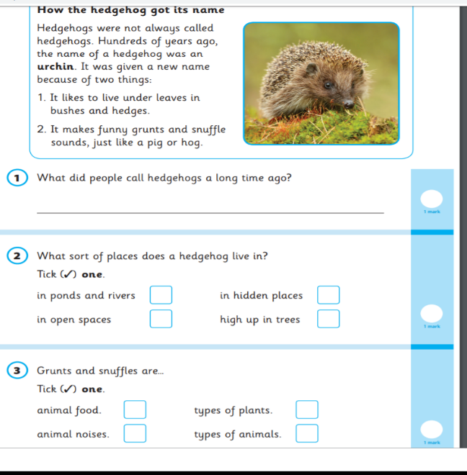
English – Reading Paper 1 Example Page
applefortheteacher.co.uk

Slide 6
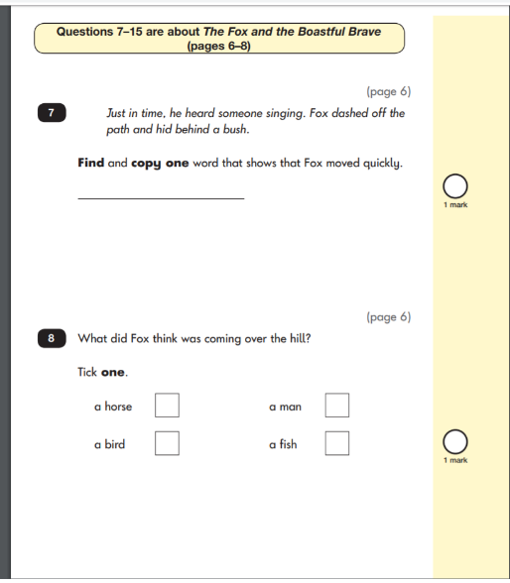
English – Reading Paper 2 Example Pages
applefortheteacher.co.uk

Slide 7
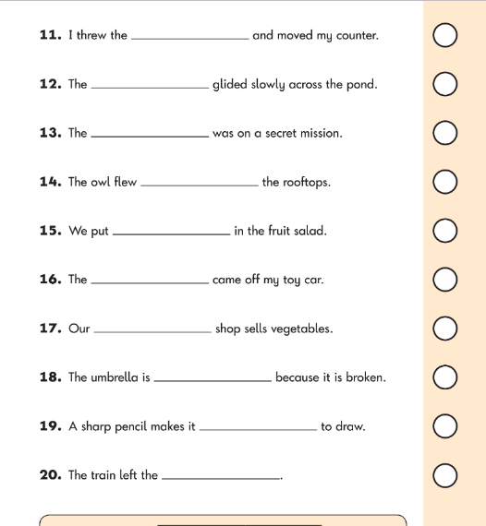
English – Spelling Example Page
English – Grammar Example Page
applefortheteacher.co.uk

Slide 8
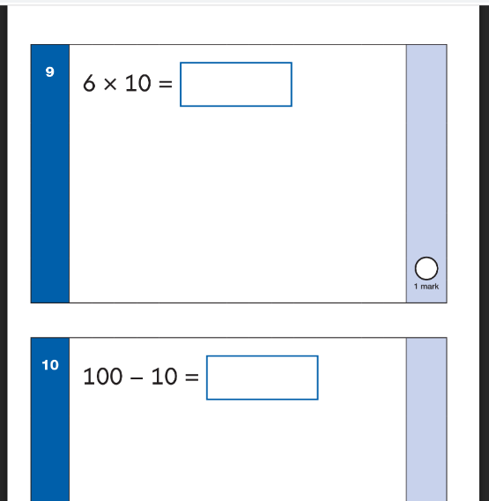
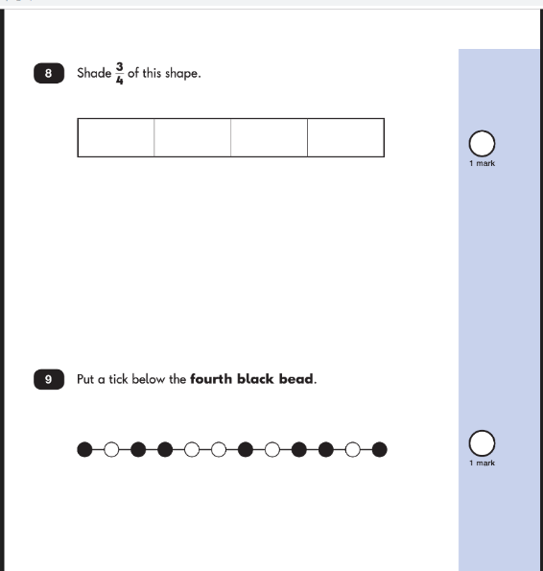
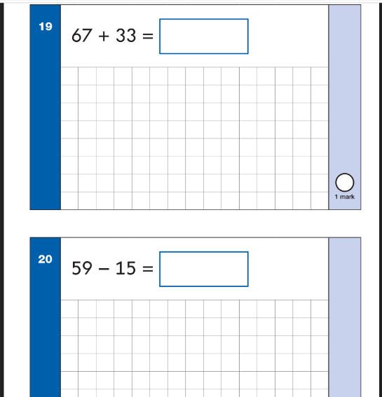
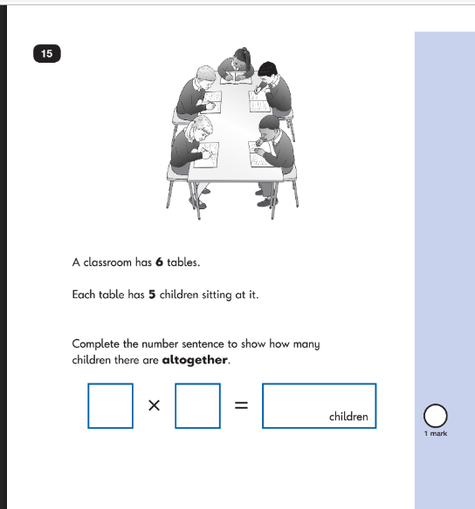
Maths Paper 1 Example Pages (Arithmetic)
Maths Paper 2 Example Pages (Reasoning)
applefortheteacher.co.uk

Slide 9
Key Stage 1 teacher assessment
There is an interim teacher assessment framework
Key Stage 1 teacher assessment framework standards for Reading, Writing and Maths:
Working at greater depth within the expected standard
Working at the expected standard
Working towards the expected standard
Science
Working at the expected standard OR does not meet the expected standard

Slide 10
What can you do to help?
Help your child at home, like you have done all year.
Continue to read with your child, particularly focussing on your child's
understanding of the text – remember that reading is so much more fun than
words on a page. Try to bring out a ‘love of reading’.
Look for opportunities to discuss numbers in the environment, simple addition
problems while you are at the supermarket, weighing and measuring things around the
home, etc.
Play simple spelling games like hangman, eye-spy, complete word searches, writing shopping lists, etc.
Reinforce skills learnt at school by completing homework, Mathletics, TTRS, etc.
Try not to discuss SATs while your child is in earshot.
Make sure your child is ready to learn and not tired when they come to school.
CGP BOOKS are available to order online.
KS1 SAT Buster available for Maths (Arithmetic and Reasoning) and English (Reading and GPS)

