Slide 1
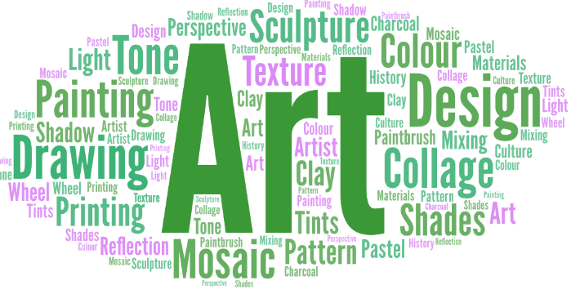
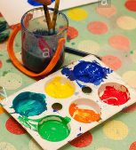
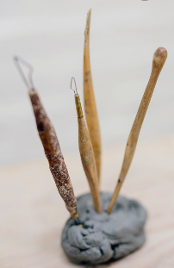
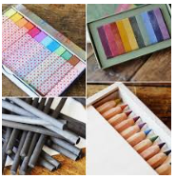
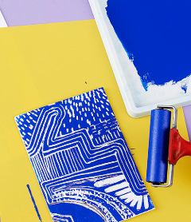
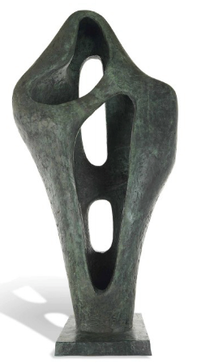
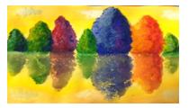
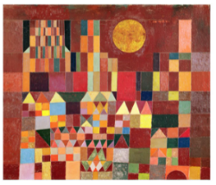
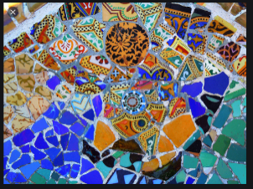
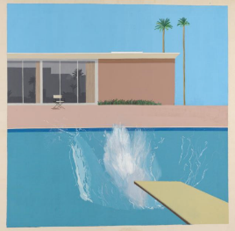
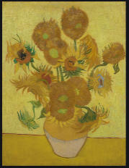
The philosophy behind Art & Design at WPS
Art & Design at Wibsey Primary School…
develops creativity
At Wibsey the intent is for pupils to have opportunities to produce creative work, explore their ideas, record their experiences and become proficient in drawing, painting, sculpture, printing and collage techniques. They will use a wide range of media and materials, learning how to use these with increasing control and technique as they progress through school.
“Creativity is intelligence having fun”- Albert Einstein
Art allows children to explore, build on and record their own creative and imaginative ideas. Making pictures allows children to express their feelings and ideas, both as a means of self-expression and to communicate to others.
Children will look at the works of at least three artists in each year group. By year 6 they will have knowledge of a range of local, national and international artists. They will evaluate and analyse creative works using the language of art, craft and design. We believe learning about a range of artists will motivate and inspire children in their own work and help them appreciate art’s role in society.
Sketchbooks
In KS2 children will be taught how to use sketchbooks to record their observations and use them to review and revisit ideas to improve their mastery of art and design techniques.

