Slide 1
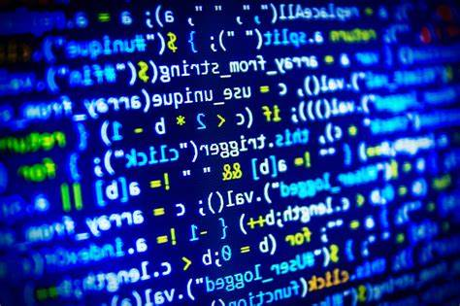
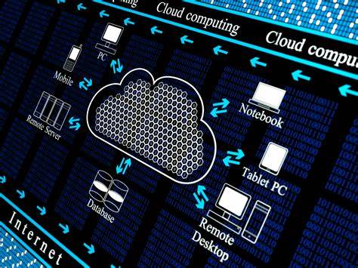
The philosophy behind Computing at WPS
Computing at Wibsey Primary School…
develops computational thinkers.
A computational thinker finds ways of solving problems and designing systems that draws on concepts fundamental to computer science. Computing equips children with the skills they need, ensuring they become digital citizens.
'When you learn computing, you're thinking about thinking' Bill Mitchell
Test
Debug
3 main areas of Computing
Digital Literacy
Using devices, software and hardware safely.
Understanding the uses of technology at home and in school.
Information Technology
Collaboration through online and networks
Manipulation of digital content
Computer Science
Creating, testing and debugging algorithms to create games, Apps and programs.
Create
Noticing
Computing
E-Safety
I wonder what happens when/if…
I notice…
I think… because I know…
I know… so…

