Slide 1
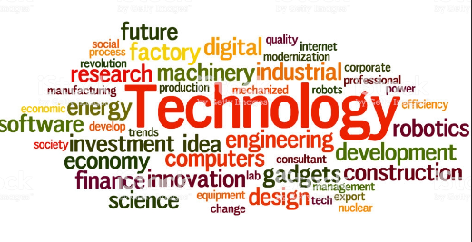
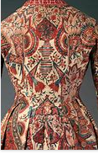
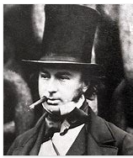
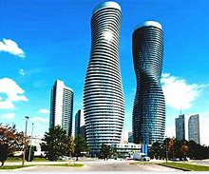
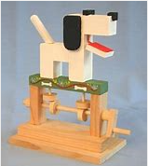
The philosophy behind DT at WPS
DT at Wibsey Primary School…
develops designers
A designer is someone who can execute designs that create structures and patterns for works of art. A designer can imagine how something can be made and creates an innovative and original product.
I notice…
“Design is intelligence made visible.” – Alina Wheeler
Evaluate
Make
I wonder what happens when/if…
Design
As pupils progress through Wibsey Primary School, they will be able to use their creativity and imagination to design and make products within a variety of contexts. They will learn how to take risks, become resourceful and innovative as well as evaluate past and present designs. With high-quality design and technology education, children will be able to contribute through creativity.
Children will be exposed key Design and Technology vocabulary to stretch their reading ability and be able to use these words when evaluating and reflecting on their own designs and learning journey.
I know… so…
Vocabulary
Designer
I think… because I know…
Structures, Mechanisms, Textiles, Electrical Systems, Food

