Slide 1
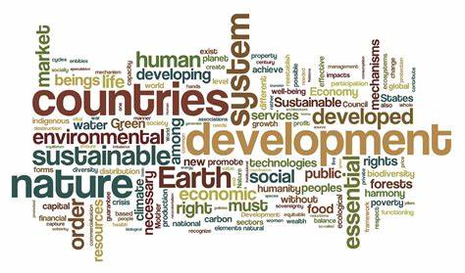
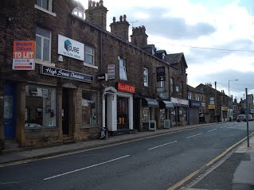
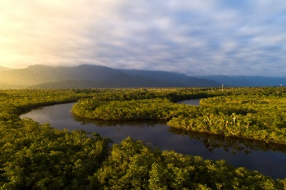
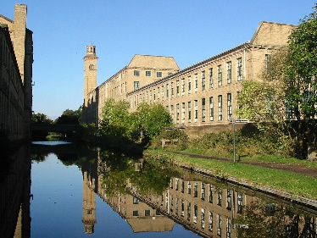
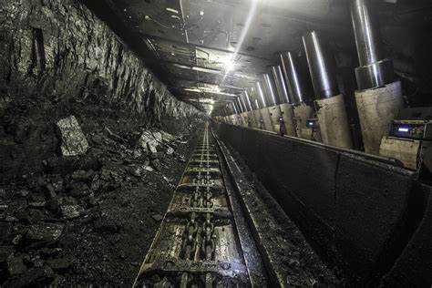
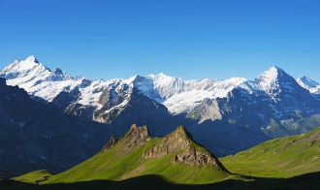
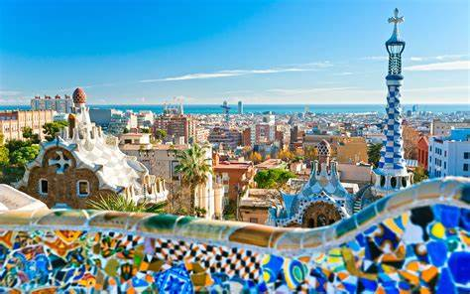
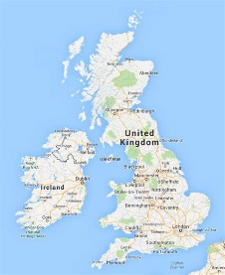
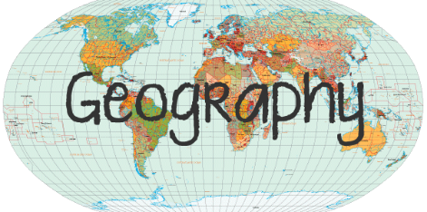
The philosophy behind Geography at WPS
Geography at Wibsey Primary School…
develops geographers
A Geographer is an expert in the study of the physical features of the earth and its atmosphere, and of human activity as it affects and is affected by these.
The purpose of the Geography curriculum is to encourage children to develop a curiosity and fascination about the world and its people, which will remain with them for the rest of their lives. Geography supports reading development as Geographers at Wibsey read to inform. They use the skill of map reading to further their learning and skimming and scanning texts as well as maps to inform their knowledge.
‘Geography is a subject which holds the key to our future.’ Michael Palin
Places
I think… because I know…
Environment
Fieldwork opportunities are offered through core learning experiences in each year group to bring Geography alive through first hand experiences.
People
I wonder what happens when/if…
As pupils progress through school, their growing knowledge about the world should help them to deepen their understanding of the interaction between physical and human processes, and of the formation and use of landscapes and environments. Geographical knowledge, understanding and skills provide the framework and approaches that explain how the Earth’s features at different scales are shaped, interconnected and change over time.
Vocabulary
This happened because…
I know the key features are…
Locational knowledge, human & physical geography, place knowledge

