Slide 1
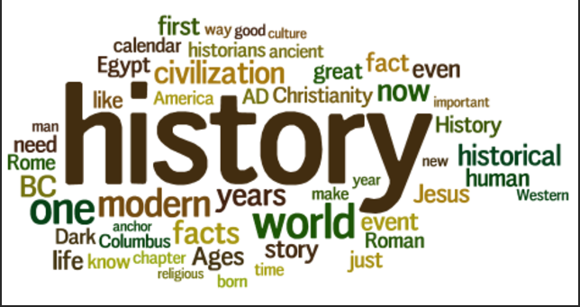
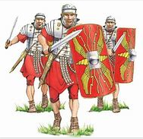
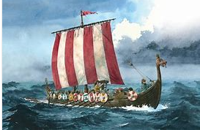
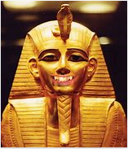
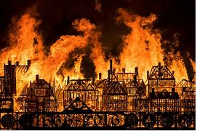
The philosophy behind History at WPS
History at Wibsey Primary School…
develops historians
A historian is an expert in or student of history, especially that of a particular period, geographical region, or social phenomenon.
Interpretations
I wonder what happens when/if…
‘“We are not makers of history. We are made by history.” – Martin Luther King, Jr
I think… because I know…
Knowledge
Chronology
As children progress through Wibsey Primary School, they will gain a coherent knowledge and understanding of Britain’s past and that of the wider world. Pupils will develop curiosity about the past and will be able to ask perceptive questions, think critically and develop perspective and judgement. Children will be encouraged to explore artefacts and a variety of sources to bring history to life. The teaching of History will help pupils to understand the complexity of people’s lives, the diversity of societies as well as their own identity and the challenges of their time.
I know… so…
I notice…
Vocabulary
Historian
Enquiry

