Slide 1
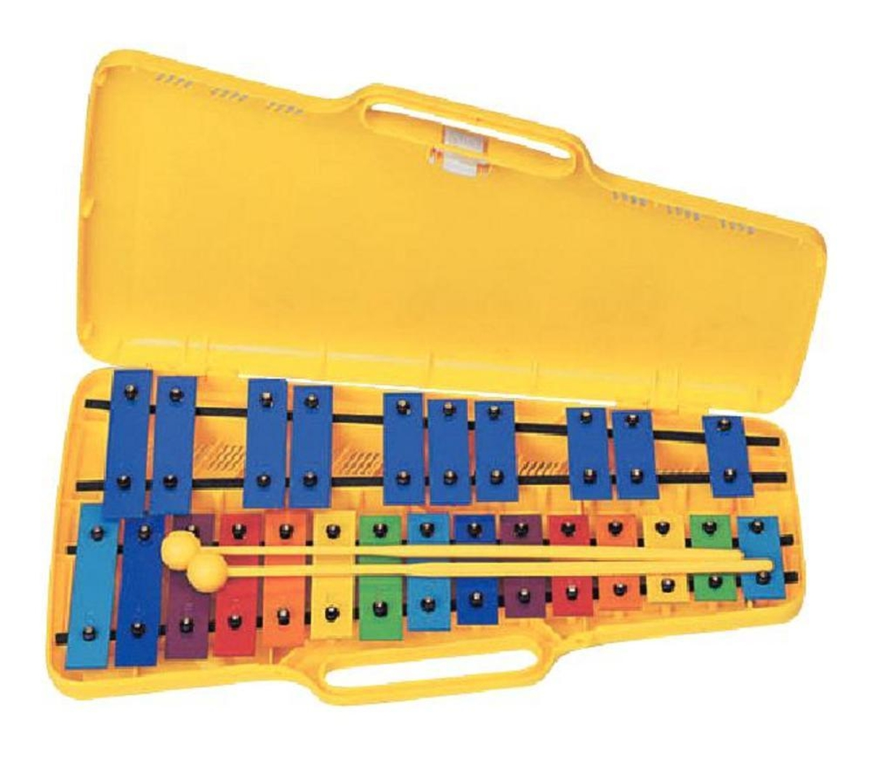
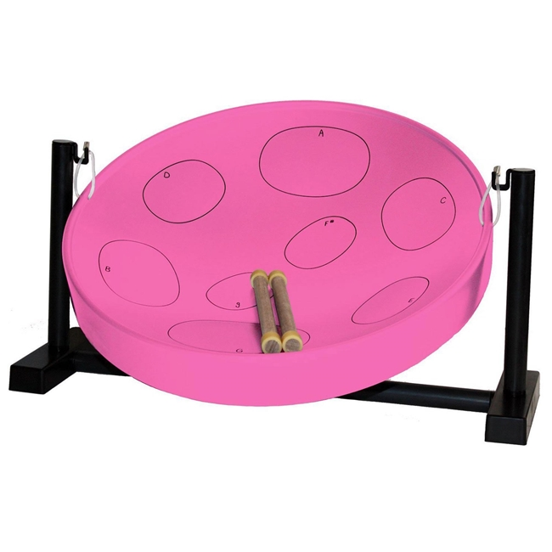
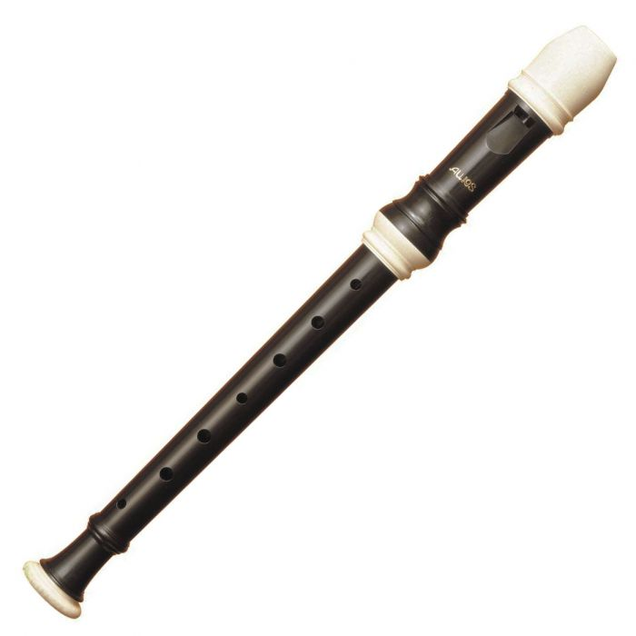
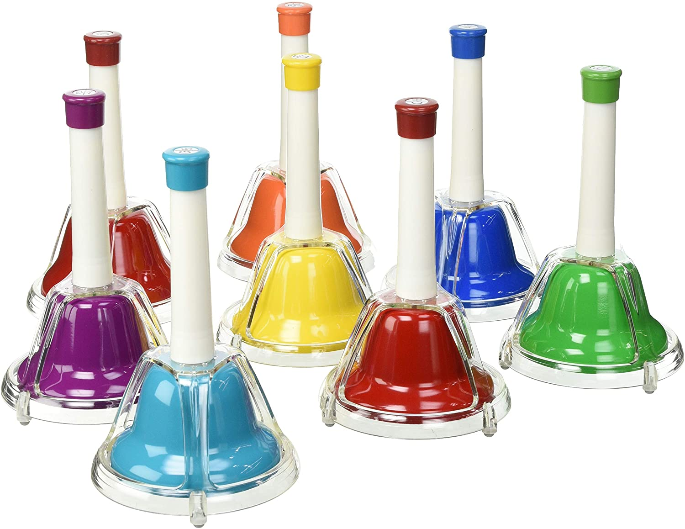
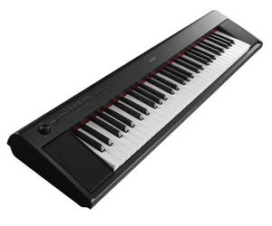
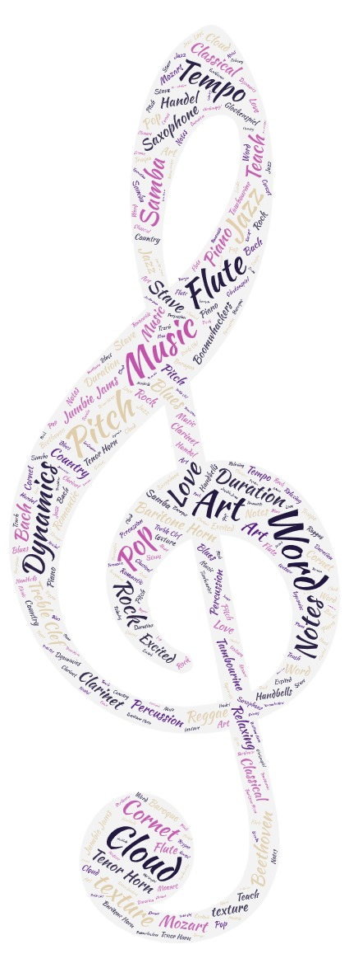
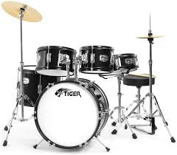
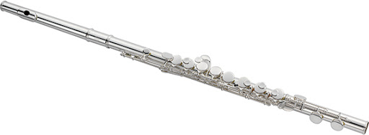
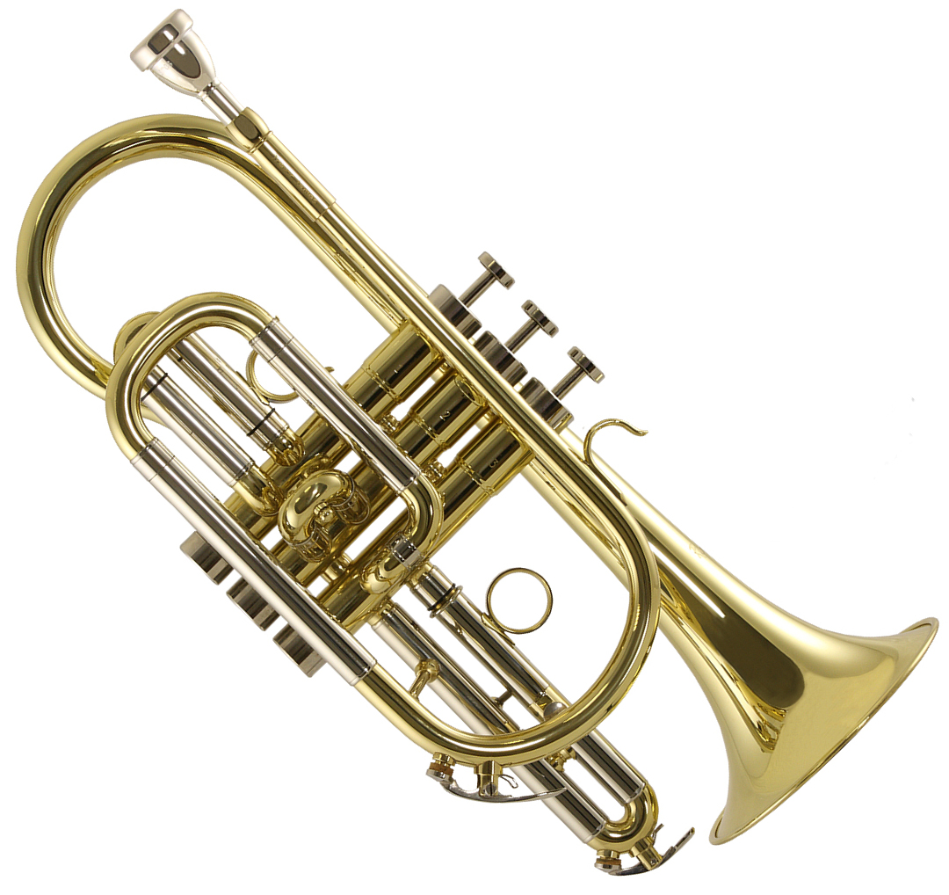
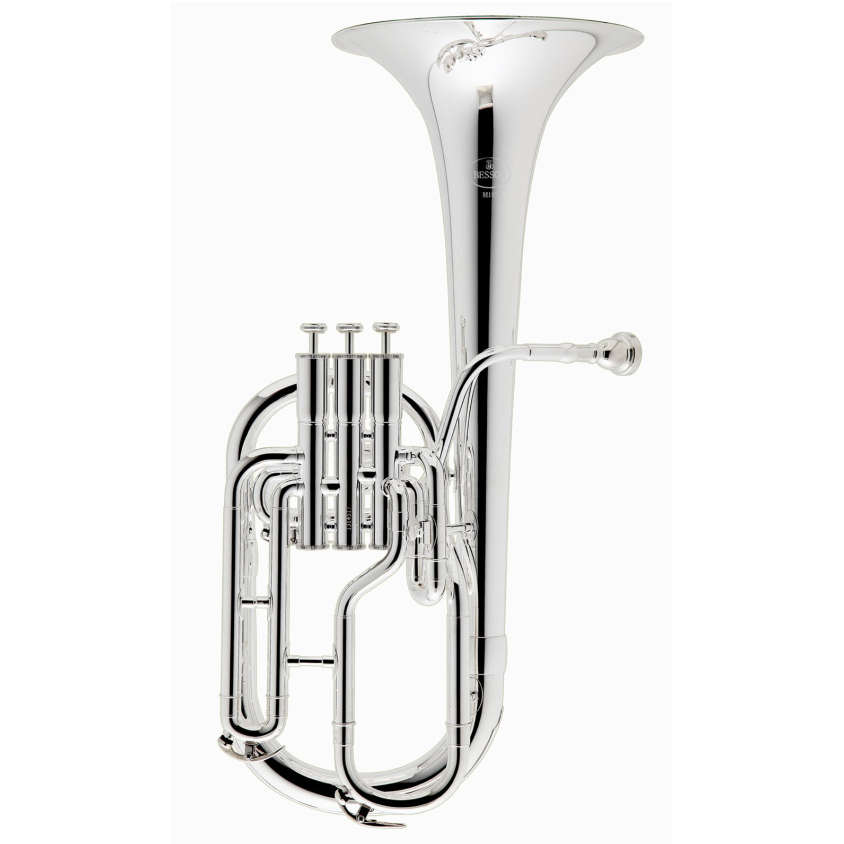
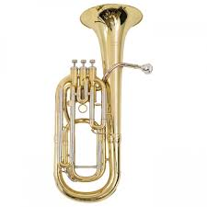
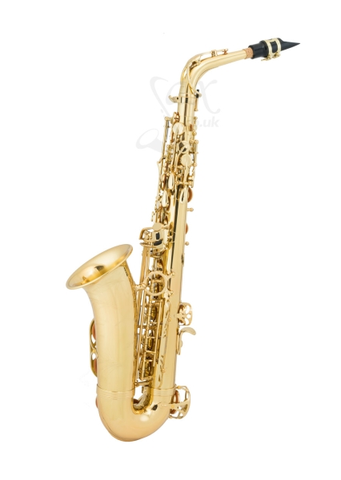
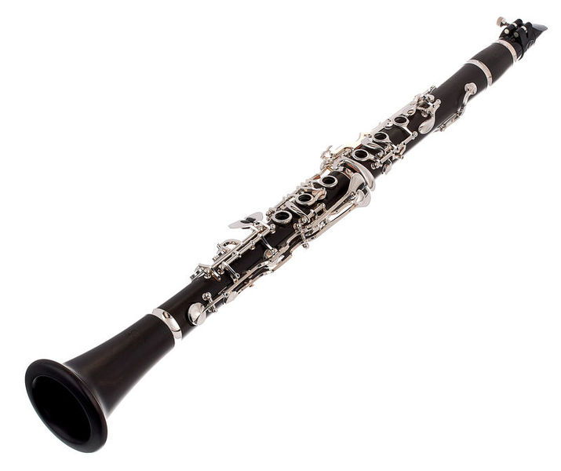
The philosophy behind Music at WPS
We use music to help raise standards of achievement in all subjects. Music is at the heart of a joyful school. Singing is used to help develop oracy and performance is used to develop confidence and character. Instrumental work develops co-ordination and fine motor skills, and there is also research that evidences that in schools that promote music, academic attainment rises. Music helps our pupils to develop self-discipline and responsibility.
‘Music gives a soul to the universe, flight to the imagination and life to everything.’ Plato
5 main areas of Music we Explore at WPS
Singing and Vocal work
We use our voices expressively by singing songs and speaking chants and rhymes.
Playing and Performing
We play tuned and untuned instruments musically
Improvisation
We experiment with, create and combine sounds.
Composition
We like to experiment with, create and combine sounds using the inter-related dimensions of music.
Listening and Appraising
We listen with concentration and understanding to a range of high-quality live and recorded music.

