Slide 1
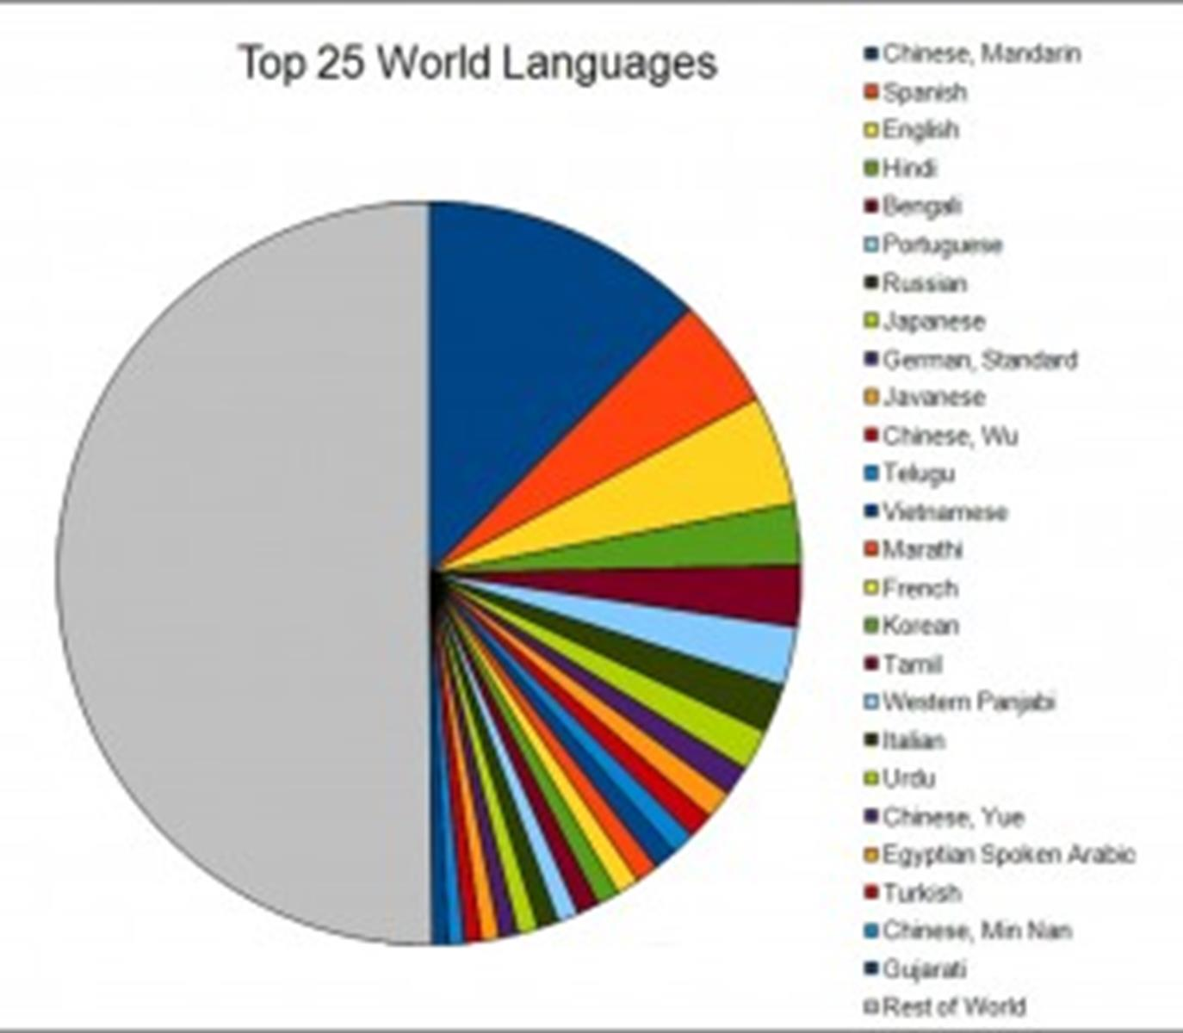
The philosophy behind Spanish at WPS
Spanish at Wibsey Primary School…
develops linguists
A linguist is accomplished in speaking foreign languages
"One language sets you in a corridor for life. Two languages open every door along the way." Frank Smith (Psycholinguist)
At Wibsey Primary School we believe that the earlier children start to learn a foreign language, the faster they acquire it. Our children start their language learning journey in Year 1 and through fun, motivating lessons, along with real world links with schools in Spanish speaking countries, we develop the 5 key language skills necessary for speaking Spanish: reading, writing, listening, speaking and grammar. We extend our knowledge of how language works and lay down strong foundations for future language learning, as well as exploring similarities and differences between English and Spanish.
In our Spanish lessons we develop curiosity, not only for the Spanish language, but for the culture and way of life in Spanish speaking countries across the world. This helps us to become more tolerant of others and also to strengthen our own sense of identity.

