Slide 1
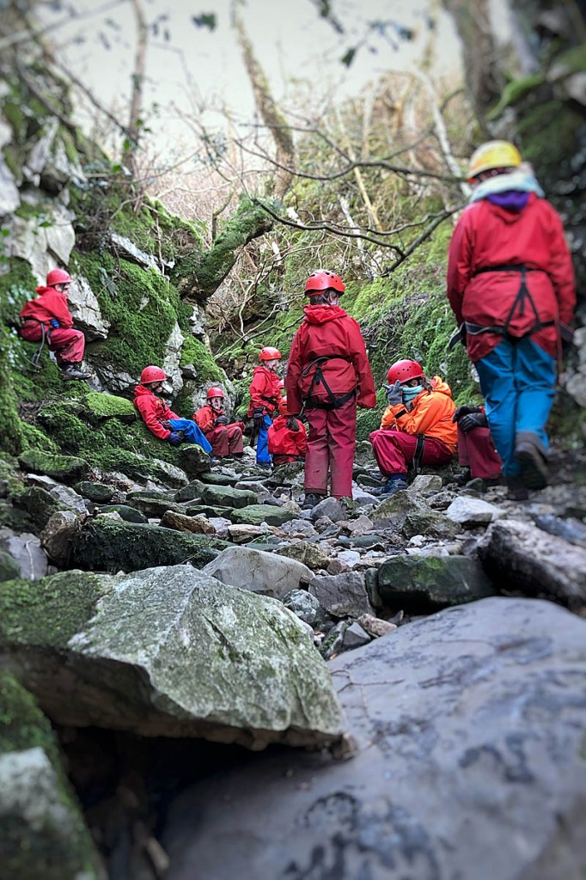
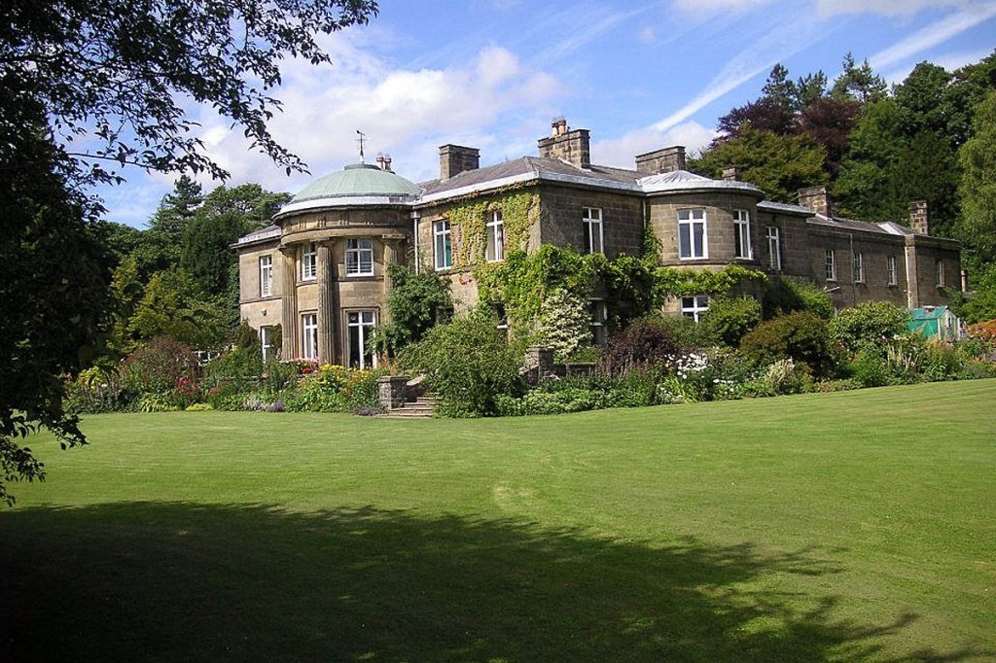
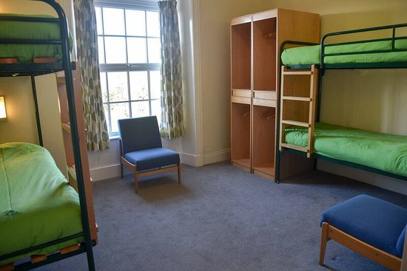
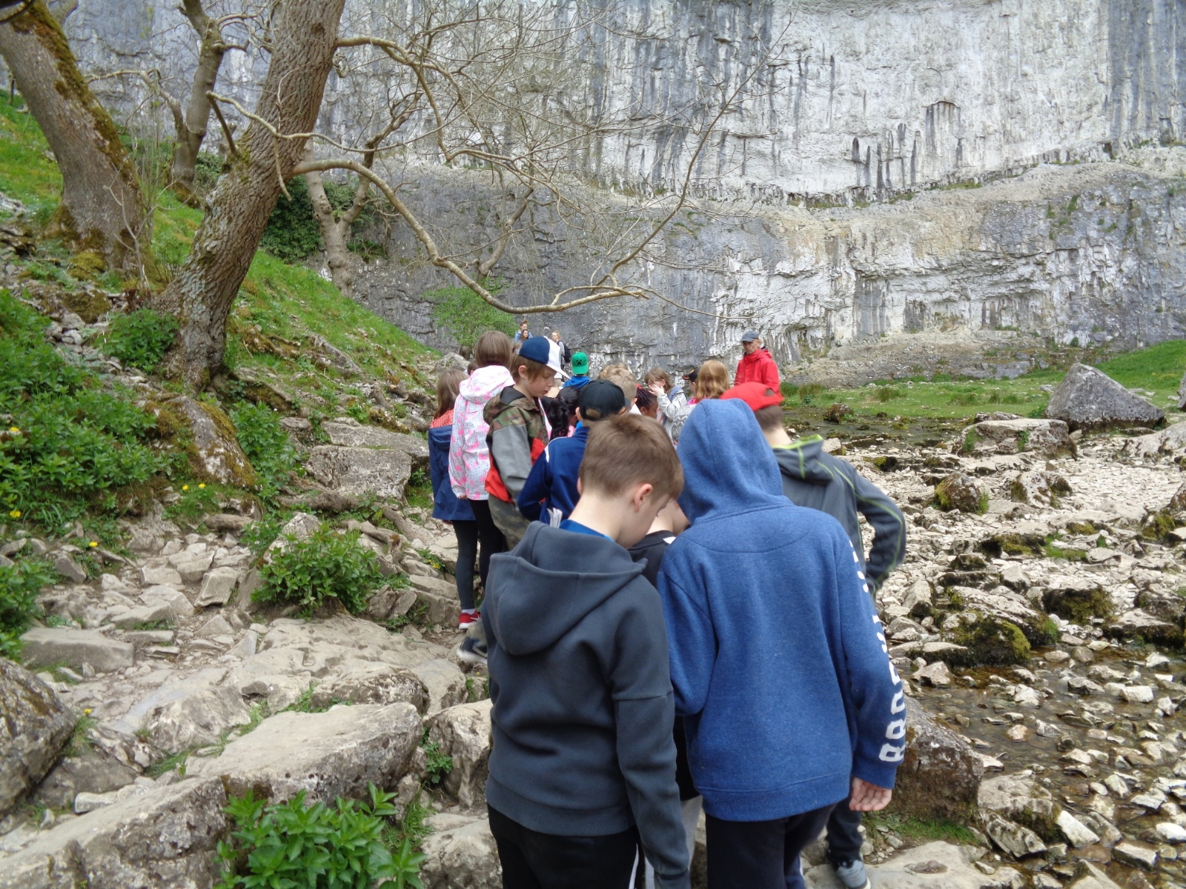
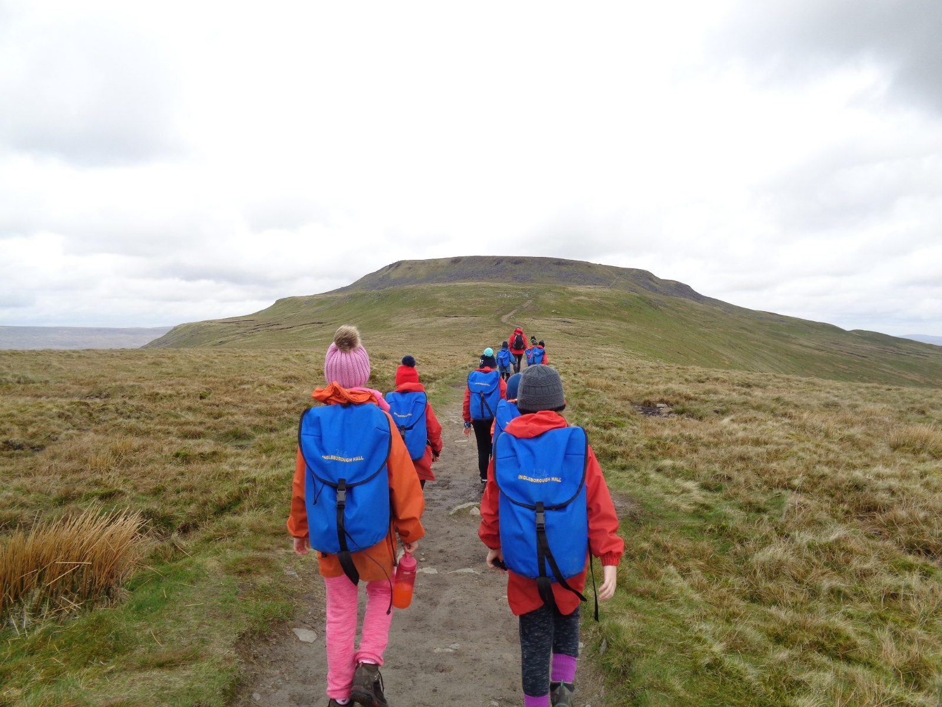
Ingleborough Hall Parent Meeting

Slide 2
Ingleborough Parent Meeting
- Activities the children will be doing
- Kit list and things to bring
- Sleeping arrangements
- Meals
- Timetable
- Medicines (medical forms)
- On the day
- Up to date contact details
- Date and Cost of the Visit
- Questions

Slide 3
Activities:
- Caving
- Archery
- Tree climbing
- Orienteering
- Hiking
All activities will be done alongside professionals from Ingleborough Hall.
Children will be in different groups with different adults. The activities will alternate according to their group.

Slide 4
Kit list - things to bring

Slide 5
Kit list - things to bring
- Ensure all clothes have names in for drying rooms
- Socks!
- Bed sheets are provided but children need to bring their own toiletries and towels. (No aerosols)
- Bring a bin liner to put wet/dirty clothes in
- No electronics/snacks
- Clothes the centre provides

Slide 6
Sleeping arrangements
- Children will be put in dormitories in groups. Girls and boys dormitories are separate. Boys dorms are located next to the male staff and girls next to the female staff.
- Bedding is provided but the children will be asked to make their bed on the first day (with support!)
- Most dorms have a toilet/shower inside, if it does not there are shower and toilet cubicles in the next room. All boys and girls bathrooms are separate.
- Children should shower daily either in the afternoon/evening after their activities or in the morning before breakfast.

Slide 7
Meals
- Breakfast: toast, cereal and cooked breakfast option of toast, beans, eggs and hash browns. (Breakfast at 8am)
- Packed lunch each day: sandwich (egg, tuna, cheese), packet of crisps, piece of fruit, piece of cake, chocolate bar.
- Dinner: 2 choices of hot meal, all halal. Dessert.
- Supper: hot chocolate and biscuit in the evening.
Juice and water available at all times. Water bottles provided.

Slide 8
Timetable:
Will set off at 9am on the Monday hoping to return by hometime at Wibsey on Wednesday.

Slide 9
Medicine and medical forms
There are 2 medical forms to complete and send back to school. Ensure that these are completed thoroughly.
Any medicine being brought on the trip needs to be labelled clearly and given to the lead teacher on the morning of the trip.
If a child has been unwell just before the trip this needs to be mentioned to the staff so that they can be monitored.

Slide 10
Keeping up to date
- If there is an emergency and you need to contact your child, this needs to be done through the school and you should not contact Ingleborough hall directly.
- If a child becomes unwell we will contact you. (This is very unlikely!) There are First Aiders from Wibsey with us and First Aid staff at the centre.

Slide 11
On the day timings
The children will need to come to school at 8.30am on the Monday so that we can sort any medicine, contact info etc. before we set off.
We hope to get to Ingleborough hall by 11am latest to get our kit and start our activities!
The children will need a packed lunch from home for the Monday. It is advised that this is brought in a carrier bag so that it can be thrown away. FSM children will be provided a lunch from school.

Slide 12
Date and Cost of the Visit
Proposed date of visit: 20-22nd March 2023
Approximate cost per child: £144.37
This cost will cover absolutely everything during the visit. This includes: staffing, supervision, board and lodgings and specialist instructors, as well as the large number of organised activities which the children will be participating in. We appreciate and understand that it is quite an amount to find, which is why we start the process early in the academic year so that you will be able to pay in instalments via Parent Pay.
Children in receipt of the benefit, Free School Meals, will be eligible for a discount. Mrs Smith will contact you directly if you are eligible.
School is paying for transport.

Slide 13
Any Questions?

