Slide 1
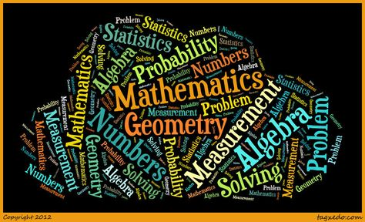
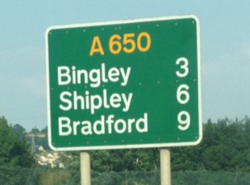
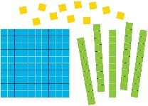
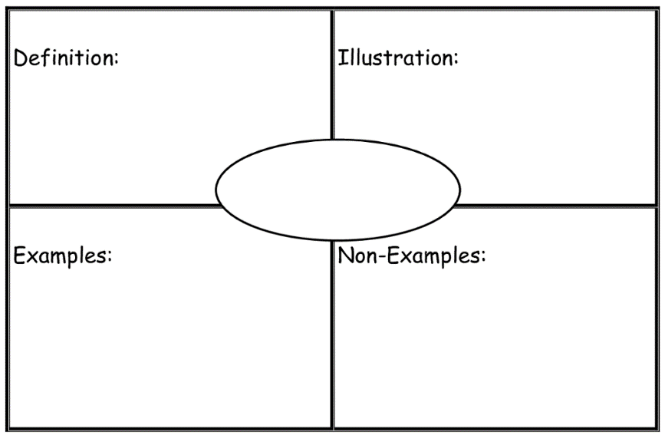
The philosophy behind Maths at WPS
Maths at Wibsey Primary School…
develops mathematicians
A mathematician is a seeker of patterns. In order to behave like a mathematician children learn how to deploy noticing, testing, proving and wondering.
Wondering
I wonder what happens when/if…
‘Without mathematics, there’s nothing you can do. Everything around you is mathematics.’ Shakuntala Devi
I think… because I know…
Testing and proving
Decision making
All children
describe and represent maths using concrete materials, pictures and symbols
use maths vocabulary to describe their own examples and non-examples
Most children ‘master’ the curriculum by
Identifying connections
Communicating results clearly
Some children demonstrate a ‘deeper’ understanding by
Exploring and investigating mathematical contexts and structures
Systematically explaining and generalising the mathematics
Noticing
I know… so…
I notice…
Vocabulary
Mathematician
Maths supports reading development as Mathematicans at Wibsey read to interpret, analyse and communicate mathematical ideas. They explore a range of mathematical vocabulary and its meaning in context, apply skimming and scanning strategies to select key information to inform their mathematical decisions and use the skill of reading when interpreting data.
Fluency, Reasoning and Problem Solving
Notes:
Maths supports reading development as Mathematicans at Wibsey read to interpret, analyse and communicate mathematical ideas. They explore a range of mathematical vocabulary and its meaning in context, apply skimming and scanning strategies to select key information to inform their mathematical decisions and use the skill of reading when interpreting data.

