Slide 1
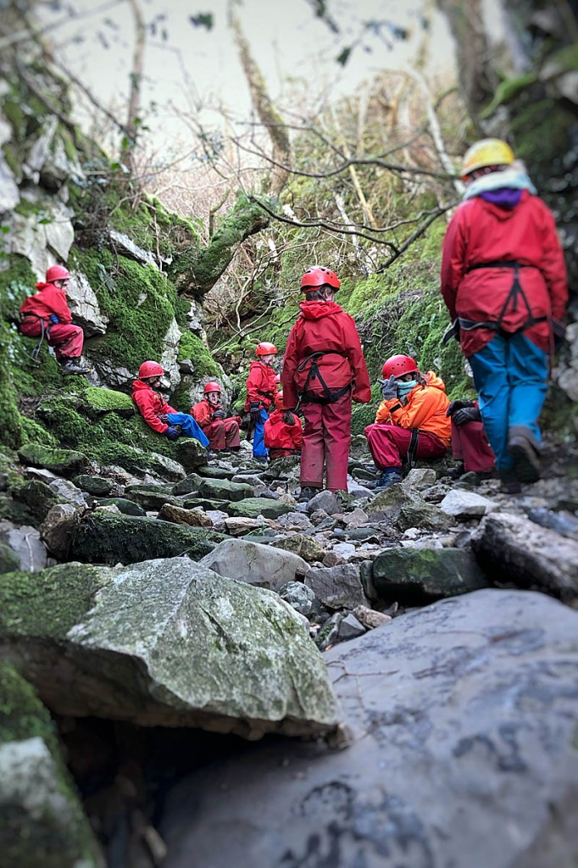
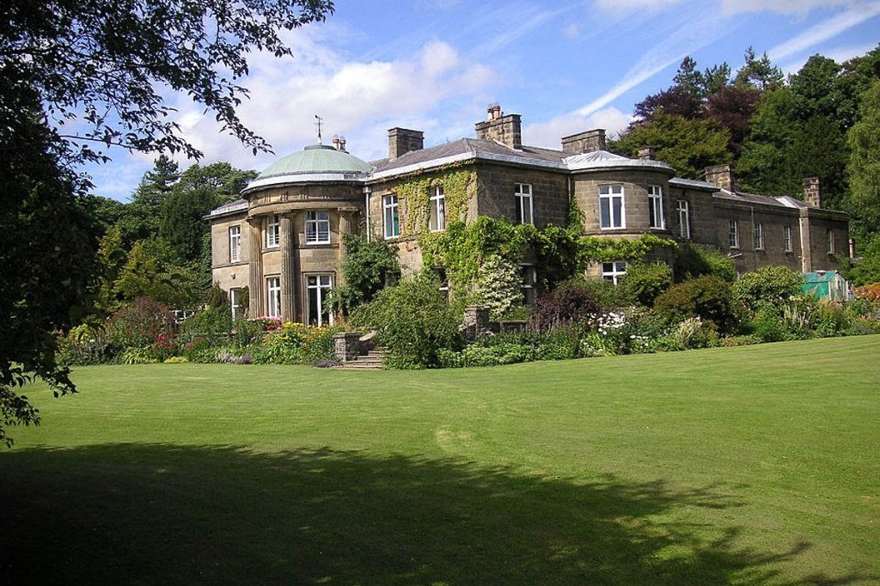
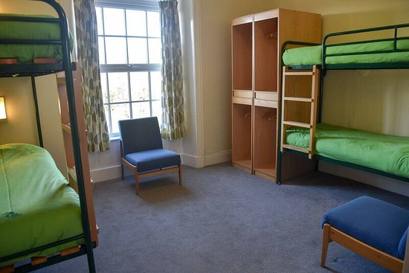
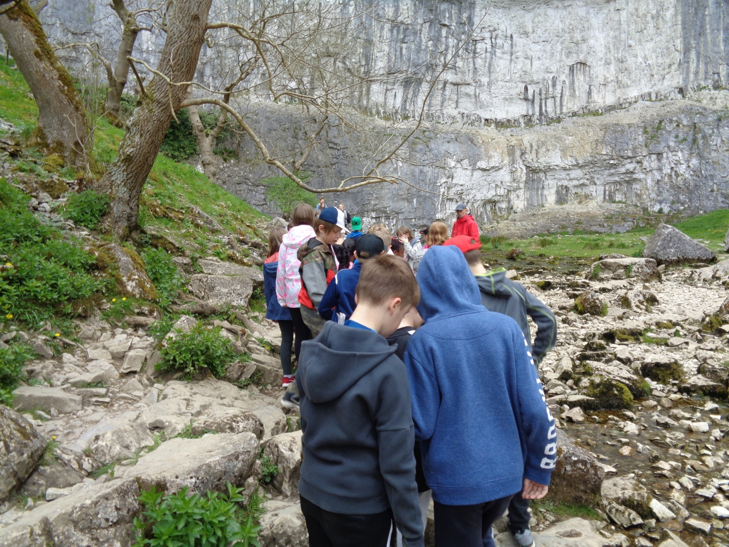
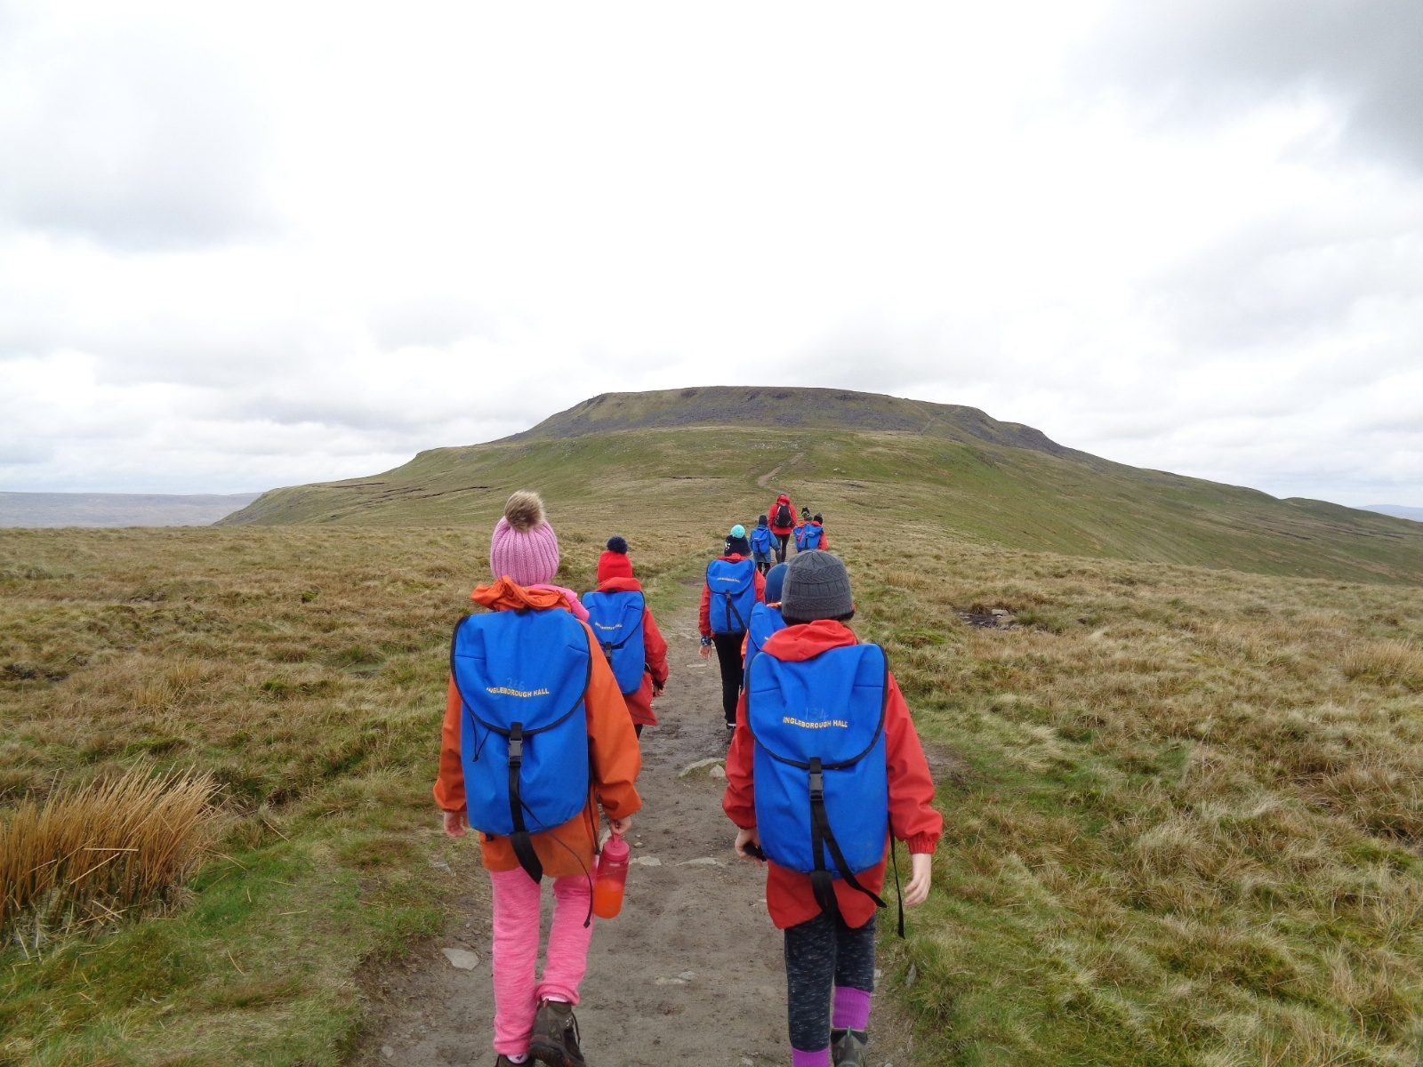
Ingleborough Hall Parent Meeting

Slide 2
Ingleborough Parent Meeting- Outline:
- Activities the children will be doing
- Kit list and things to bring
- Sleeping arrangements
- Meals
- Medicines (medical forms)
- Illness
- Keeping up to date
- Gift Shop
- Schedule
- Questions

Slide 3
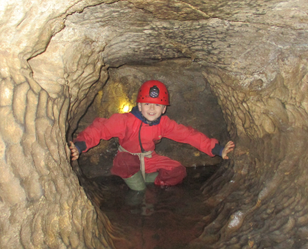
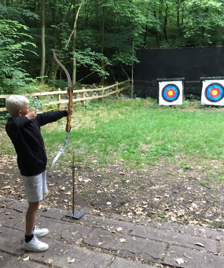
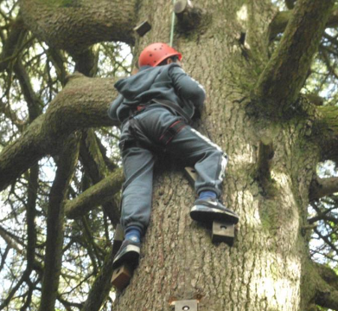
Activities:
- Caving
- Archery
- Tree climbing
- Orienteering
- Hiking
- Country dancing
All specialist activities will be lead by professionals from Ingleborough Hall.
Children will be in different groups with different adults. The activities will alternate according to their group.
Class Teachers who are not staying for the entire residential are expected to come and spend a day with the children to share in their experiences.

Slide 4
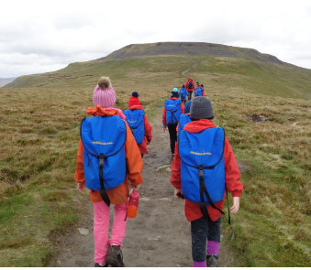
Kit list - things to bring
-Ensure all bags and clothing are labelled clearly with your child’s name. (This helps your child identify their items when hanging up a drying room, for example!)
- Socks!
- Bed sheets are provided but children need to bring their own toiletries and towels. (No aerosols)
- Bring a bin liner to put wet/dirty clothes in
- No electronics/snacks
- Clothes the centre provides

Slide 5
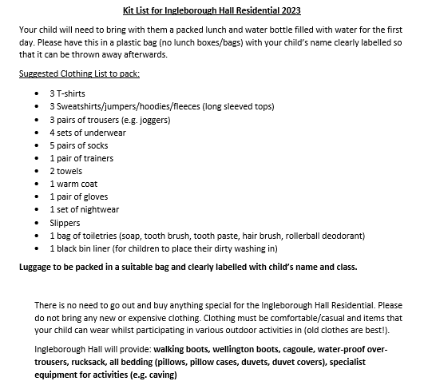
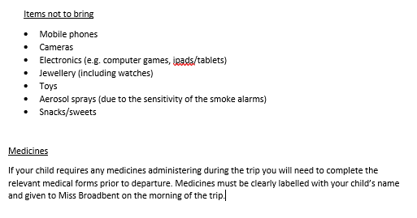
Kit list - things to bring
Due to the practical nature of the activities,
please no jewellery, including no earrings.

Slide 6
Sleeping arrangements
- Children will be put in dormitories in groups. Girls and boys dormitories are separate. Boys dorms are located next to the male staff and girls next to the female staff.
- Bedding is provided but the children will be asked to make their bed on the first day (with support!)
If you are aware that your child occasionally can have accident during the night, please pack spare bedding. This can be discretely changed without causing embarrassment.
- Most dorms have a toilet/shower inside. If not there are shower and toilet cubicles in the next room. All boys and girls bathrooms are separate.
- Children should shower daily either in the afternoon/evening after their activities or in the morning before breakfast.

Slide 7
Meals
- Breakfast: toast, cereal and cooked breakfast option of toast, beans, eggs and hash browns. (Breakfast at 8am)
- Packed lunch each day: sandwich (egg, tuna, cheese), packet of crisps, piece of fruit, piece of cake, chocolate bar.
- Dinner: 2 choices of hot meal, all halal. Dessert.
- Supper: hot chocolate and biscuit in the evening.
Juice and water available at all times. Water bottles provided.

Slide 8
Medicine and medical forms
There are 2 medical forms to complete and send back to school. Ensure that these are completed thoroughly.
Any medicine being brought on the trip needs to be labelled clearly (as per school policy) and given to Miss Broadbent on the morning of the trip.

Slide 9
Illness
If your child has had sickness within the last 24 hours before departure, they will be unable to attend the residential.
If your child becomes ill whilst at Ingleborough Hall:
A designated first aider will make an assessment as to whether your child needs to return home.
If they do not need to return home, the first aider will make the decision about the ability of your child to undertake activities. First Aider will stay with the child.
Parent contacted and informed by Mrs Mitchell and a decision for next steps agreed.
If your child needs to go home then Mrs Mitchell will contact Mr Cooper/Mrs Yates and parents will be called to come and collect your child. First Aider to stay with your child until parent collects.

Slide 10
Keeping up to date
- If there is an emergency and you need to contact your child, this needs to be done through the school. Do not contact Ingleborough hall directly.
- If a child becomes unwell we will contact you. There are First Aiders from Wibsey with us and First Aid staff at the centre.
Daily Communication
- Daily updates as to how the children are doing will be sent out via the School App. We will also update when we have arrived at Ingleborough on Monday and when we have departed on Wednesday.

Slide 11
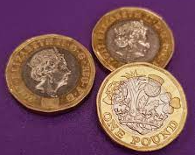
Ingleborough Gift Shop
There is a small gift shop at Ingleborough that sells little souvenirs such as pencils, rubbers, pens, keyrings etc. Items are generally priced at approximately 50p each.
Children can bring a maximum of £3 to spend at the gift shop if they so wish. This needs to be placed in a sealed envelope with your child’s name clearly written on the front.
The envelope can be handed to a member of staff for safe keeping until it is time to go to the shop.

Slide 12
Monday 20th March- Arrival at School and Departure
- 8.00am children arrive at school. Enter by the breakfast club door. Staff will meet the children and register them.
- Contact details are checked and any medical forms completed and medicines handed in. Parents to hand medicines to Miss Broadbent. All medicines should be clearly labelled as per school policy.
The children will need a packed lunch from home for the Monday. It is advised that this is brought in a carrier bag so that it can be thrown away. FSM children will be provided a lunch from school.
8.30am depart school by mini buses/coaches.
10.30am Arrive at Ingleborough Hall.

Slide 13
Monday 20th March
- The children will be issued their kit (waterproofs, boots etc).
- Rules and fire regulations explained.
- Bedrooms allocated where the children will make up their own beds using bedding provided by Ingleborough Hall.
-Lunch 12.00-12.30pm.
-The children will be organised into their groups ready for their first activity.
-Dinner at 5.00pm
- Evening activities (Nightline – night walk and indoor/outdoor activities)
-8.30pm Hot Chocolate and begin getting ready for bed
-9.30pm Lights out.

Slide 14
Tuesday 21st March
-7.00am Wake up knock! Children begin to leave their dorms and come downstairs to socialise and complete their diaries.
-8.00am Breakfast
-9.00am Children begin their morning activities
-12.30pm Return to the Hall for lunch
-1.15pm Afternoon activities
- 5.00pm Dinner
- Evening activities (Country Dancing and indoor/outdoor activities)
-8.30pm Hot Chocolate and begin getting ready for bed
-9.30pm Lights out

Slide 15
Wednesday 22nd March
-7.00am Wake up knock! Children begin to leave their dorms and come downstairs to socialise and complete their diaries.
-8.00am Breakfast
-9.00am Children begin their morning activities
-12.15pm Back at Ingleborough Hall and return kit issued on Monday.
-12.30-1.00pm Lunch
-1.00pm Packing, games and preparing for return journey.
-2.00pm Depart Ingleborough Hall
- 4.00pm Arrive back at Wibsey Primary School.

Slide 16
Arrival Back at School- Wednesday 22nd March
The children will disembark the mini-buses/coach and walk through the staff car park and assemble in classroom 5:3 (via the fire door).
Luggage will be placed in the bottom yard with a member of staff, ready for collection.
Children will be dismissed to named parent/contact from 5:3 fire door.

Slide 17
Any Questions?

