Slide 1
Key Stage 1 SATs 2023
Information Workshop
Thursday 23rd February 2023

Slide 2
KS1 SATs
Why are we doing them?
How do we do them?
What do they look like?
How can you help?
Questions

Slide 3
Why are we doing them?
Teacher assessment is the main focus for Key Stage 1 assessment and reporting. There are 3 main forms of assessment in schools:
Day-to-day formative assessment: to inform teaching on an ongoing basis
In-school summative assessment: to understand pupil performance at the end of a period of teaching
Statutory summative assessment: to understand pupil performance in relation to national expectations and comparisons
Teachers will administer the SATs Tests to help make a secure judgement for their final teacher assessment at the end of KS1.

Slide 4
Why are we doing them?
They are designed to assess pupils’ knowledge and understanding of the KS1 programmes of study (content from both the Year 1 and Year 2 National Curriculum).
The raw score (how many marks your child gets) is translated into a scaled score but this is not reported to parents
What is meant by ‘scaled scores’?
It is planned that 100 will always represent the ‘national standard’.
Each pupil’s raw test score will therefore be converted into a score on the scale, either at, above or below 100.
A child who achieves the ‘national standard’ (a score of 100) will be judged to have demonstrated sufficient knowledge in the areas assessed by the tests.
If the scaled scores indicate that your child isn’t working at the expected standard, you shouldn’t worry. It’s important to remember that these test results aren’t the whole picture. Teachers use the test results as one piece of evidence to help them arrive at their overall teacher assessment judgements and help them identify what additional support your child may need.

Slide 5
Key Stage 1 teacher assessment
There is an interim teacher assessment framework
Key Stage 1 teacher assessment framework standards for Reading, Writing and Maths:
Working at greater depth within the expected standard
Working at the expected standard
Working towards the expected standard
Science
Working at the expected standard OR does not meet the expected standard

Slide 6
How do we do them?
The tests are set externally but marked internally by the class teacher.
Testing takes place during May and it is not possible to take them at any other time

Slide 7
Which tests will the children take?
Reading
Paper 1 – a combined reading prompt and answer booklet with texts of around 400 – 700 words.
Paper 2 – a reading booklet of a selection of passages totalling 800 – 1100 words and a separate answer booklet. It contains more challenging texts than Paper 1.
Each test should take about 30-40 minutes but the tests are not strictly timed

Slide 8
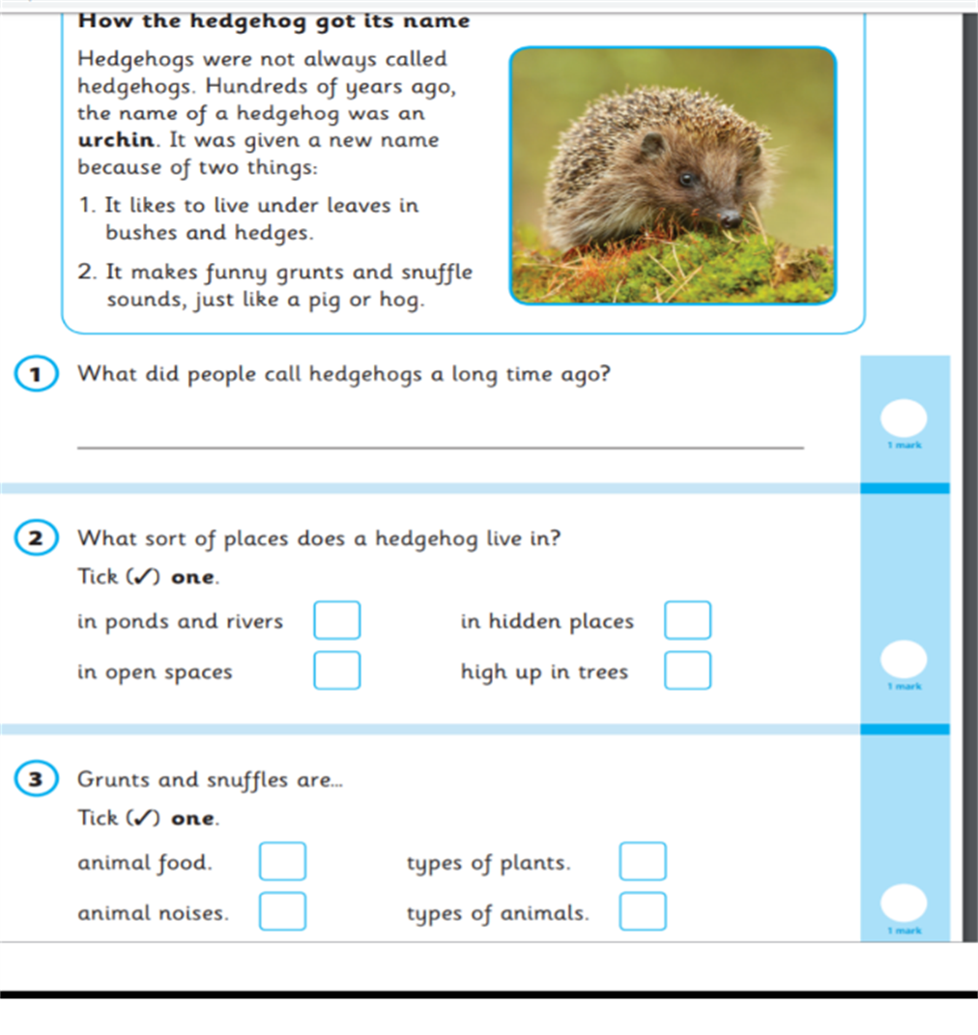
Reading
The Reading Test consists of two separate papers:
Paper 1 – consists of a combined reading prompt and answer booklet. The paper includes a list of useful words and some practice questions for teachers to use to introduce the contexts and question types to pupils. The test takes approximately 30 minutes to complete, but is not strictly timed. This test is worth 20 marks.

Slide 9
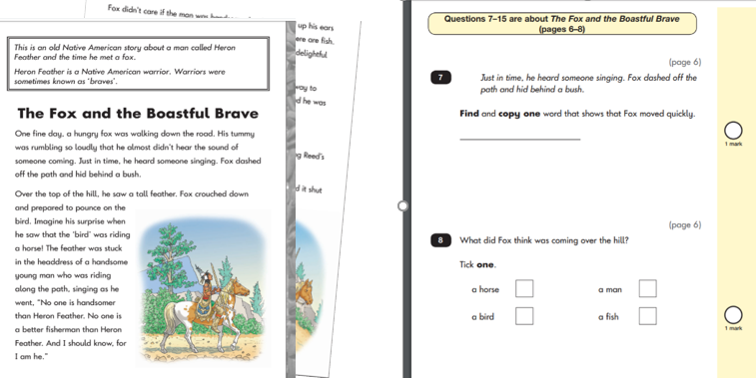
Reading
Paper 2 – consists of an answer booklet and a separate reading booklet. There are no practice questions on this paper. Teachers can use their discretion to stop the test early if a pupil is struggling. The test takes approximately 40 minutes to complete, but is not strictly timed. This test is worth 20 marks.
The texts will cover a range of poetry, fiction and non-fiction.

Slide 10
Sequencing question

Slide 11
matching question short answer

Slide 12
Find and copy one word
Explain why with reference to the text

Slide 13
Which tests will the children take?
Grammar, Punctuation and Spelling (non statutory)
Paper 1 – a 20 word spelling test lasting approximately 15 minutes
Paper 2 – a grammar, punctuation and vocabulary test in two sections which will take about 20 minutes

Slide 14
Grammar questions

Slide 15
Circling question – notice that two nouns need to be circled in order to be awarded the mark.

Slide 16
Tick question

Slide 17
Spelling
Within the assessment, the spelling words are read out to the children to fill into the gaps within the sentences. In this example, the missing spelling words are: pack, sky, shell and baby.

Slide 18
Which tests will the children take?
Mathematics
Paper 1 – Arithmetic – this takes about 20 minutes to complete
Paper 2 – Reasoning: a range of mathematical fluency, reasoning and problem solving questions. This takes about 35 minutes
Children cannot use any apparatus such as number lines, hundred squares, etc.

Slide 19
Maths Arithmetic – paper 1

Slide 20
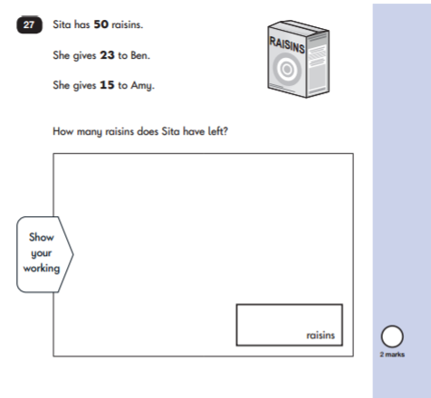
Maths – Reasoning Paper 2

Slide 21
What can you do to help?
First and foremost, support and reassure your child that there is nothing to worry about and that they should always just try their best.
Ensure your child has the best possible attendance at school.
Support your child with any homework tasks.
Make sure your child has a good sleep and healthy breakfast every morning.

Slide 22
What can you do to help your child with reading?
Enjoy stories together – reading stories to your child is equally as important as listening to your child read.
Read a little at a time but often, rather than rarely but for long periods of time!
Talk about the story before, during and afterwards – discuss the plot, the characters, their feelings and actions, how it makes you feel, predict what will happen and encourage your child to have their own opinions.
Ask your child questions and encourage them to find the answers in the text independently.
Discuss new vocabulary and the meaning of words.

Slide 23
What can you do to help your child with writing?
Practise and learn weekly spelling lists.
Encourage opportunities for writing, such as letters to family or friends, shopping lists, notes or reminders, stories or poems.
Remember that good readers become good writers! Identify good writing features when reading (e.g. vocabulary, sentence structure, punctuation).

Slide 24
What can you do to help your child with maths?
Play Maths games – Times Tables Rockstars and Mathletics
Encourage opportunities for telling the time.
Encourage opportunities for counting coins and money e.g. finding amounts or calculating change when shopping.
Look for examples of 2D and 3D shapes around the home.
Identify, weigh or measure quantities and amounts in the kitchen or in recipes.

Slide 25
Any Questions?

