Slide 1
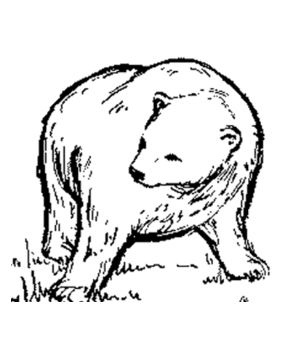
Dialogue Punctuation Stories by Rudyard Kipling
Why did thou not warn the Man-cub of the Bandar-log? Make a plan. This is no time for chasing.
The Bandar-log fear Kaa the rock snake. He can climb as well as they can. He steals young monkeys in the night.

Slide 2
Direct Speech What rules do we know about…?
Inverted commas
Capital letters
Commas
Starting a new line
Interruptions
Questions & Exclamations

Slide 3
Direct Speech
Inverted commas'hug' the spoken words
What will he do for us? He is not of our tribe, being footless and with most evil eyes.
"What will he do for us? He is not of our tribe, being footless and with most evil eyes," said Bagheera.

Slide 4
Direct Speech
Inverted commas'hug' the spoken words
What will he do for us? He is not of our tribe, being footless and with most evil eyes.
"What will he do for us? He is not of our tribe, being footless and with most evil eyes," said Bagheera.

Slide 5
Direct Speech
Inverted commas'hug' the spoken words
What will he do for us? He is not of our tribe, being footless and with most evil eyes.
"What will he do for us? He is not of our tribe, being footless and with most evil eyes," said Bagheera.

Slide 6
Direct Speech
A comma usually separates the direct speech from the reporting clause
"He has not eaten," said Baloo, with a grunt of relief.

Slide 7
Direct Speech
A comma usually separates the direct speech from the reporting clause
"He has not eaten," said Baloo, with a grunt of relief.

Slide 8
Direct Speech
A comma usually separates the direct speech from the reporting clause
"He has not eaten," said Baloo, with a grunt of relief.
"We are hunting," said Baloo carelessly.
Kaa said, "Give me permission to come with you."

Slide 9
Direct Speech
A comma usually separates the direct speech from the reporting clause
Unless the speech ends in
! or ?
"Good hunting!" cried Baloo, sitting up on his haunches.
"Oho, Baloo, what dost thou do here? " said Kaa.

Slide 10
Direct Speech
Speech begins with a capital letter, unless the sentence is interrupted by a reporting clause.
“I am,” said Kaa with a little pride, “a fair length - a fair length.”
“I came very near to falling on my last hunt,” said Kaa, “ and the noise of my slipping waked the Bandar-log, and they called me most evil names."

Slide 11
Direct Speech
Each change of speaker starts a new line
"What will he do for us? He is not of our tribe, being footless and with most evil eyes," said Bagheera. "He is very old and very cunning. Above all, he is always hungry," said Baloo hopefully. "Promise him many goats." "He sleeps for a full month after he has once eaten. He may be asleep now, and even were he awake, what if he would rather kill his own goats?" Bagheera, who did not know much about Kaa, was naturally suspicious. "Then in that case, thou and I together, old hunter, might make him see reason." Here Baloo rubbed his faded brown shoulder against the Panther, and they went off to look for Kaa the Rock Python.
It’s hard to see who is speaking when the dialogue is squashed together.

Slide 12
Direct Speech
Each change of speaker starts a new line
"What will he do for us? He is not of our tribe, being footless and with most evil eyes," said Bagheera. "He is very old and very cunning. Above all, he is always hungry," said Baloo hopefully. "Promise him many goats." "He sleeps for a full month after he has once eaten. He may be asleep now, and even were he awake, what if he would rather kill his own goats?" Bagheera, who did not know much about Kaa, was naturally suspicious. "Then in that case, thou and I together, old hunter, might make him see reason." Here Baloo rubbed his faded brown shoulder against the Panther, and they went off to look for Kaa the Rock Python.

Slide 13
Direct Speech
Each change of speaker starts a new line
"What will he do for us? He is not of our tribe, being footless and with most evil eyes," said Bagheera. "He is very old and very cunning. Above all, he is always hungry," said Baloo hopefully. "Promise him many goats." "He sleeps for a full month after he has once eaten. He may be asleep now, and even were he awake, what if he would rather kill his own goats?" Bagheera, who did not know much about Kaa, was naturally suspicious. "Then in that case, thou and I together, old hunter, might make him see reason." Here Baloo rubbed his faded brown shoulder against the Panther, and they went off to look for Kaa the Rock Python.

Slide 14
Direct Speech
Each change of speaker starts a new line
"What will he do for us? He is not of our tribe, being footless and with most evil eyes," said Bagheera. "He is very old and very cunning. Above all, he is always hungry," said Baloo hopefully. "Promise him many goats." "He sleeps for a full month after he has once eaten. He may be asleep now, and even were he awake, what if he would rather kill his own goats?" Bagheera, who did not know much about Kaa, was naturally suspicious. "Then in that case, thou and I together, old hunter, might make him see reason." Here Baloo rubbed his faded brown shoulder against the Panther, and they went off to look for Kaa the Rock Python.

Slide 15
Direct Speech
Each change of speaker starts a new line
"What will he do for us? He is not of our tribe, being footless and with most evil eyes," said Bagheera. "He is very old and very cunning. Above all, he is always hungry," said Baloo hopefully. "Promise him many goats." "He sleeps for a full month after he has once eaten. He may be asleep now, and even were he awake, what if he would rather kill his own goats?" Bagheera, who did not know much about Kaa, was naturally suspicious. "Then in that case, thou and I together, old hunter, might make him see reason." Here Baloo rubbed his faded brown shoulder against the Panther, and they went off to look for Kaa the Rock Python.

Slide 16
Direct Speech
Each change of speaker starts a new line
"What will he do for us? He is not of our tribe, being footless and with most evil eyes," said Bagheera.
"He is very old and very cunning. Above all, he is always hungry," said Baloo hopefully. "Promise him many goats." "He sleeps for a full month after he has once eaten. He may be asleep now, and even were he awake, what if he would rather kill his own goats?" Bagheera, who did not know much about Kaa, was naturally suspicious. "Then in that case, thou and I together, old hunter, might make him see reason." Here Baloo rubbed his faded brown shoulder against the Panther, and they went off to look for Kaa the Rock Python.

Slide 17
Direct Speech
Each change of speaker starts a new line
"What will he do for us? He is not of our tribe, being footless and with most evil eyes," said Bagheera.
"He is very old and very cunning. Above all, he is always hungry," said Baloo hopefully. "Promise him many goats."
"He sleeps for a full month after he has once eaten. He may be asleep now, and even were he awake, what if he would rather kill his own goats?" Bagheera, who did not know much about Kaa, was naturally suspicious. "Then in that case, thou and I together, old hunter, might make him see reason." Here Baloo rubbed his faded brown shoulder against the Panther, and they went off to look for Kaa the Rock Python.

Slide 18
Direct Speech
Each change of speaker starts a new line
"What will he do for us? He is not of our tribe, being footless and with most evil eyes," said Bagheera.
"He is very old and very cunning. Above all, he is always hungry," said Baloo hopefully. "Promise him many goats."
"He sleeps for a full month after he has once eaten. He may be asleep now, and even were he awake, what if he would rather kill his own goats?" Bagheera, who did not know much about Kaa, was naturally suspicious.
"Then in that case, thou and I together, old hunter, might make him see reason." Here Baloo rubbed his faded brown shoulder against the Panther, and they went off to look for Kaa the Rock Python.
Much clearer

Slide 19
Direct Speech Summary of Rules
Inverted commas'hug' the spoken words
A comma usually separates the direct speech from the reporting clause
Direct speech begins with a capital letter, unless the sentence is interrupted by a reporting clause.
Each new speaker starts on a new line
Unless the speech ends in
! or ?

Slide 20
Over to you

Slide 21
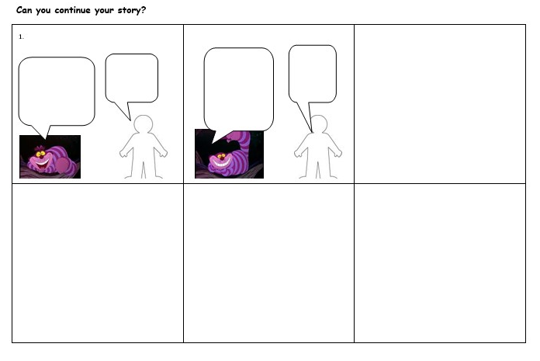

Slide 22
