Slide 1
Parent Information Year 1
Tuesday 25th April 2023

Slide 2
When will it take place?
The screening will take place at the beginning of June.
It will be done over the course of the school day.

Slide 3
What happens during the screening?
The test contains 40 words.
Each child will complete the test with Mrs Barker.
It will take between 5 and 10 minutes to complete.
The list of words the children read is a combination of 20 real words and 20 pseudo words (nonsense words).

Slide 4
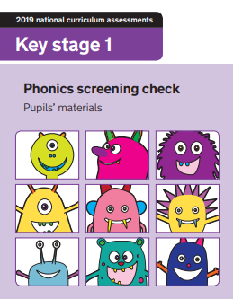
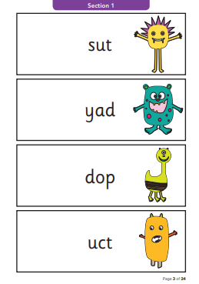
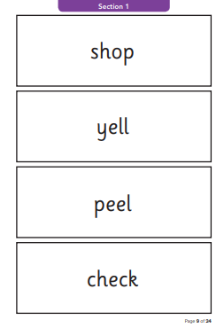

Slide 5
Pseudo words (nonsense words)
These words will be shown to your child with a picture of an alien.
Nonsense words are included because they are new to all the children; they do not favour children with a good vocabulary knowledge or visual memory of words.

Slide 6
Reporting to parents
When you receive your child’s report in July it will have a section that will say if they met the standard.
Children who do not achieve the expected level will retake the test when they are in Year 2.

Slide 7
How can you help your child?
Make it fun!
Play lots of sound and listening games.
Read as much as possible.
Discuss the meaning of the words if your child does not know what they have read.
Look at past papers. Type phonic check into a search engine.

Slide 8
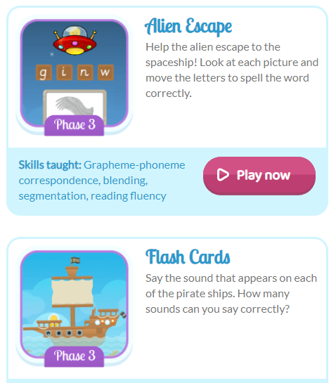
Phonics Bloom
https://www.phonicsbloom.com/

Slide 9
https://www.youtube.com/watch?v=LbKGLJPp6ww

Slide 10
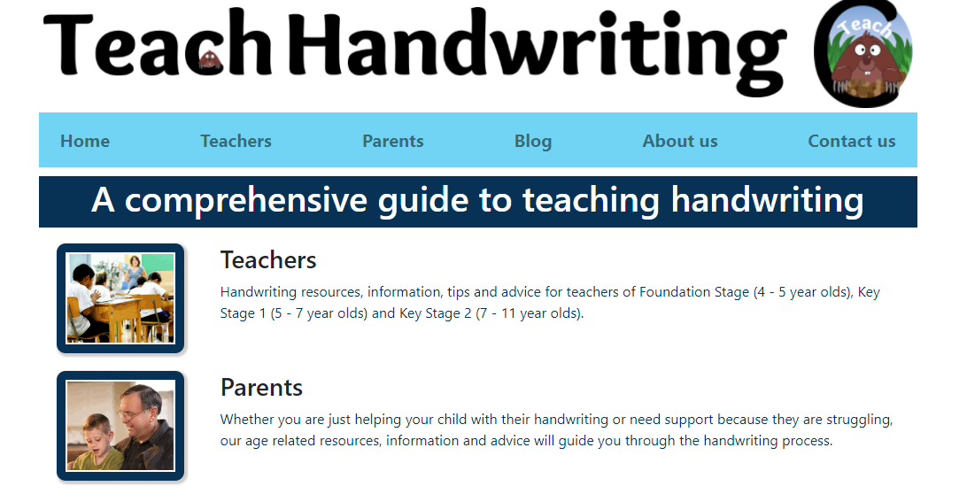
Handwriting
https://teachhandwriting.co.uk/continuous-cursive-beginners-choice-3.html

Slide 11
Teach handwriting website
Click teachers
Click KS1
Click Handwriting animations and worksheets
Click Route B
Click Choice 3
Click continuous cursive beginners

Slide 12
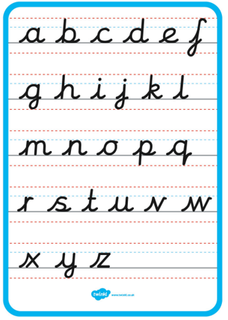

Slide 13
Reading journals

