Slide 1
Welcome to Nursery
2023

Slide 2
Inclusion at Wibsey
Special Educational Needs
SEND register
External Agencies
Support for families and children
Named persons in school for Safeguarding
Work with Early help and social services/other professionals
Pastoral staff
Any concerns please see the class teacher who will then direct to the appropriate staff member in school.

Slide 3
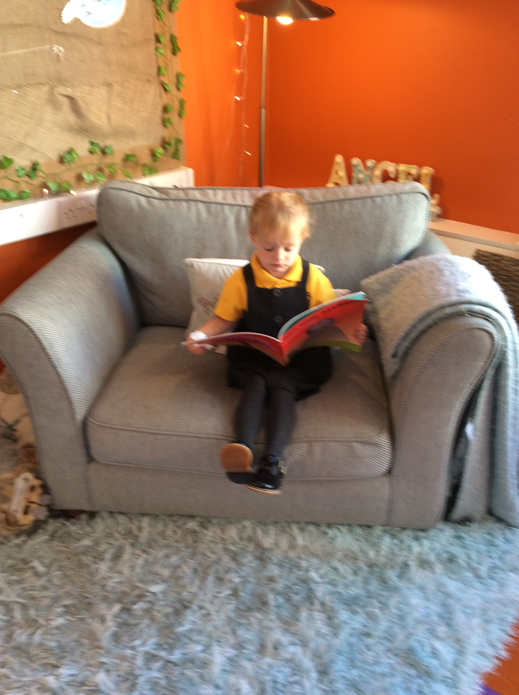

Slide 4
Induction
Dates and times for induction an be found in your packs.
We have invited you to visit over the next two weeks and hope the children will stay for an hour on their own on their second visit.
In September, children will be admitted in small groups over the first two weeks and then will all attend full time (am/pm/ad)

Slide 5
Arrival & Departure
Morning session
Doors open at 8:40am until 8:50am
Session ends at 11:40 – children collected 11.30-11.40
Afternoon session
Doors open at 12:40pm until 12:50pm
Session ends at 3:30pm- children collected 3.30-3.40
Please let a member of staff know if someone else will be collecting your child.
Please be punctual as children can become upset and worried.

Slide 6
Structure of the day
Children self- register in the morning.
Choice of indoor activities until everyone has arrived and are settled.
Whole class meeting – calendar, register, group activity (ie: phonics, mark making, mathematics, speaking and listening).
Indoors/conservatory free flow
Snack is on offer throughout the session – children will access this independently
Outdoors/indoors free flow
Small group activities with an adult –speaking and listening, maths, early phonics
Tidying up
Fab five story time

Slide 7
Clothing- label, label, label!

Slide 8
Preparing your child for Nursery
If your child is starting in Nursery there are ways that you can prepare them and yourself for this time of change.
Throughout the summer holidays there are small steps you can take to make sure the transition happens in a smooth and relaxed manner.
Here are our top tips for being Nursery ready!
Discuss how you will take your child into Nursery each day and be clear about when and how you will say goodbye. This is usually the most difficult part - for parents! A positive and confident hand over is key to leaving a child happy and engaged from the very start.
Encourage your child to practise putting on their own coat and taking it off again! This will help them to get out to play quicker if they don’t have to wait for the teacher for help.

Slide 9
How to prepare for Nursery
To recognise their own name and to be able to tell an adult their name.
Make sure your child has been left with a relative/friend/playgroup so they are used to you leaving and coming back.
Encourage your child to share and take turns with others.
Ensure your child can feed themselves and drink from a cup.
Share stories, books and rhymes – this is essential for developing language and understanding.
Encourage your child to be independent at the toilet and to know how to wipe their own bottom properly and to wash their hands once their have finished.

Slide 10
Preparing your child
Please do feel you can phone the school office during the day if you are concerned about your child and how they have settled in a morning – of course, the chances are that if they have been upset at your leaving, by the time you have reached the school gate they are laughing with their teachers and friends!
Remember- no questions are silly questions and we would always encourage you to ask us if you are unsure of anything.
Please contact us if you have questions as you prepare for the start of term. We are teachers - and parents - and know all too well the anxieties that go hand in hand with wanting to do our best by our children. We are here to support you and your child in this time of new beginnings and look forward to the partnership we share in what will be one of the most exciting years of development in your child’s life.

Slide 11
Information can be found on our school website under Transition September 2023.

