Slide 1
Welcome to Reception.
2023

Slide 2
Inclusion at Wibsey
Special Educational Needs
SEND register
External Agencies
Free School Meals / Pupil Premium
Free School Meals - apply at https://www.bradford.gov.uk/benefits/applying-for-benefits/free-school-meals/ instant response
Pupil Premium – school uniform voucher, used in school for staffing, support and residentials
Support for families and children
Named persons in school for Safeguarding
Work with Early help and social services/other professionals
Pastoral staff
Any concerns please see the class teacher who will then direct to the appropriate staff member in school.

Slide 3
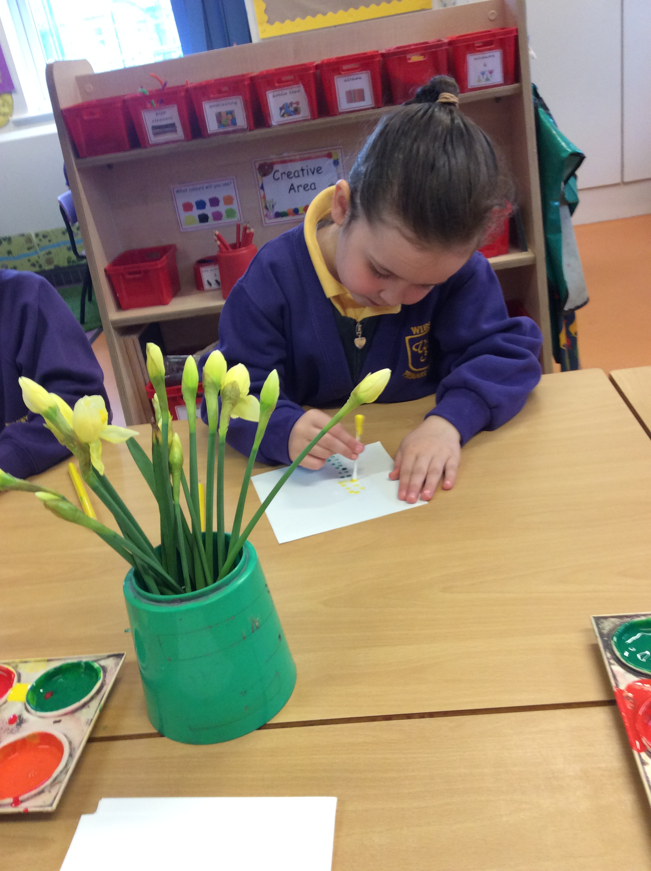

Slide 4
Induction
Monday 4th until Thursday 7th September children will come for half days.
From Friday 8th children will be fulltime.

Slide 5
Arrival & Departure
Doors open at 8:45am until 8:55am
Home time is 3:30pm
Reception 1 parents/carers come to Nursery Playground.
Reception 2 & 3 exit via the main doors.

Slide 6
Structure of the day
Children self register in the morning.
Whole class inputs
Group work
Areas opened – Outdoors and indoors
Phonics
Lunch
Story time/ singing

Slide 7
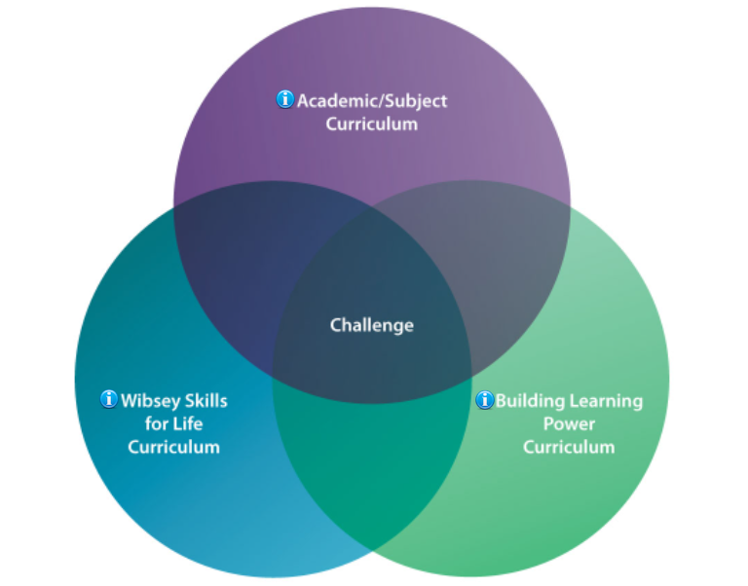
Our curriculum
At Wibsey we combine three curriculums together.
WSFL provides children with the skills for life such as recognising our self worth, finances, nurturing and valuing different friendships.
Building Learning Power develops learning muscles such as collaboration, noticing and resilience to overcome challenges.
These run alongside our curriculum which has been shaped for our children and meets the needs of the community. As part of this we build upon life experiences alongside academics to give each child the very best opportunities.

Slide 8
Our Curriculum
Physical Development is crucial in the Foundation Stage and much was lost during the pandemic. In Wibsey we foster this by using our outdoor spaces, having a PE specialist and children taking part in various activities such as Doh Disco.
We develop PSED by teaching WSFL and through developing BLP.
As teachers we are here to develop children as learners and subjects such as Maths and English are taught through the delivery of focused sessions e.g. phonics but then also planned activities in the provision.

Slide 9
Clothing- label, label, label!

Slide 10
Preparing your child for Reception
If your child is starting in Reception there are ways that you can prepare them and yourself for this time of change.
Throughout the summer holidays there are small steps you can take to make sure the transition happens in a smooth and relaxed manner.
Here are our top tips for being Reception ready!
Encourage your child to practise putting on their new school uniform- and taking it off again! This will help them to establish an order to getting dressed and become quicker at doing up buttons, zips and velcro. Being able to zip up their own coat is also a bonus- and will help your child to get out to play quicker if they don’t have to wait for the teacher to help them!
Discuss how you will take your child into school in the morning and be clear about when and how you will say goodbye. This is usually the most difficult part - for parents! A positive and confident hand over is key to leaving a child happy and engaged from the very start.

Slide 11
How to prepare for Reception
To recognise their own name.
Encourage your child to write their name.
Play simple phonic and number games.
Share stories, books and rhymes.
Encourage them to be independent at the toilet and to know how to wipe their own bottom properly and to wash their hands once their have finished.
Encourage them to practise using a knife and fork during meal times.

Slide 12
Preparing your child
Please do feel you can phone the school office or send APP message during the day if you are concerned about your child and how they have settled in a morning – of course, the chances are that if they have been upset at your leaving, by the time you have reached the school gate they are laughing with their teachers and friends!
Remember- no questions are silly questions and we would always encourage you to ask us if you are unsure of anything.
Please contact us if you have questions as you prepare for the start of term. We are teachers - and parents - and know all too well the anxieties that go hand in hand with wanting to do our best by our children. We are here to support you and your child in this time of new beginnings and look forward to the partnership we share in what will be one of the most exciting years of development in your child’s life.

Slide 13
Information can be found on our school website under Transition September 2023.

