Slide 1

Welcome to Year 1
Friday 13th October 2023

Slide 2
A day in Year 1
Morning
  Daily maths, English, phonics
  Snack
  Assembly
  Playtime
  Afternoon
    Lunch and playtime
    Foundation subjects
    Story time

Slide 3
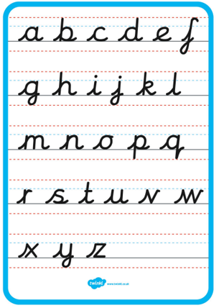
Handwriting

Slide 4
Phonics
Year 1 phonics screening in June
Daily small group phonics sessions
Half-termly assessments
Useful websites: Phonics Bloom games
Reading at home helps!

Slide 5
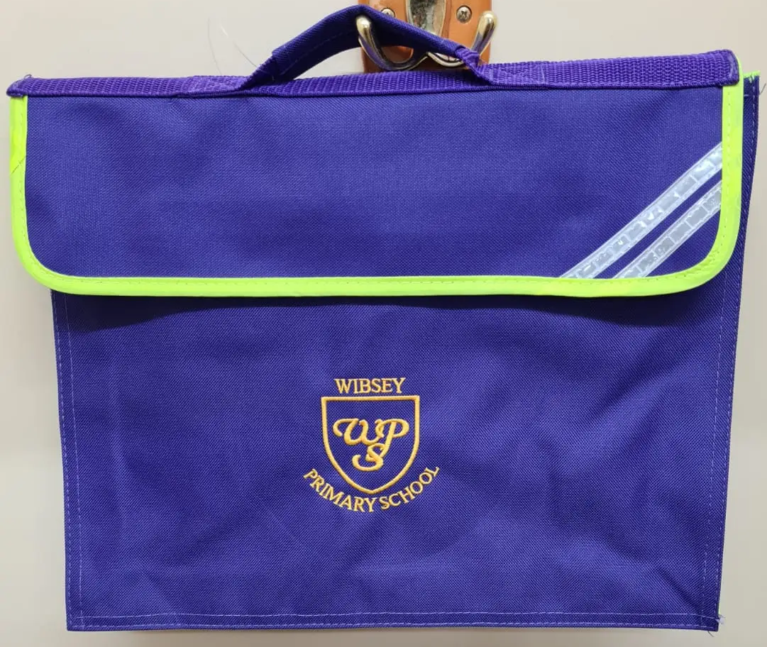
Book bags
To be brought in every day
School book bags
Book linked to phonics group
Reading for pleasure book
Spelling book, linked to phonics group
Reading journal

Slide 6
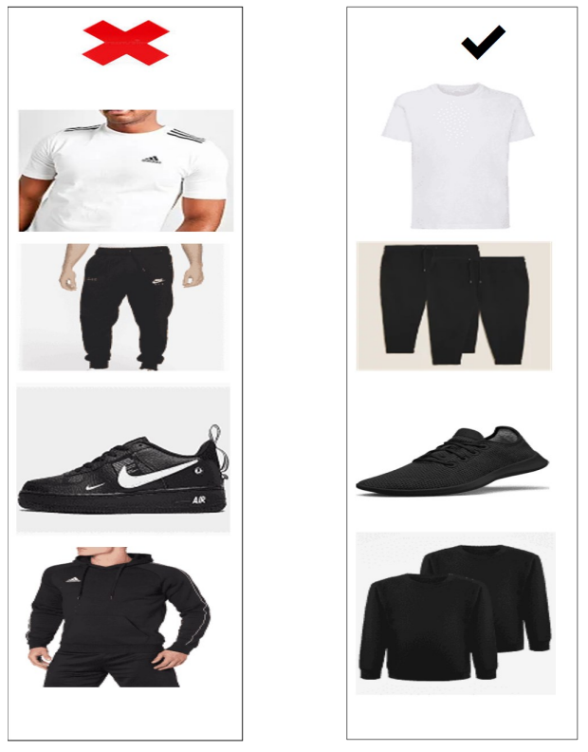
PE
1.1 and 1.2 every Tuesday
1.3 every Friday
All classes have additional days on a Monday. See the school website for your child’s dates.
Kit
  Come to school in PE kits
  Named clothing
  Plain black shorts or jogging bottoms, plain white T shirt, plain black jumper or hoody.

Slide 7
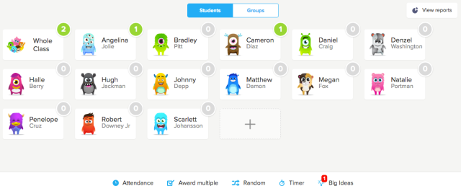
Class Dojo

Slide 8


Maths Seeds and Purple Mash
Log in details stuck onto your child’s reading journal
Maths Seeds
  Games to be accessed from home, only for Year 1
  Set to your child’s level
  As your child progresses, they will reach new maps and achieve certificates
Purple Mash
  Used for computing in school
  Can be used for your child to explore
  Homework occasionally

