Slide 1
Ingleborough Hall Parent Information Meeting
Thursday 2nd November 2023
HP

Slide 2
Why is a residential important?
HP
Opportunity for your child to stay away from home in a well-structured environment with friends and school staff – for many, this is their first experience of being away from home for a few days.
Opportunity to try a range of new and exciting activities with outdoor qualified professionals.
Chance to visit the Yorkshire Dales – a contrasting area to Wibsey (National Curriculum Geography). Work in class will be looking at different types of settlements.

Slide 3
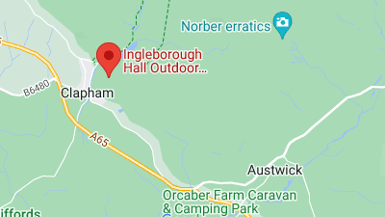
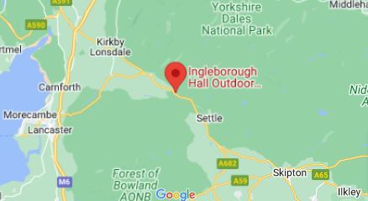
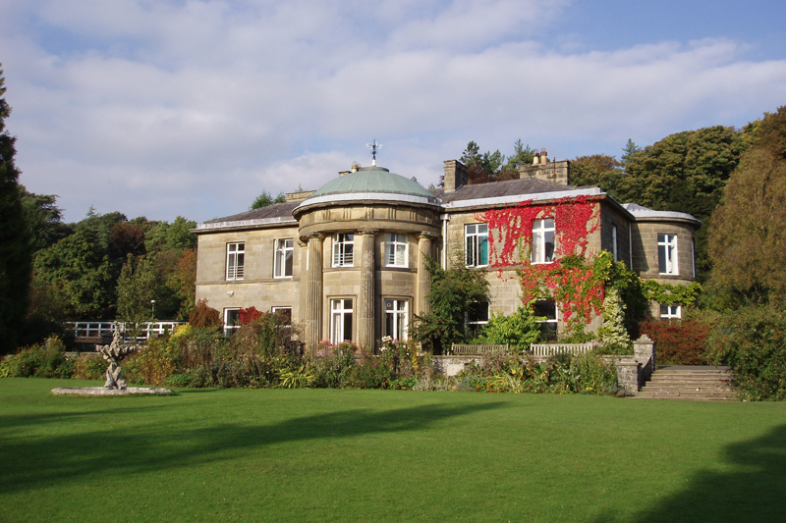
Where is Ingleborough Hall?
Ingleborough Hall Outdoor Education Centre is owned by Bradford Council.
It is in the Yorkshire Dales village of Clapham.
HP

Slide 4
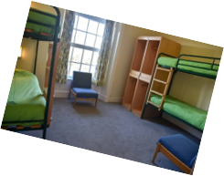
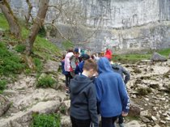
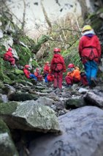
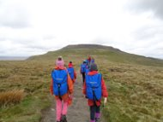
106 bedrooms (some ensuite) – we take 60 children.
3 dining rooms
Supper bar
Classrooms
Boot room
Extensive garden
HP

Slide 5
HP
When is the Ingleborough Hall residential?
Monday March 18th to Wednesday March 20th
9:00am departure – home by the end of the school day.
Return travel by coach
Two nights accommodation
All activities
All food
Use of hiking boats and waterproofs throughout the visit
Which staff will be going?
SMLT Lead – Mrs Bilevych
Deputy Lead – Mr Quinn
Not all Year 5 staff will attend the residential but all will visit their children for the day.
Other staff will be from across school – all will be known to the children.
There will be staff first aiders – and also at the centre.

Slide 6
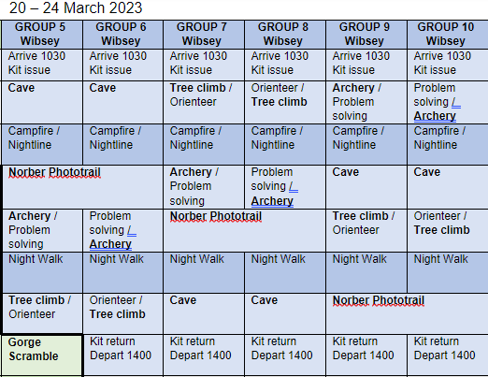
What will my child be doing?
- Archery
Tree climbing
Orienteering
Hiking
Caving
All activities will be done alongside professionals from Ingleborough Hall. All their staff are qualified outdoor activity instructors.
Children will be in different groups with different adults. They activities will alternate according to their group.
JQ

Slide 7
What about the practicalities?
Children will be put in dormitories in groups. Girls and boys dormitories are separate. Boys dorms are located next to the male staff and girls next to the female staff.
Bedding is provided but the children will be asked to make their bed on the first day (with support!)
Most dorms have a toilet/shower inside, if it does not there are shower and toilet cubicles in the next room. All boys and girls bathrooms are separate.
Children should shower daily either in the afternoon/evening after their activities or in the morning before breakfast.
- Breakfast: toast, cereal and cooked breakfast option of toast, beans, eggs and hash browns. (Breakfast at 8am)
- Packed lunch each day: sandwich (egg, tuna, cheese), packet of crisps, piece of fruit, piece of cake, chocolate bar.
- Dinner: 2 choices of hot meal. All halal. With dessert.
- Supper: hot chocolate and biscuit in the evening.
Juice and water available at all times. Water bottles provided.
All dietary needs catered for.
JQ

Slide 8
What about my child’s additional needs?
Ingleborough Hall is an inclusive education centre and is open to all our year 5 children.
We have booked for 60 children and usually take 60
Children will be placed in separate day and night groups – these groups are created by year 5 class teachers. All children will have one friend in their day group and night group (this may not be the same friend). This residential is a great opportunity to make new friends.
A comprehensive risk assessment covers the
visit – this is submitted to David Maw (Bradford
Authority Educational Visits Lead) who reads
and signs off the risk assessment.
- Medical Needs: first aiders will be attending the visit and will administer any medication needed by your child. Further details will be given at the parental meeting nearer the time.
- Dietary Needs: all dietary needs are catered for, including halal.
- Special Educational Needs: an individualised risk assessment will be produced for your child – you will be asked for your input and to sign it.
- Night fears: Wibsey staff patrol the dormitory areas until all children are asleep. A member of staff is up very early for early risers.
JQ

Slide 9
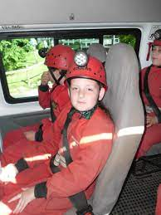
Do I need to provide anything?
Outdoor
Socks – thick ones
Trousers – thick close woven – not jeans
Headwear – woolly hat
Gloves
Jumpers
Indoor
Shoes – indoor footwear
Nightclothes
Toiletries
Ingleborough Hall will provide:
Boots
Cagoule
Over-trousers
Rucsac
Any specialist equipment
A parents meeting will be held nearer the time when you will receive a full kit list.
HA

Slide 10
How much will this cost?
HA
The approximate cost is £150 per child
This cost will cover absolutely everything during the visit: staffing, supervision, board and lodgings and specialist instructors, as well as the large number of organised activities which the children will be participating in.
If you are registered for and entitled to free school meals, there may be provision for a reduced rate. Mrs Mitchell will contact you directly if you are eligible.
To keep costs down school pays for the transport – this is in the region of £700
We appreciate and understand that it is quite an amount to find, which is why we start the process early in the academic year so that you will be able to pay in instalments via Parent Pay.
What next?
The permission letter will be put on the APP by the end of the week.
If you wish for your child to take part in the visit to Ingleborough, please complete the permission slip and return it to the school office as soon as possible.
A non-refundable deposit of £25.00 must be paid by Friday 8th December 2023.
The balance, which may be paid by instalments through ParentPay, should be paid by March 1st 2024.
This letter will also be on the school website for your future reference.

Slide 11
Any Questions?
HA

