Slide 1
Year 4 Times Tables Check
Parent Workshop – Tuesday 10th October

Slide 2
Aims of this workshop
To achieve a stronger understanding of what the Multiplication Tables Check (MTC) is and what the expectations are
To understand how , when and why the Multiplication Tables Check (MTC) will be administered
To achieve a stronger understanding of how times tables is taught in Year 4
To be provide you with a range of strategies and websites you can use with your child at home

Slide 3
Under the current National Curriculum, children are expected to know their times tables by the end of Year 4, and in preparation for the MTC. They are expected to know these up to 12 x 12. The MTC covers all tables to 12 x 12 in a mixed order. This is immediate recall of multiplication facts.
What are the times tables expectations now that the Multiplication Tables Check (MTC) has been introduced?

Slide 4
- Children with special educational needs will be provided for when taking the MTC. Some examples include colour contrast, font size and a NEXT button. These will only be used if it is usual classroom practice for the child. Extra time cannot be given as it is a fluency check.
What if my child has a statement of special educational needs?

Slide 5
All Year 4 children will have their multiplication skills formally checked in the Summer Term of this academic year 2023-2024 Schools will have a 3 week window to administer the MTC. Attendance across the 3 weeks is vital. Teachers will have the flexibility to administer the check and we deliver the MTC as fits the needs of our children. Therefore this can be to individual pupils, small groups or a whole class at the same time.
When will the Multiplication Tables Check be administered?

Slide 6
School-level results and individual pupil results will be made available to schools. This will allow schools to provide additional support to pupils who require it. You will be given a letter with your child’s individual result. It will give a score out of 25 and there is no pass mark. The expectation is 25 Children need a secure times table knowledge to prepare for the Year 5 and 6 curriculum and for the 6 SATS where speedy accurate mental agility is vital.
How will the MTC data be used now that the check is compulsory?

Slide 7
Children will be checked using an on-screen check (on a computer or a tablet), where they will have to answer multiplication questions against the clock. Calculators and wall displays that could provide children with answers will be removed from the room the MTC is taking place in. The check will last no longer than 5 minutes and is similar to other checks already used by primary schools. It will be automatically scored, and results will be available to schools some time after the assessment period.
How will the Multiplication Tables Check be administered?

Slide 8
Children will have 6 seconds to answer each question in a series of 25 questions. Questions will be selected from the 121 number facts that make up the multiplication tables from 2 to 12, with a particular focus on the 6, 7, 8, 9 and 12 times tables as they are considered to be the most challenging. This allows pupils the time required to demonstrate their recall of multiplication tables, whilst limiting pupils’ ability to work out answers to the questions. Each question will be worth one mark and be presented to the child in this format: _ x _ = ____
How will the Multiplication Tables Check be administered? (continued...)

Slide 9
How is the school preparing pupils for the MTC?
How is multiplication taught in Year 4?
Using knowledge of key table facts (e.g. doubling, compensating)
Multiplication games
Use of manipulatives
Times Table Rockstars worksheets (daily)
TTRS Soundcheck in ICT lessons

Slide 10
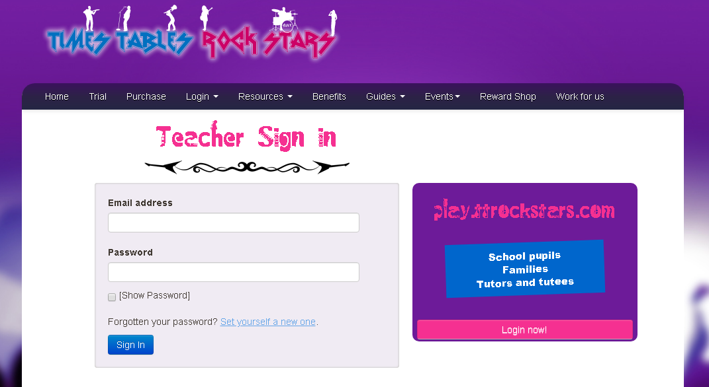
TIMES TABLES ROCKSTARS https://ttrockstars.com/login -At home and in-school learning platform -Get your child to practise daily for 15 minutes - We set this as homework EVERY WEEK Sound check is the same format as the MTC so will be the most helpful for your child to practice!
What else is the school doing to prepare pupils for the MTC?

Slide 11
Times Tables Rock Stars https://ttrockstars.com/login https://www.timestables.co.uk/multiplication-tables-check/
What can you do at home to support your child?

Slide 12
Useful Websites
Maths Games http://www.maths-games.org/times-tables-games.html
Cool Maths https://www.coolmathgames.com/
Ixl https://uk.ixl.com/
Times tables Rock starS https://ttrockstars.com/
Topmarks https://www.topmarks.co.uk/
DfE Video - https://youtu.be/GhAJMJUsAac

Slide 13
Questions?

Slide 14
Thank you very much for taking the time to attend this workshop!
Should there be any further developments in regards to the MTC, we will keep you updated.

