Slide 1
Continuum – Lesson 10
Group 1 | Group 2/3 |  | Group 4

Slide 2
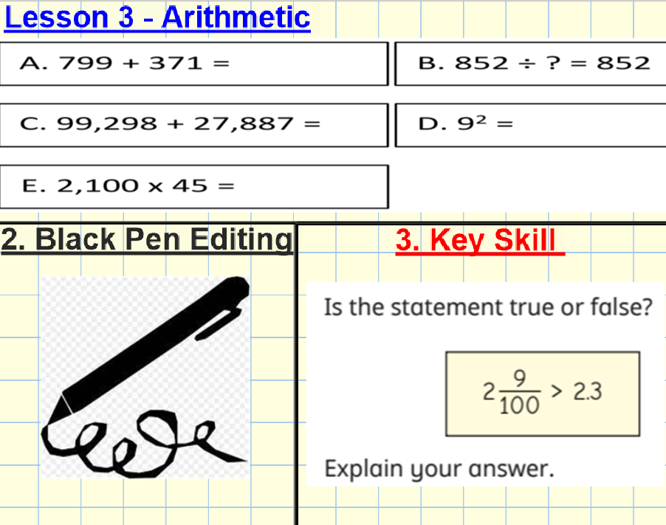

Slide 3
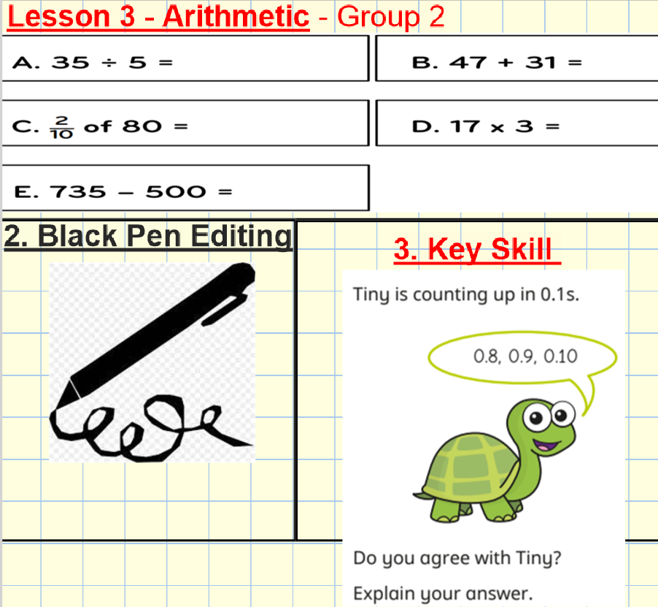

Slide 4
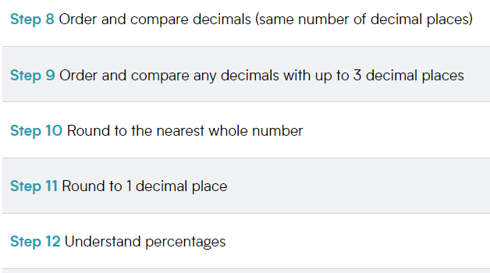

Slide 5
Whole Class Input

Slide 6
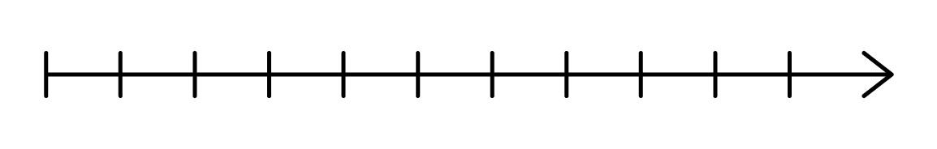
12
13
12.3
12.3
12
12.3 is between ___ and ___
13
12
The nearest whole number to 12.3 is ___
12
12.3 rounded to the nearest whole number is ___

Slide 7
12
13
12.3 is between ___ and ___
12
The nearest whole number to 12.3 is ___
12
12.3 rounded to the nearest whole number is ___
120
123 is between ___ and ___
130
The nearest multiple of 10 to 123 is ___
120
123 rounded to the nearest ten is ___
120
What is the same?
What is different?

Slide 8

7
8
7.9
Have a think
7
7.9 is between ___ and ___
8
The nearest whole number to 7.9 is ___
8
8
7.9 rounded to the nearest whole number is ___

Slide 9


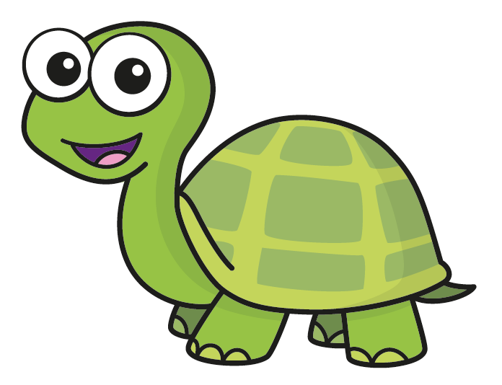
Tiny makes the number 4.3 using place value counters.
I need to add seven tenths to make 5 but I need to subtract three tenths to make 4
so 4.3 is closer to 4
Use Tiny’s method to decide what integer 5.6 is closer to.
5.6 is six tenths away from 5 but four tenths away from 6
Have a think
5.6 is closer to 6

Slide 10
Use your preferred method to round each number
to the nearest whole number.
5.4
3.7
5
5.4
4
5
6
I need to subtract seven tenths to get to 3 but I need to add three tenths to get to 4
3.7 is closer to 4
Have a think

Slide 11
Round 6.9 to the nearest whole number
7
Round 6.97 to the nearest whole number
7
6.97
6
6.9
7
What do you notice about your answers?

Slide 12

Rosie rounds 3.42 to the nearest whole number.
3
3.5
4
3.42
I know 3.42 is smaller than 3.5, so the nearest whole number to 3.42 is 3
Rosie
Why does Rosie’s method work?

Slide 13
Rosie rounds 3.42 to the nearest whole number.
3
3.5
4
3.42
I know 3.42 is smaller than 3.5, so the nearest whole number to 3.42 is 3
Rosie
Why does Rosie’s method work?
Have a think

Slide 14
Round the numbers to the nearest whole number.
3.78
4
23.48
23
5.91
6
Have a think

Slide 15
Miss Rose receives £70.42 for her birthday.
She has £339.63 in her bank account.
Can she afford to purchase a new television which costs £405?
Yes
70
+
340
=
£410

Slide 16
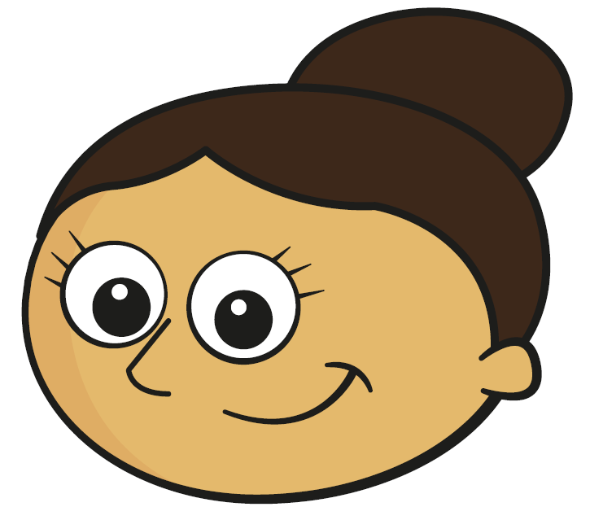
Dora thinks of a decimal number with 1 decimal place.
Rounded to the nearest whole number, my number is 5
Dora
What number could Dora be thinking of?
5.1
Has Tiny found all the possibilities?
5.2
5.3
5.4
Have a think

Slide 17
Dora thinks of a decimal number with 1 decimal place.
Rounded to the nearest whole number, my number is 5
Dora
What is the difference between the greatest and smallest possible numbers?
0.9
4.5
4.6
4.7
4.8
4.9
5
5.1
5.2
5.3
5.4
5.5
5.4 $−$ 4.5 $=$ 0.9
Have a think

Slide 18
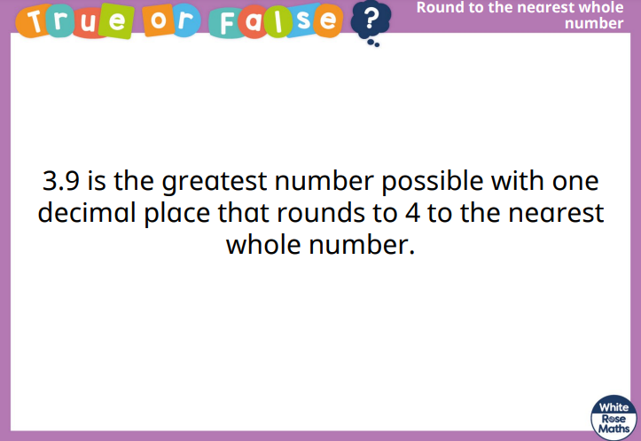

Slide 19
