Slide 1
Welcome to Reception
2024

Slide 2
Inclusion at Wibsey
Special Educational Needs
SEND register
External Agencies
Free School Meals / Pupil Premium
Free School Meals - apply at https://www.bradford.gov.uk/benefits/applying-for-benefits/free-school-meals/ instant response
Pupil Premium – school uniform voucher, used in school for staffing, support and residentials
Support for families and children
Named persons in school for Safeguarding
Work with Early help and social services/other professionals
Pastoral staff
Any concerns please see the class teacher who will then direct to the appropriate staff member in school.

Slide 3
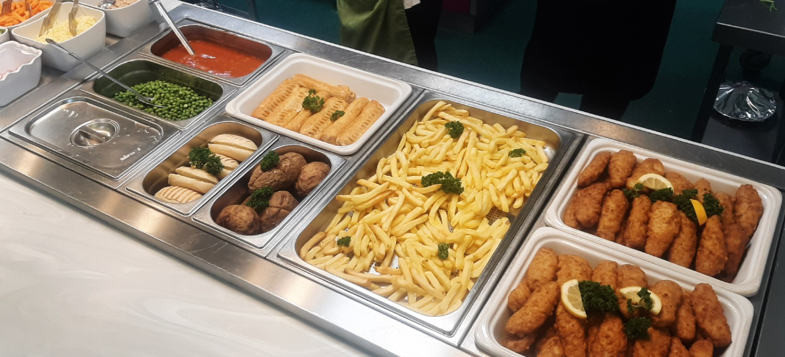
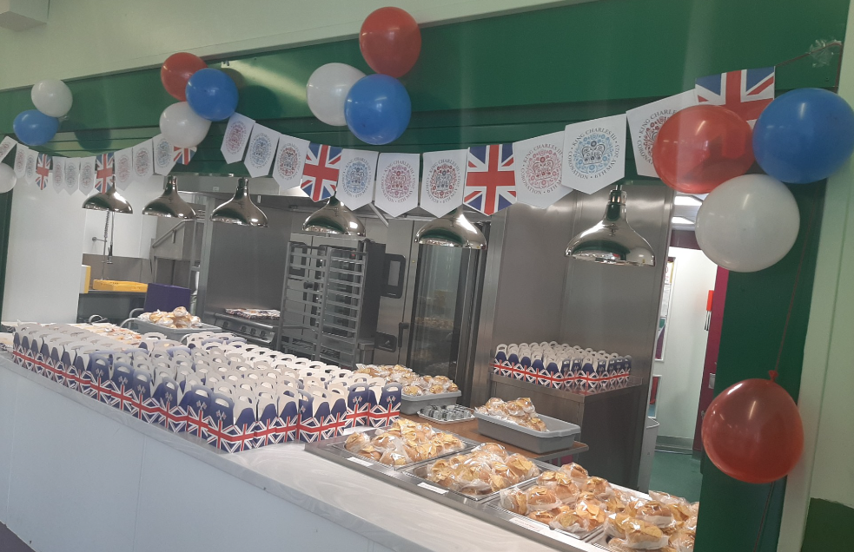
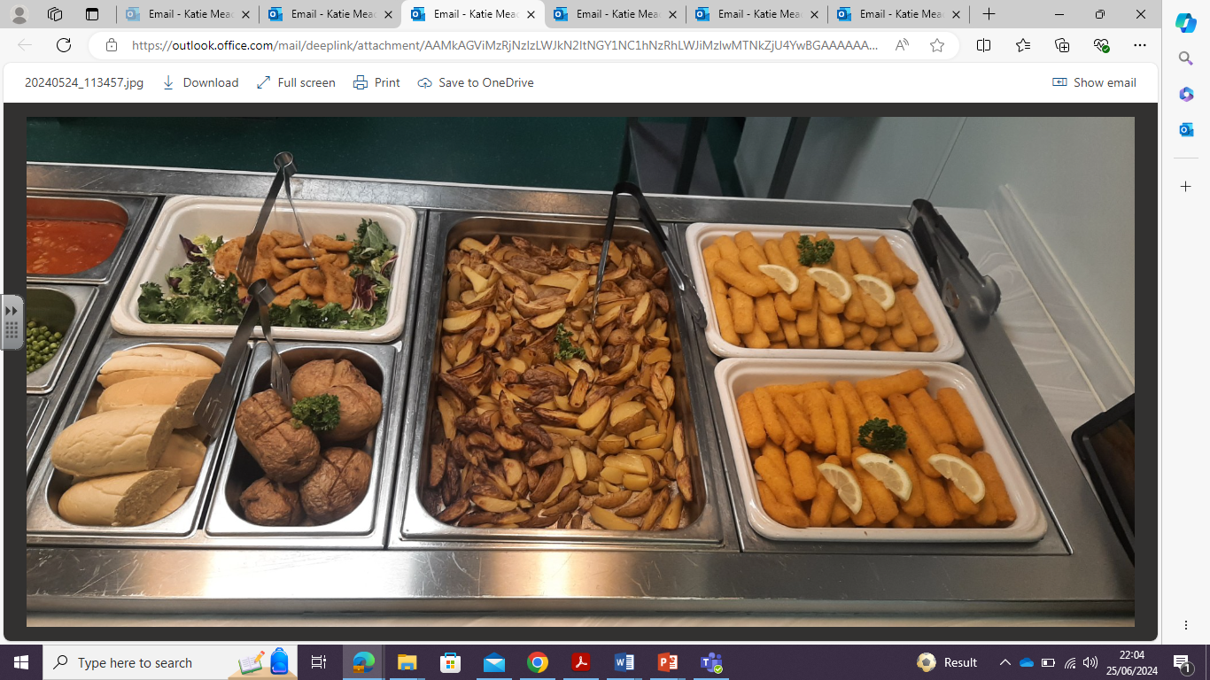
School Lunch

Slide 4
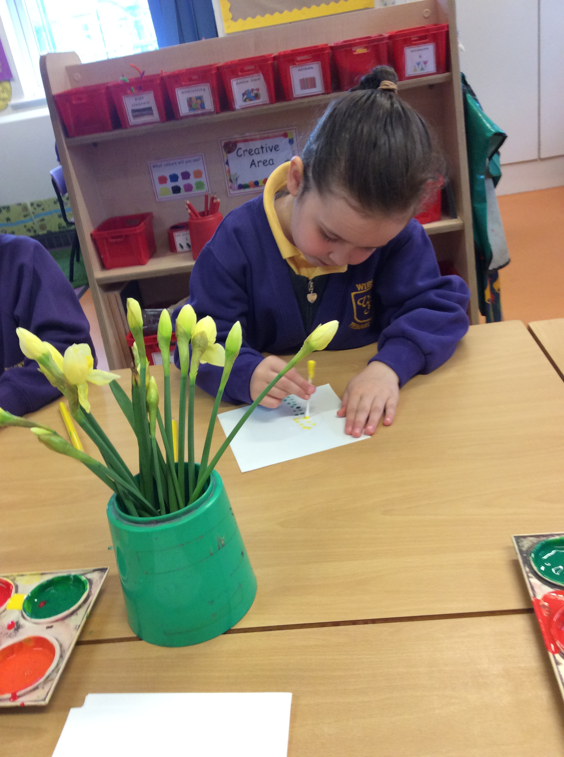

Slide 5
Induction
Dates and times for induction can be found in your packs.
From Monday 2nd until Thursday 5th September children will come for half days.
Friday 6th children will be in all day.
Full time from Friday.

Slide 6
Arrival & Departure
Doors open at 8:45am until 8:55am
Home time is 3:30pm
Reception 1 & 2 enter/exit via the main doors.
Reception 3 enter/exit via the Upper Deck (back playground near Nursery).
Reception 1 & 2 enter/exit via the main doors.

Slide 7
Activities throughout the day
Self registration
Class registration- calendar/weather discussion
Whole class teaching inputs
Group work- mark making/writing, mathematics
Provision areas opened – outdoors and indoors
Phonics
Lunch
Snack time
Tidy up time
Story time/ singing

Slide 8
Clothing- label, label, label!
Information about school uniform can be found in your packs

Slide 9
Preparing your child for Reception
Here are our top tips for being Reception ready!
Encourage your child to practise putting on their new school uniform- and taking it off again!
Discuss how you will take your child into school in the morning and be clear about when and how you will say goodbye.
To recognise their own name.
Encourage your child to write their name.
Play simple phonic and number games.
Share stories, books and rhymes.
Encourage them to be independent at the toilet and to know how to wipe their own bottom properly and to wash their hands once they have finished.
Encourage them to practise using a knife and fork during meal times.

Slide 10
Preparing your child
Please do feel you can phone the school office or send an APP message during the day if you are concerned about your child and how they have settled in a morning.
Remember- no questions are silly questions and we would always encourage you to ask us if you are unsure of anything.

Slide 11
Information can be found on our school website under Transition September 2024.

