Slide 1

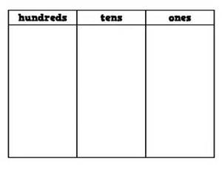
Year 3 – Autumn 1
I know the place value of each digit in a three-digit number
Key Vocabulary
What is the face value of ..?
What is the value of the 3?
How many tens are there in this number?
What is the value of 8 in this number?
Challenge
To recognise that there are 10 tens in one hundred and use this knowledge to explain questions like: How many tens are there in 426? There are 2 tens in the tens column, however there are also 40 tens in the hundred column. Therefore, there is total of 42 tens.
Top Tips
The secret to success is practising little and often. Use time wisely. Can you practise these KIRFs while walking to school or during a car journey? You don’t need to practise them all at once: perhaps you could have a fact of the day. If you would like more ideas, please speak to your child’s teacher.
Use numbers in the environment to challenge your child on the value of each digit.
Play games – There are missing number questions at www.conkermaths.com . See how many questions you can answer in just one minute.

