Slide 1

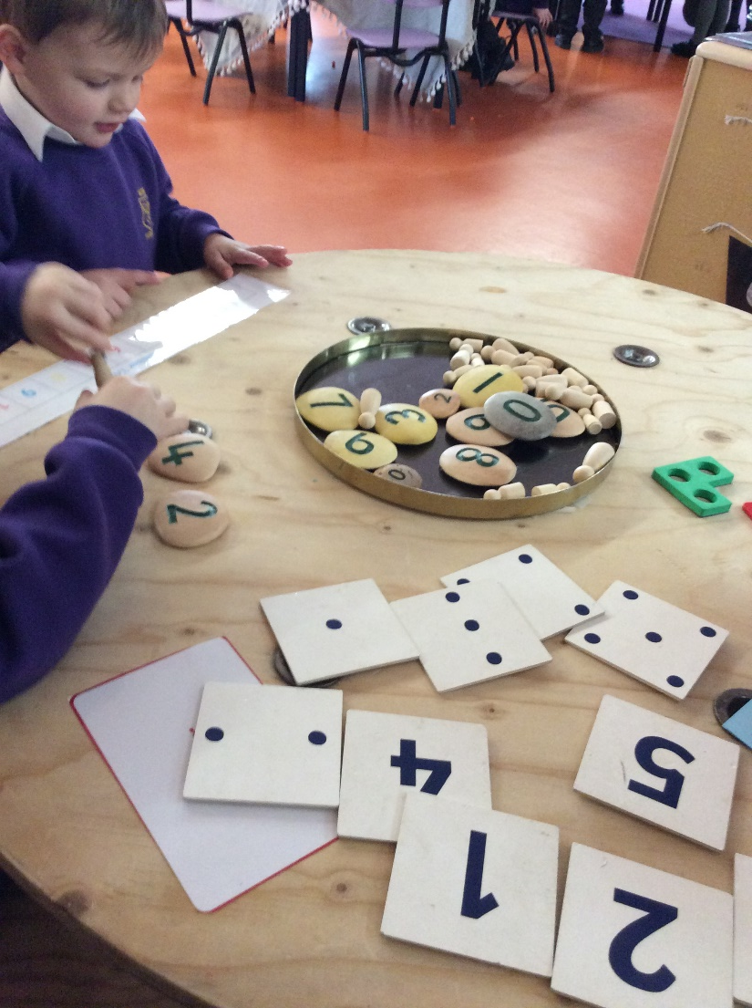
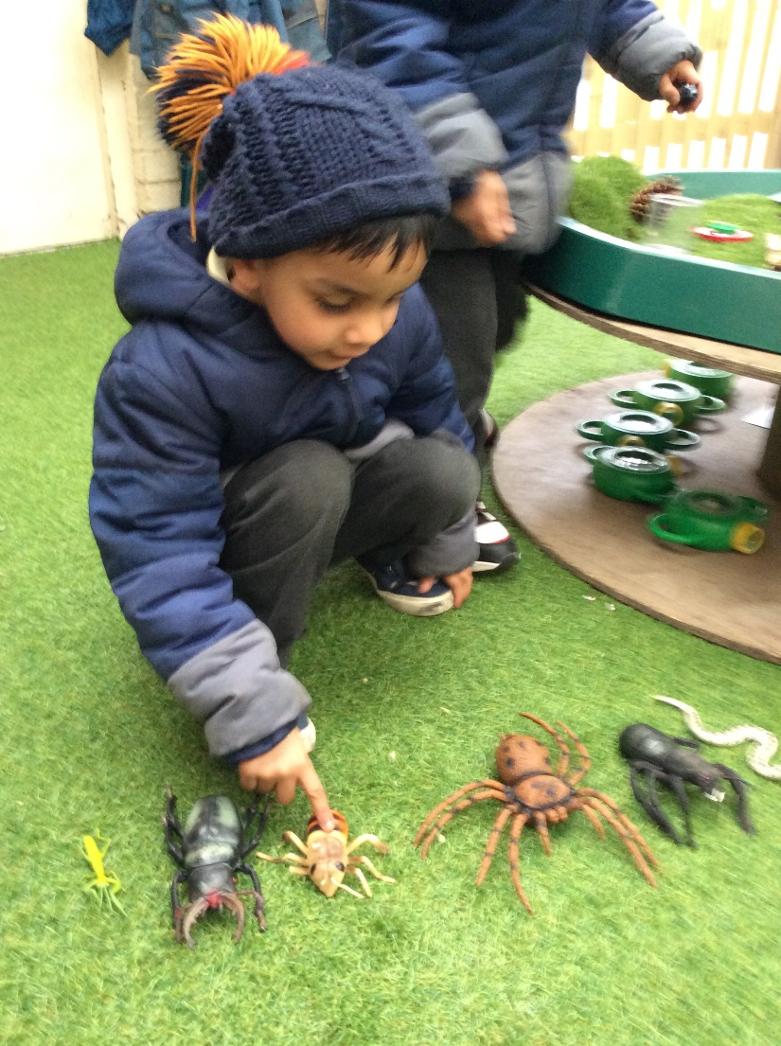
Early Years Maths

Slide 2
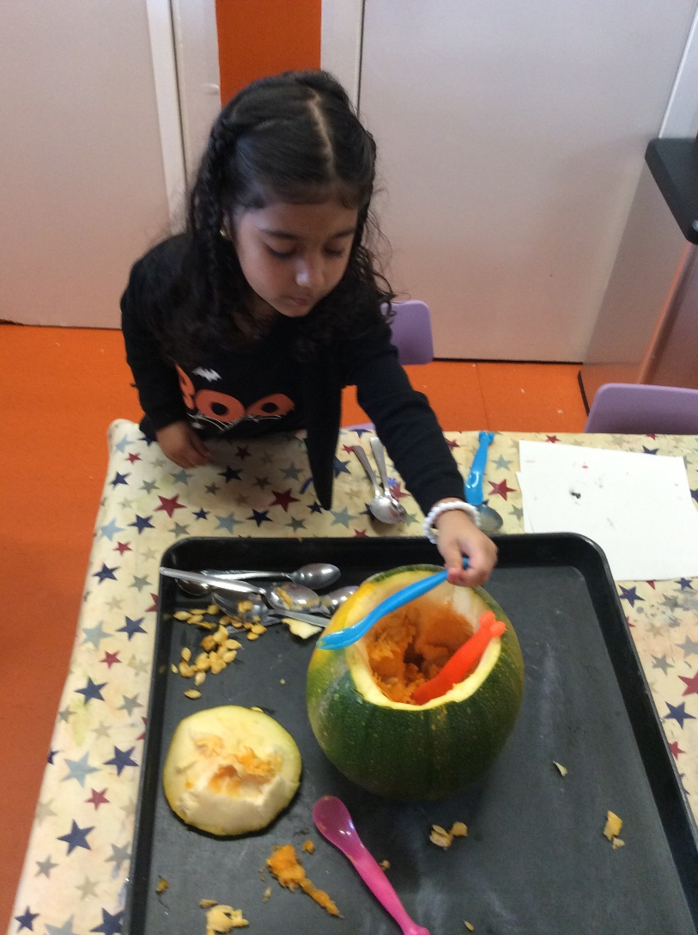
Learning through play at school and home
Play is essential in teaching and consolidating in maths.
Many of the maths objectives within Development Matters can only be developed during free play.
Play enables children to be independent and remain curious.

Slide 3
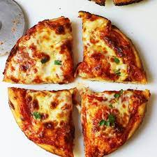
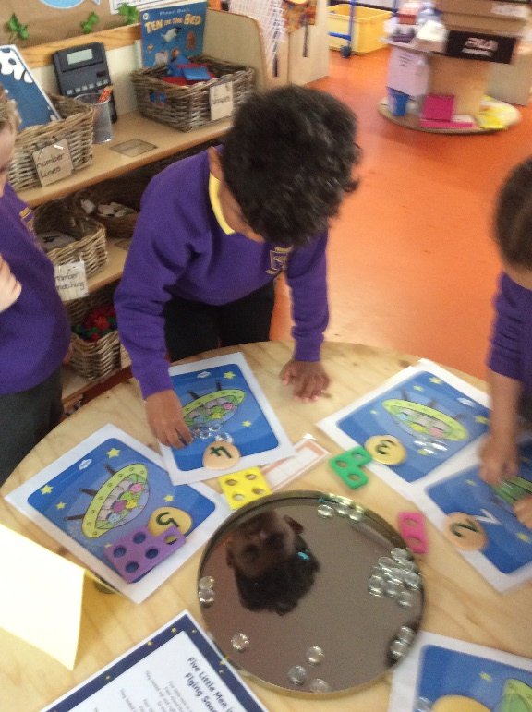
Learning through play at school and home
By setting up and supporting activities in the environment, children are not only learning about one specific maths objective, they are also learning so much more in other areas of learning; the possibilities are endless!

Slide 4
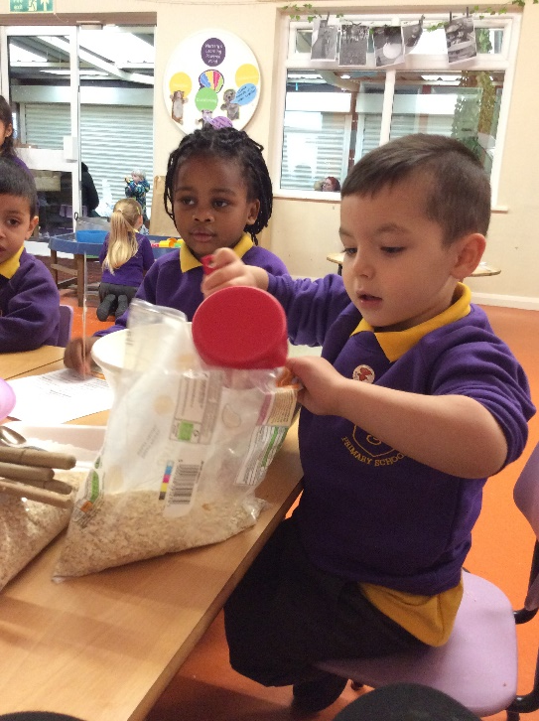
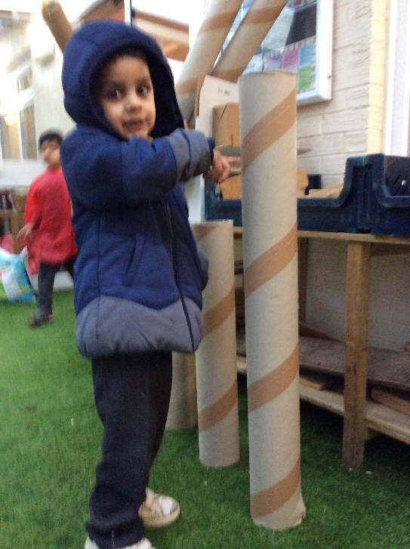
What can the environment teach in maths and how
teachers facilitate learning?

Slide 5
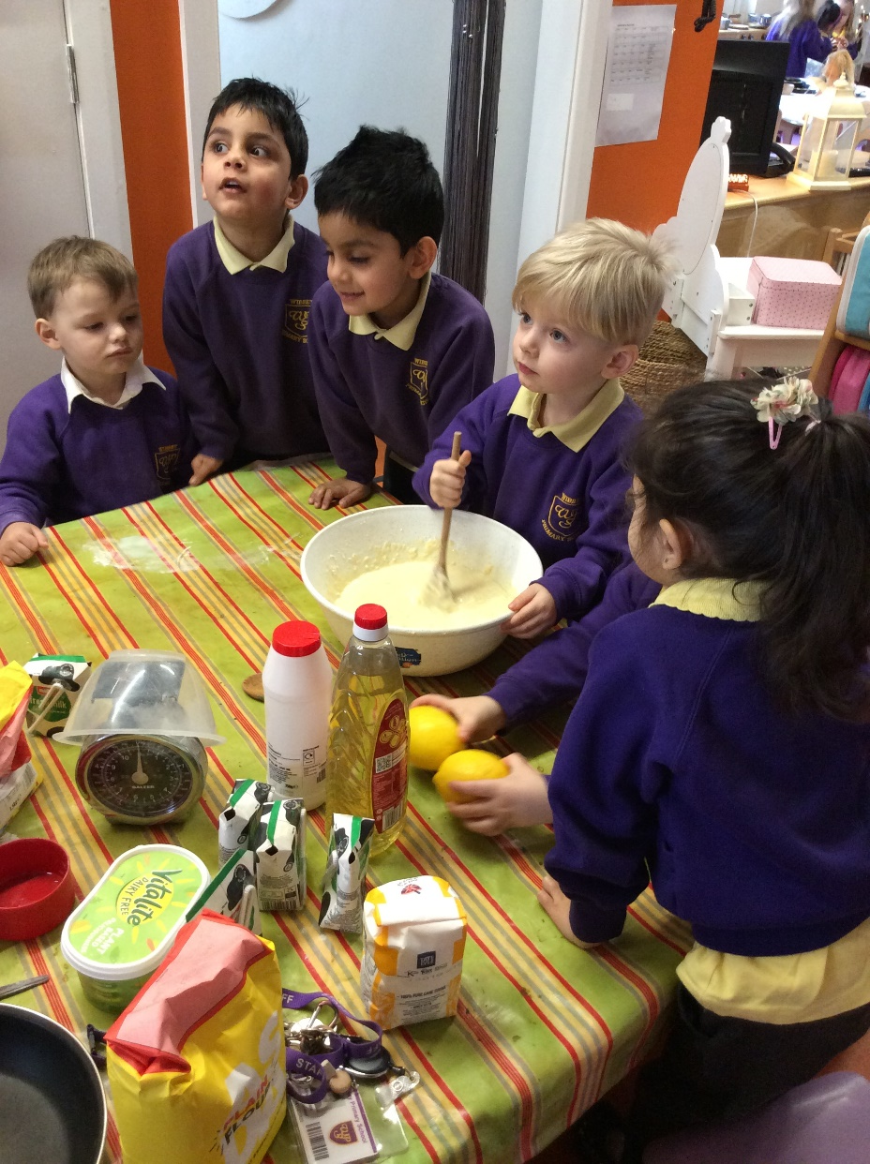
Mathematical Language
Lots of maths language for example more, less, big, small, wide, thin, heavy, light and positional language needs to be modelled by adults for children to learn and it is so much more effective if it's during authentic play experiences.
This can be replicated at home when doing every day activities.

Slide 6
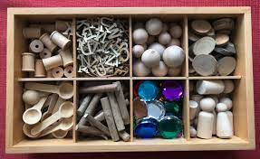
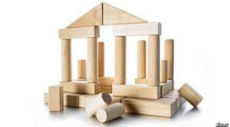
Problem solving, reasoning and pattern
Loose parts are not only amazing for helping children to develop creativity, problem-solving and reasoning skills, but are also perfect for developing and embedding pattern creating.
Construction is another area where children can learn these undervalued skills.

Slide 7
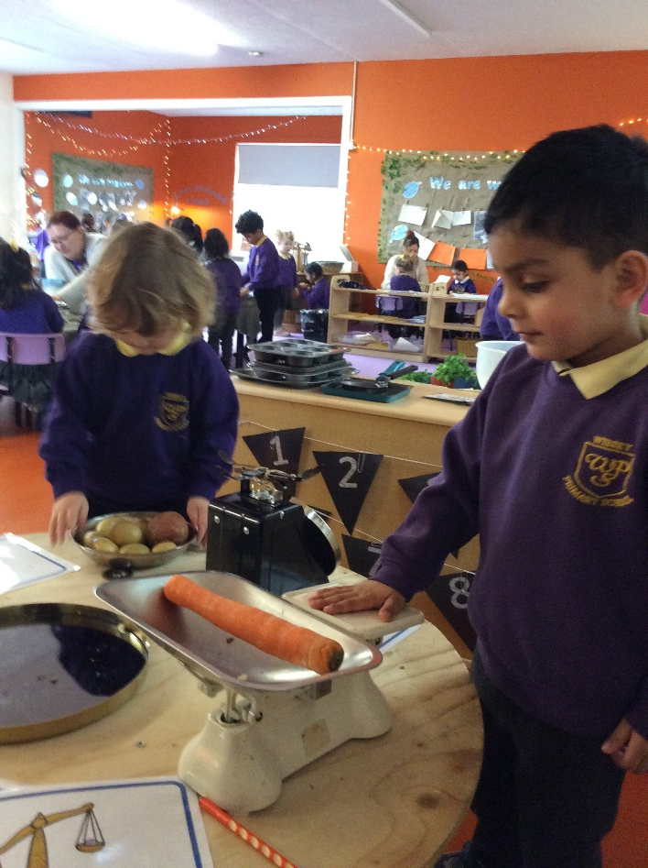
Weight and Measures
We model measuring for example outside during building and construction: large scales outside, small balance scales inside for children to explore.
Self-service play dough stations and cooking areas help children independently develop important maths skills while having fun!
Any cooking you do with your child at home will be really helpful.

Slide 8
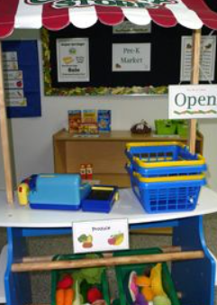
Money
The best way to learn about money is to use it in a purposeful way. We use a role play shop, rolling snack till, or impromptu shop. Children can use it independently, where children must buy things using money.
Any shopping children can help with at home will help embed the learning.

Slide 9
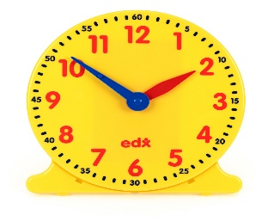
Time
We encourage children to use time every day for example measuring how long running races or car racing through guttering takes: estimate then check; will a sand timer work?
Modelling using stop clocks during races or games.
Ask children for the time.
When discussing the daily routine, we talk about the times that things will happen.
Always have as many clocks and watches at home as you can and modelling using time.

Slide 10
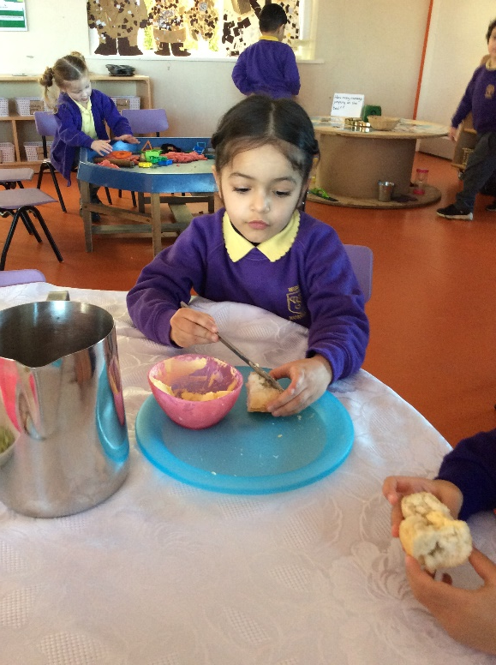
Fractions
At snack time we ask children to share things by cutting them in half and quarters.
You can encourage children to cut up sandwiches at home into halves and quarters or pizzas.

Slide 11
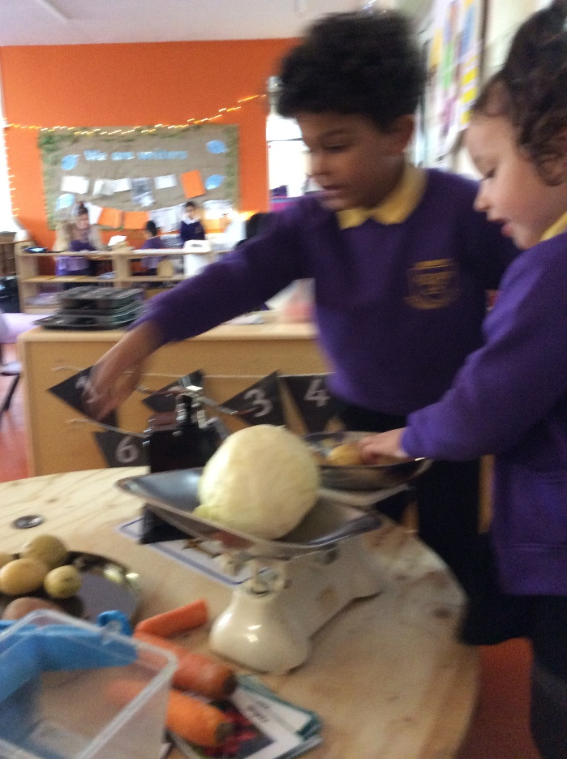
Maths Group Work
As well as learning through play, we teach maths with a teacher for short 10-minute bursts in small mixed groups.
Our guided maths planning is practical, extremely fun, and sometimes messy!

Slide 12
Other ideas to help at home
Play board games such as Orchard Toys
Sing number songs and nursery rhymes
Engage in imaginative play with your child
Go on a number or shape hunt at home

