Slide 1

Notes:
Welcome to 50 Things To Do Before You’re Five at Whetley Academy !

Slide 2

50 Things to Do Before You’re Five is an initiative developed by a team at
St Edmund’s Nursery School, launched in May 2018.
Based on the theory of experiential learning, it celebrates and supports the difference parents and play can make to children’s outcomes
Notes:
'50 Things To Do Before You're Five' has content inspired by parents' and carers' ideas, then developed by experts. The 50 Things low or no cost activities have been designed to support child development from birth to five.
In the four years since it was launched, parents, schools and settings throughout the city have had great fun whilst improving their wellbeing.

Slide 3
Poster -Back of the kitchen door to tick off each as you complete and re visit!
A smart phone app - Provides detailed information, collects photos as ‘memories’. Users can choose to share memories with family, friends, settings on/or social media
50 postcards on a ring - Useful for families that don’t have access to a smart phone
A web site- Filled with additional detail, links to helpful web sites and ‘how to’ videos. A great place to find suggestions of what’s on locally!
Notes:
You’ll receive a free poster to display in your home-A great visual aid for choosing your activities.
Our free smartphone app can be downloaded for iPhone or Android-You will be asked for your postcode (not address) to help us plan local activities. Collect multiple pictures as you enjoy each activity again and again. Don’t forget no one else can view your photos unless you choose to share them by email, message, WhatsApp or via social media. Check out the events tab to find out what's going on across the district
If you don’t have a smart phone, ask about our 50 Things post cards.
Visit our website for lots of useful videos and links- bradford.50thingstodo.org

Slide 4
How to download the app
iPhone Users
Click on to the apple store
Type in ‘ 50 Things Bradford’
Click download
Once you are on the app click ‘Bradford’ & enter your post code.
Android Users
Click on to the play store
Type in ‘ 50 Things Bradford’
Click download
Once you are on the app click ‘Bradford’ & enter your post code.
Once these steps have been completed, simply enjoy and start exploring our app.
If you are still having difficulty downloading please get in touch.
Notes:
Step by step instructions for downloading the app or alternatively, use the QR code on the poster

Slide 5
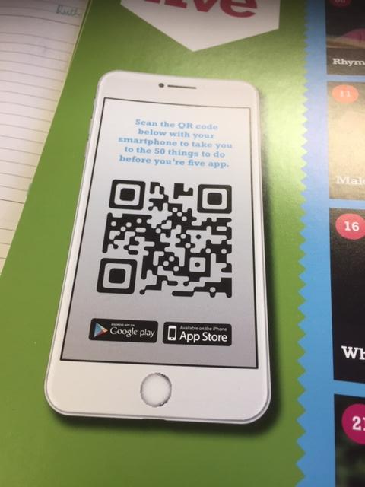
…or use the QR code on the 50 Things poster
Notes:
Or use the QR code

Slide 6
We want to support everyone to access our app so we have researched and found ways that can help make it easier for users to understand. Below is a guide for both Apple and Android users to enable ‘speak screen’.
iPhone Users · Settings · General · Accessibility · Speech · Speak Screen · Slide the button · Swipe down with two fingers from the top of the screen to hear the screen content read out | Android Users · Settings · Accessibility · Screen Reader · Voice Assistant · Slide the button · Allow · Okay · Press the text you would like to be read aloud
Notes:
Use these instructions to facilitate smart phones to read out the content of the smart phone app

Slide 7
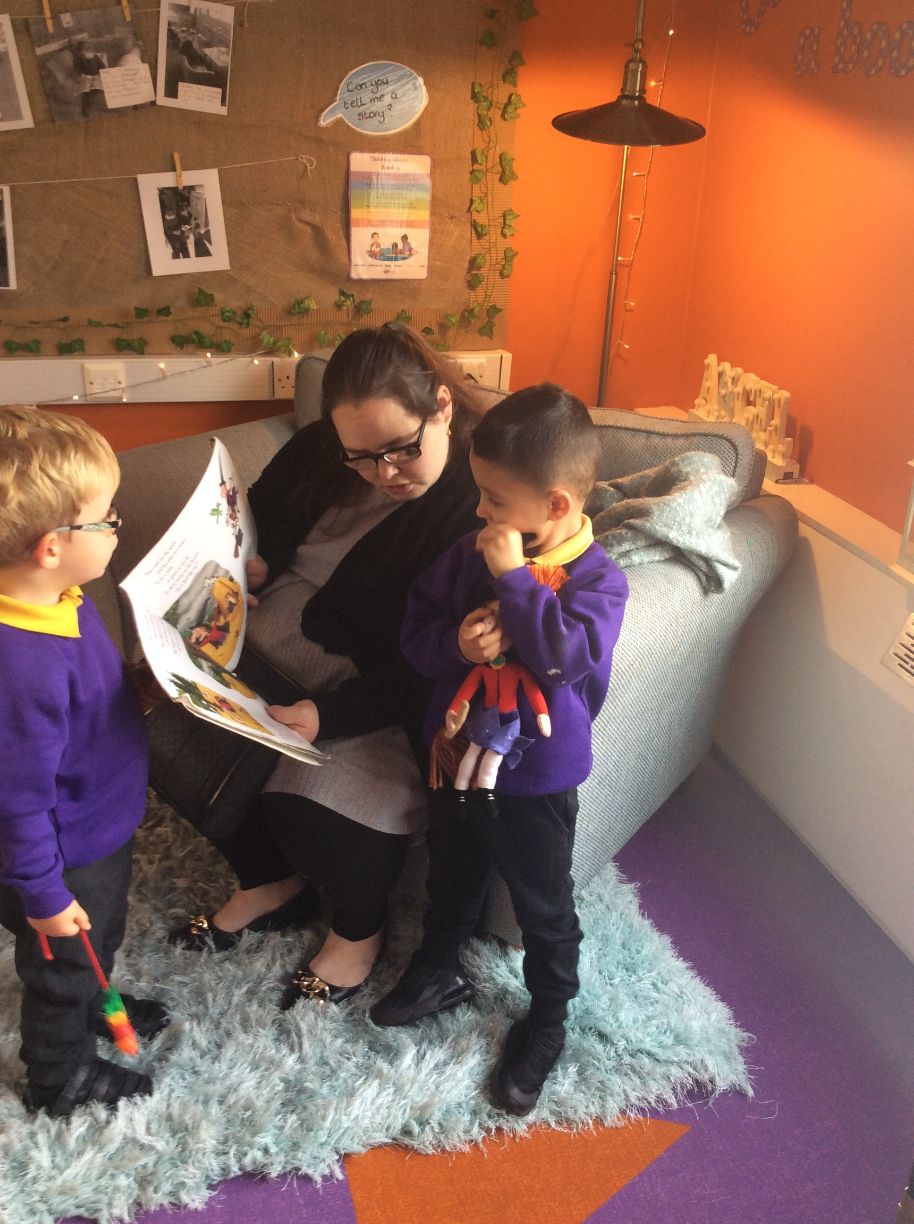
#10 | Sharing Stories
Notes:
Here are some examples of the 50 Things

Slide 8
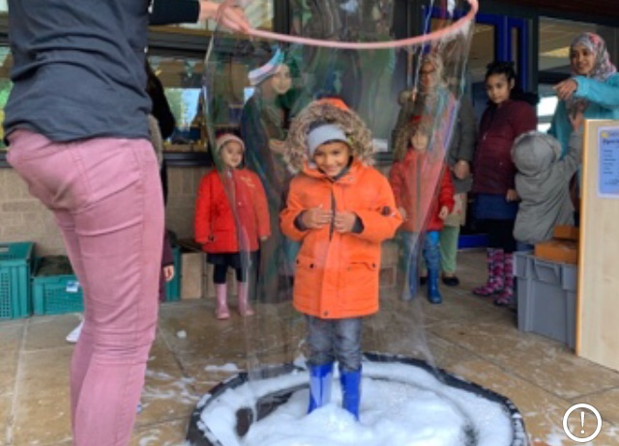
#08 | Bubbles

Slide 9
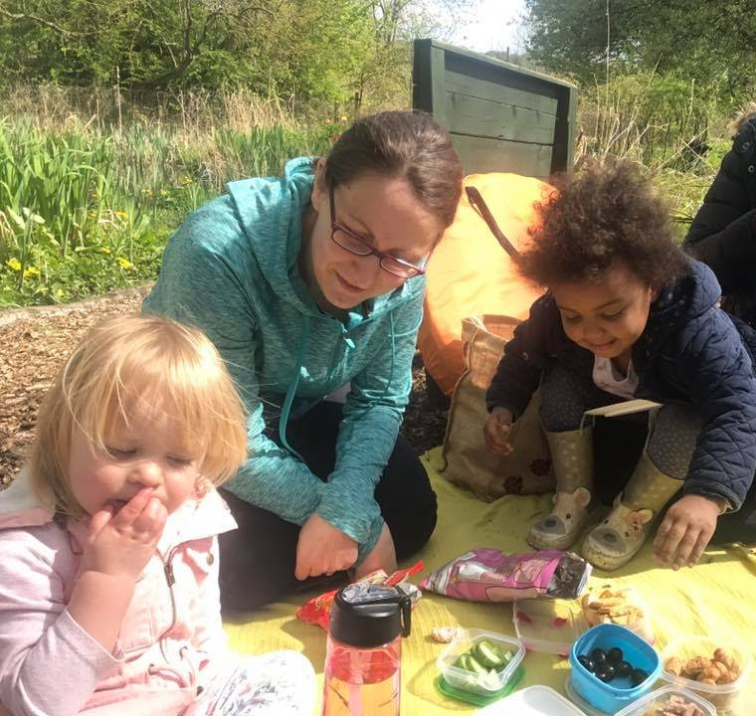
#30 | Yummy Picnic

Slide 10
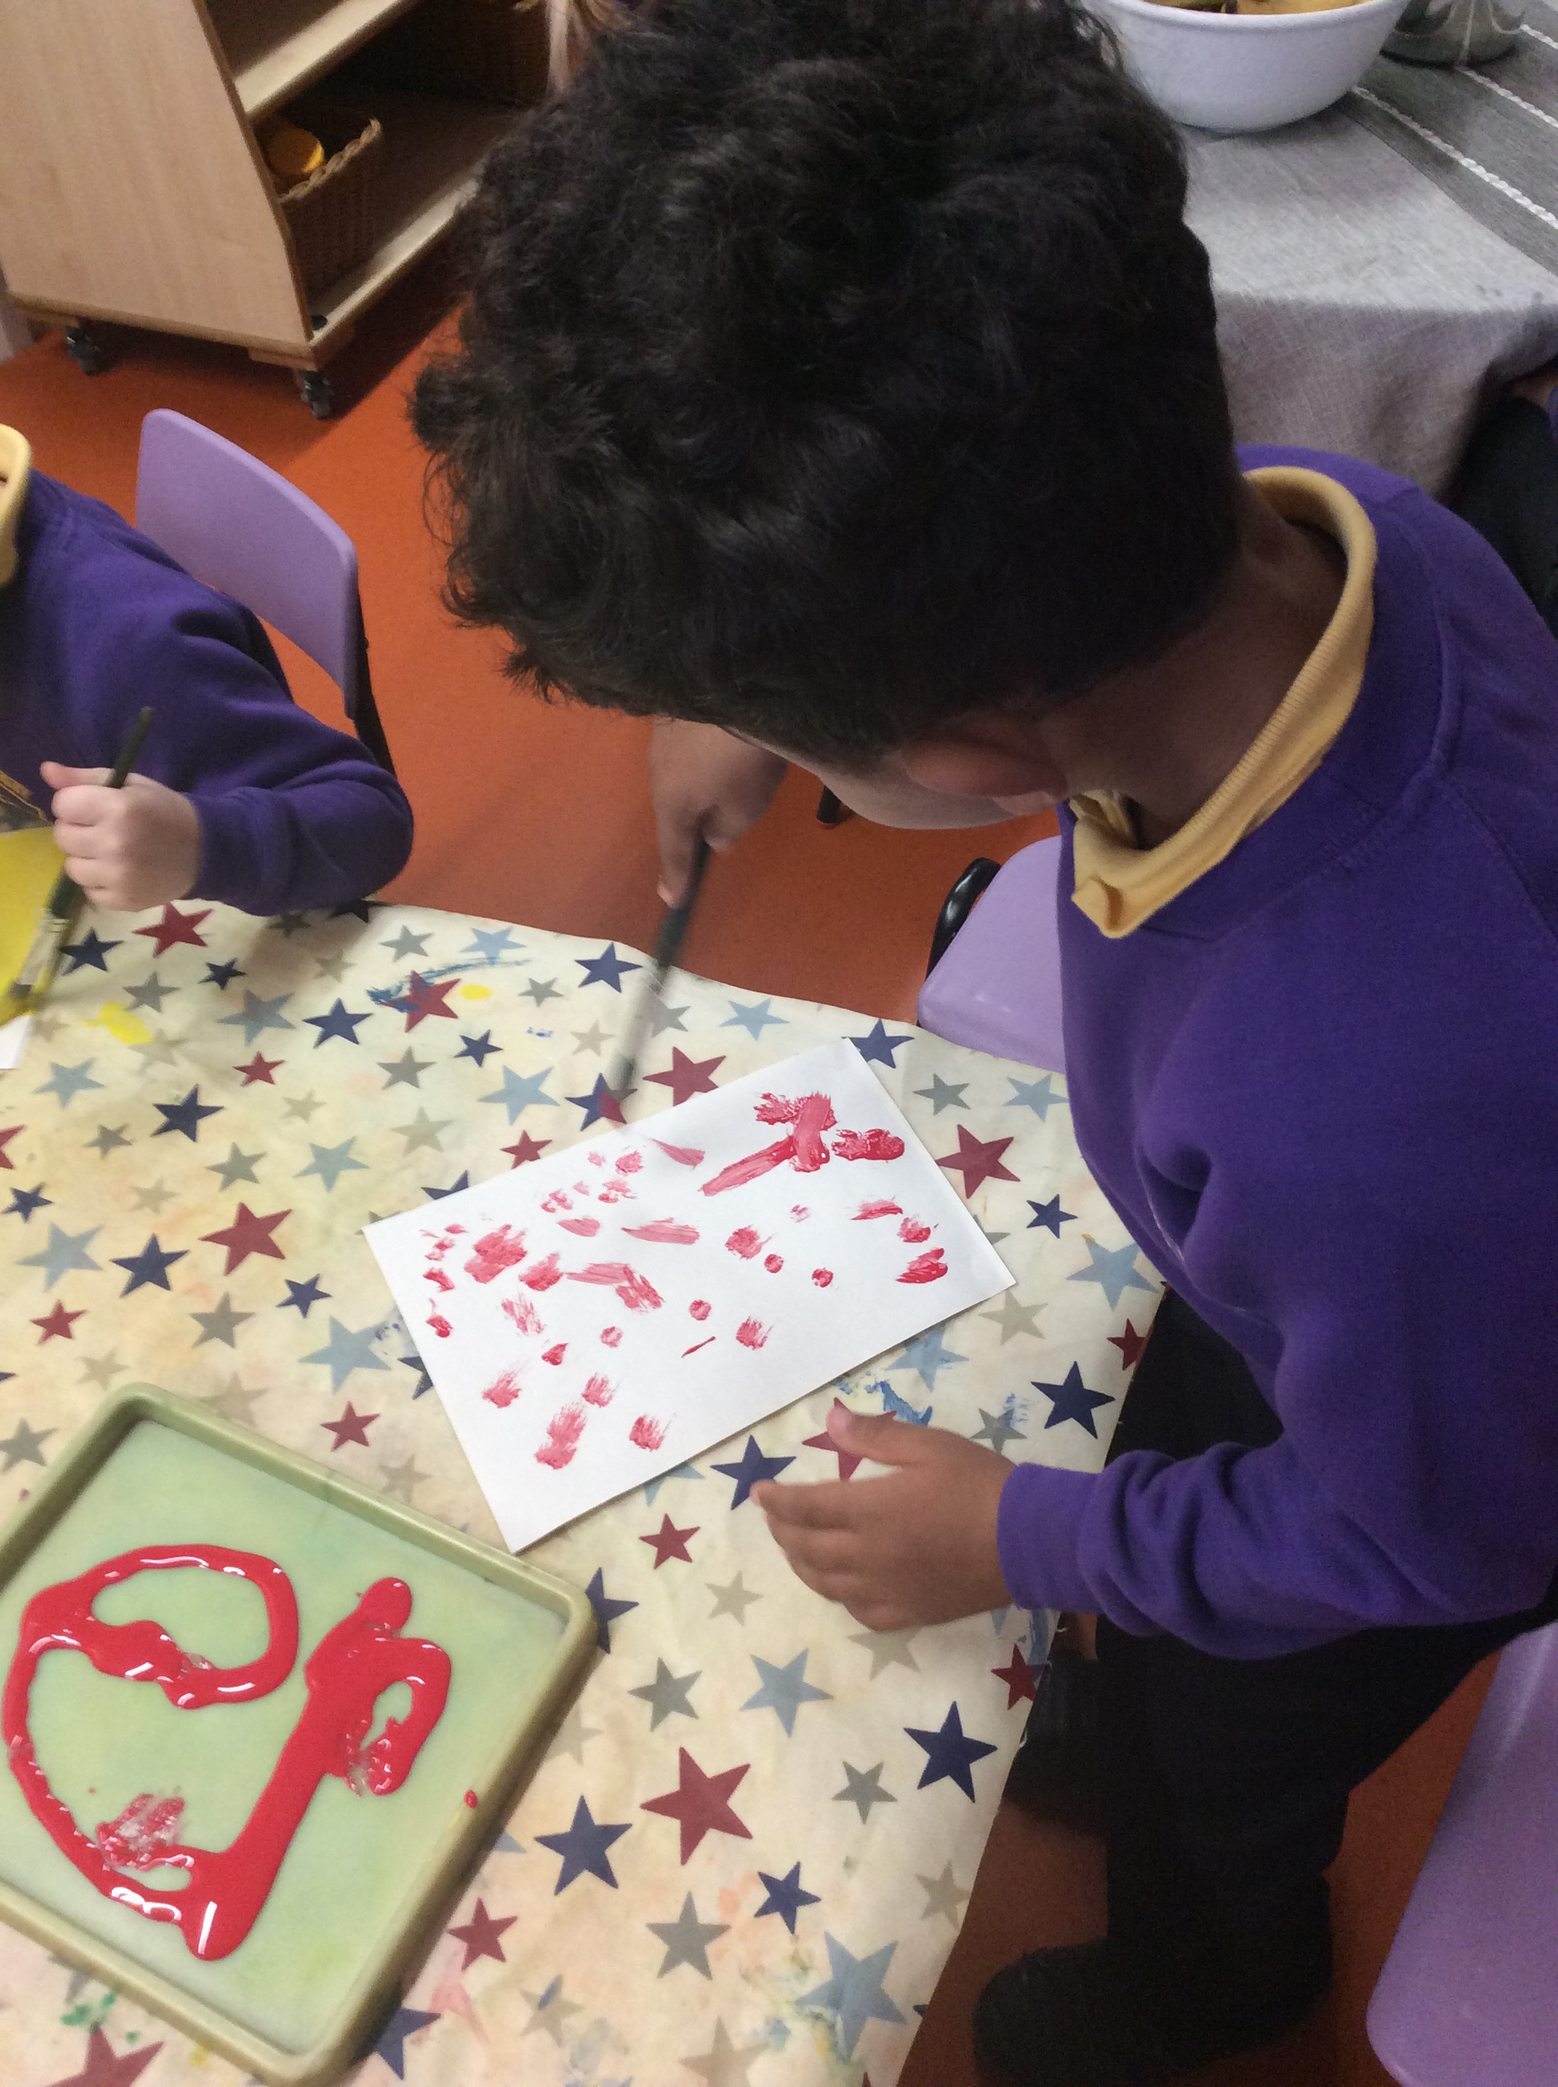
#04 | Make Your Mark

Slide 11
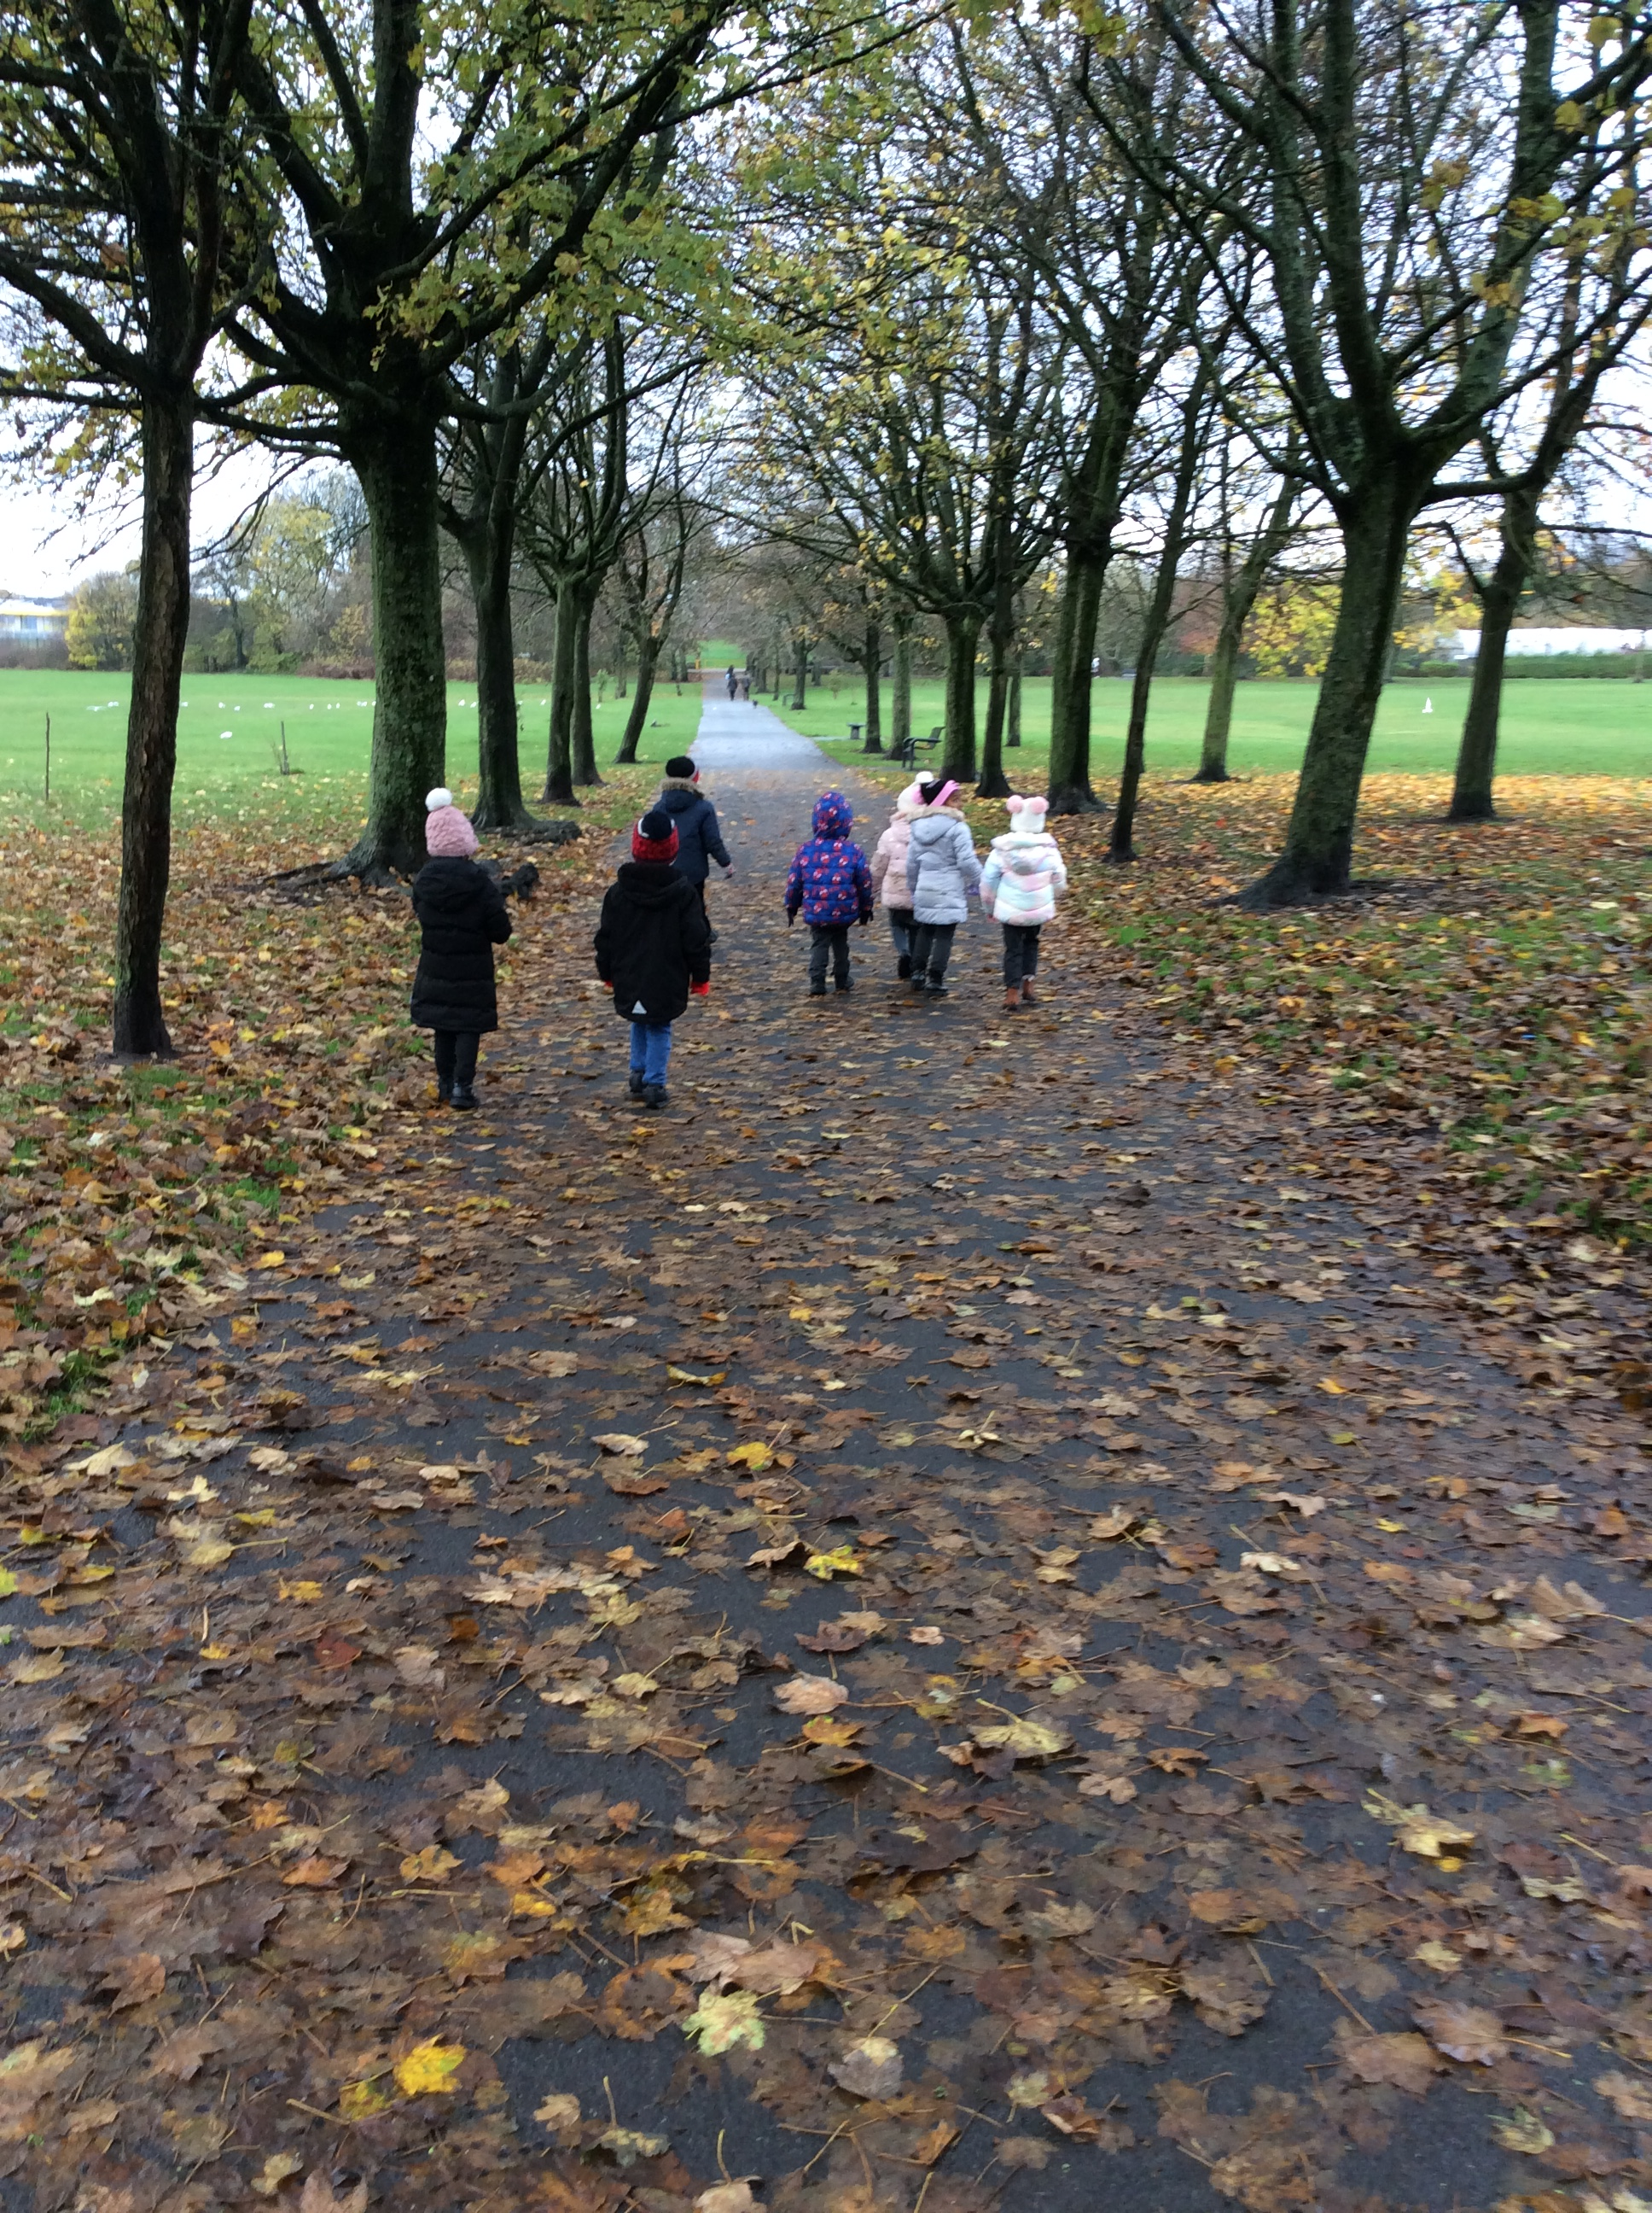
#34 | Woodland Wandering

Slide 12
Sharing at school
We would love to see the activities you are doing with your child and would welcome any photos you would like to share with us.
Please send any photos to :
Nurseryclass@wibsey.bradford.sch.uk
Wibsey123
Reception1Class@wibsey.bradford.sch.uk
Wibsey123
Reception2Class@wibsey.bradford.sch.uk
Wibsey123
Reception3Class@wibsey.bradford.sch.uk
Wibsey123

Slide 13
Any questions?
Please take a look at the free poster.
Download the FREE app – 50 Things to Do Bradford
Visit our website -Bradford.50thingstodo.org
Enjoy!!
Notes:
Any questions, get in touch with rachael.dennis@stedmundsbradford.org.uk

Slide 14
Notes:
Enjoy 50 Things To Do Before You’re Five!!!

