Slide 1

Welcome to Year 2
^{18th September 2025}

Slide 2
Meet the staff
Mr Evans 2.1 Class teacher
Mrs Ellis-Barker 2.2 Class teacher/ Phase Lead/ Assistant Head
Miss Miss Jones 2.3 Class teacher
Mrs Meakin
Miss Airstone
Mrs McCormack
Miss Lofthouse

Slide 3
A day in Year 2
Morning
Morning arithmetic
Maths
Assembly
Break
Phonics/reading
English
Afternoon
Lunch and playtime
Foundation subjects (History, Geography, Science, Art, PE etc)
Story time

Slide 4
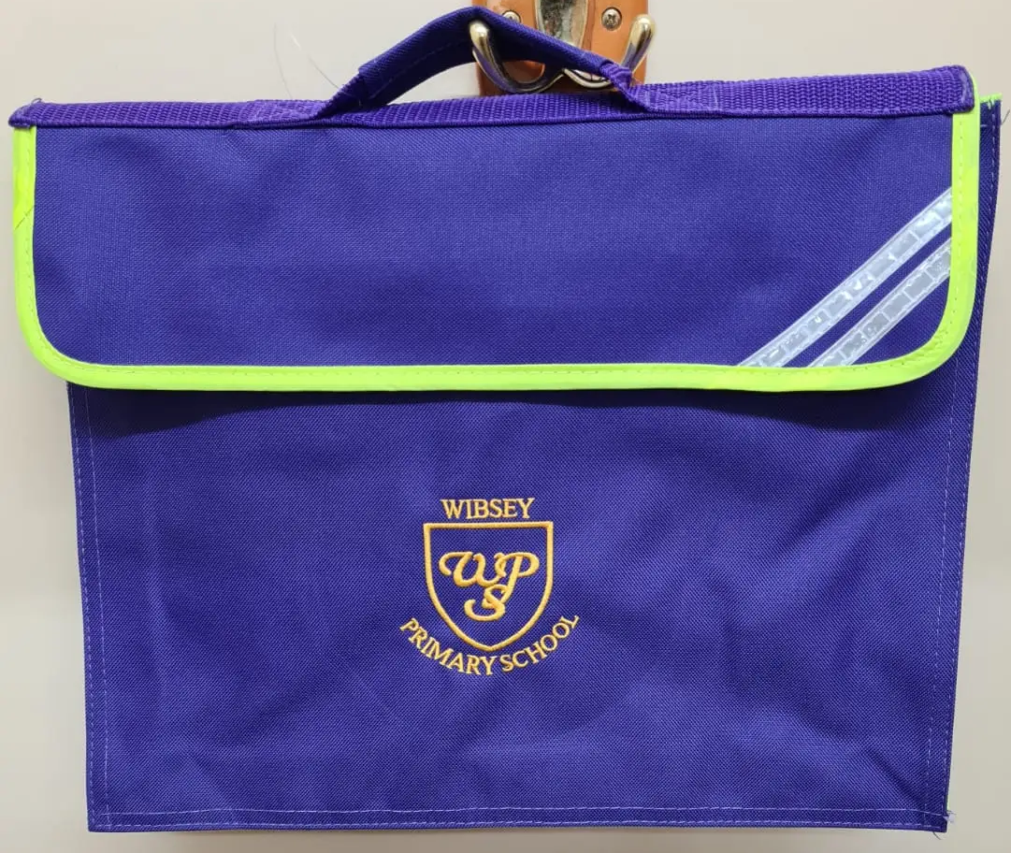
Book bags
To be brought in every day
Book linked to phonics group
ZPD book (RWI Grey or above)
Reading journal
Water bottle

Slide 5
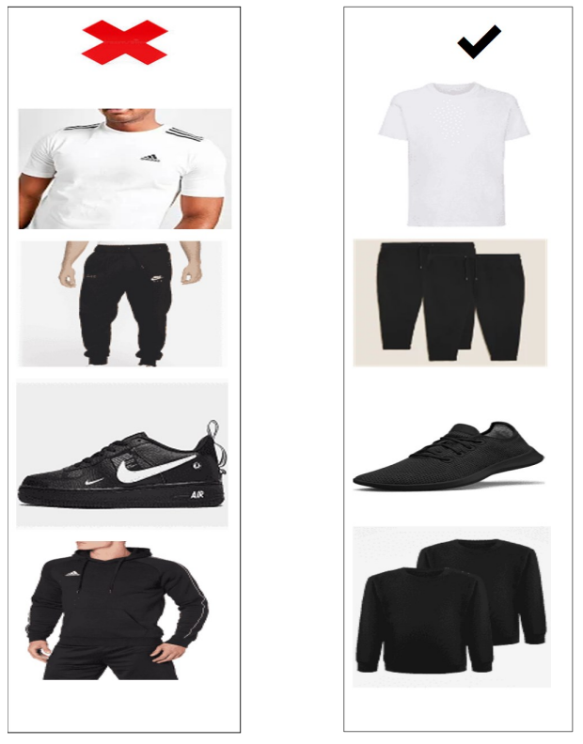
PE
2.1 Friday
2.2 Friday
2.3 Wednesday
All classes have additional days on a Thursday. See the school website for your child’s dates.
Kit
Come to school in PE kits
Named clothing
Plain black shorts or jogging bottoms, plain white T shirt, plain black jumper or hoody.

Slide 6
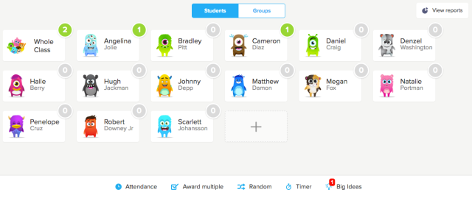
Class Dojo
Dojos are swapped for rewards

Slide 7


Homework
Log in details stuck onto your child’s reading journal
My Maths
Times Tables Rock Stars (TTRS)
Weekly reading – record in reading journal
Spellings

Slide 8
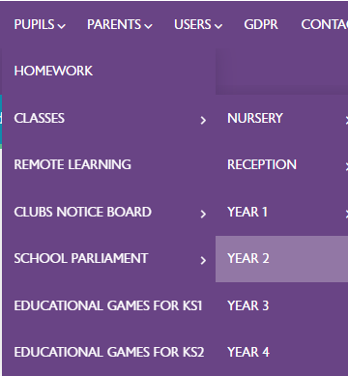
Half termly letter
Letter uploaded to school website outlining our topic for the half term, key learning question, school trips, PE dates and more.

Slide 9
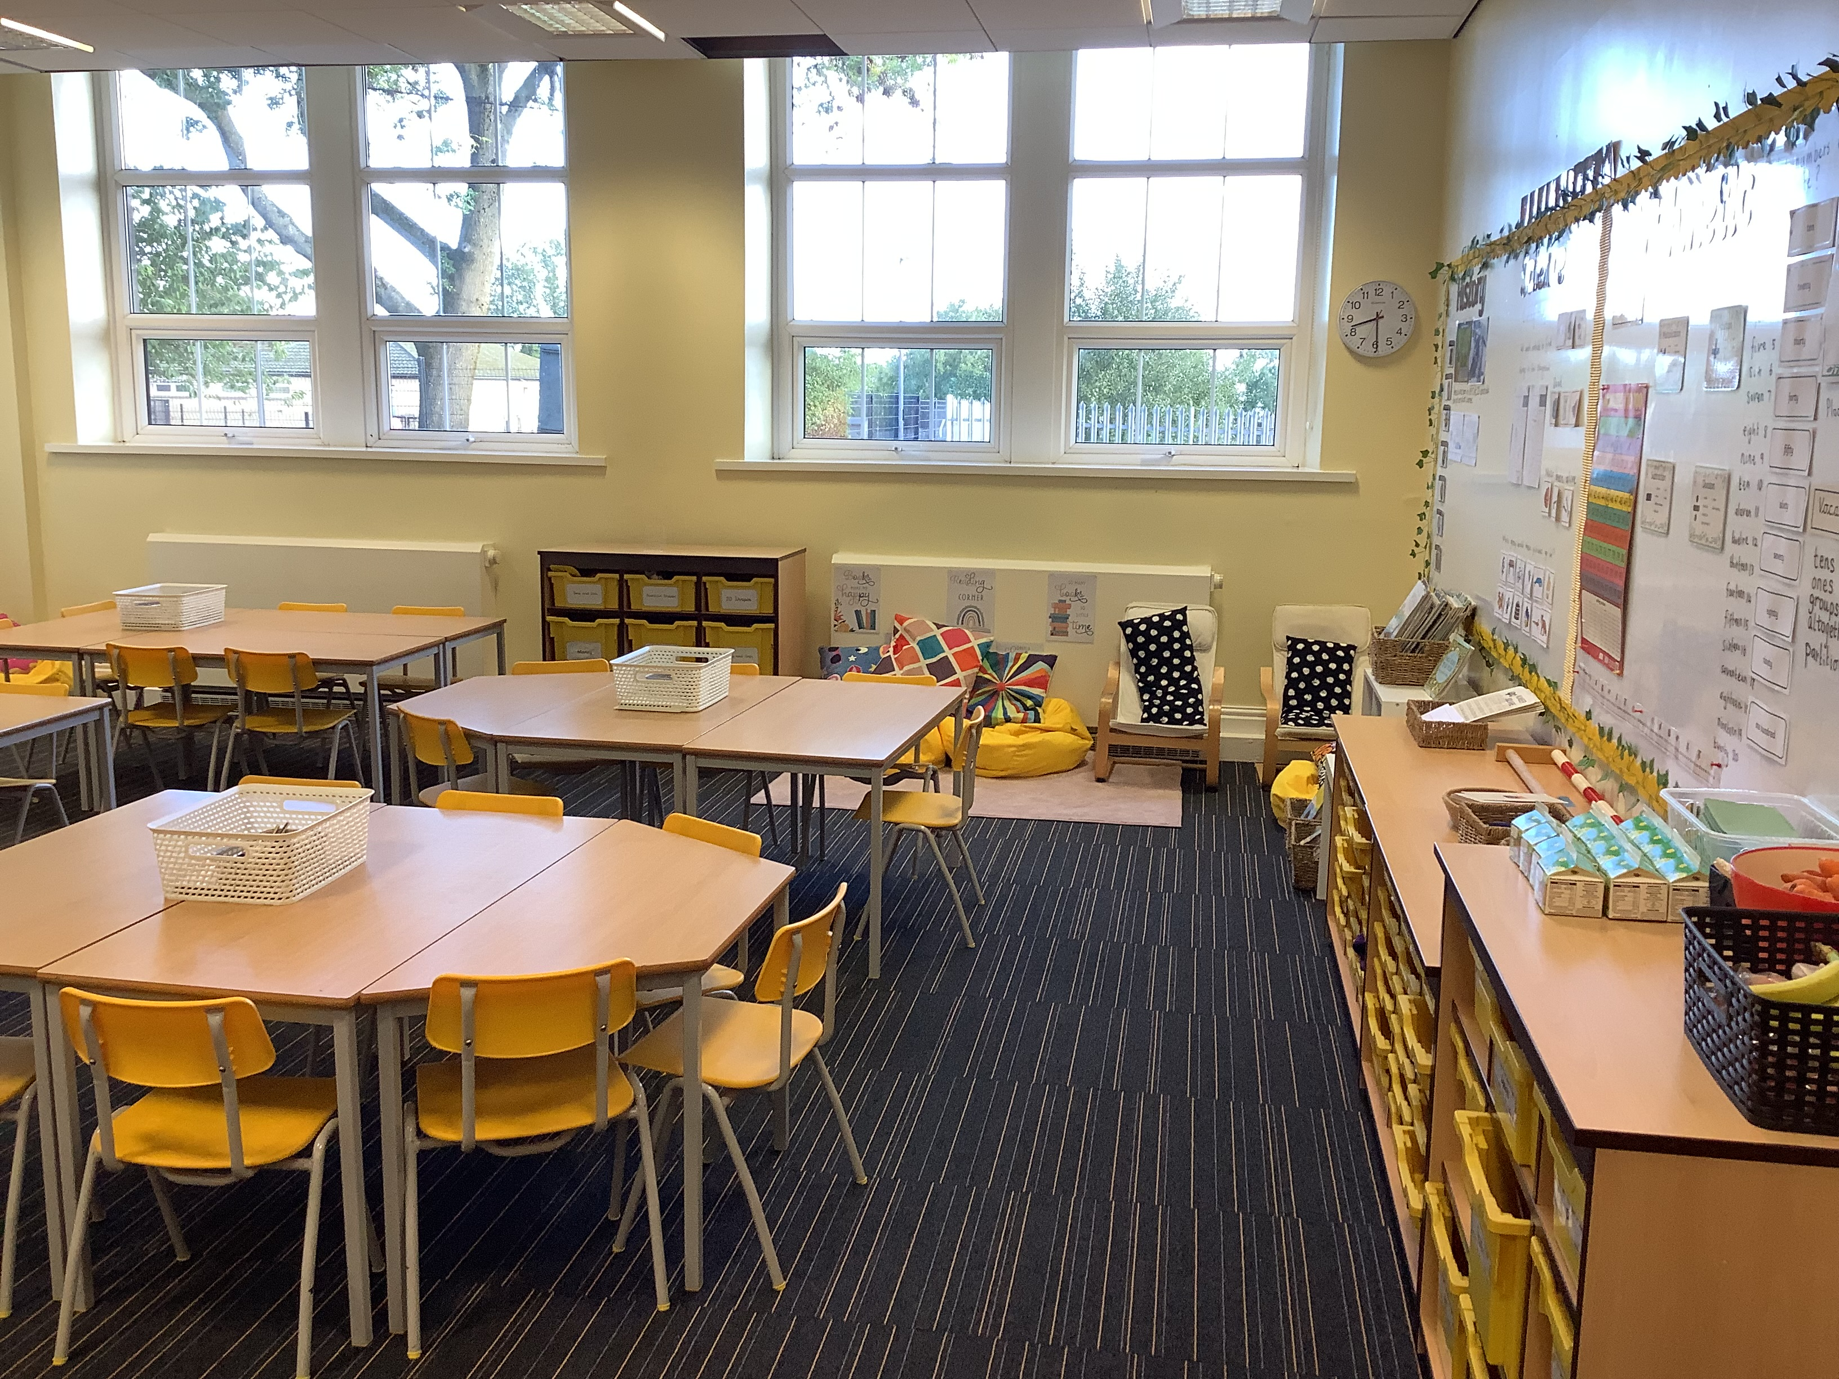
Class 2.1

Slide 10
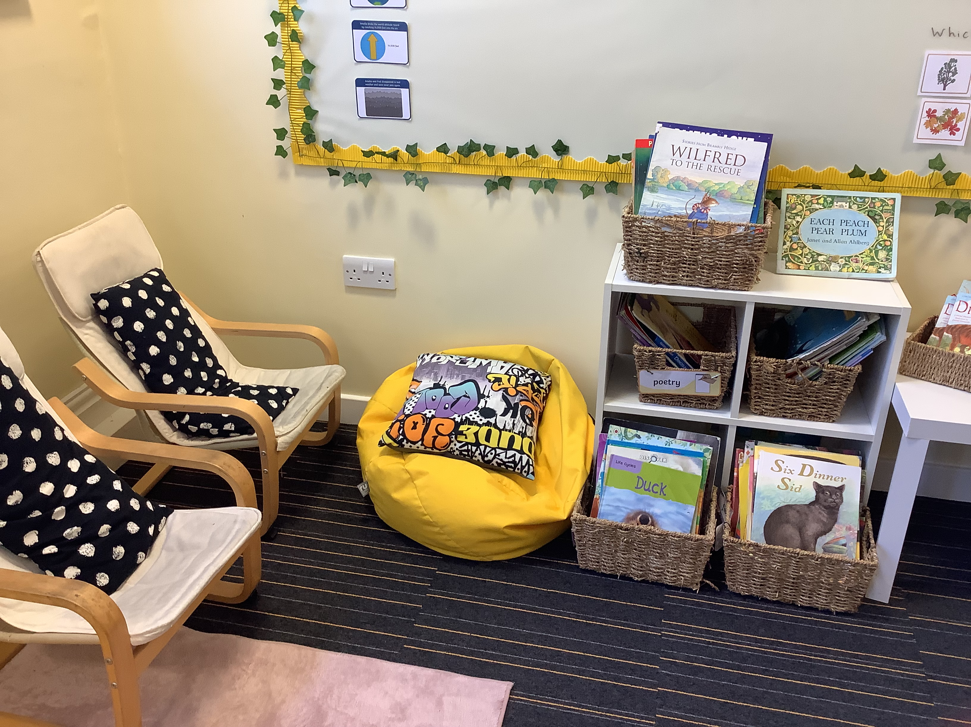

Slide 11
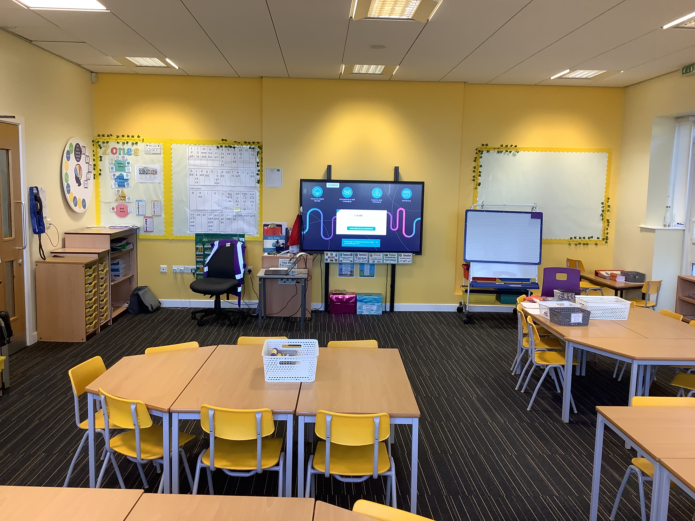

Slide 12
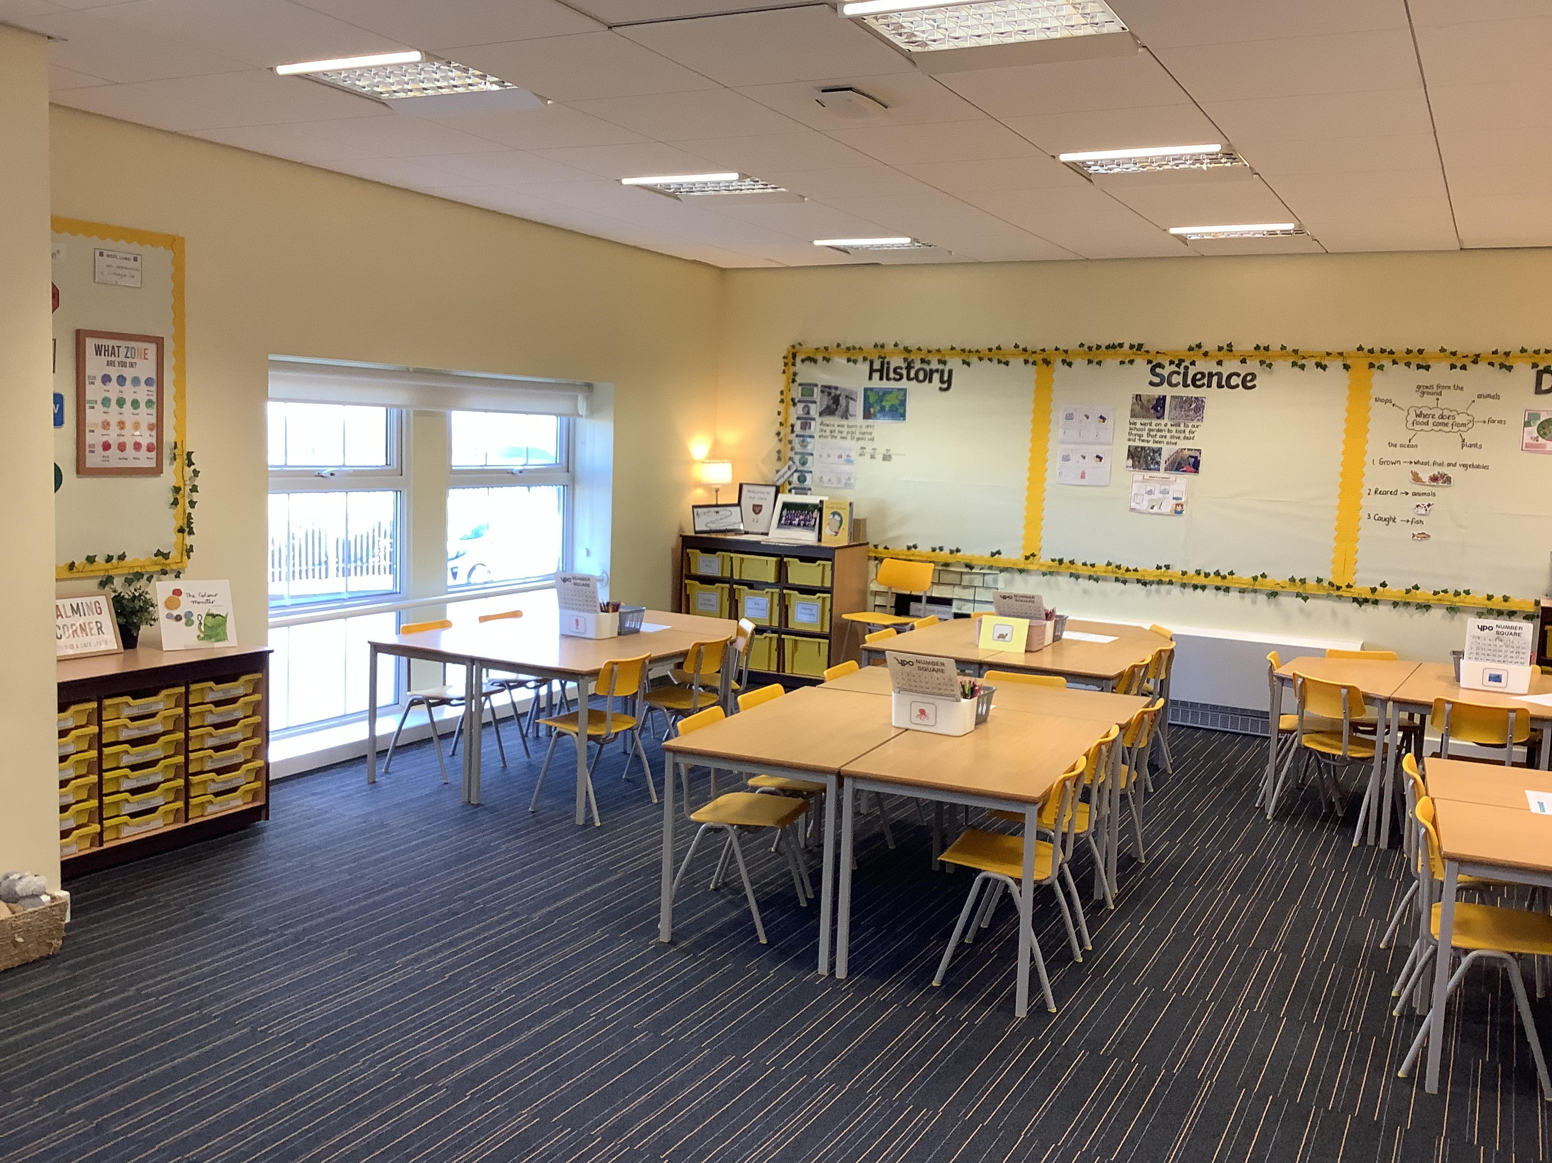
Class 2.2

Slide 13
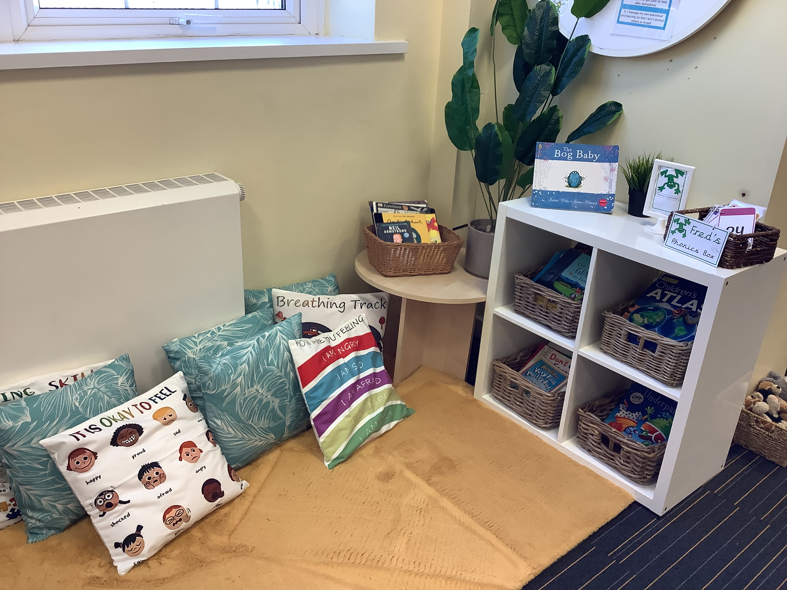

Slide 14
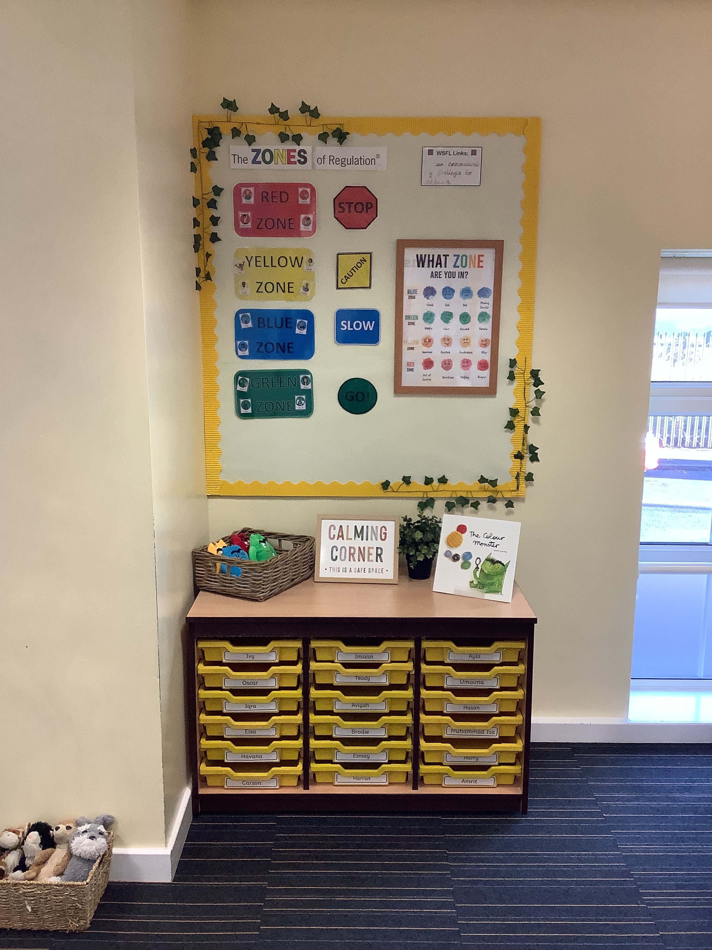

Slide 15
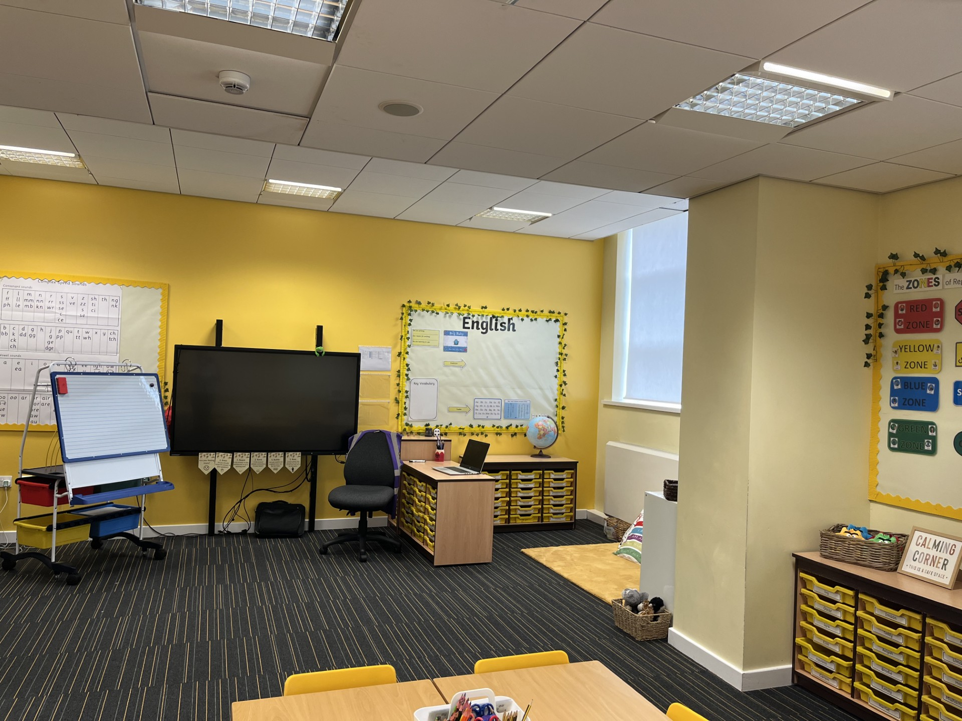

Slide 16
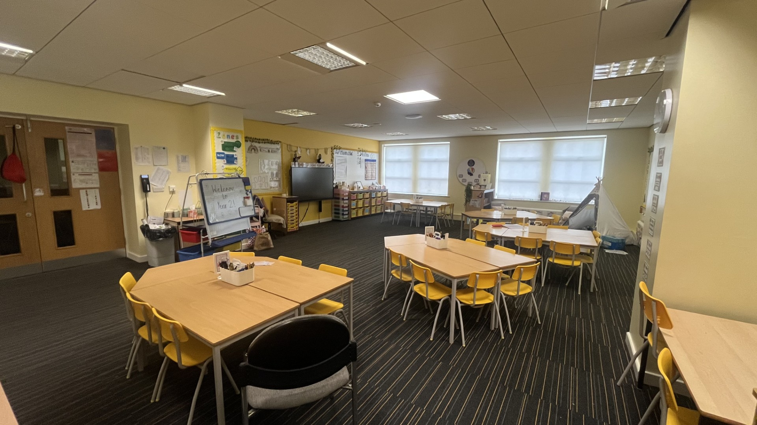
Class 2.3

Slide 17
