Slide 1

Welcome to Year 1
25th September 2025

Slide 2
Meet the staff
Miss Hammond 1.1 Class teacher
Miss Shepherd 1.2 Class teacher
Mrs Kershaw 1.3 Class teacher
Mrs Arato
Miss Lee
Ms Rawlins
Miss Burniston
Mrs Robertshaw

Slide 3
A day in Year 1
Morning
Daily maths, English, phonics
Snack
Assembly
Playtime
Afternoon
Lunch and playtime
Foundation subjects (Science, History, Geography, Art, PE etc)
Story time

Slide 4
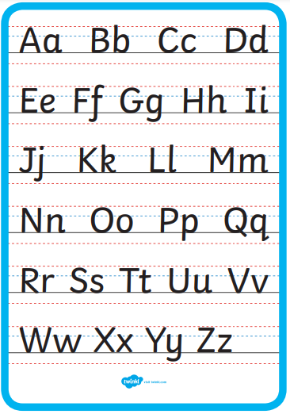
Handwriting

Slide 5
Phonics
Year 1 phonics screening in June
Daily small group phonics sessions
Half-termly assessments
Useful websites: Phonics Bloom games
Reading at home helps!

Slide 6
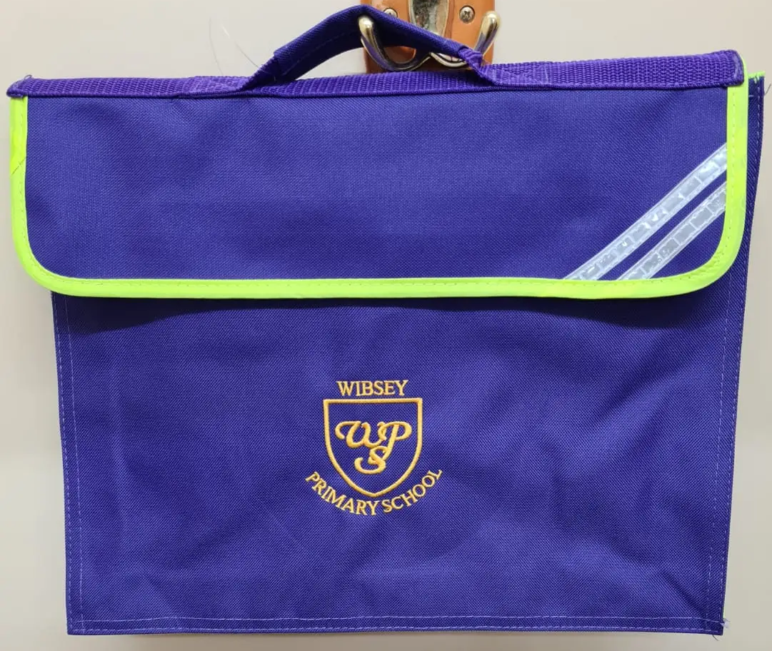
Book bags
To be brought in every day
School book bags
Book linked to phonics group
Reading for pleasure book
Spelling book, linked to phonics group
Reading journal

Slide 7
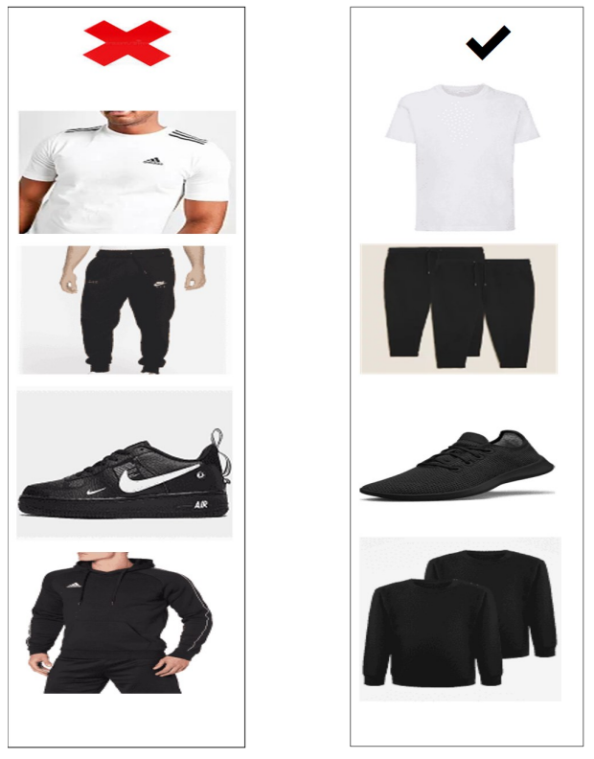
PE
1.1 and 1.3 every Tuesday
1.2 every Friday
All classes have additional days on a Monday. See the school website for your child’s dates.
Kit
Come to school in PE kits
Named clothing
Plain black shorts or jogging bottoms, plain white T shirt, plain black jumper or hoody.

Slide 8
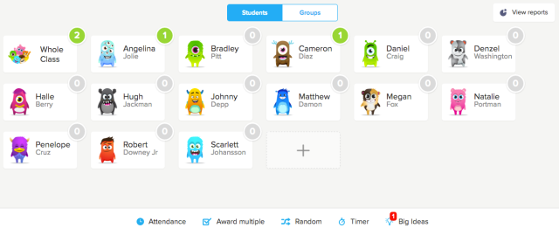
Class Dojo

Slide 9



Homework
Weekly home- linked to English or maths
-sentence writing
-phonics
-topic related
Log in details stuck onto your child’s reading journal- mymaths

Slide 10
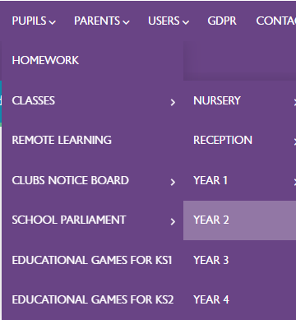
Half termly letter
Letter uploaded to school website outlining our topic for the half term, key learning question, school trips, PE dates and more.

